Slide 1
SketchBook for Education
Quick Look Instructions

Slide 2
Table of Contents
Opening a Page 3
Left Side Tool Bar 4
Top Tool Bar 5
Brushes Exercise 6
Color-picker 7
Color Diamond 8
Eyedropper 9
Mirroring Exercise 10
Styles 11
Background Color 12
New Layer 13
Copy & Paste 14
Move Copy 15
Merge Layers 16
Import a Photo 17
Adjust Photo 18
Add Text 19
Add More Layers 20
Share Image 21
Save to Gallery 22
Name and Share 23
More Information 24

Slide 3
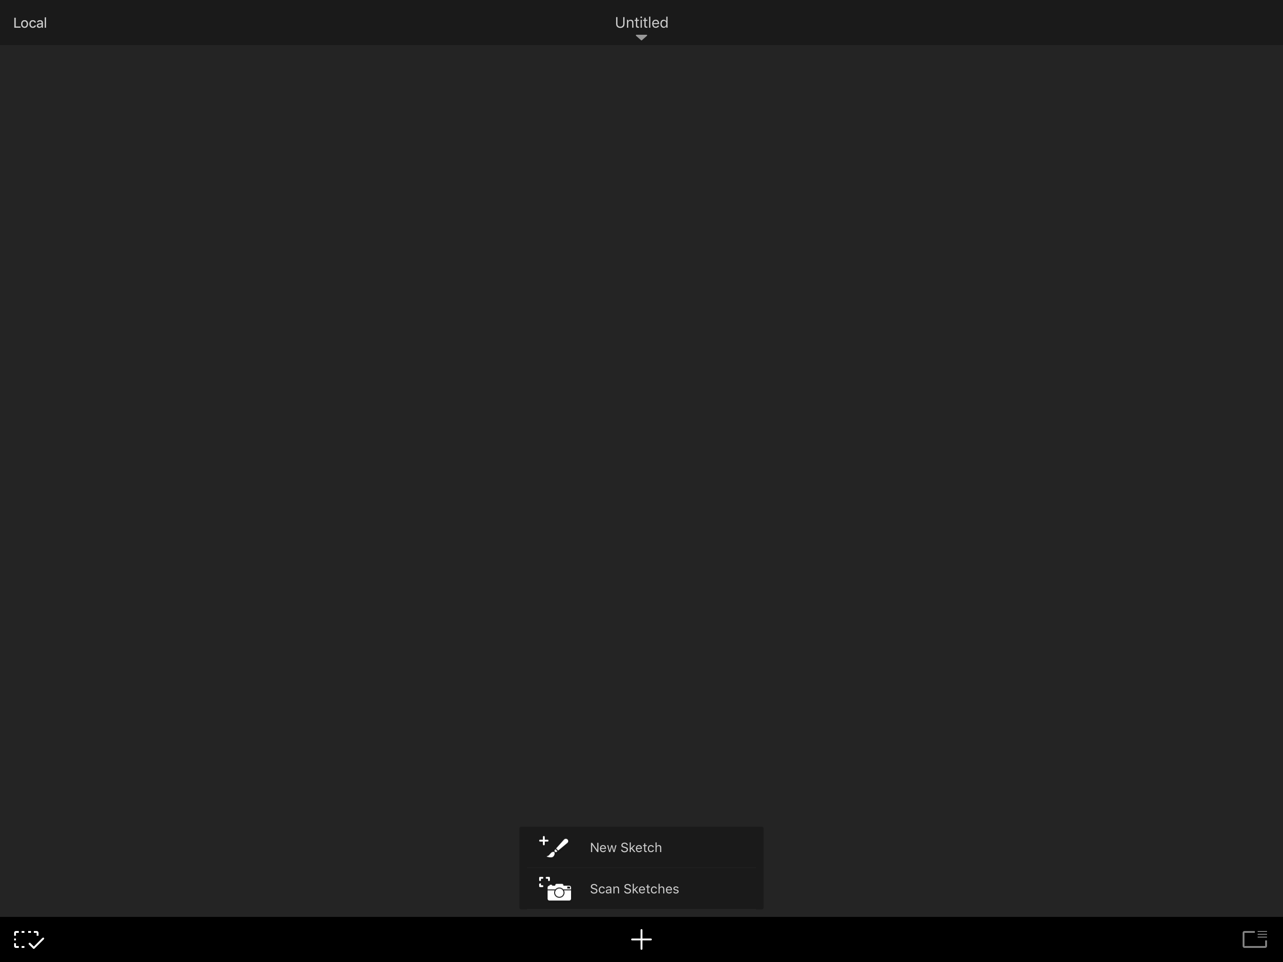
Open a Page
3
Usually the app opens on a new page. If it does not, then this is how to open a new page from Gallery
Tap the + icon at the bottom of the gallery screen and then tap New Sketch

Slide 4
Left Side Toolbar
4
Color Picker (see slides 7&8)
Eyedropper (see slide 9)
Sketching Tools, Brushes (see slide 6)
Erasers (see slide 6)

Slide 5
Top Toolbar
5
Actions Menu
Undo
Redo
Symmetry(9) Styles (10) Import Image, Type
Puck

Slide 6
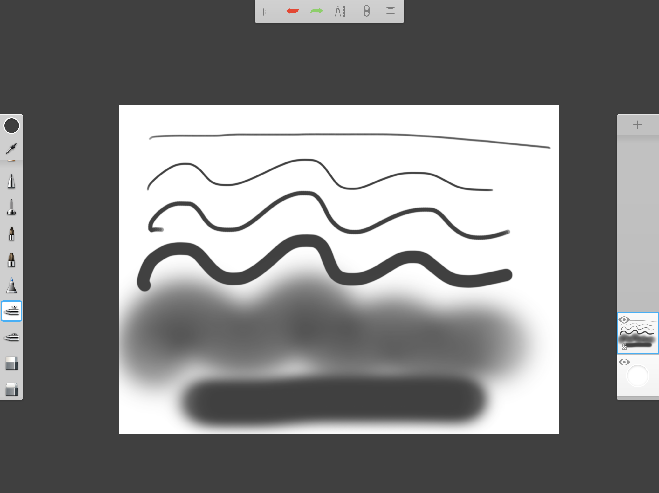
Brush Exercise
6
Tap the top brush and notice two sliders appear which will adjust size (top slider) and opacity (bottom slider)
Draw a line with the brush then go to the next brush until you have experimented with each of them
Then use the two erasers to see how they work

Slide 7
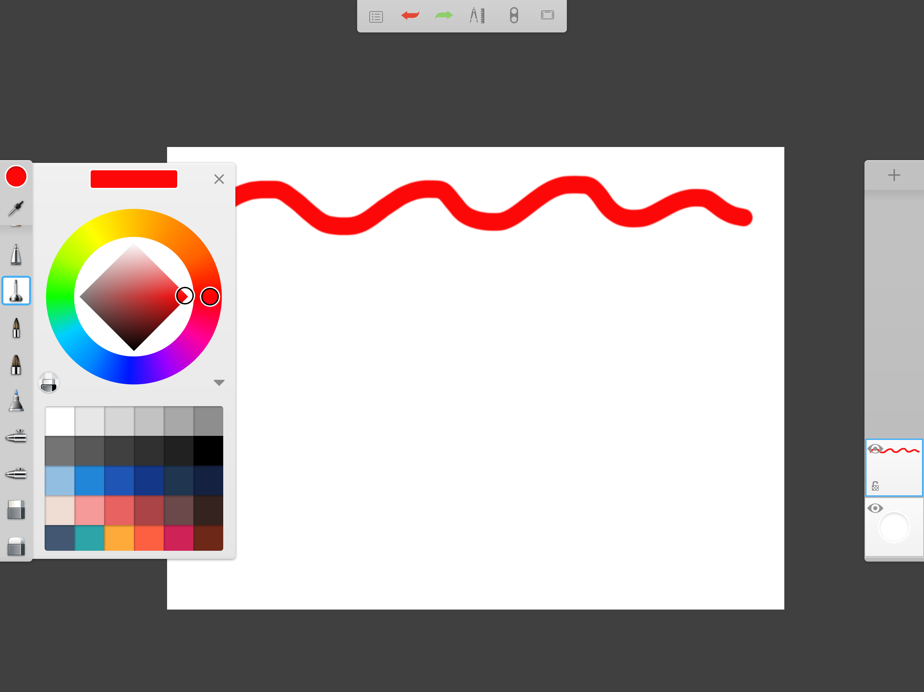
Color Picker
7
When you tap the color picker you will see a circle and a diamond inside
Find red on the outer circle and then tap the diamond on the right corner to get a pure red then paint a line using the top brush

Slide 8
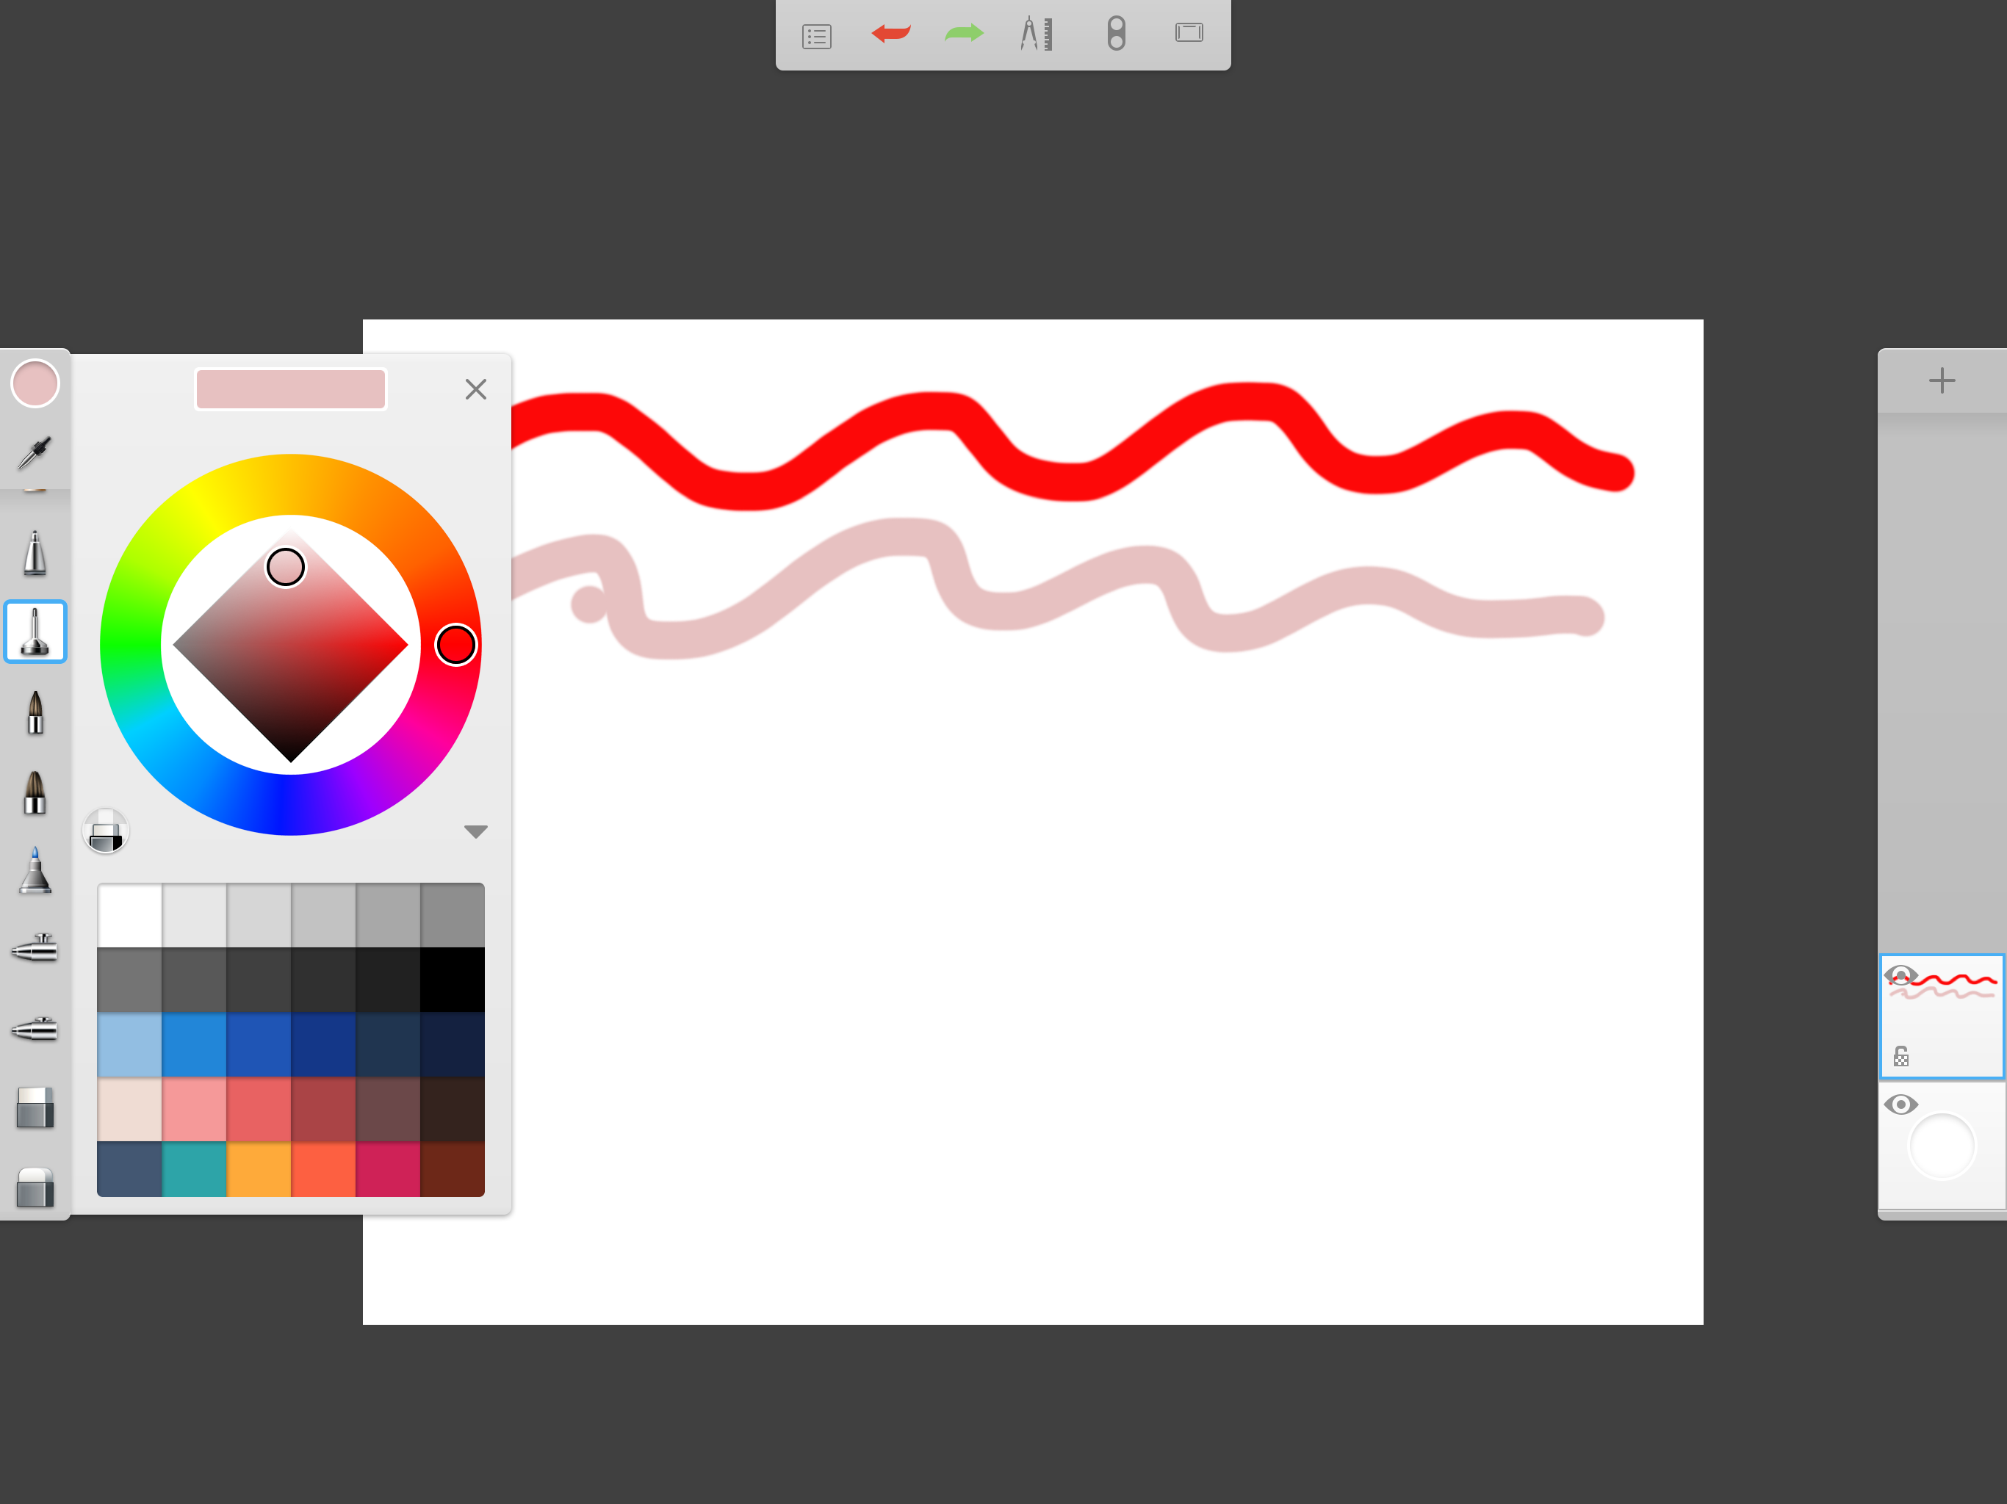
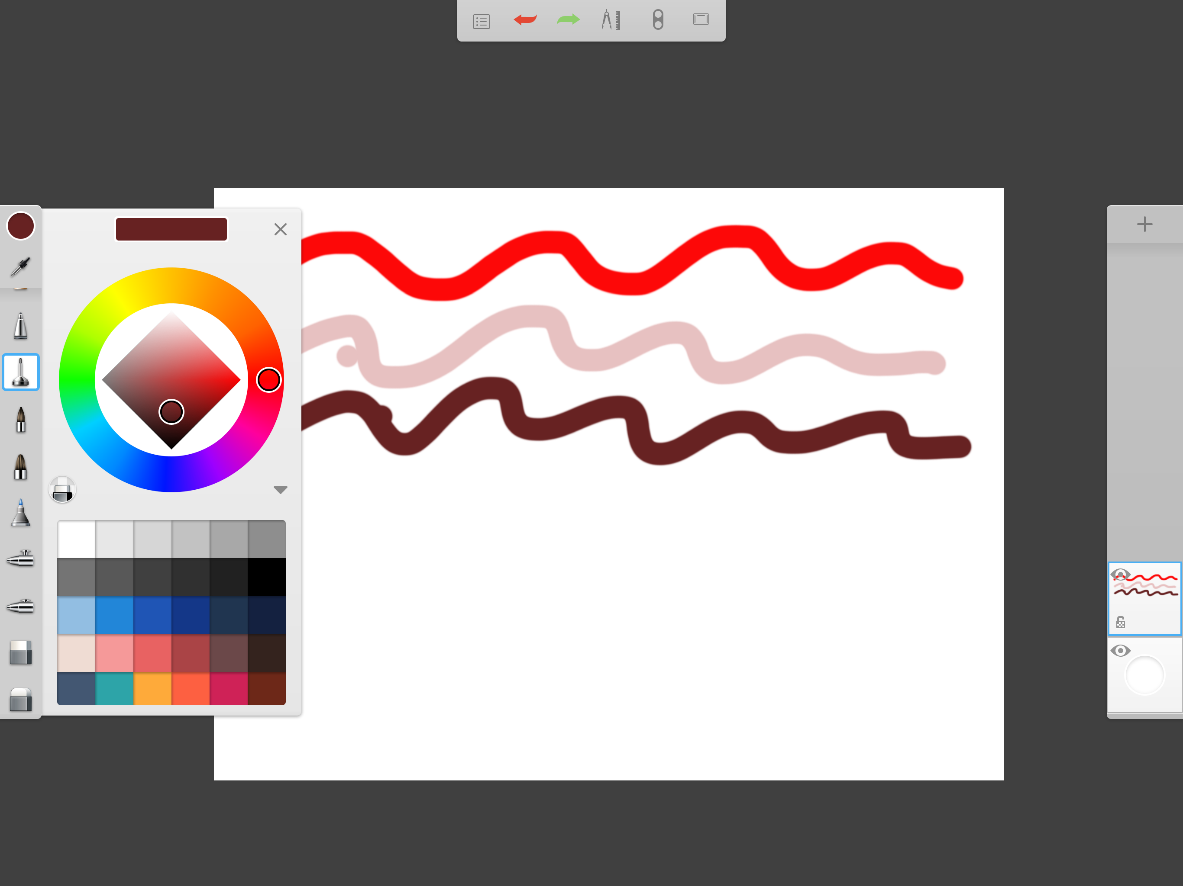
Color Diamond
8
Tap the color picker and this time tap the light side of the diamond and draw a line
Tap the color picker again and this time tap the dark side of the diamond and draw a line
You can create many colors by selecting a hue from the outer circle, then tapping the inner diamond to create different shades.

Slide 9
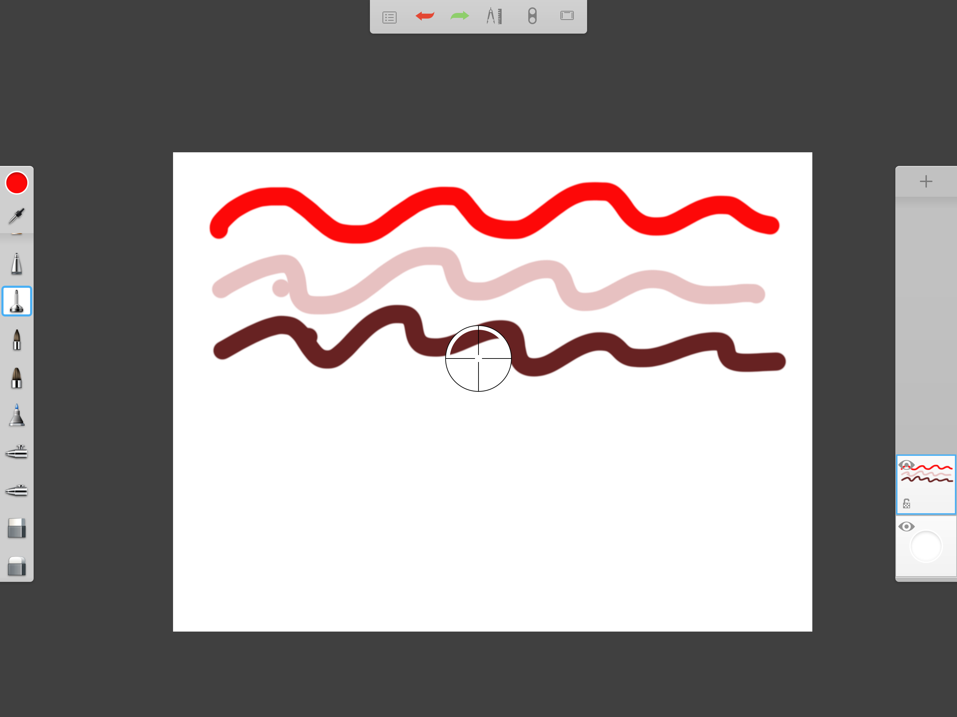
Eyedropper
9
Tap the eye dropper
Move the circle that appears on the screen over the color you want to capture in the color picker

Slide 10
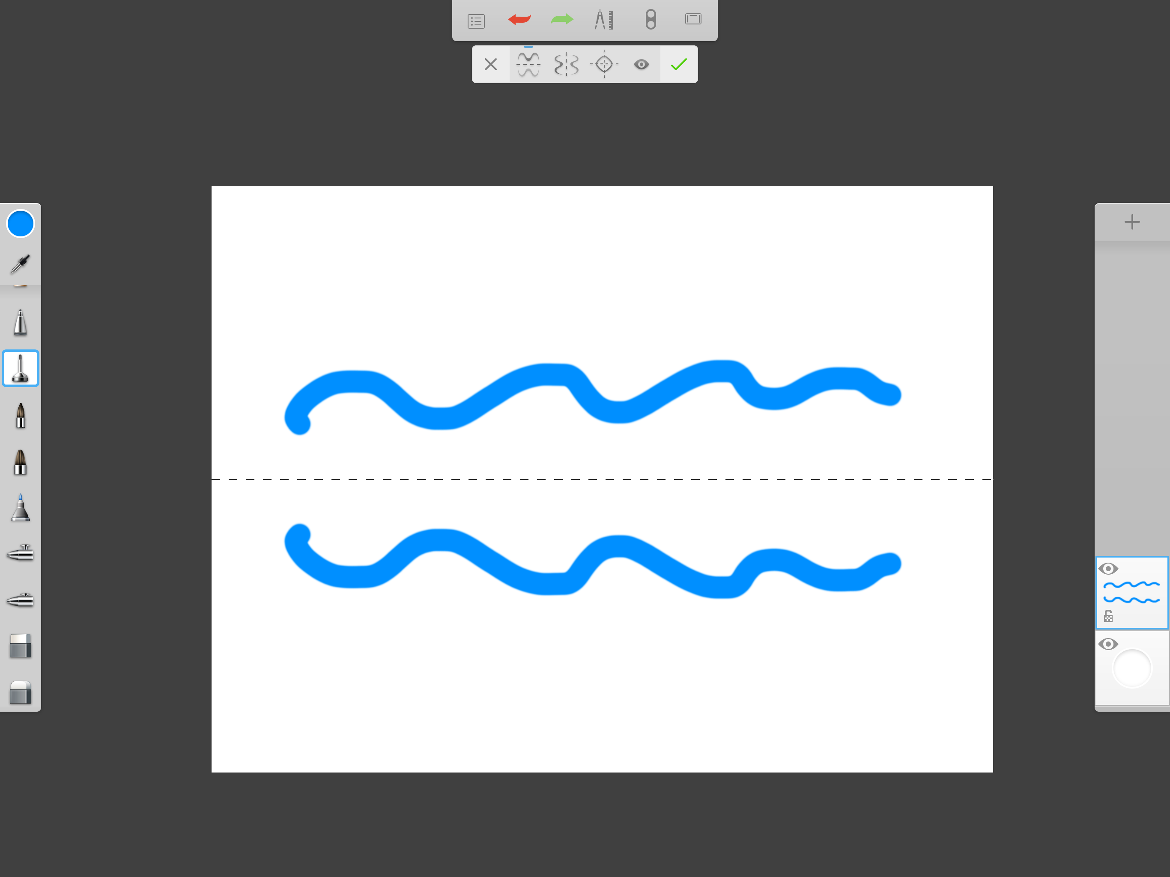
Mirroring Exercise
10
Tap the pencil icon on the top toolbar and tap mirroring on the drop down menu
Tap on the different mirroring options and try them out

Slide 11
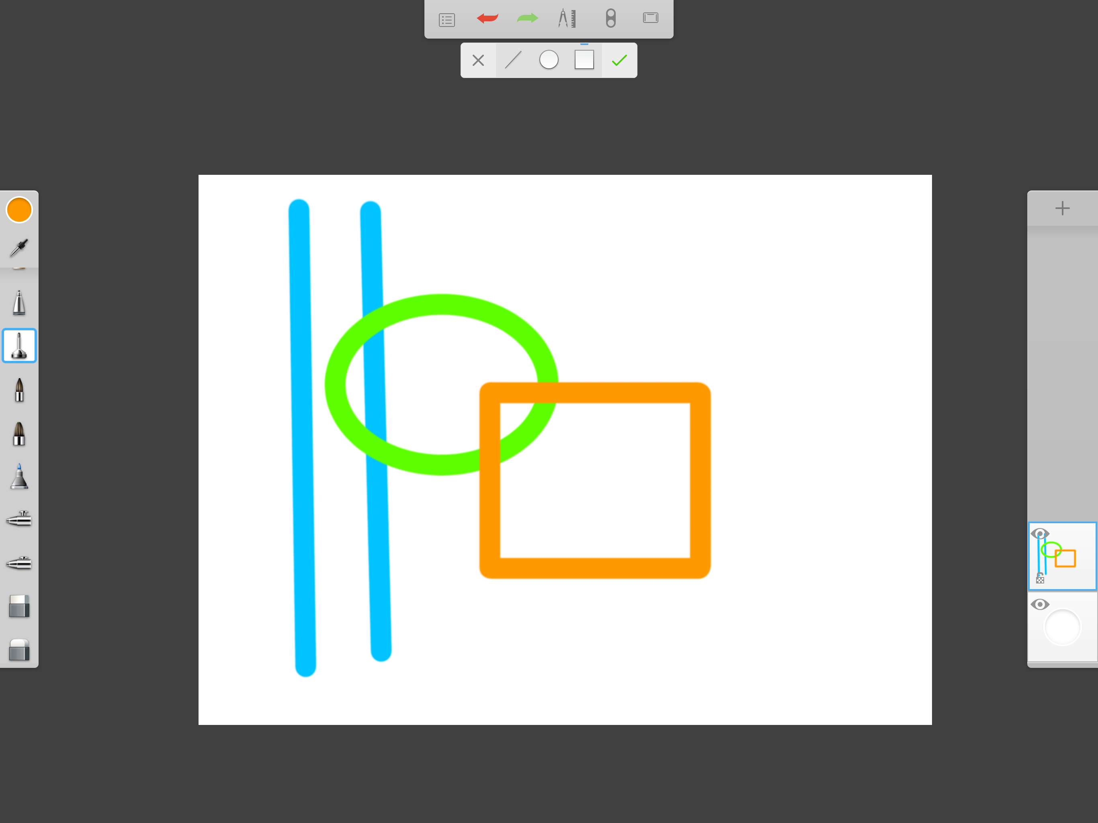
Styles Exercise
11
Tap the pencil icon on the top toolbar
Tap STYLES on the dropdown menu
Tap the ruler and draw some lines
Tap the circle and draw one
Tap the square and draw one

Slide 12
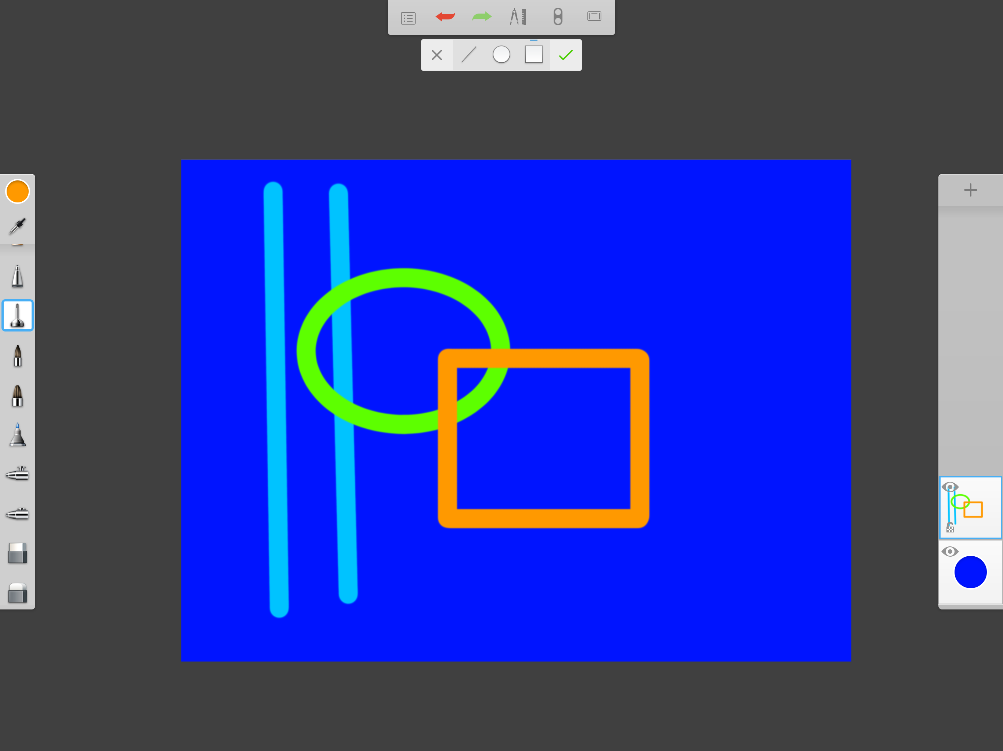
Background Color
12
Tap the background color picker on the bottom of the layers tool bar
Select a color for your background (NOTE: You can change this at any time)

Slide 13
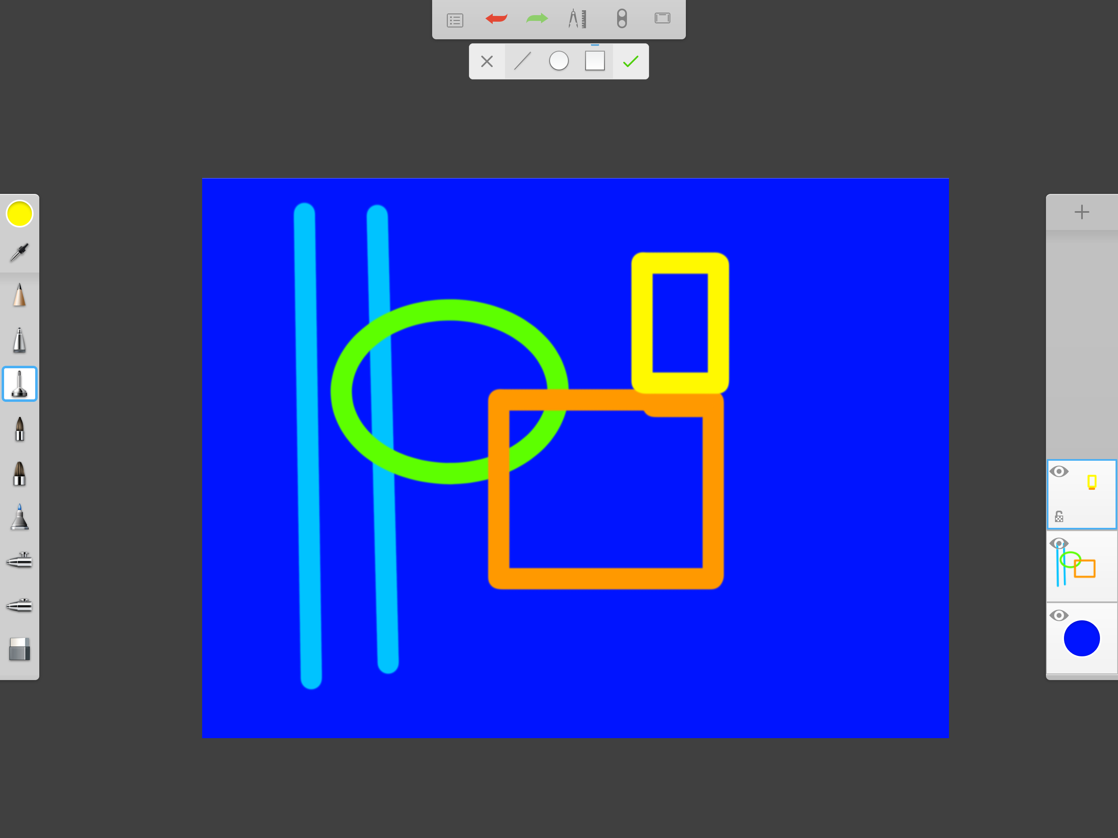
New Layer
13
Open a new layer by tapping the + icon at the top of the layers menu
Select a new color and create a new shape on the new layer

Slide 14
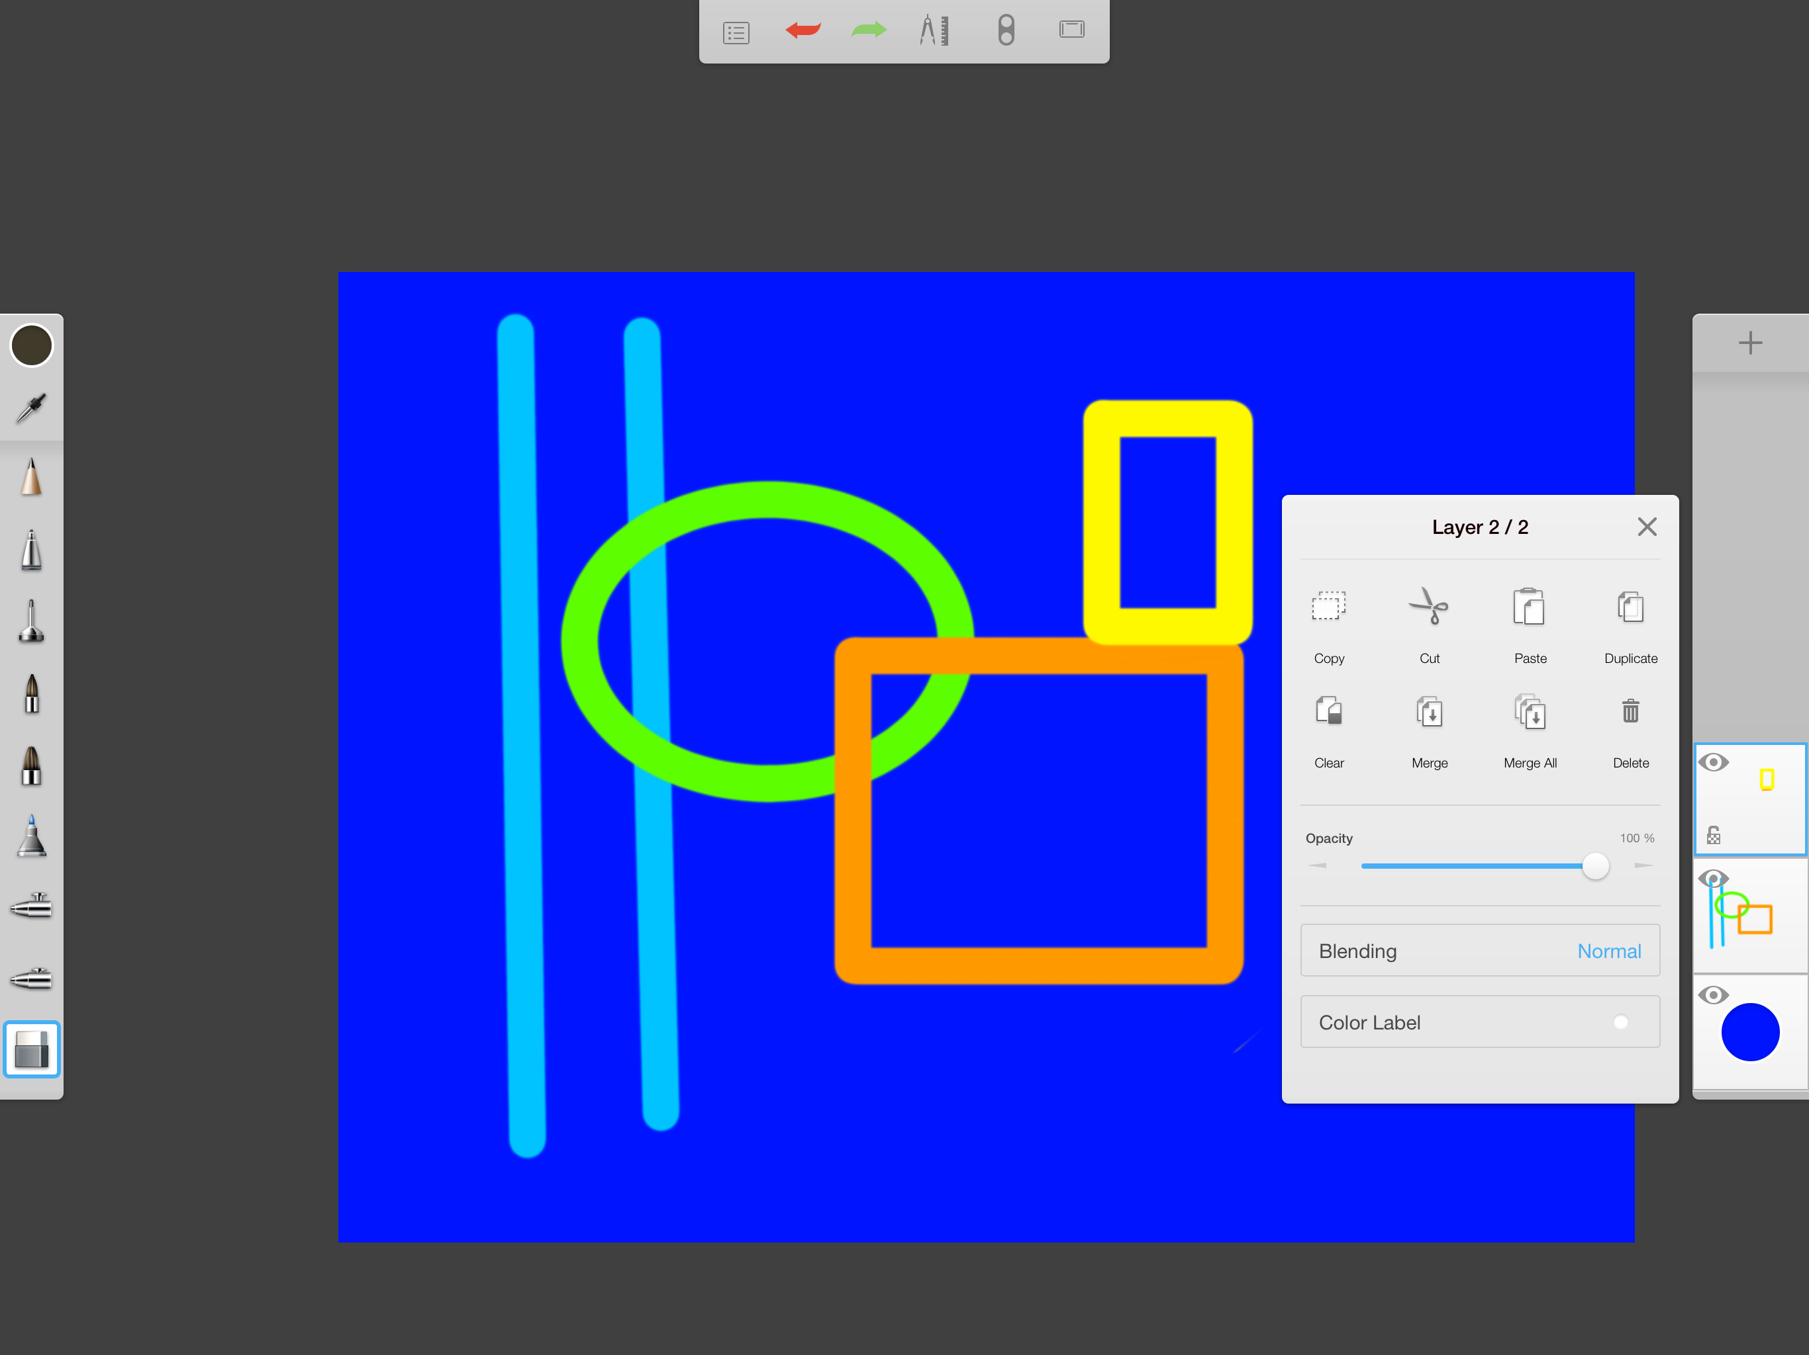
Copy and Paste
14
Tap layer 2 to see the menu of actions available
Tap Copy
Open layer 3
Tap layer 3 and tap Paste

Slide 15
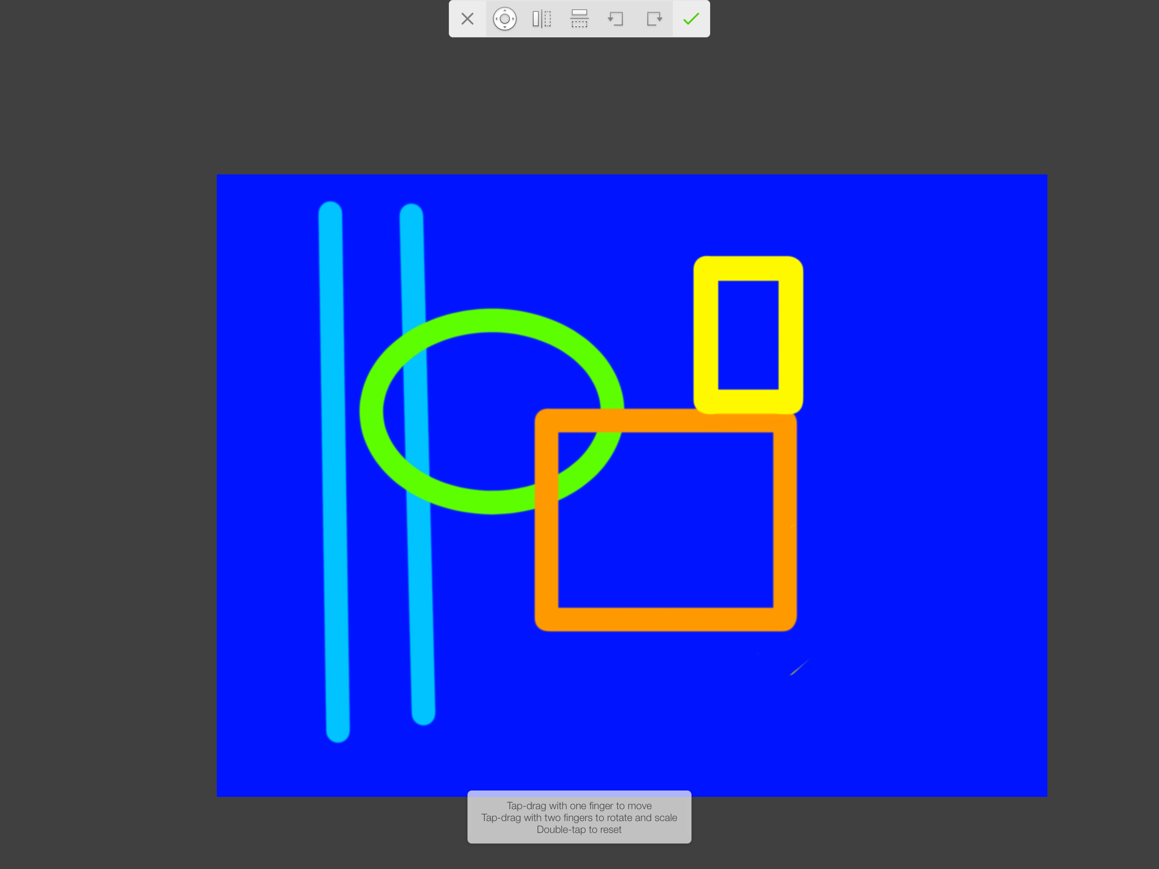
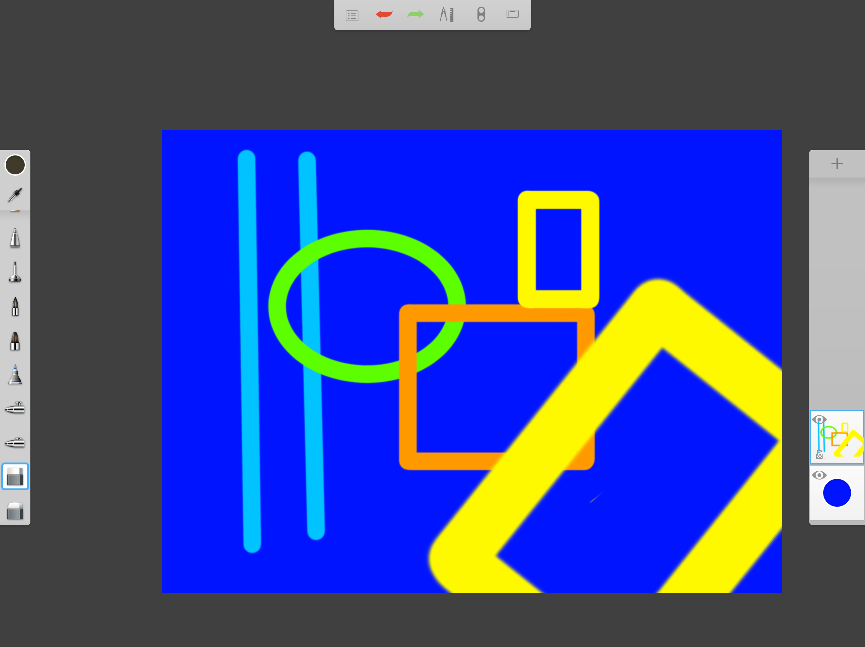
Move Copy
15
When you tap PASTE a small window shows at the bottom of the screen that tells you how to adjust the copied object to make it smaller, larger or change its position
The tool bar at the top also gives you quick keys to use to adjust position, size etc.

Slide 16
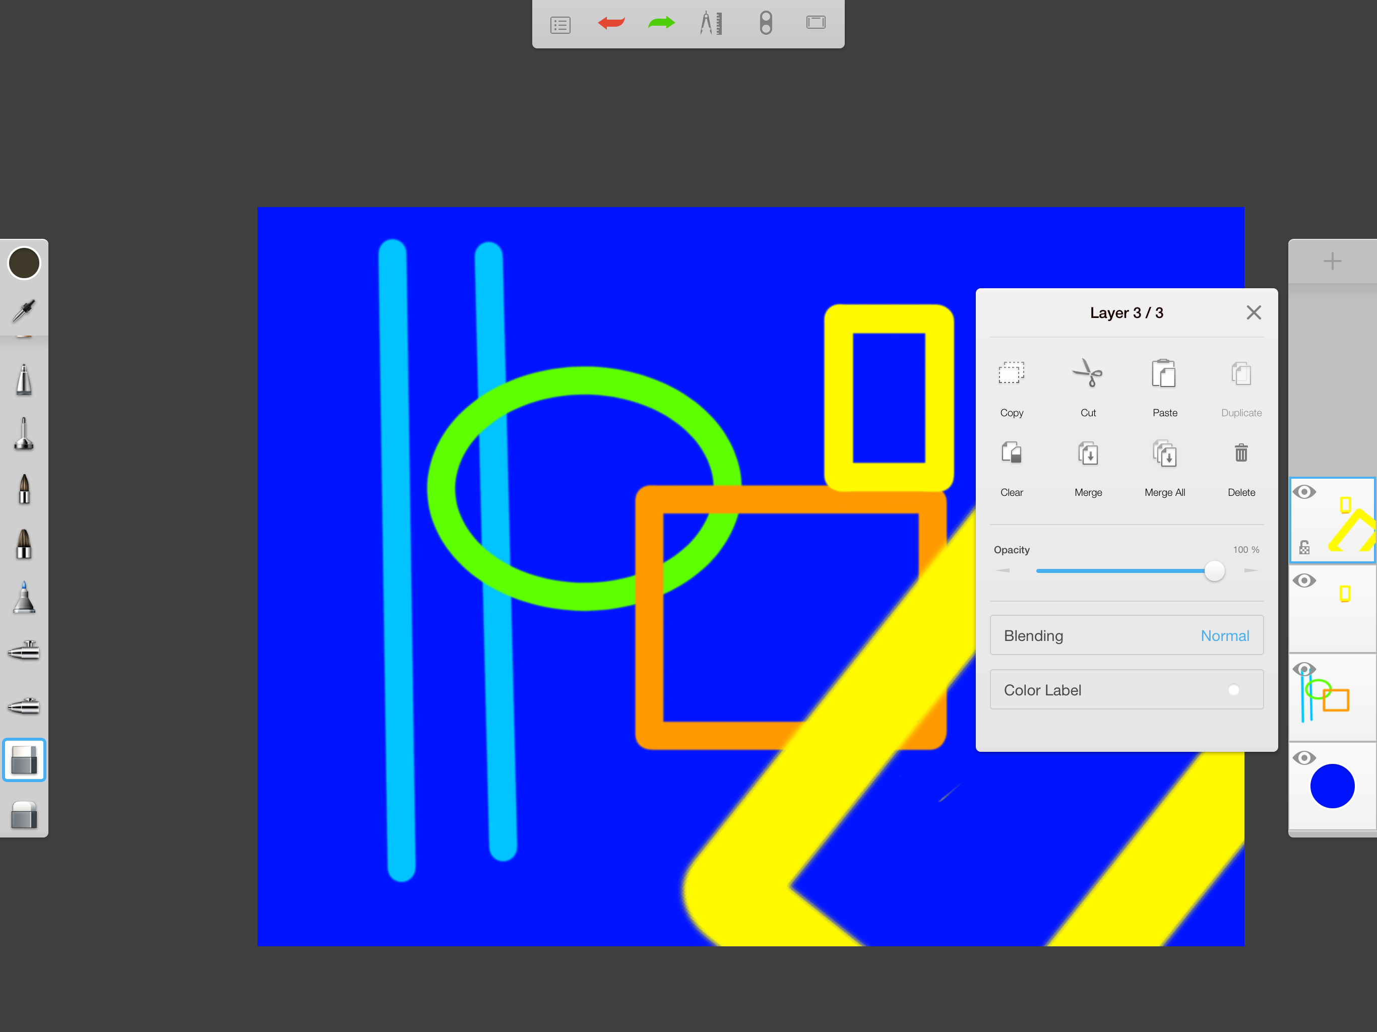
Merging Layers
16
Tap the top layer and tap Merge All
You will now see only one layer instead of three
NOTE: SketchBook for Education only provides you with 3 layers, so you have to keep merging to add more layers

Slide 17
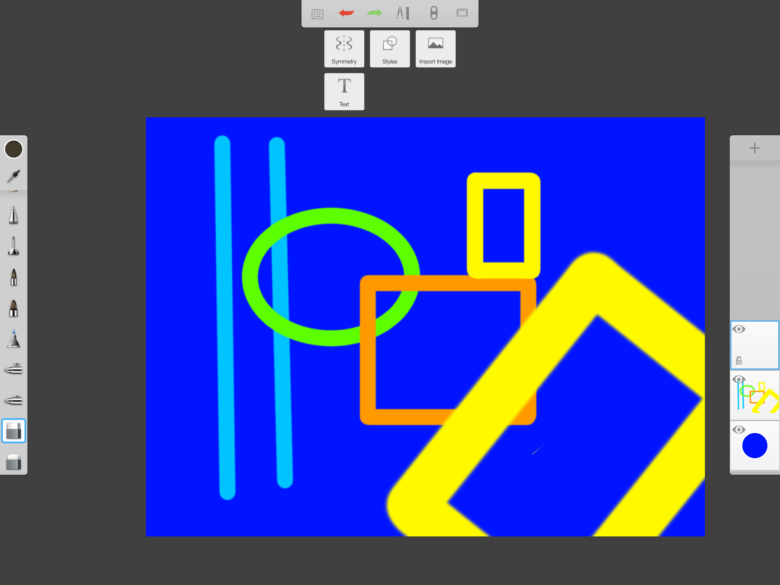
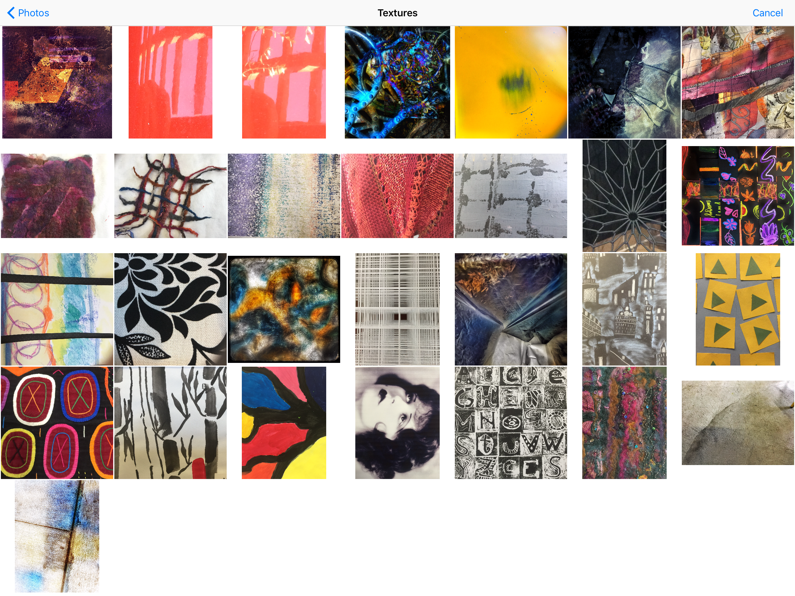
Import a Photo
17
Tap the pencil icon and tap Import Image
Select a photo from your camera roll to import into your collage

Slide 18
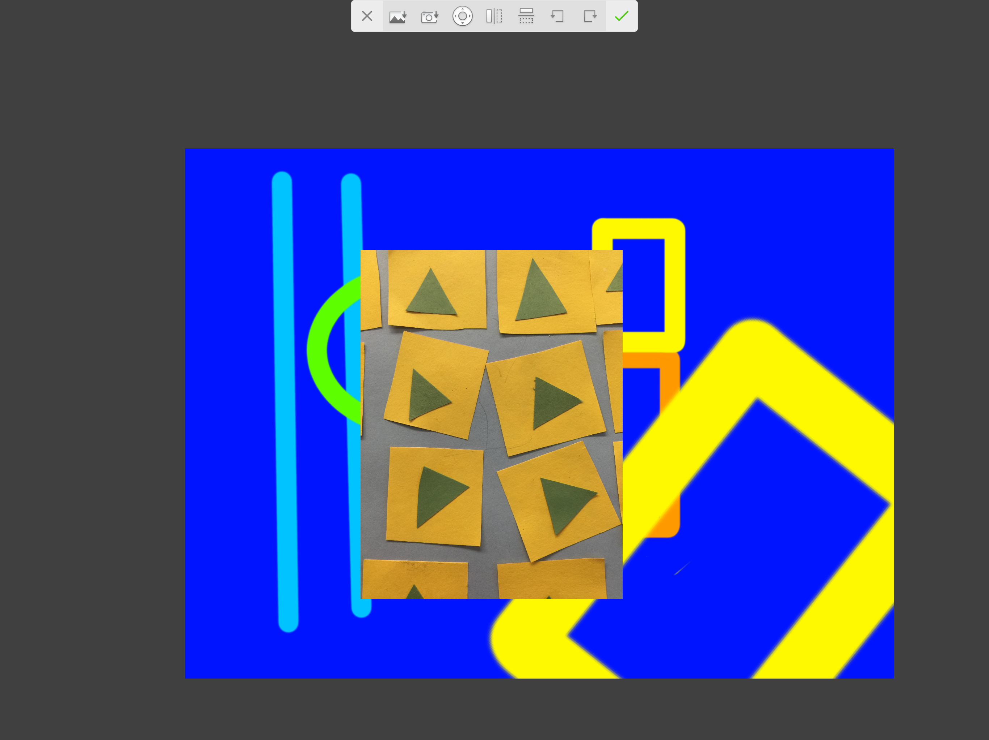
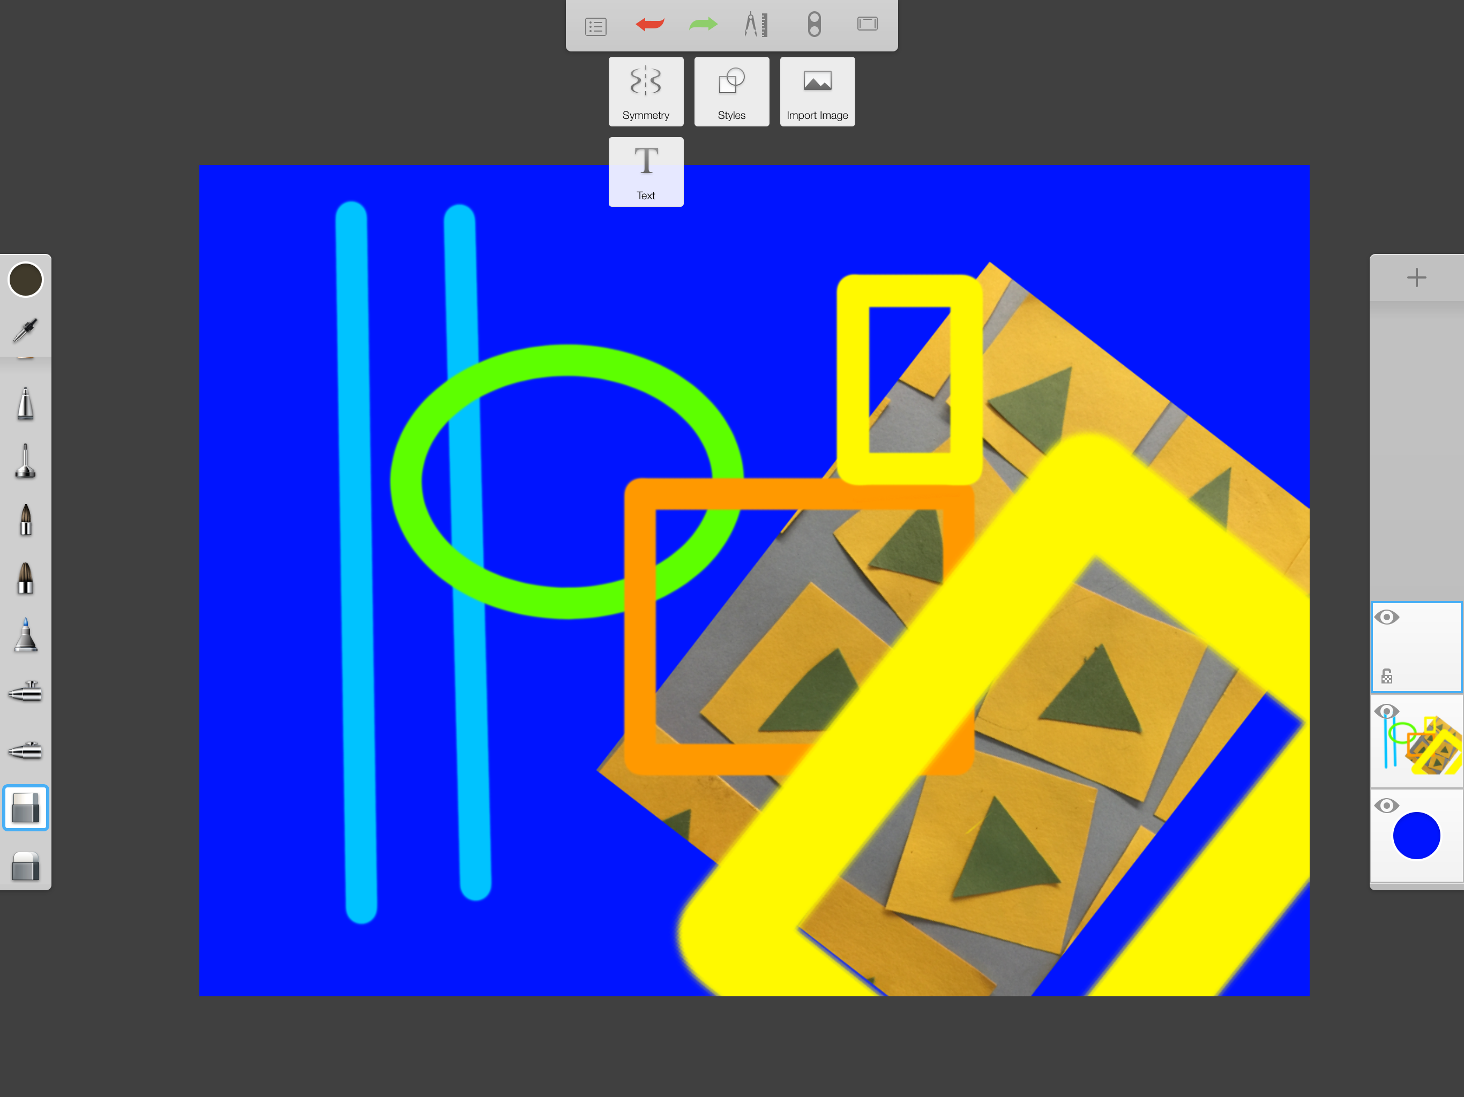
Adjust Photo
18
Adjust the imported image and place it where you want on the collage
Move layer two under layer one if you want
Merge the layers together and open a new layer
Tap the pencil icon and select Text

Slide 19
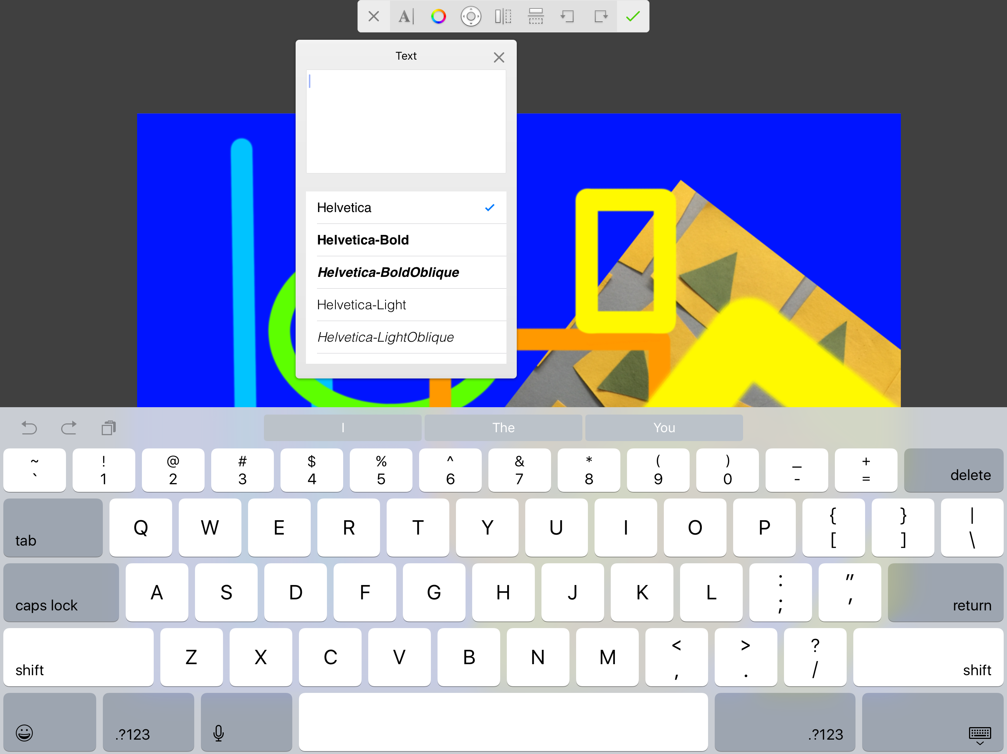
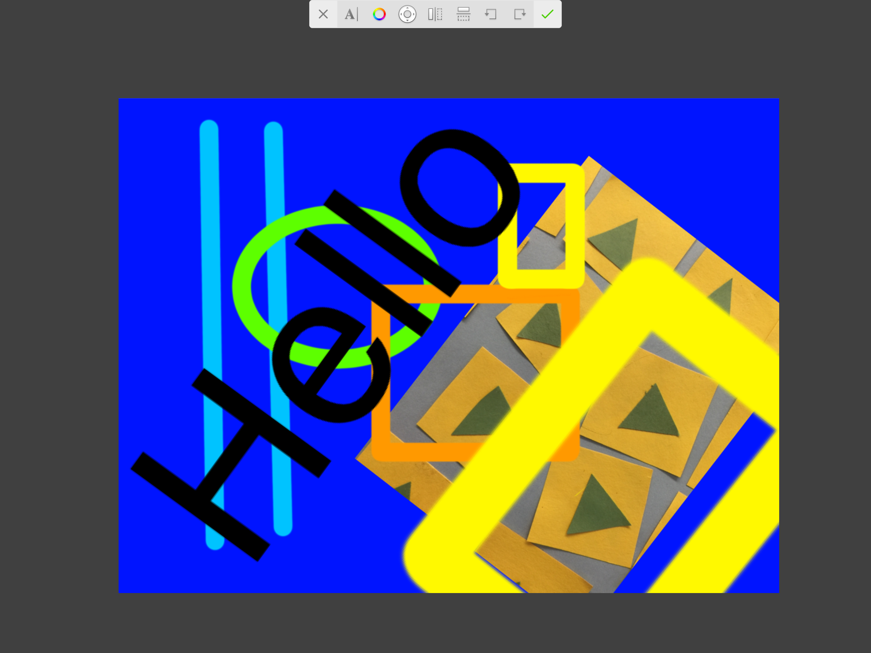
Add Text
19
Type the text you want to add to your collage
Tap DONE and then you can adjust the size and position of the text NOTE: in this app the type is always black and you cannot change it.

Slide 20
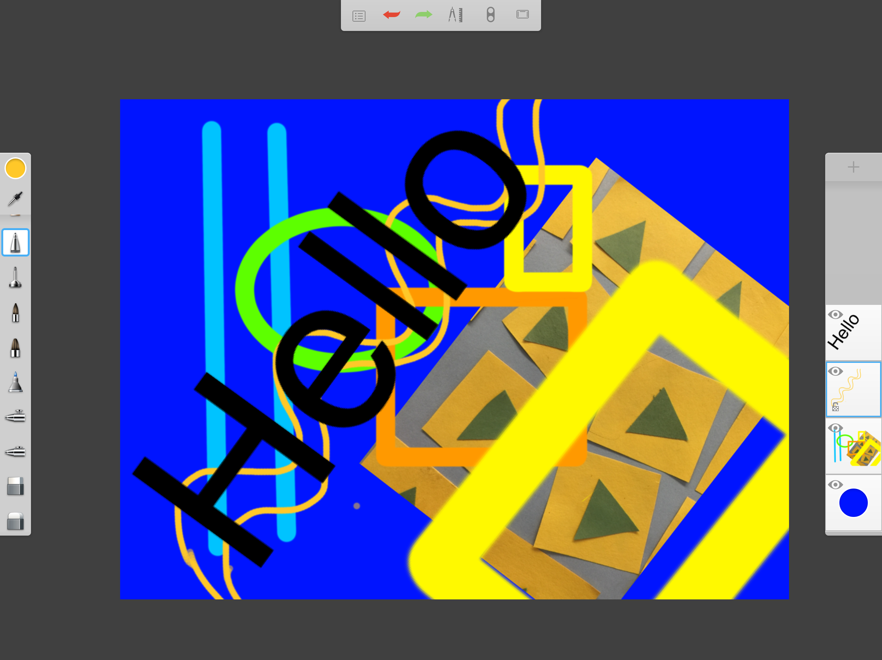
Add More Layers
20
You can add a new layer above or below the other layers to import another image or to do more painting.
Keep merging and you can add more and more layers until you are done.

Slide 21
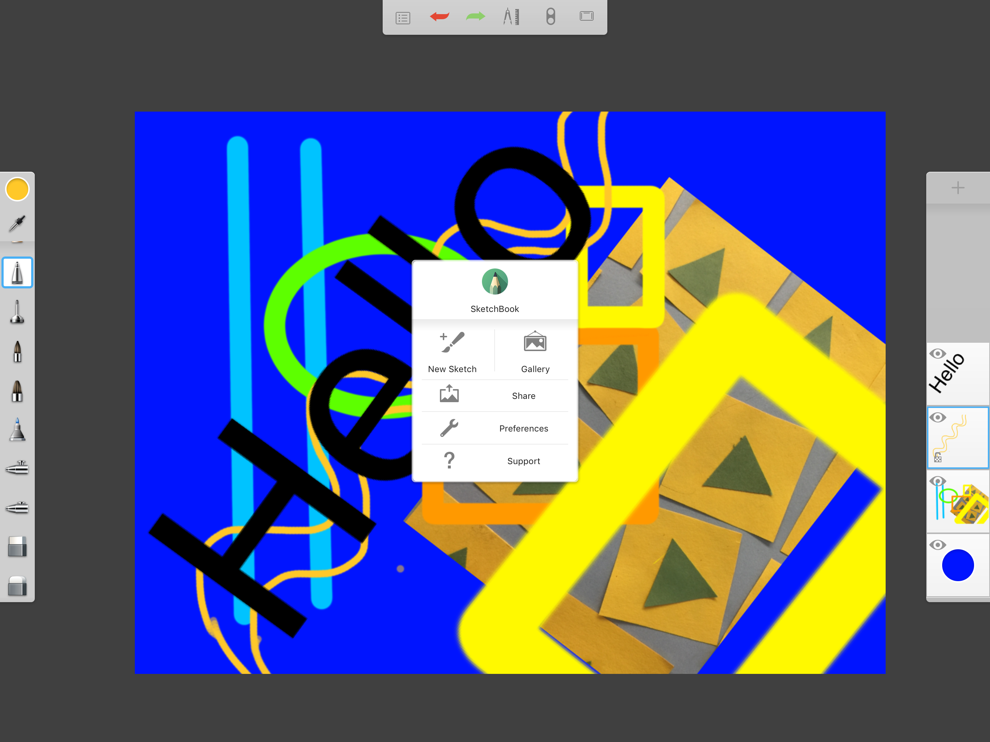
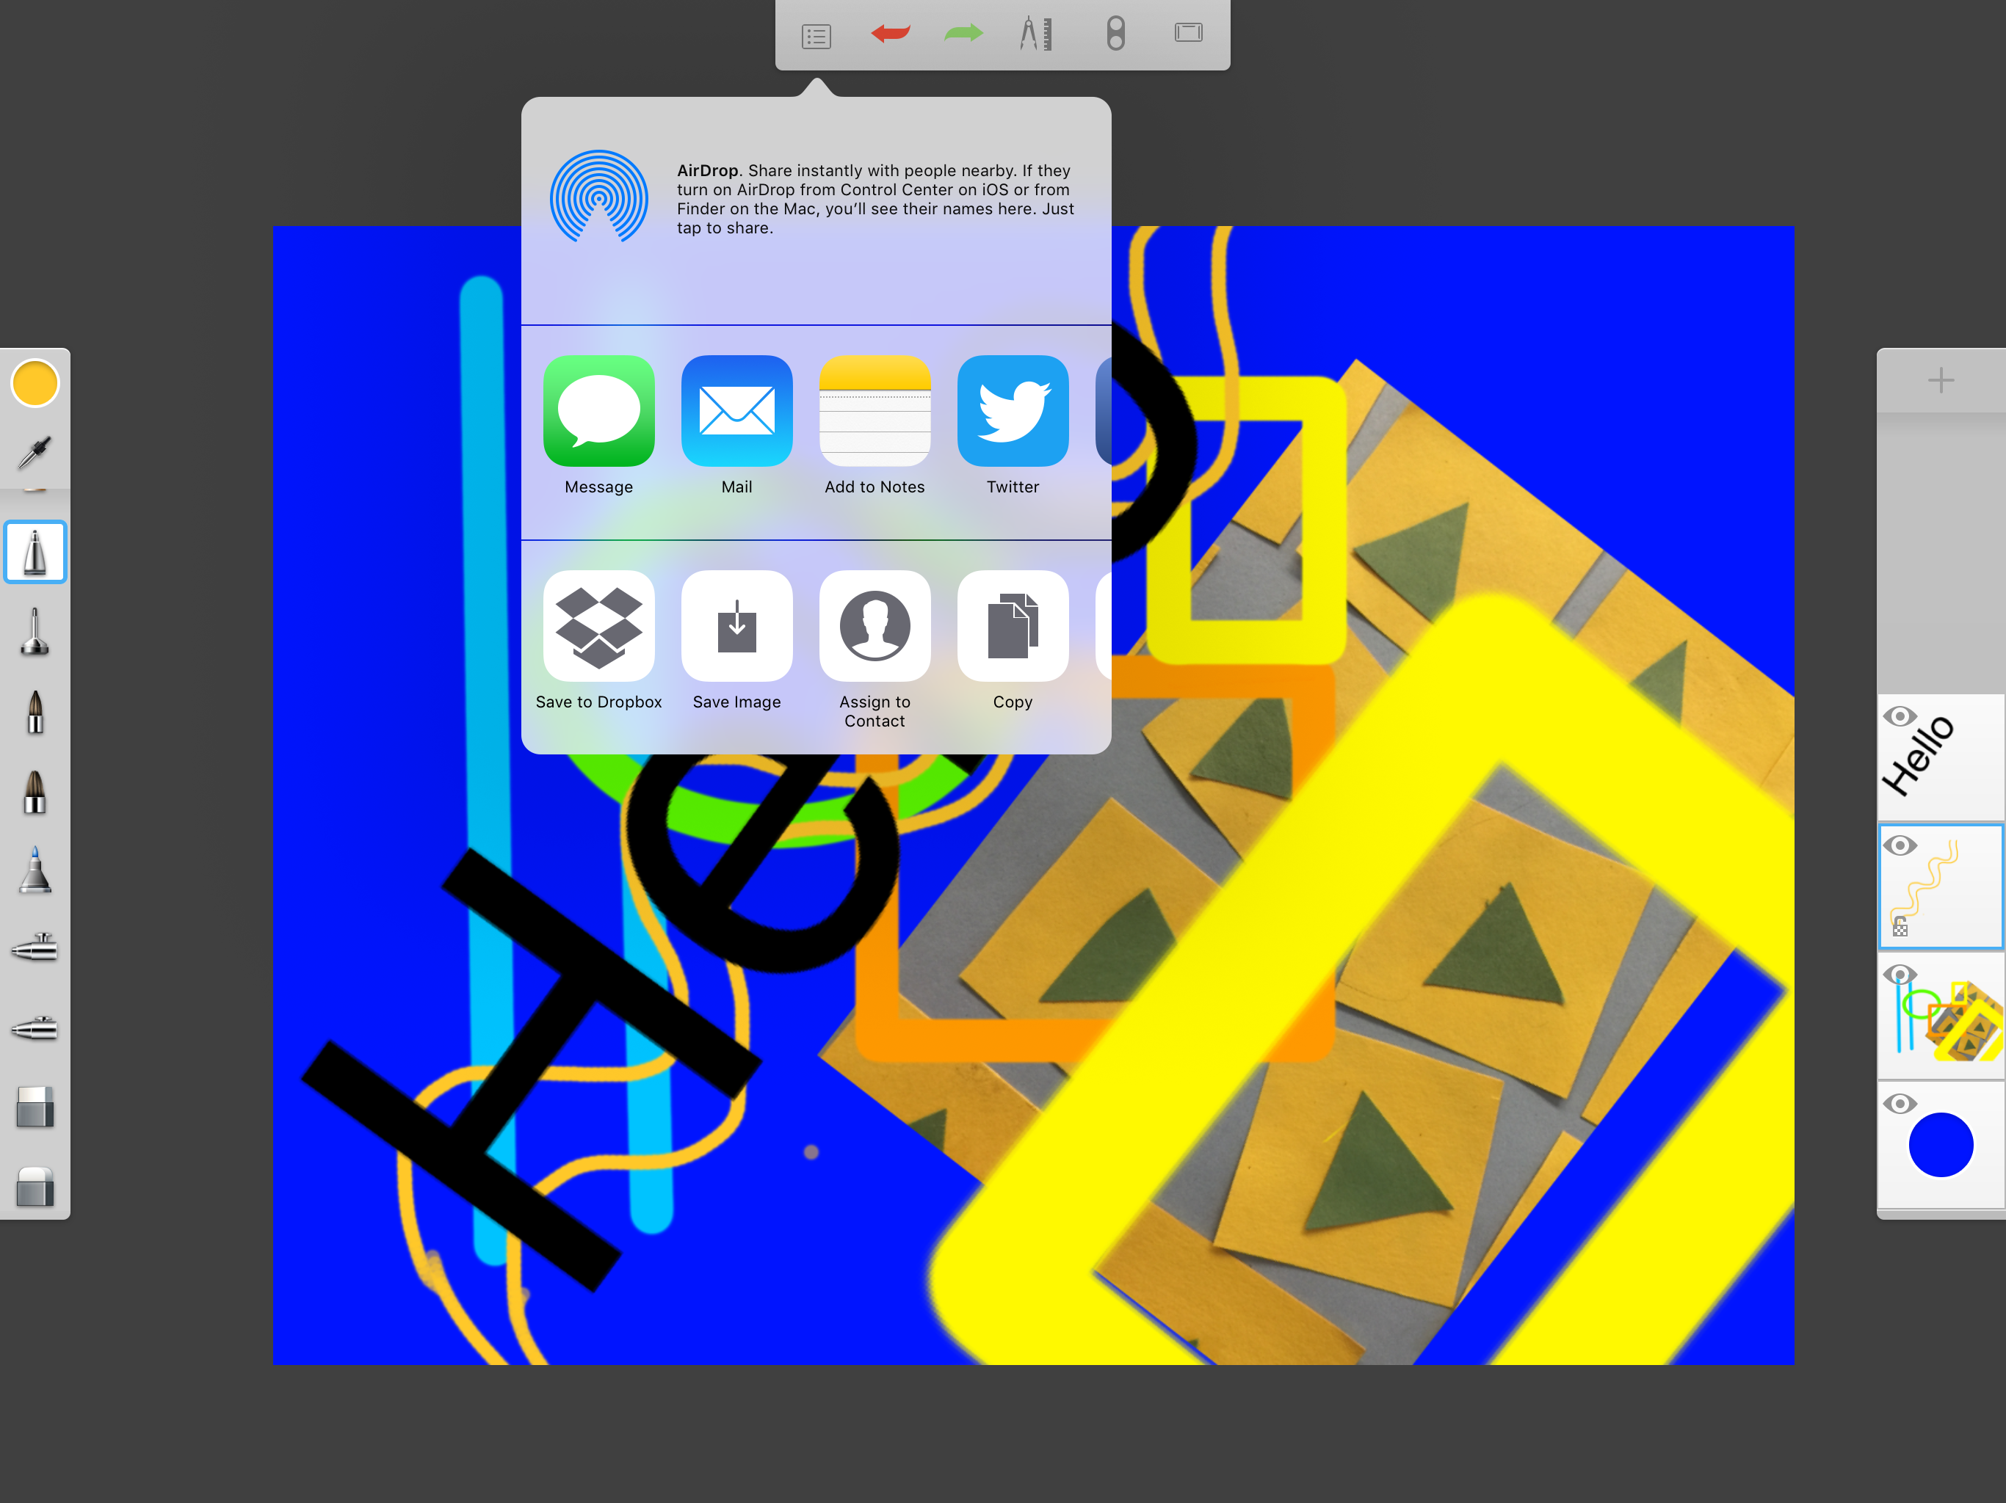
Sharing the Image
21
Tap the actions menu icon on the far left and tap Share image
The drop down menu gives you sharing options. Save Image will result in your image being saved to your camera roll.

Slide 22
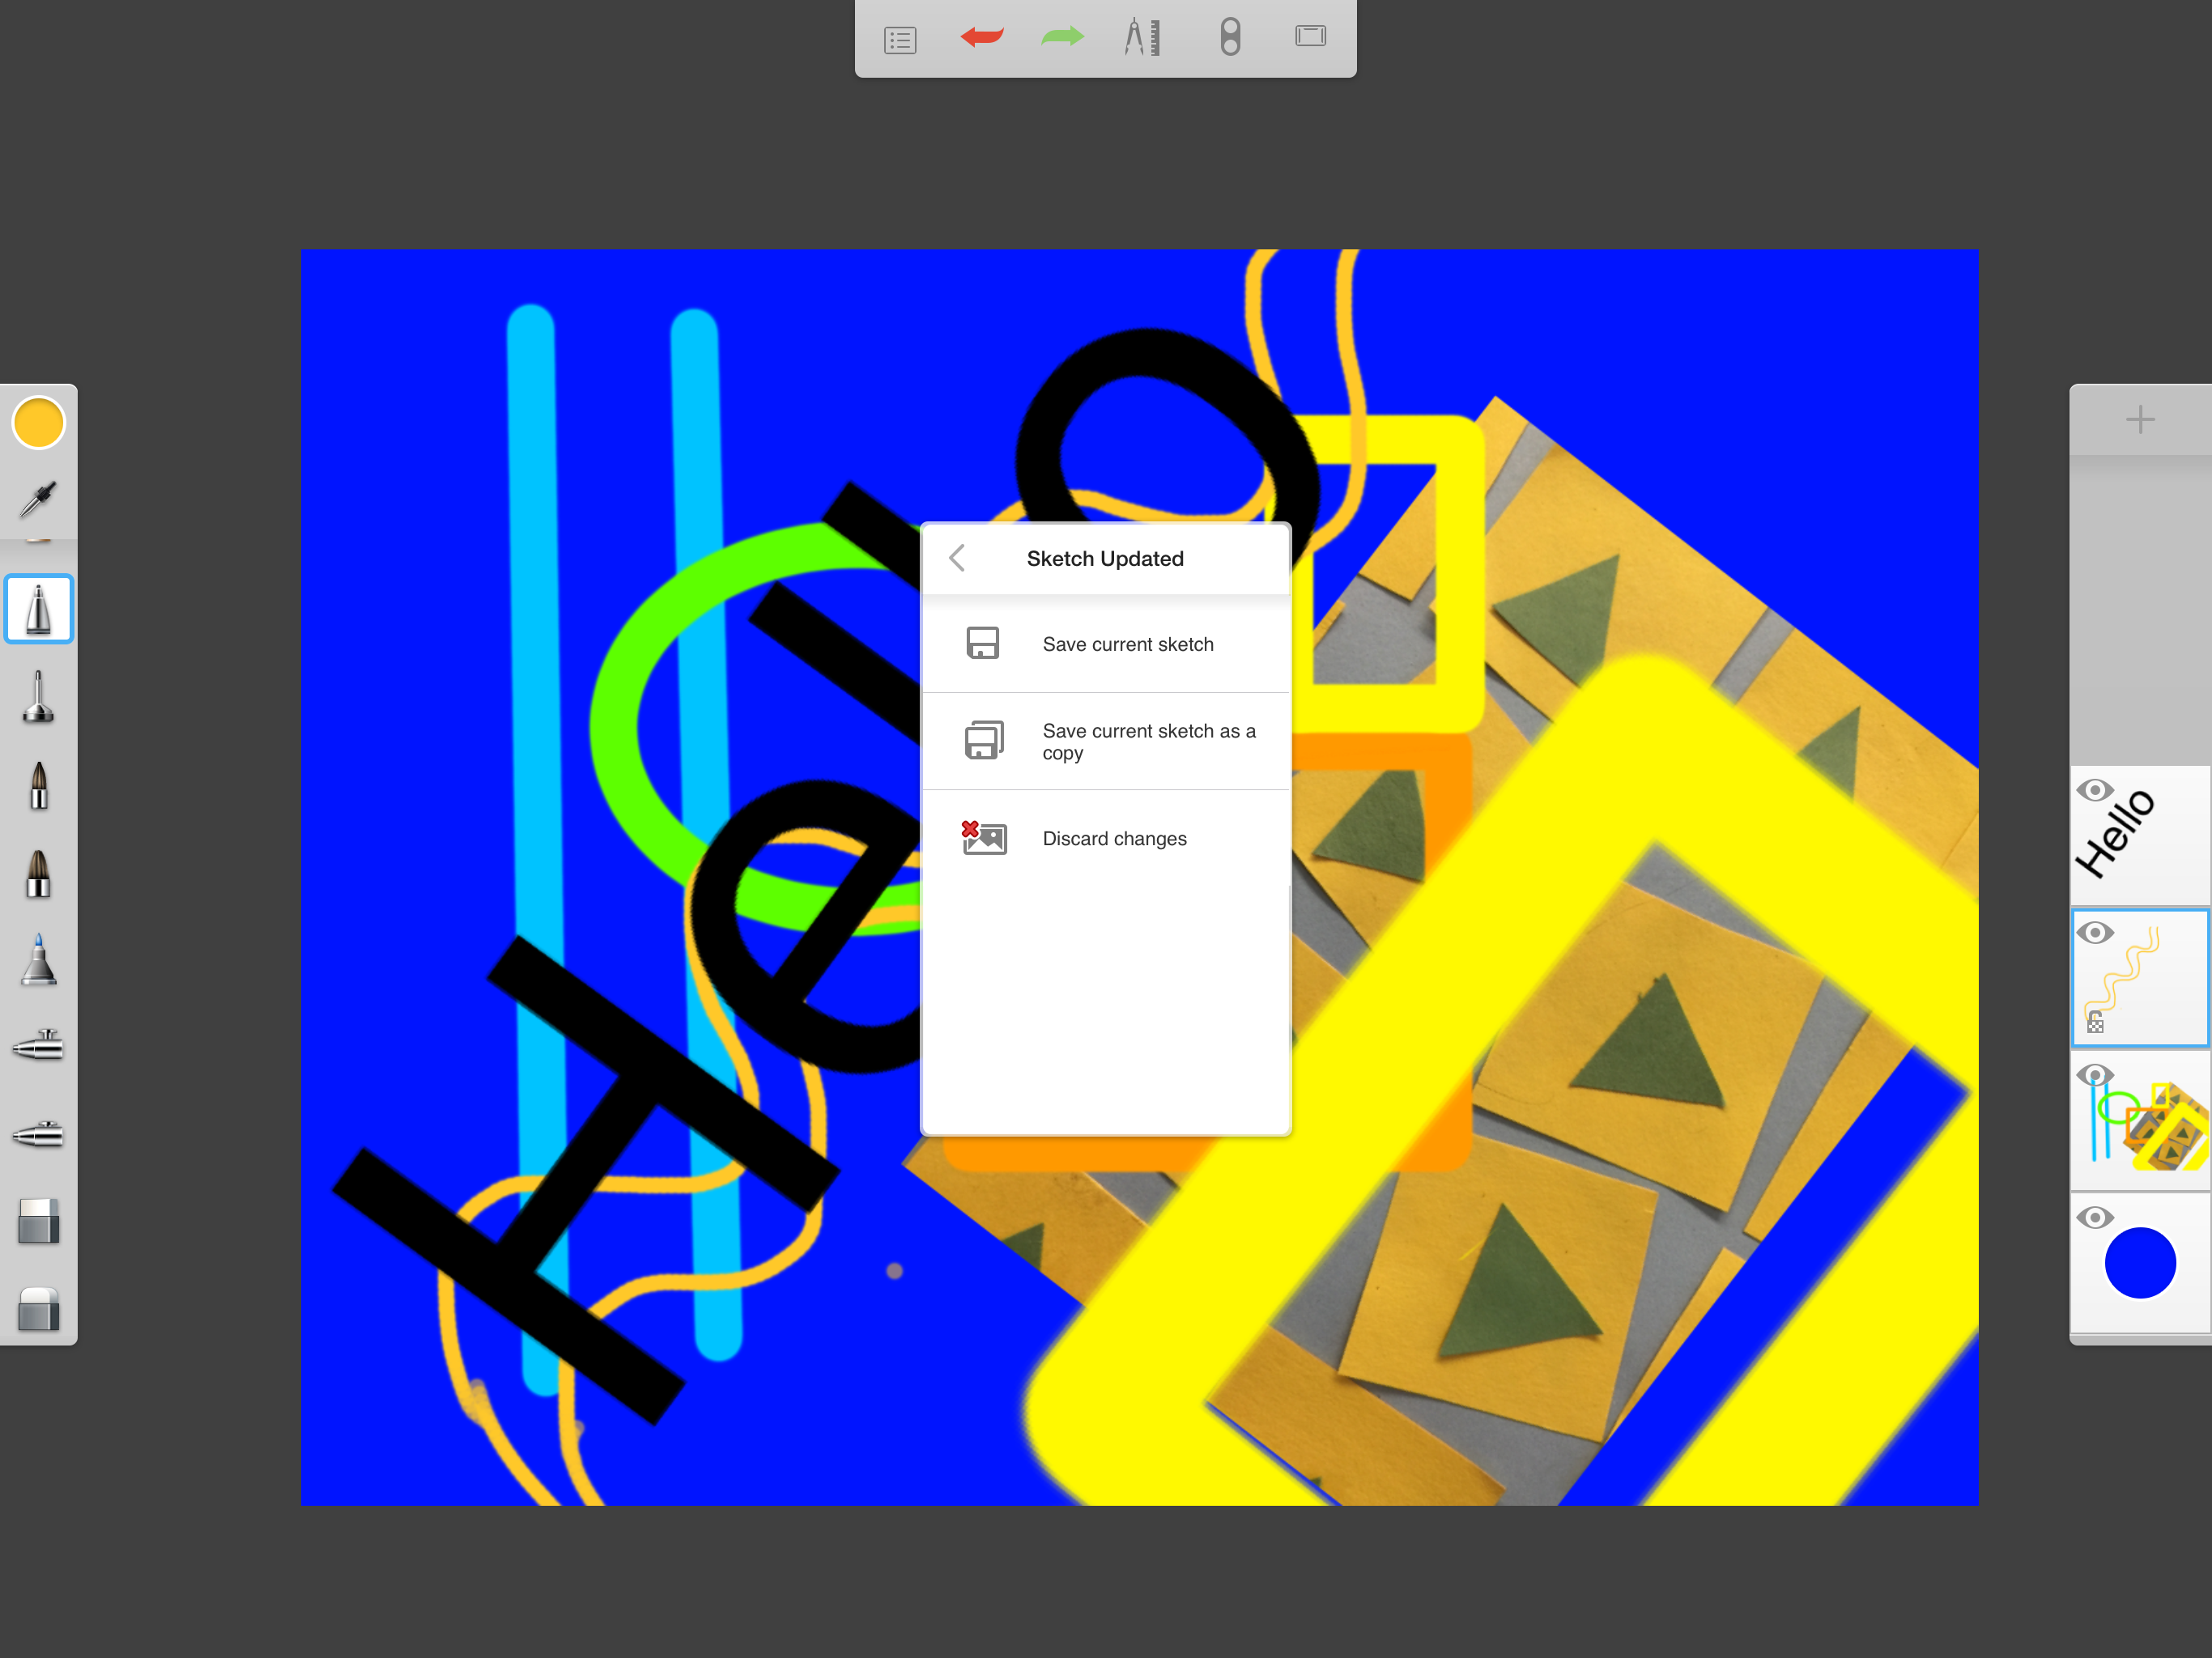
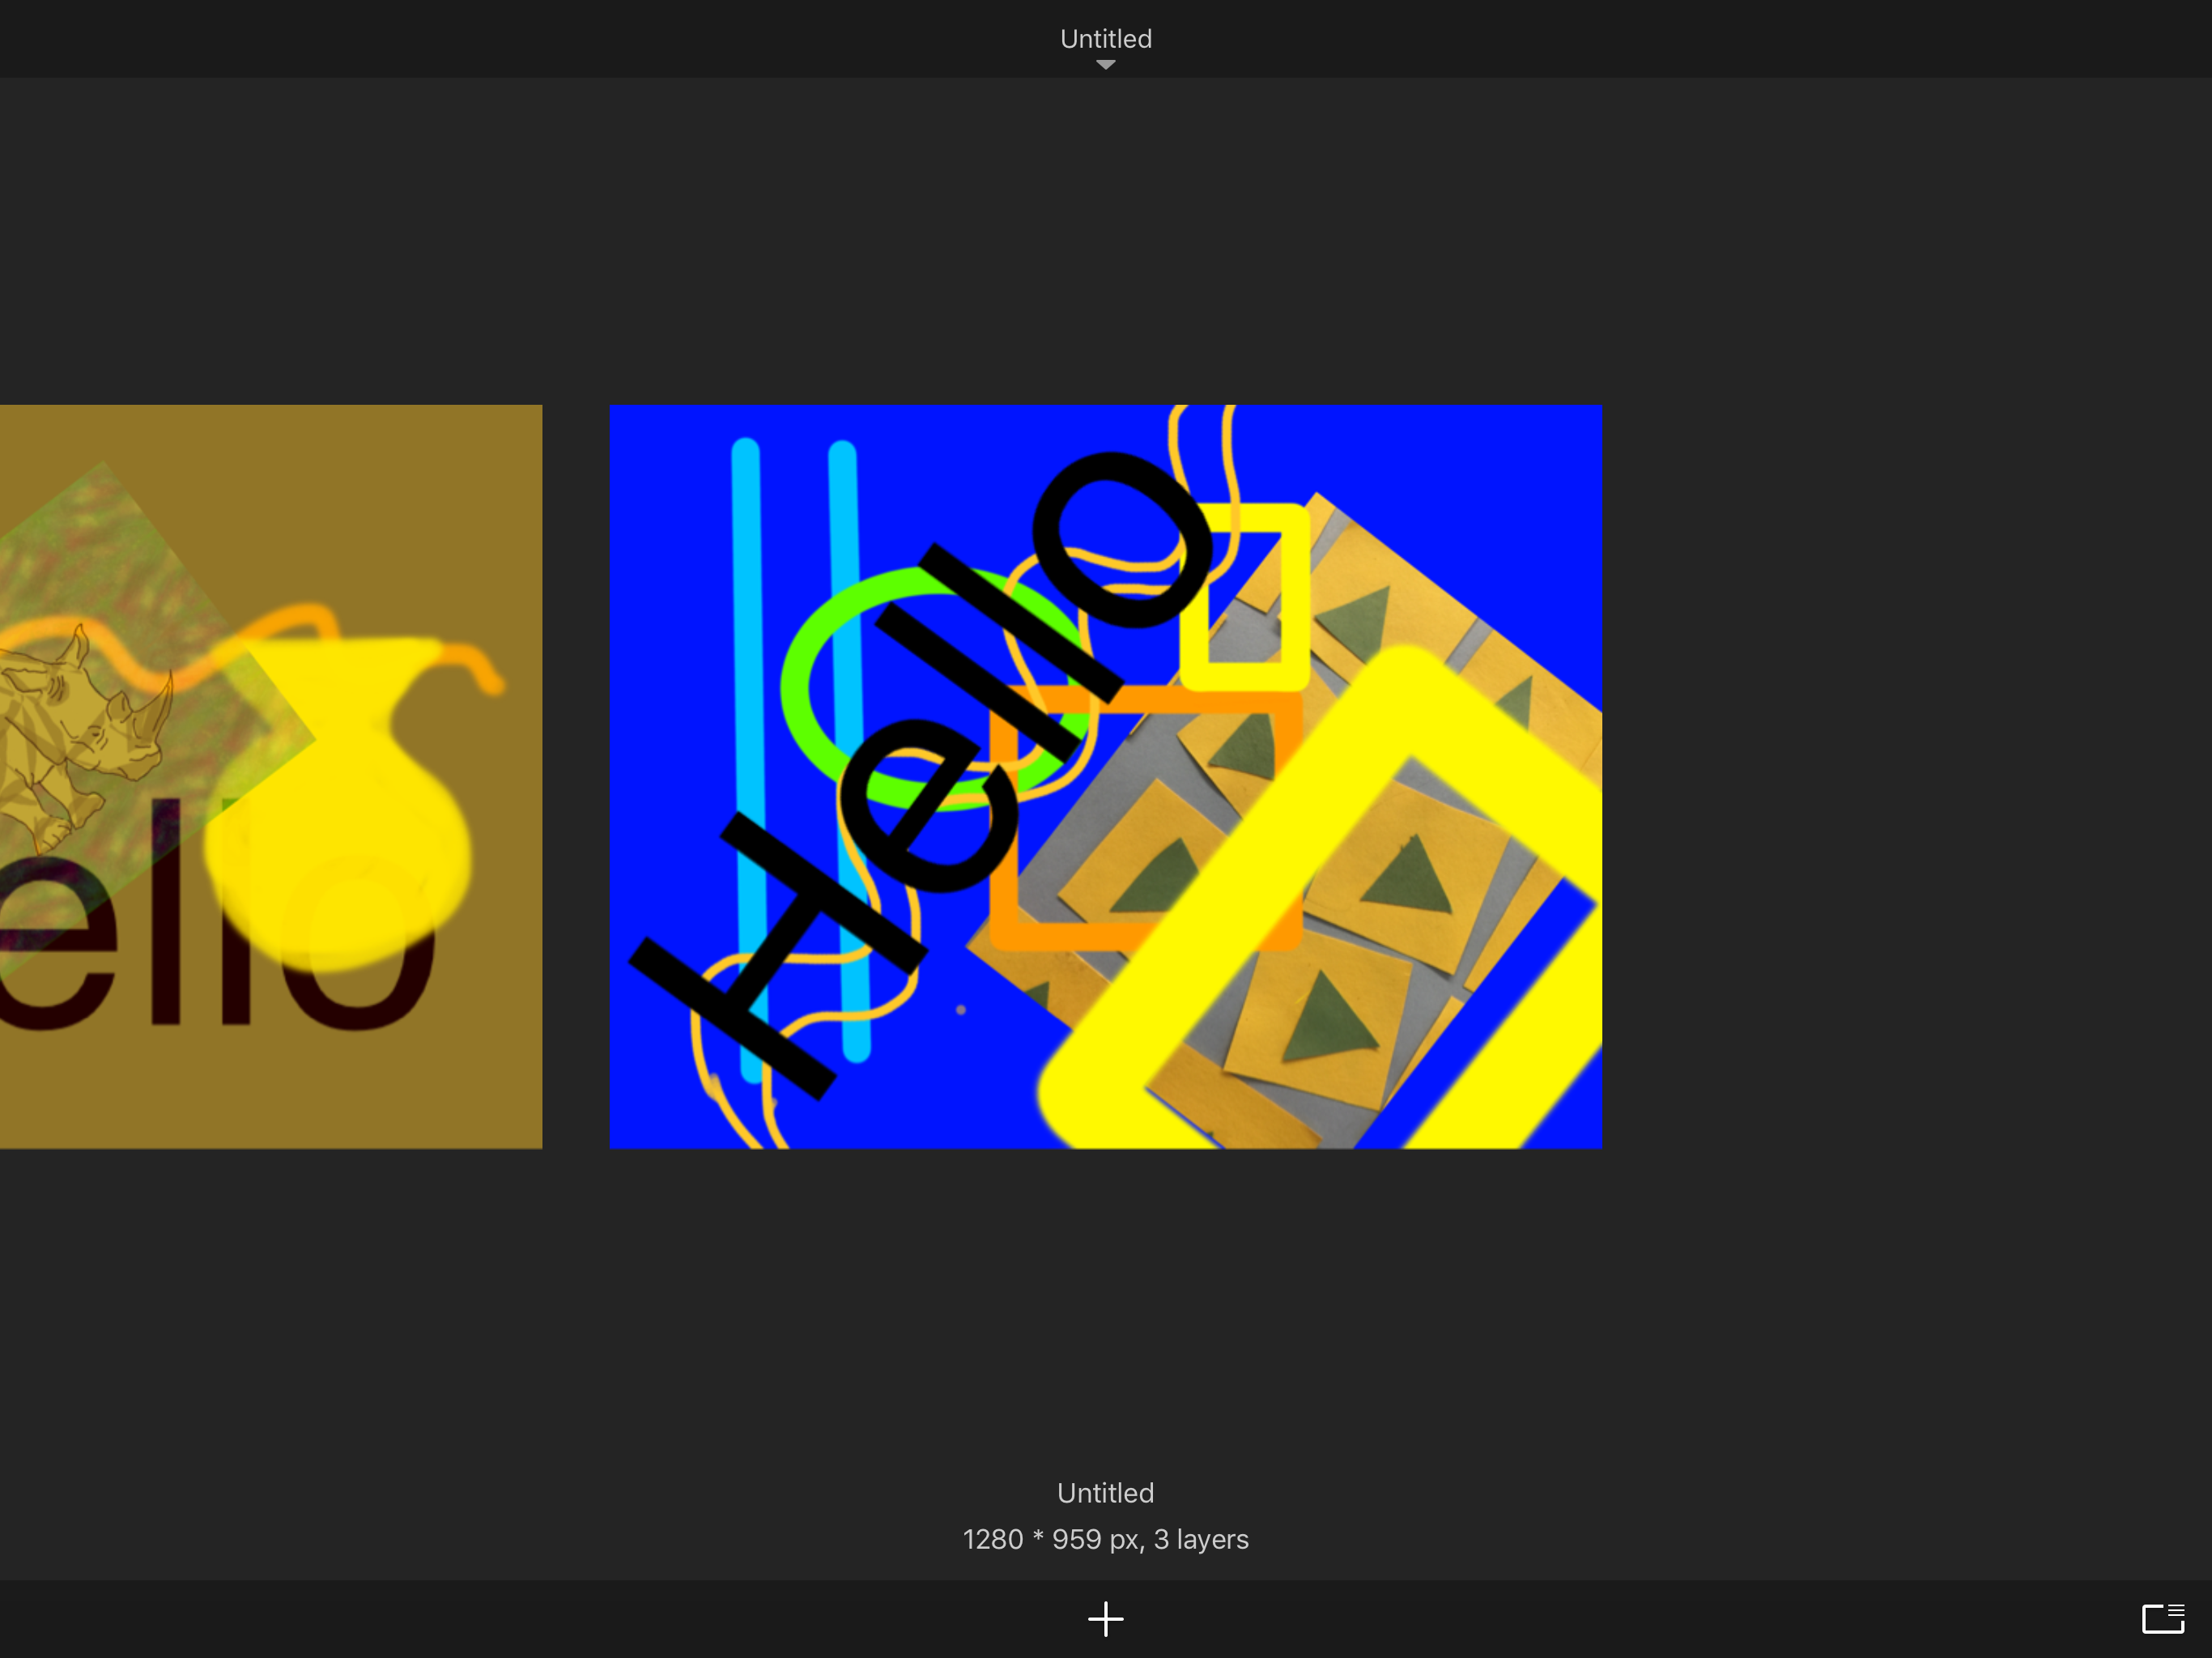
Save to Gallery
22
Tap actions menu icon again and this time tap the gallery icon
The drop down menu allows you to save or discard your current sketch

Slide 23
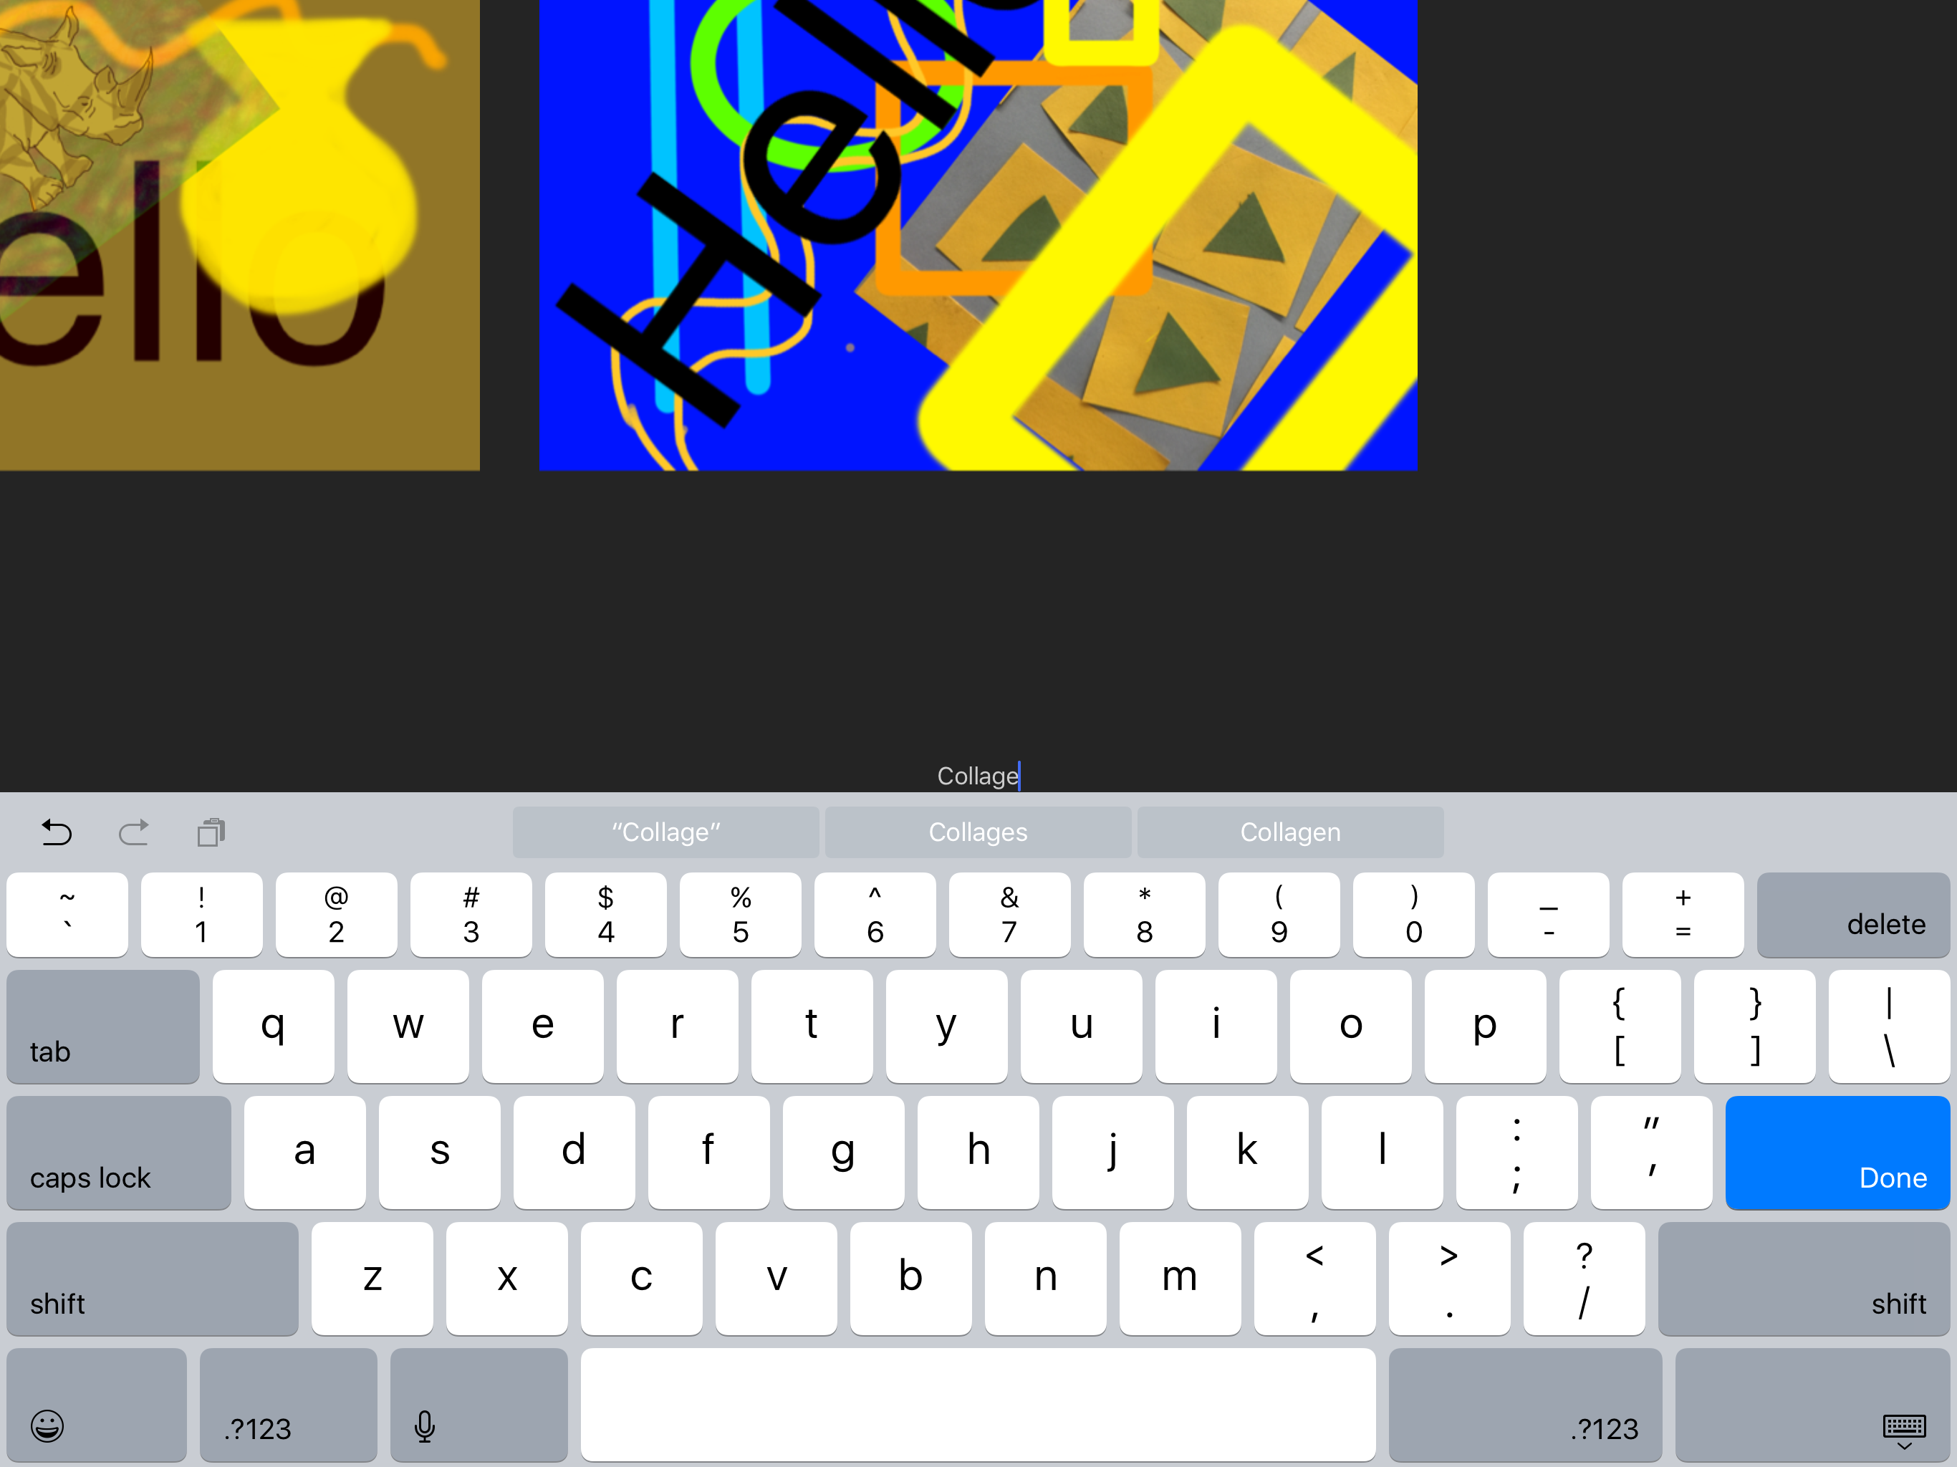
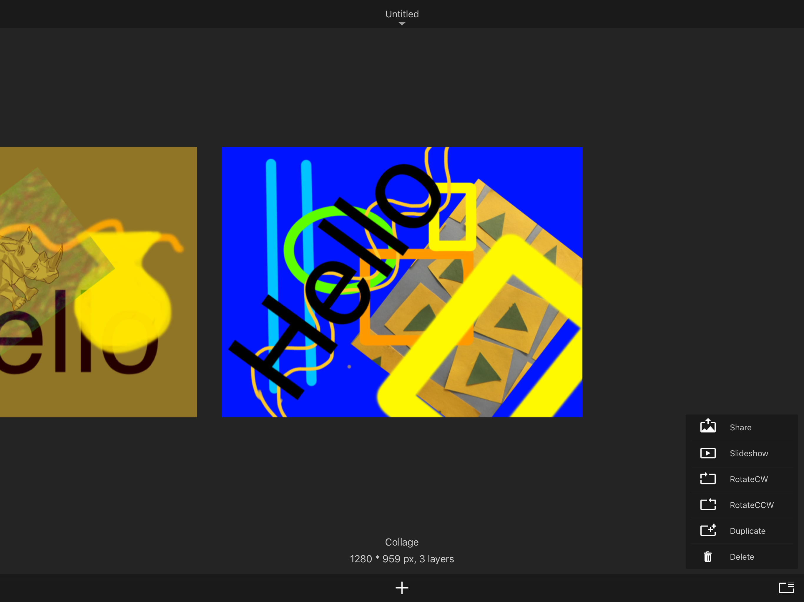
Name and Share
23
You can title the image by tapping Untitled and then typing in your new title
Tap the icon at the bottom right and see the options now available to share, duplicate, delete the image etc…

Slide 24
More information
24
If you feel you need more instruction on using this app, you can request access to mobileart.how, Mobile Art Academy’s instructional website, and study the SketchBook video class which gives you more detailed understanding of using SketchBook. Just request help from support@artinaction.org.

