Slide 1
Sketch Pad 4.1
Quick Look Instructions
Prepared for Art in Action by
Mobile Art Academy

Slide 2
Table of Contents
Opening the program 3
Open the app 4
Crop and zoom tools 5
Drawing tools 6
Selecting color 7
Using the sliders 8
Blending tool 9
Save a file 10
Open a new file 11
Fill the background 12
Draw and fill a shape 13
Experiment with fill tool 14
Draw and fill together 15
Save and download 16

Slide 3
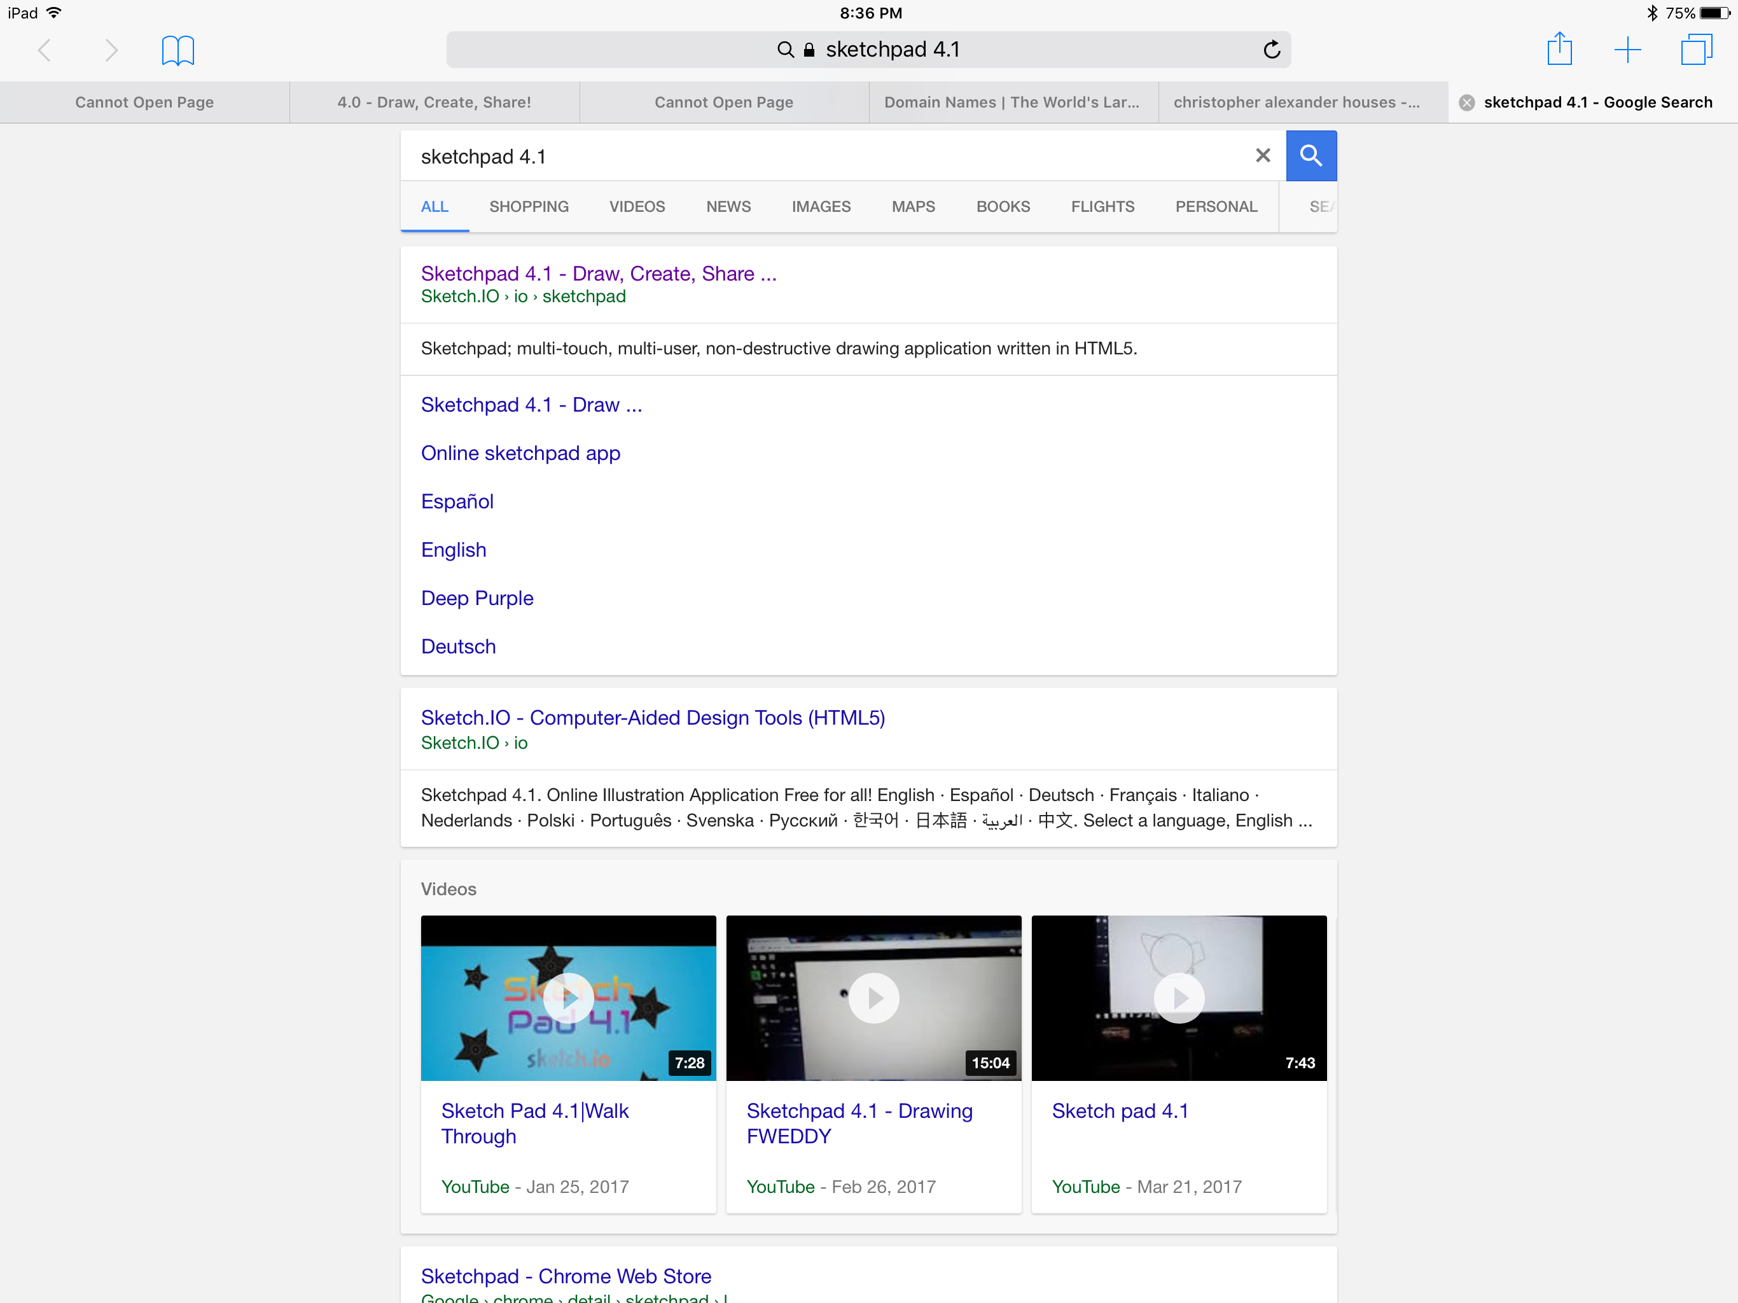
Opening the program
Sketch Pad 4.1 is a web-based online app that you can access from any device through your web browser
You must be connected to Wi-Fi so your browser will function
Type “Sketch Pad 4.1” into your search window and then click on the entry to open it on your device

Slide 4
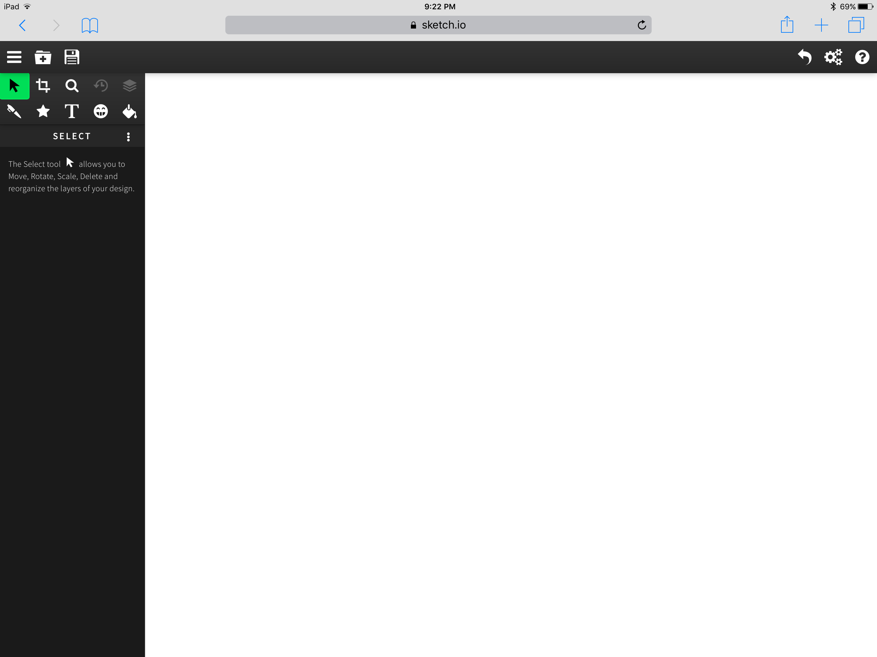
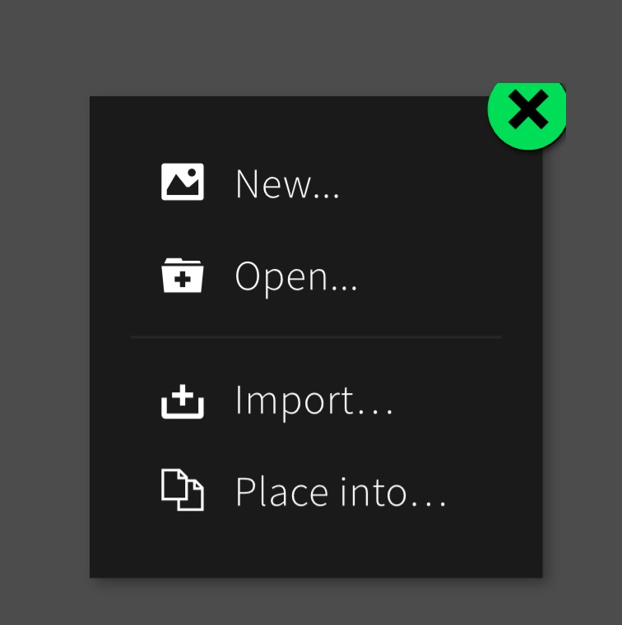
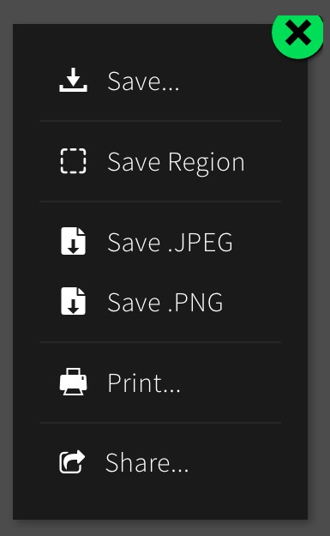
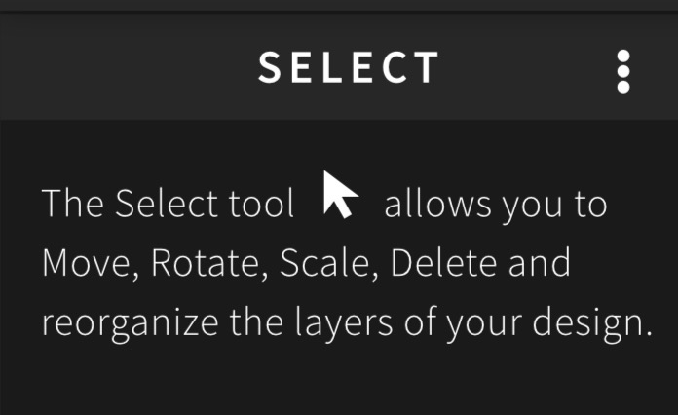
Open the app
Undo/redo
Settings
Undo/redo
Help
When you tap the tool the instructions on how to use it are underneath

Slide 5
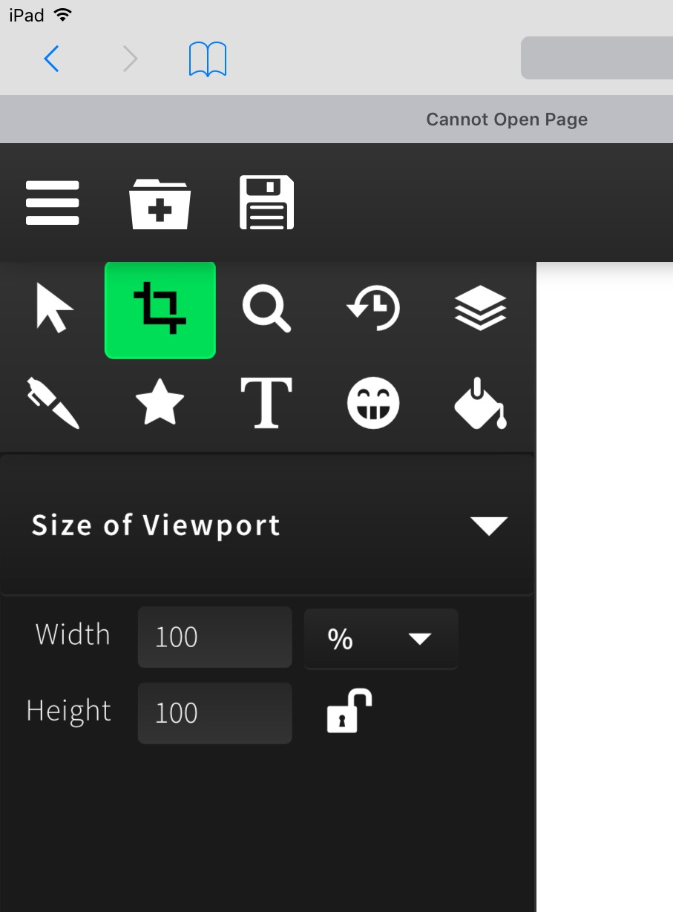
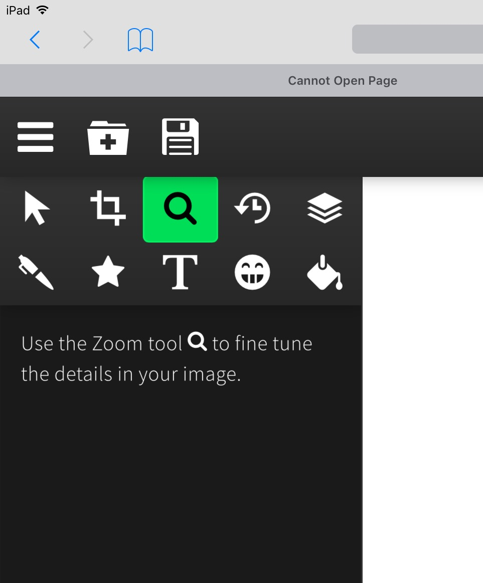
Crop and zoom tools
Undo/redo
When you tap the tool the instructions on how to use it are underneath

Slide 6
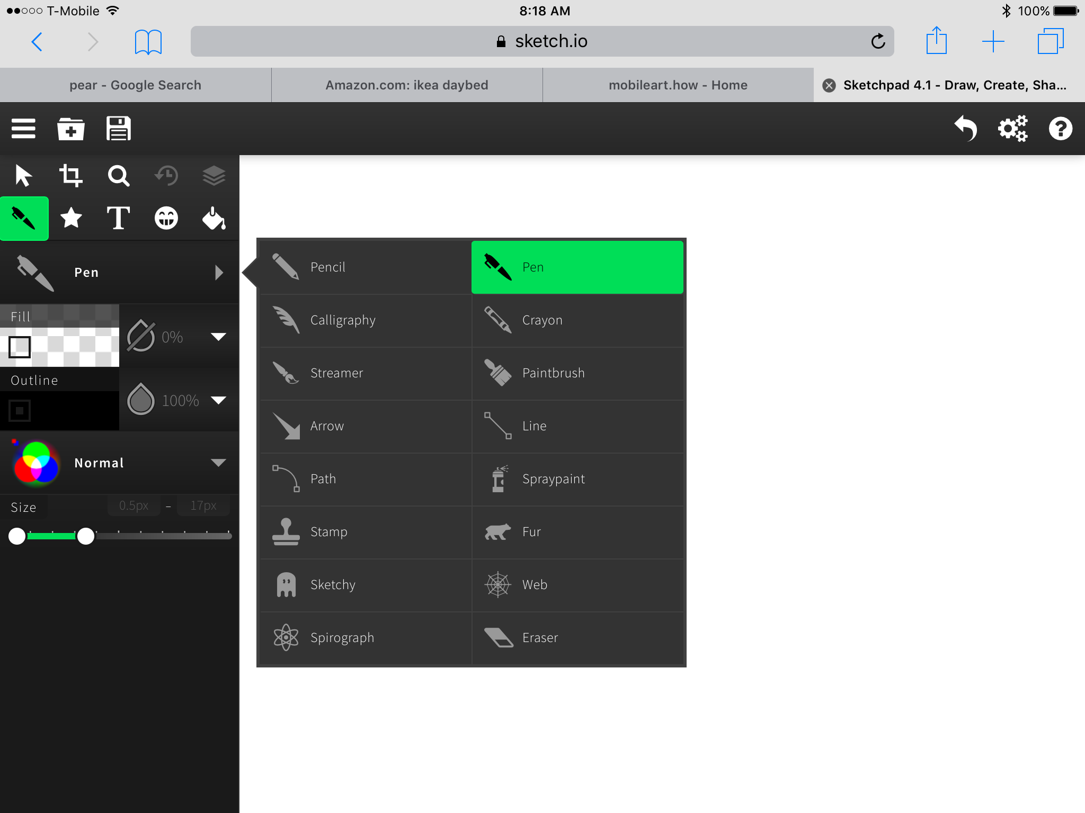
Drawing tools
Tap the drawing too and a window appears so you can select the tool you want
Undo/redo

Slide 7
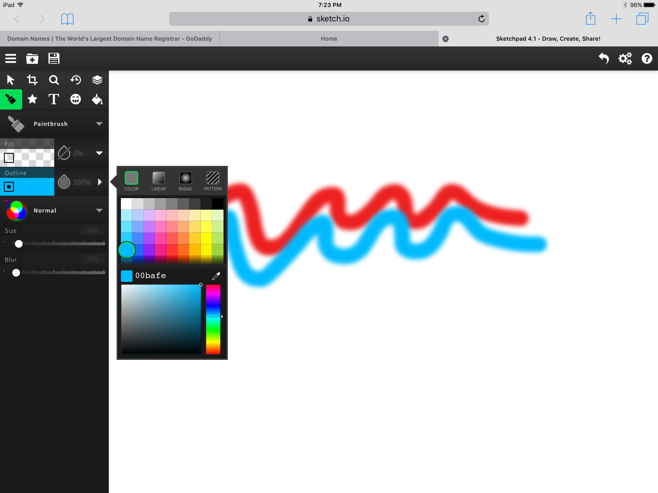
Selecting color
Select the color you want from the color-picker window
Tap the outline tool and a color-picker window will appear
Tap on the square to get the color shade you want (bright, dark, light, etc.

Slide 8
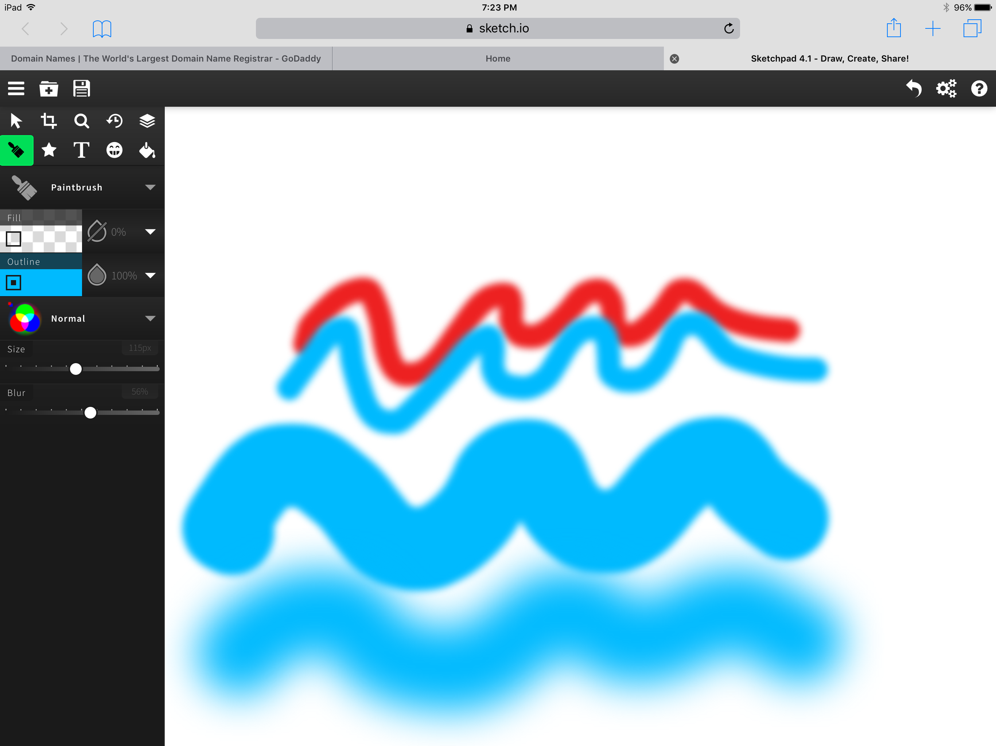
Using the brush sliders
Move the slider to adjust the size
Move the bottom slider to blur the line

Slide 9
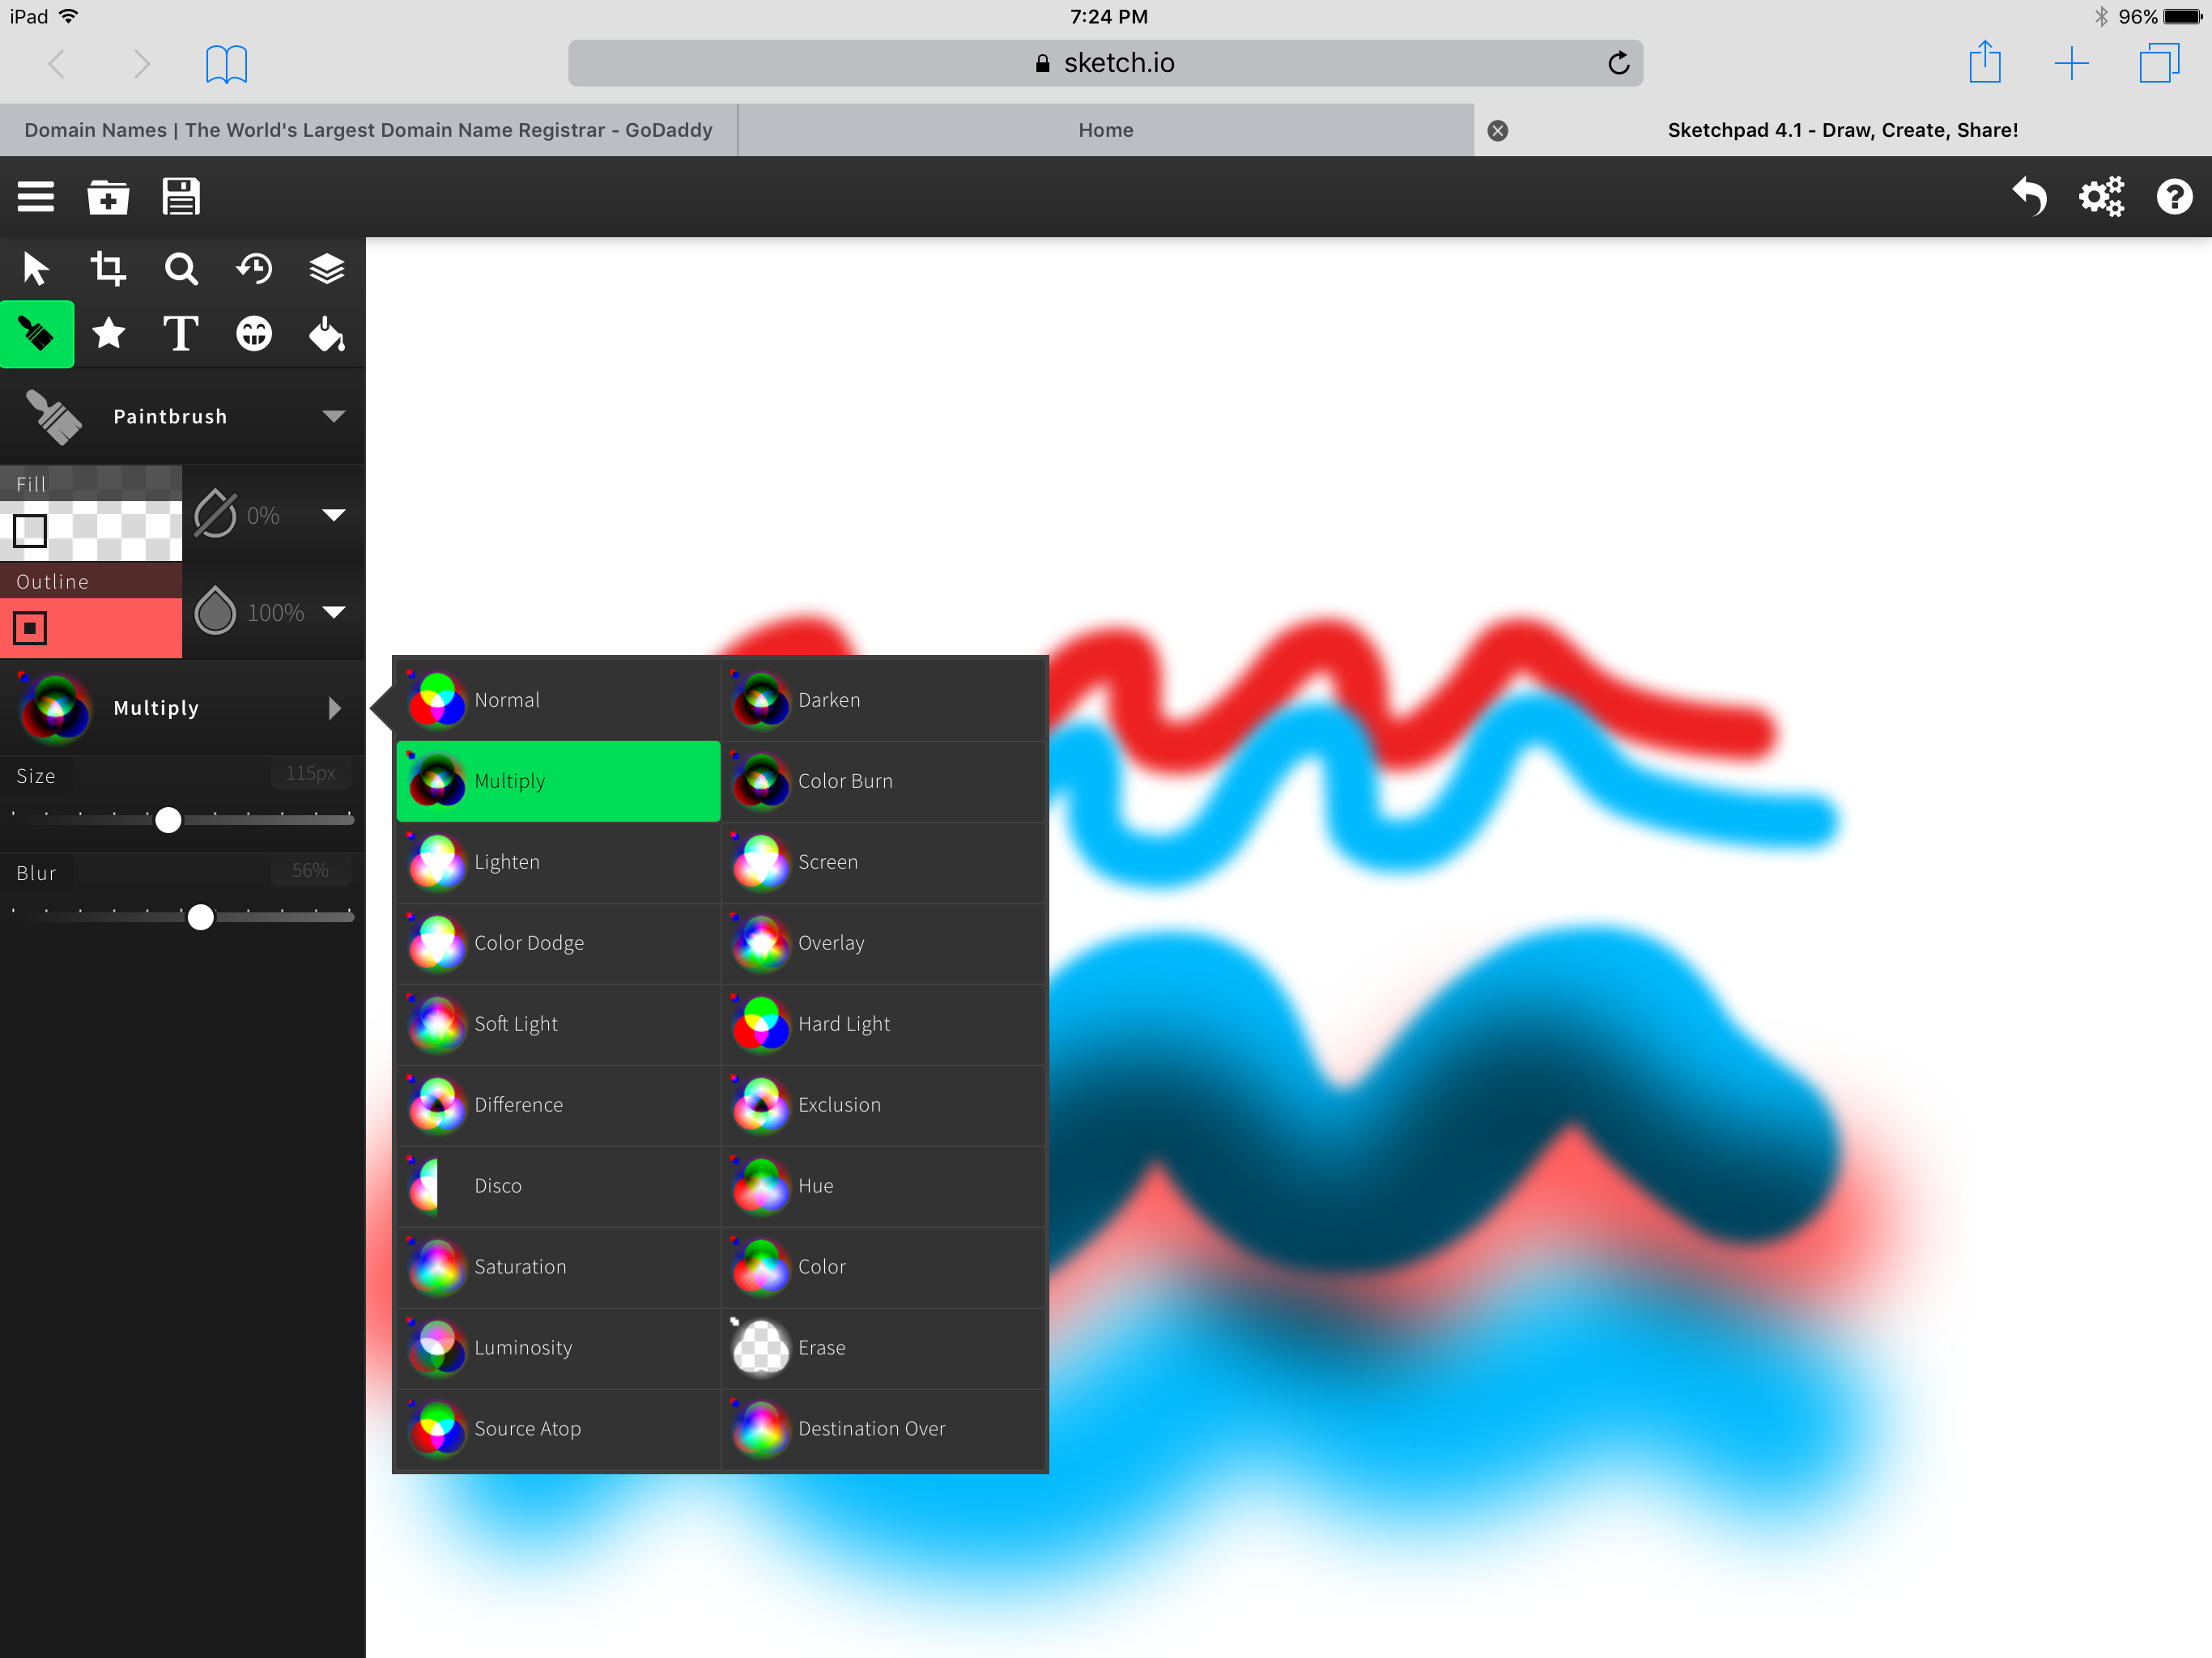
Blending tool
Experiment with the blending tool and see how it affects the lines you draw

Slide 10
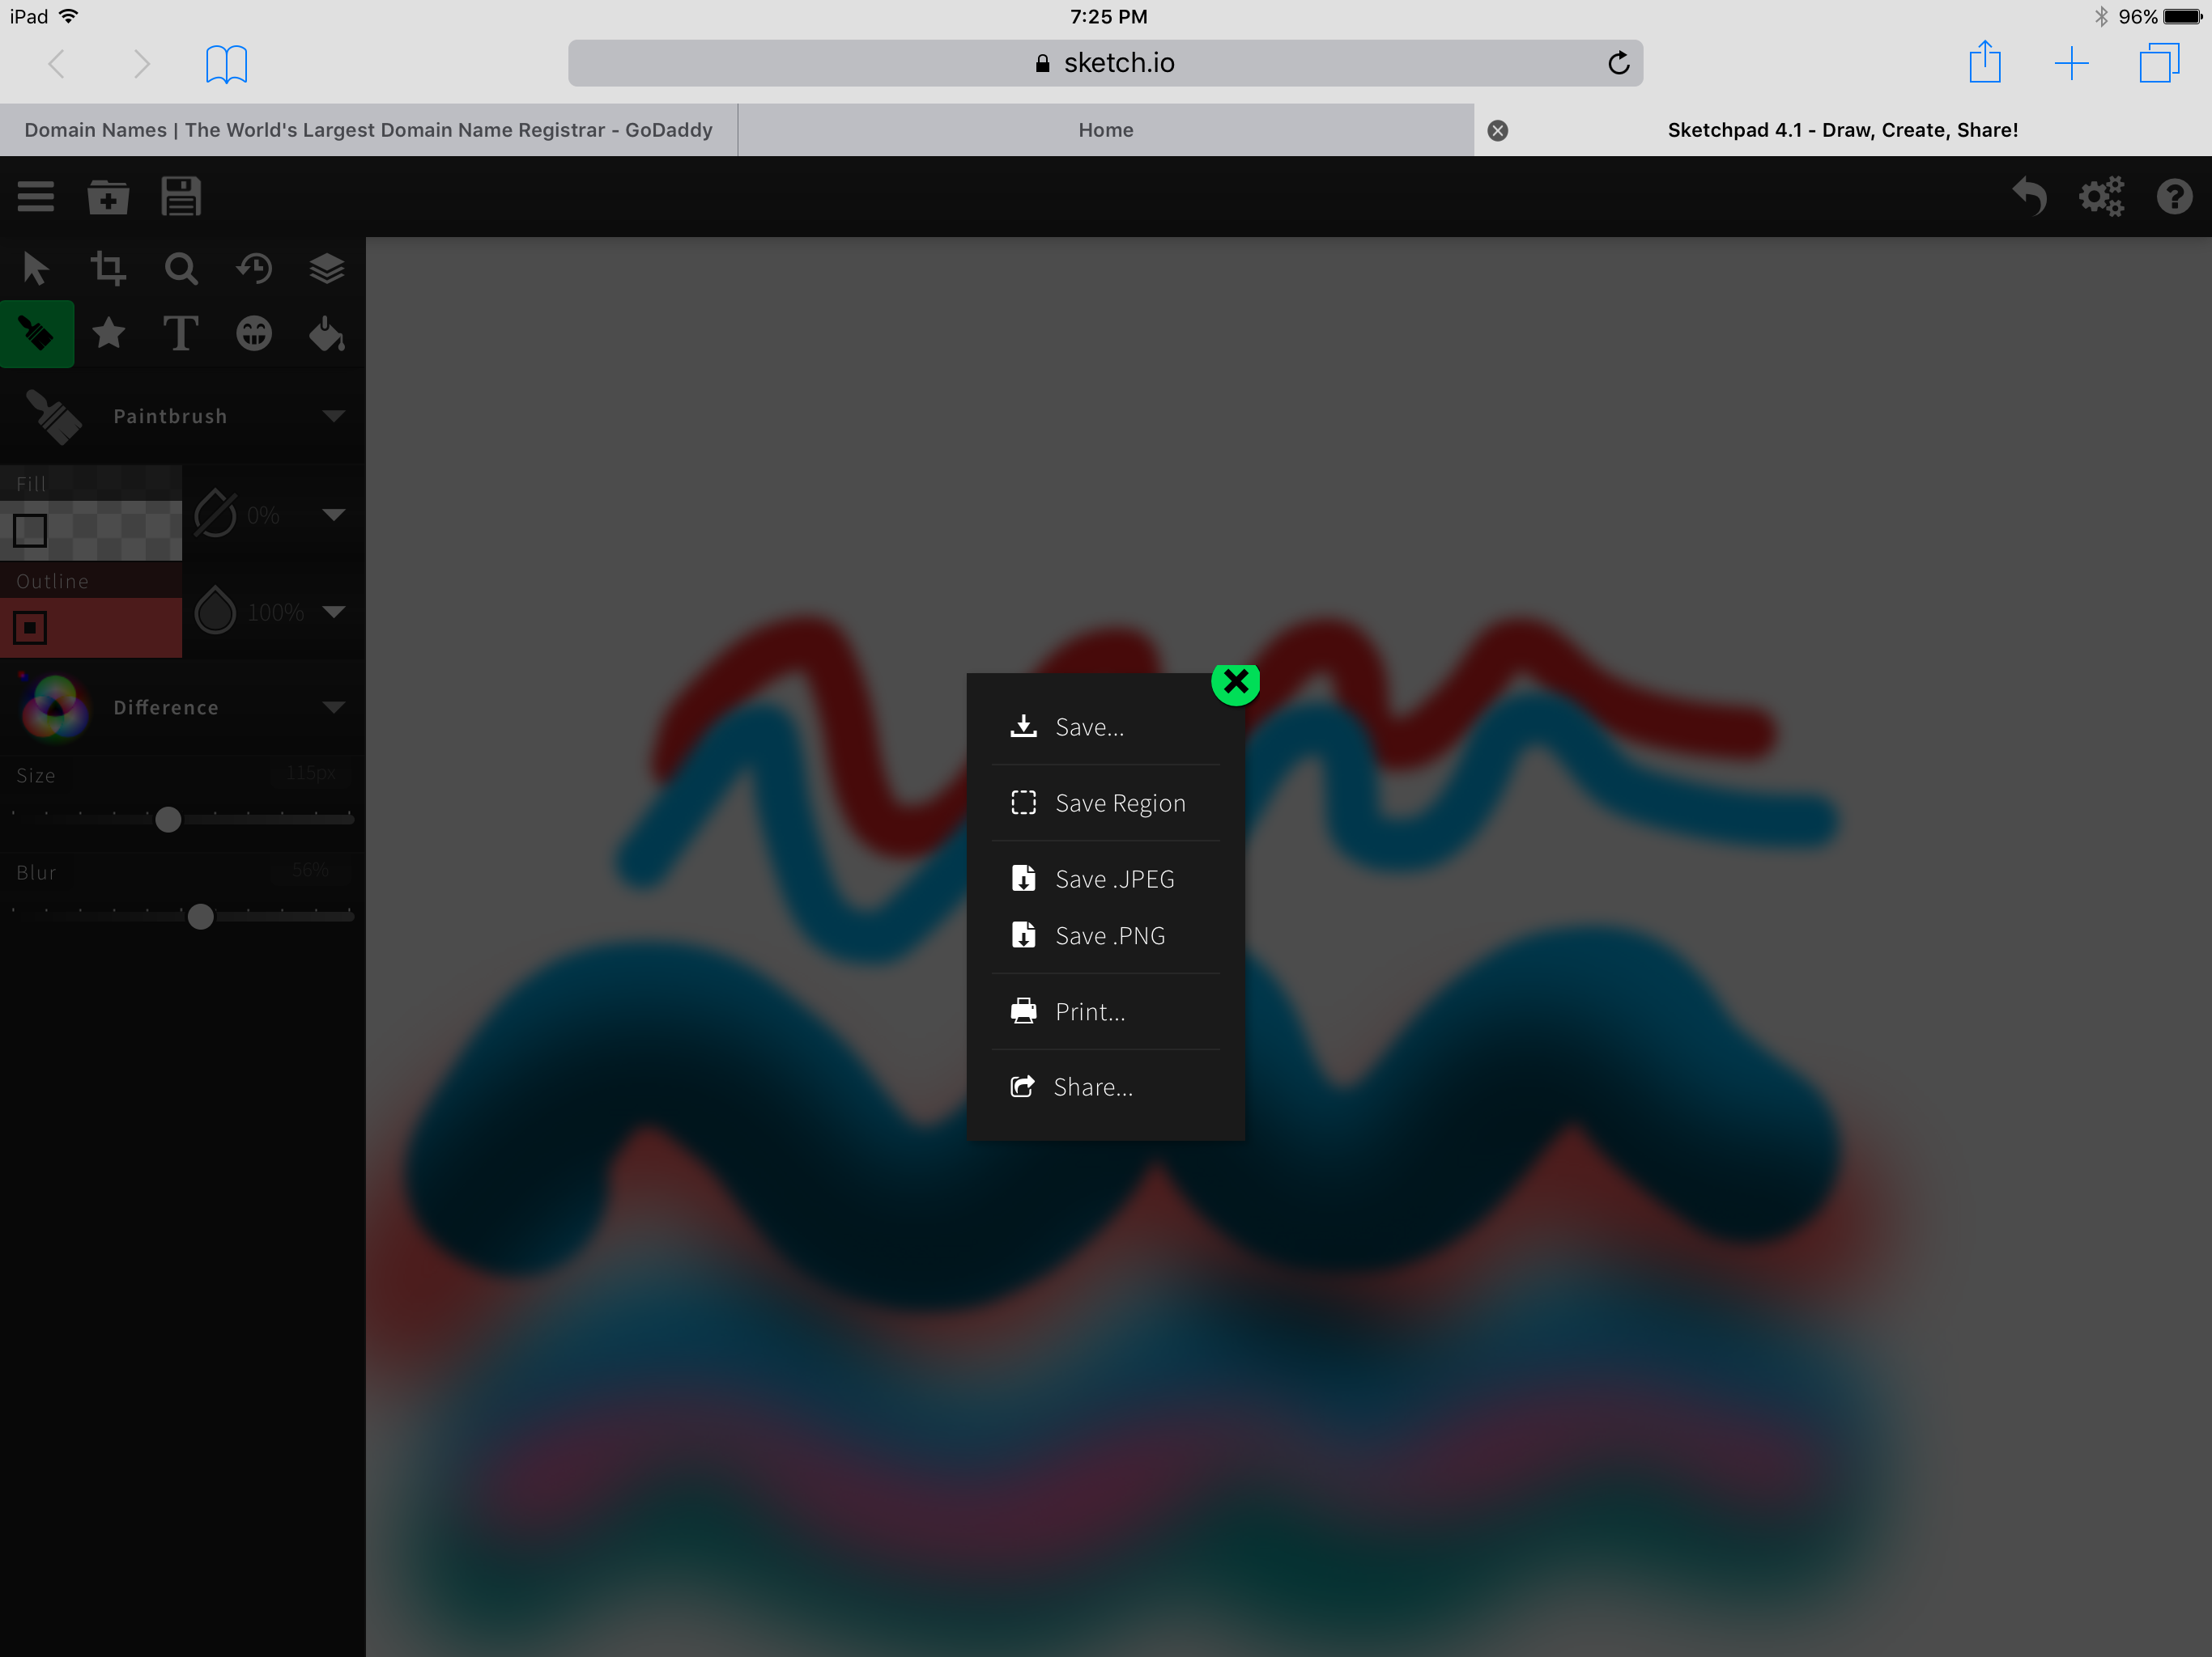
Save the file
When you are done with your artwork you can save it by tapping the share icon and selecting the file type

Slide 11
Open a new file
Tap this icon to open a new file
Notice it doesn’t have a background

Slide 12
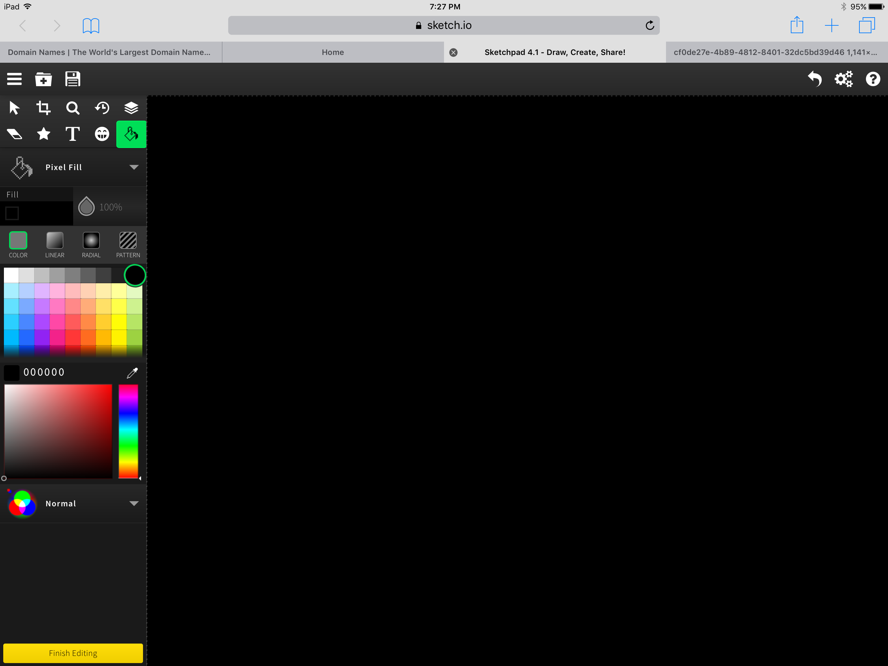
Fill the background
Tap the bucket to fill the background
Select the color you want and the background wil fill when you touch the screen

Slide 13
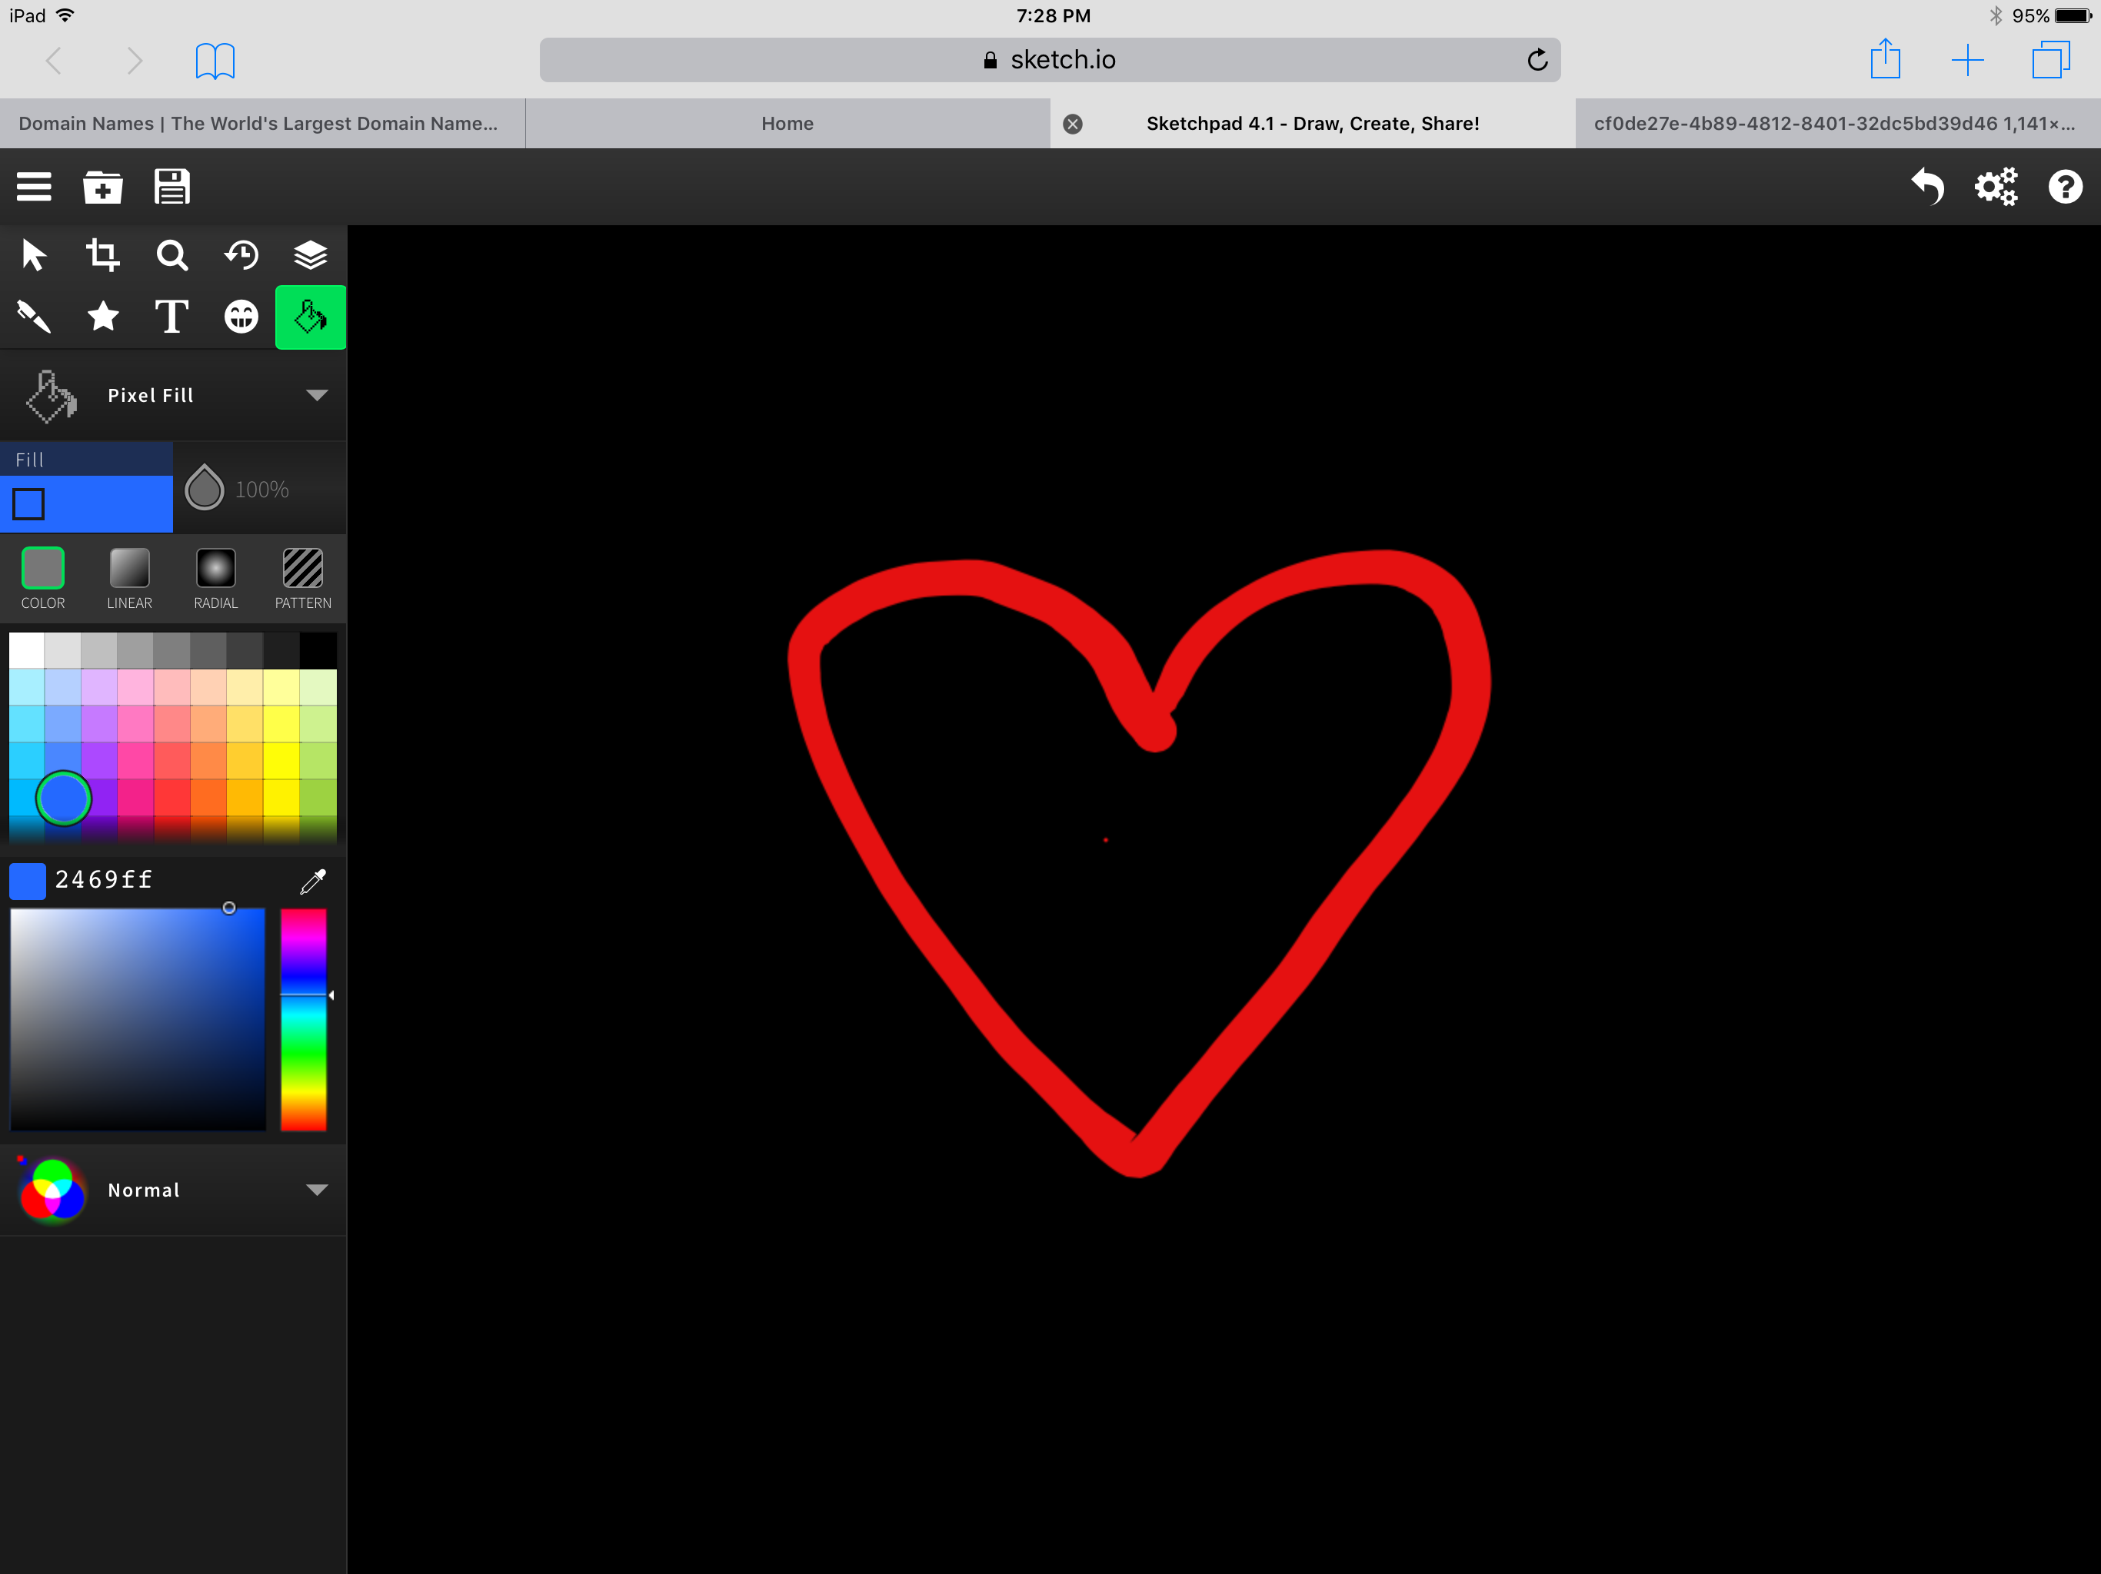
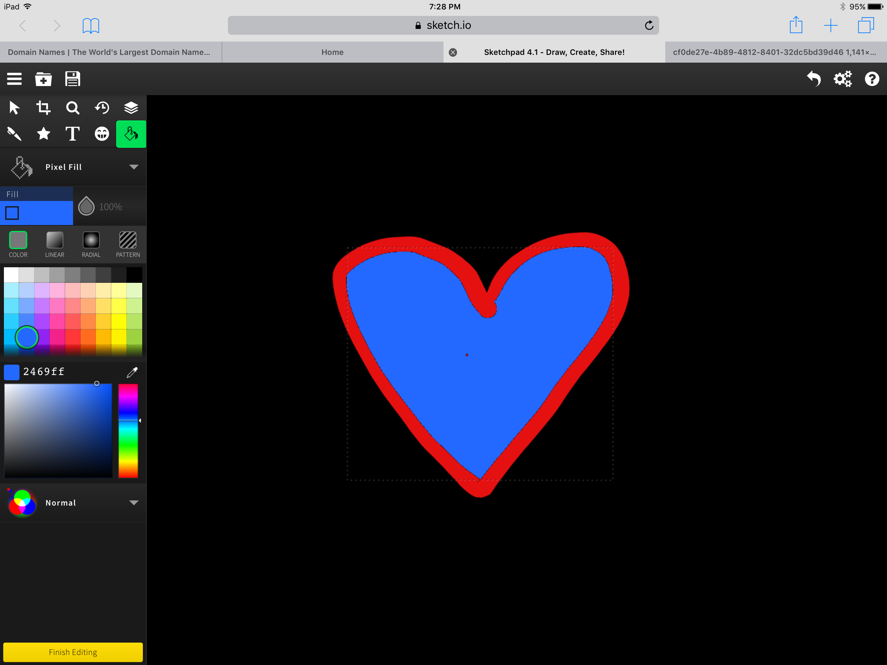
Draw and fill a shape
Select the fill tool and tap inside the shape to fill it
Select the tool and color you want
Draw a shape
Change the color to something different

Slide 14
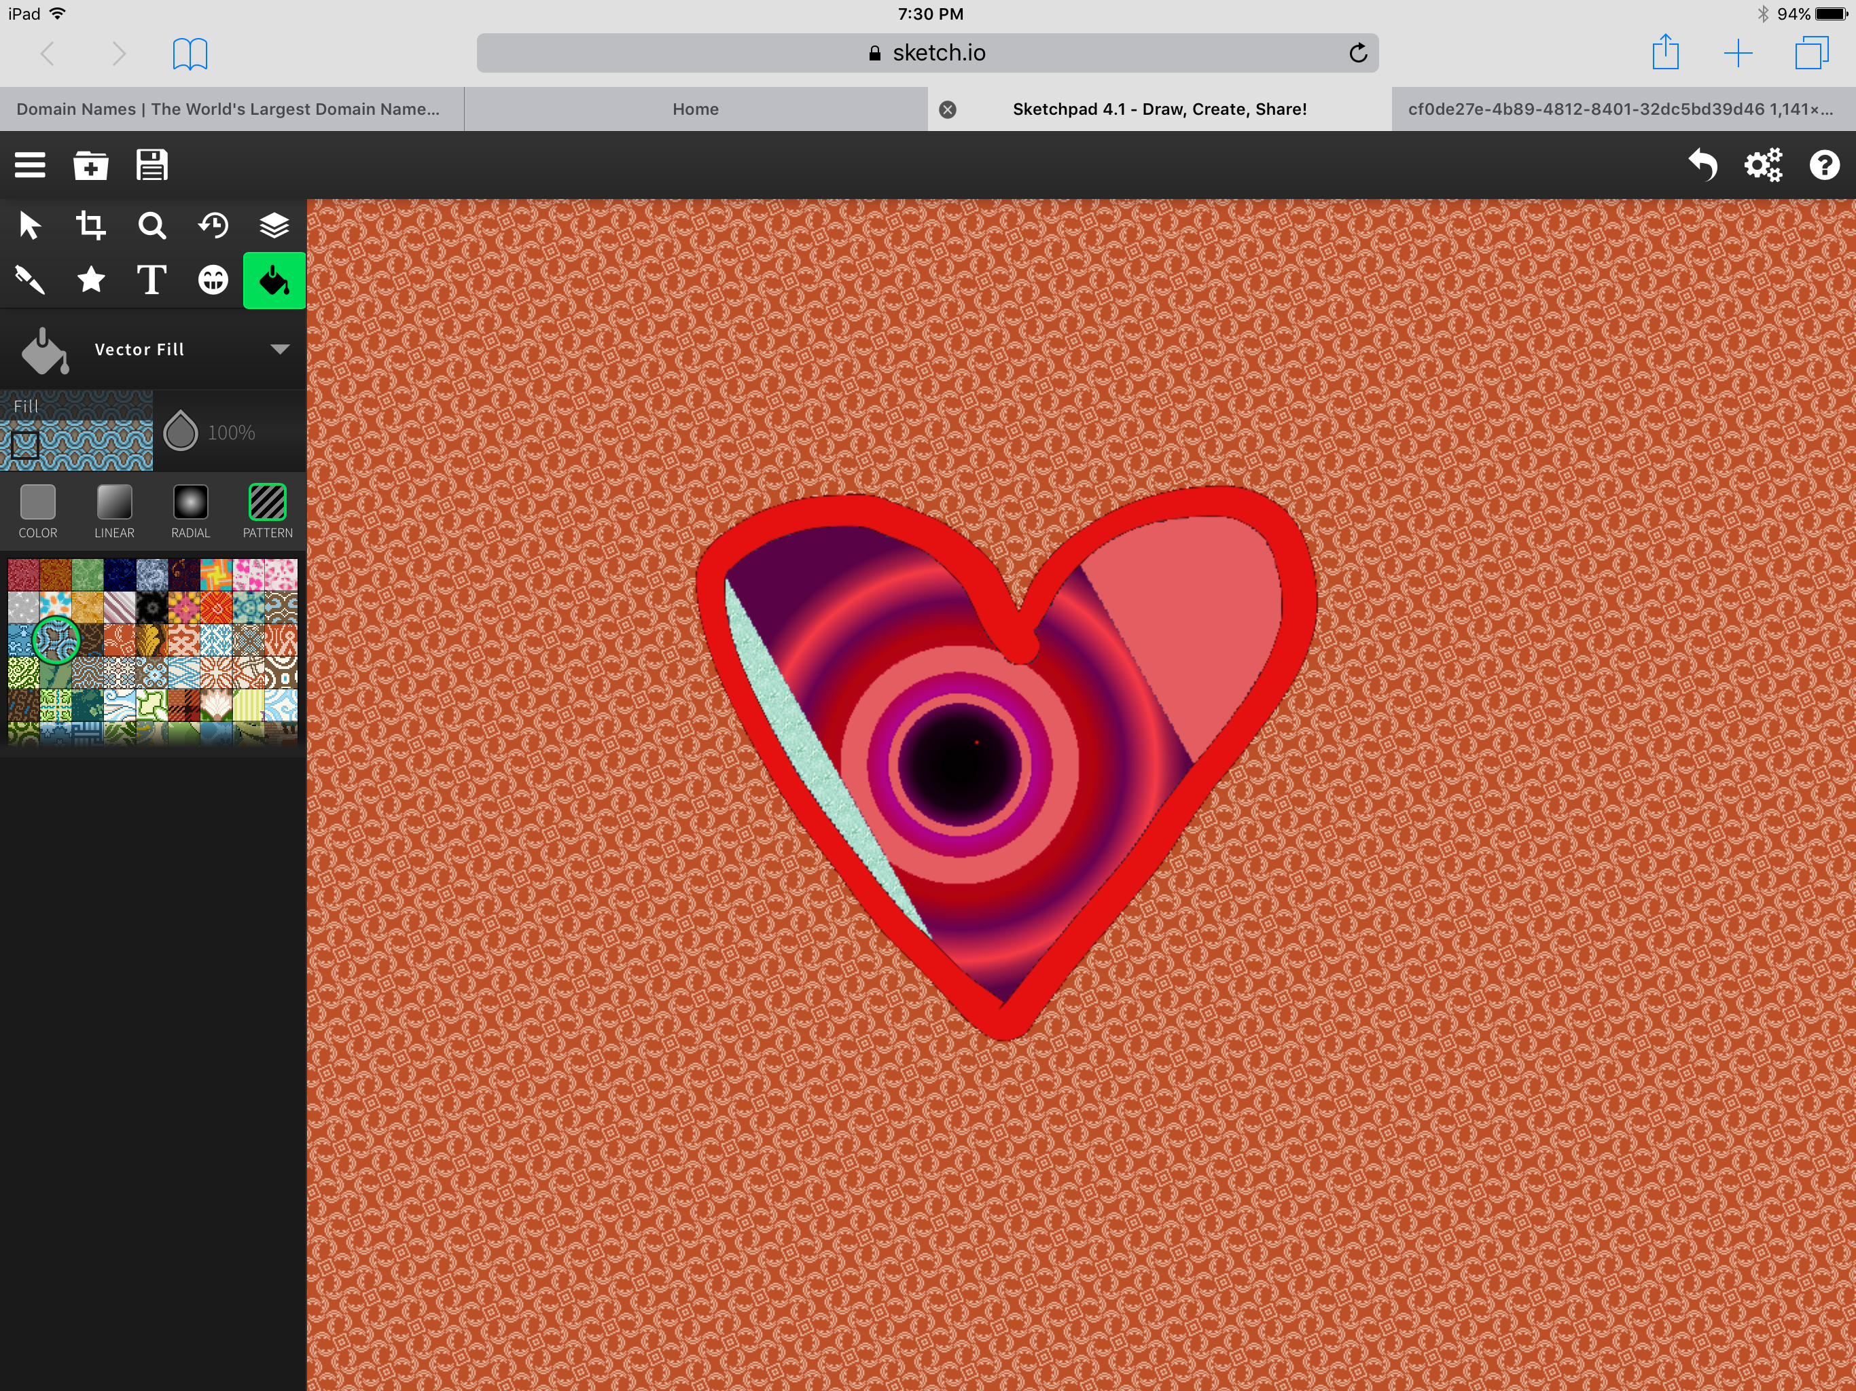
Experiment with fill tool
Experiment with the different options for the fill tool
Select the fill tool and tap inside the shape to fill it

Slide 15
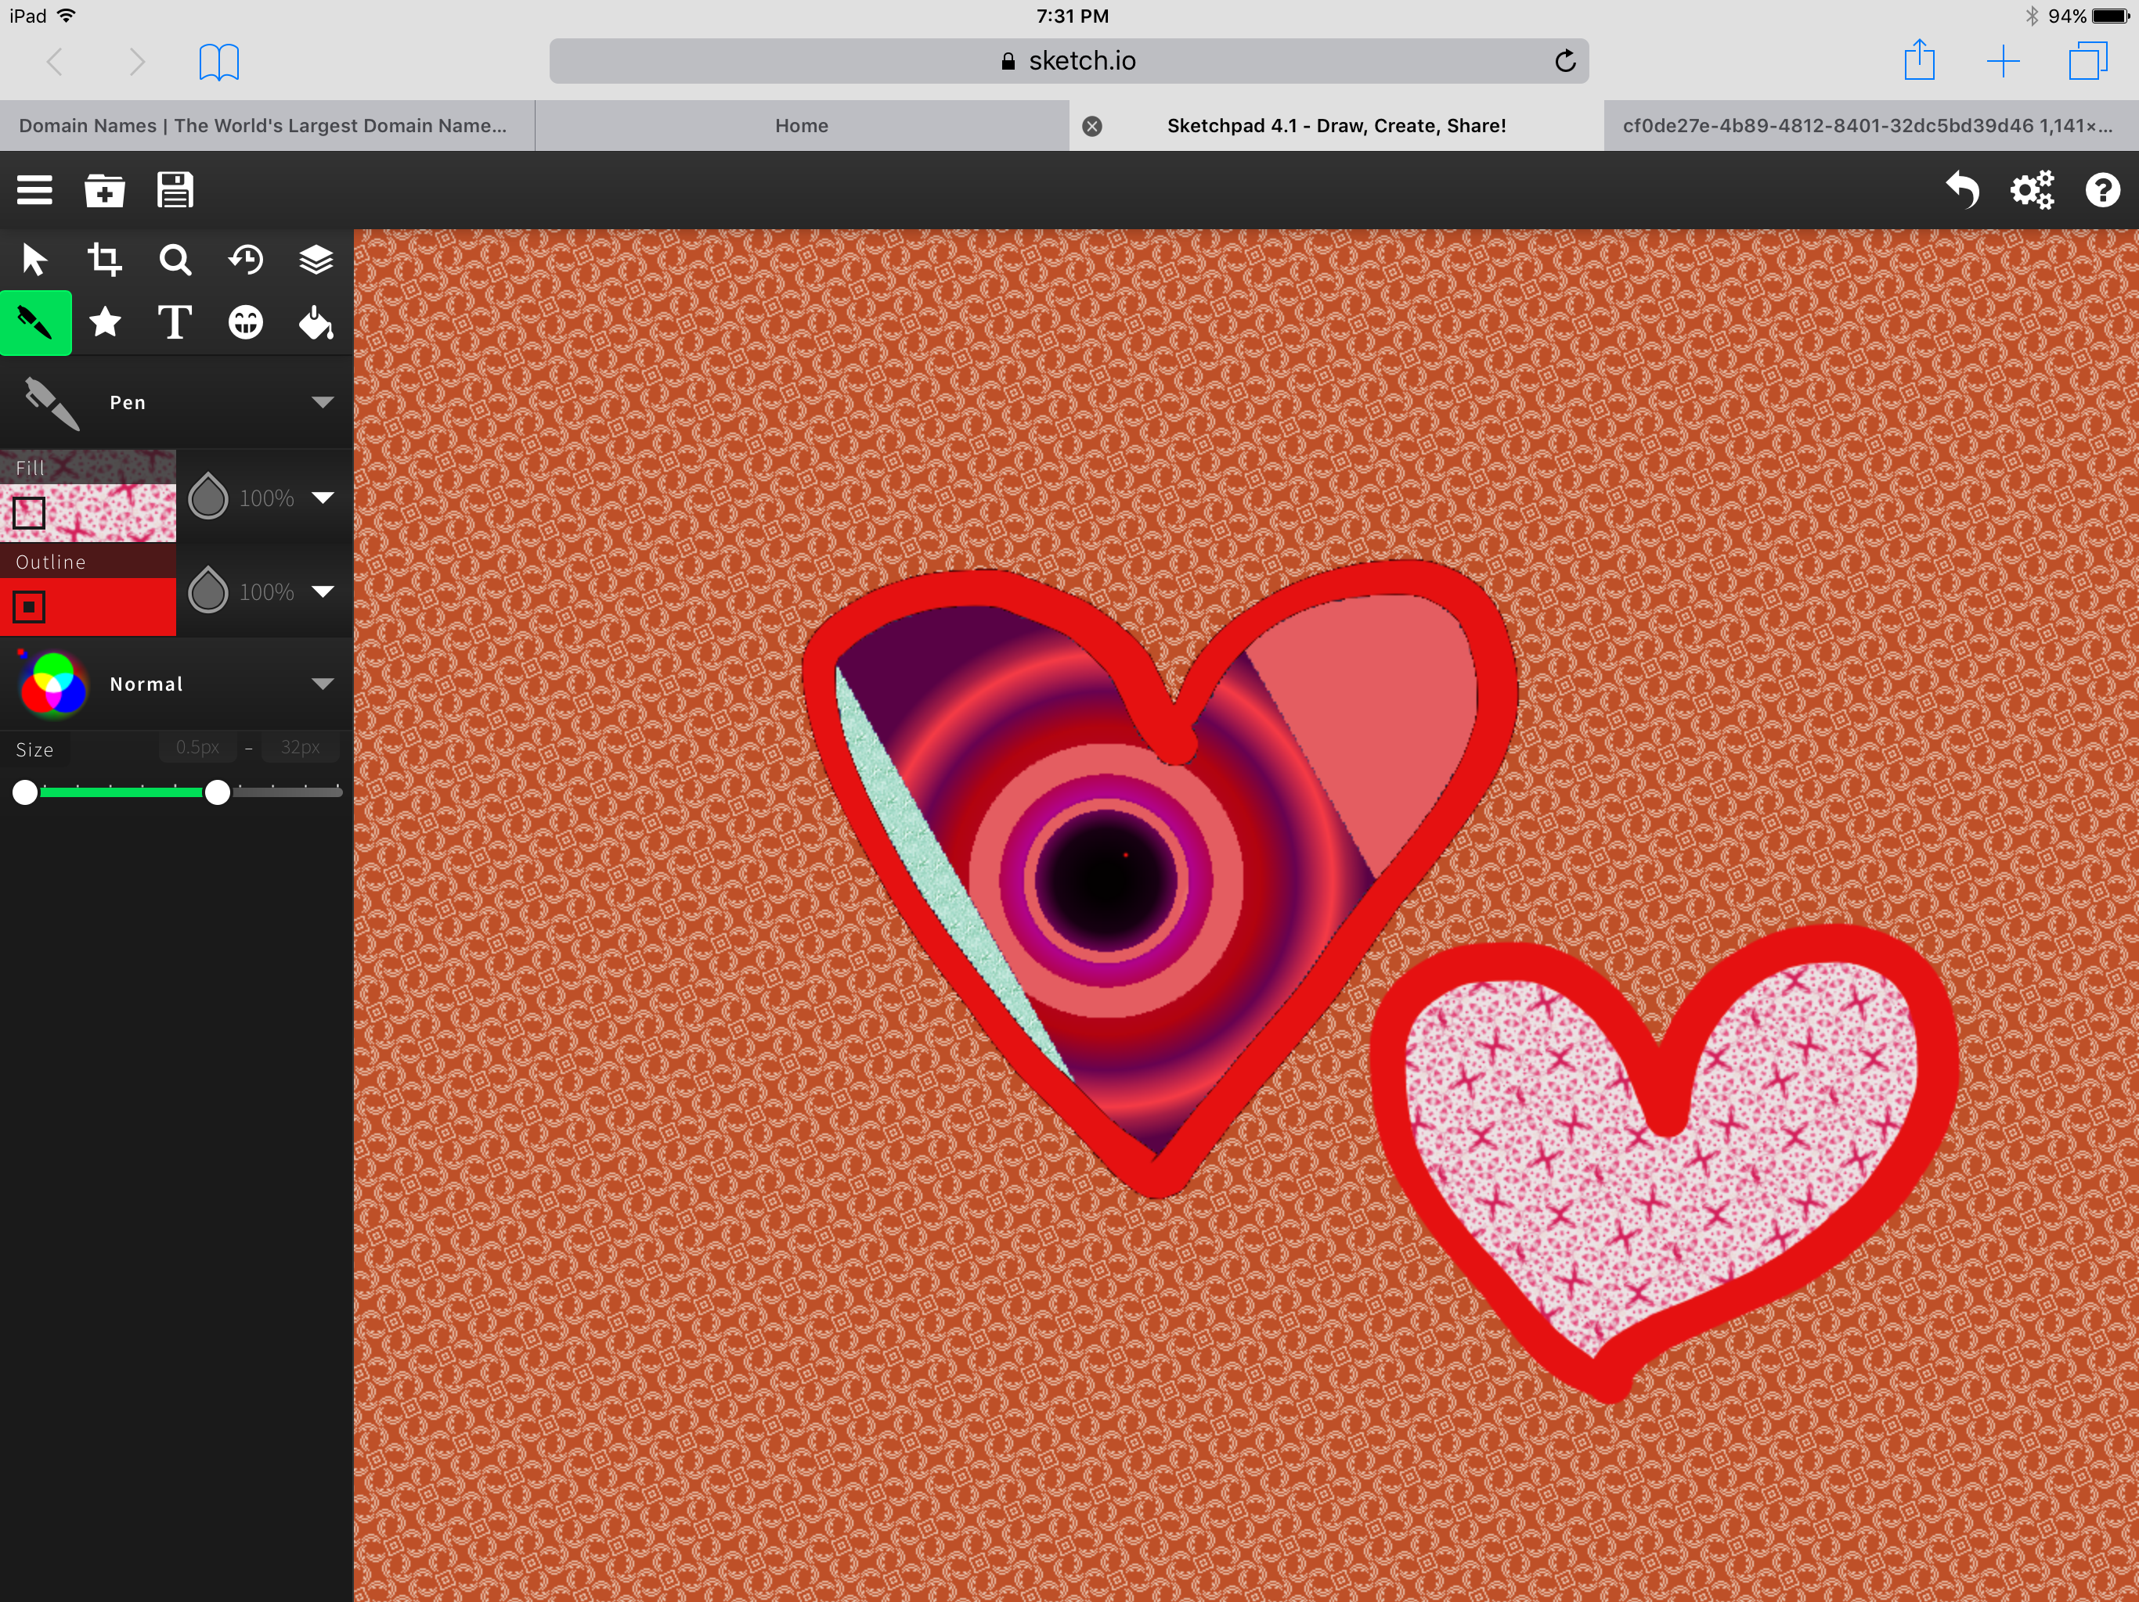
Draw and fill together
Select both outline and fill then select colors/patterns for each
Draw a shape
Select the fill tool and tap inside the shape to fill it

Slide 16
Save and download
When you save your final artwork, tap share
Download it to your computer and print or share from there

