Slide 1
Paper 53
Quick Look Instructions
Prepared for art in action

Slide 2
Table of contents
Making a folder 3
Opening a page 4
Toolbar A 5
Toolbar B 6
Drawing Tools 7
Ruler Tool 8
Fill shapes with color 9
Paint with the roller 10
Fill the background with color 11
Select and move an object 12
Color picker 13
Color Slider Exercise 14
Eye dropper 15
Save Color 16
Insert photo 17
Adjust and position photo 18
Name a Page 19
Save a page 20
Duplicate or delete a page 21
Share a page 22
Save without a background 23
More information 24

Slide 3
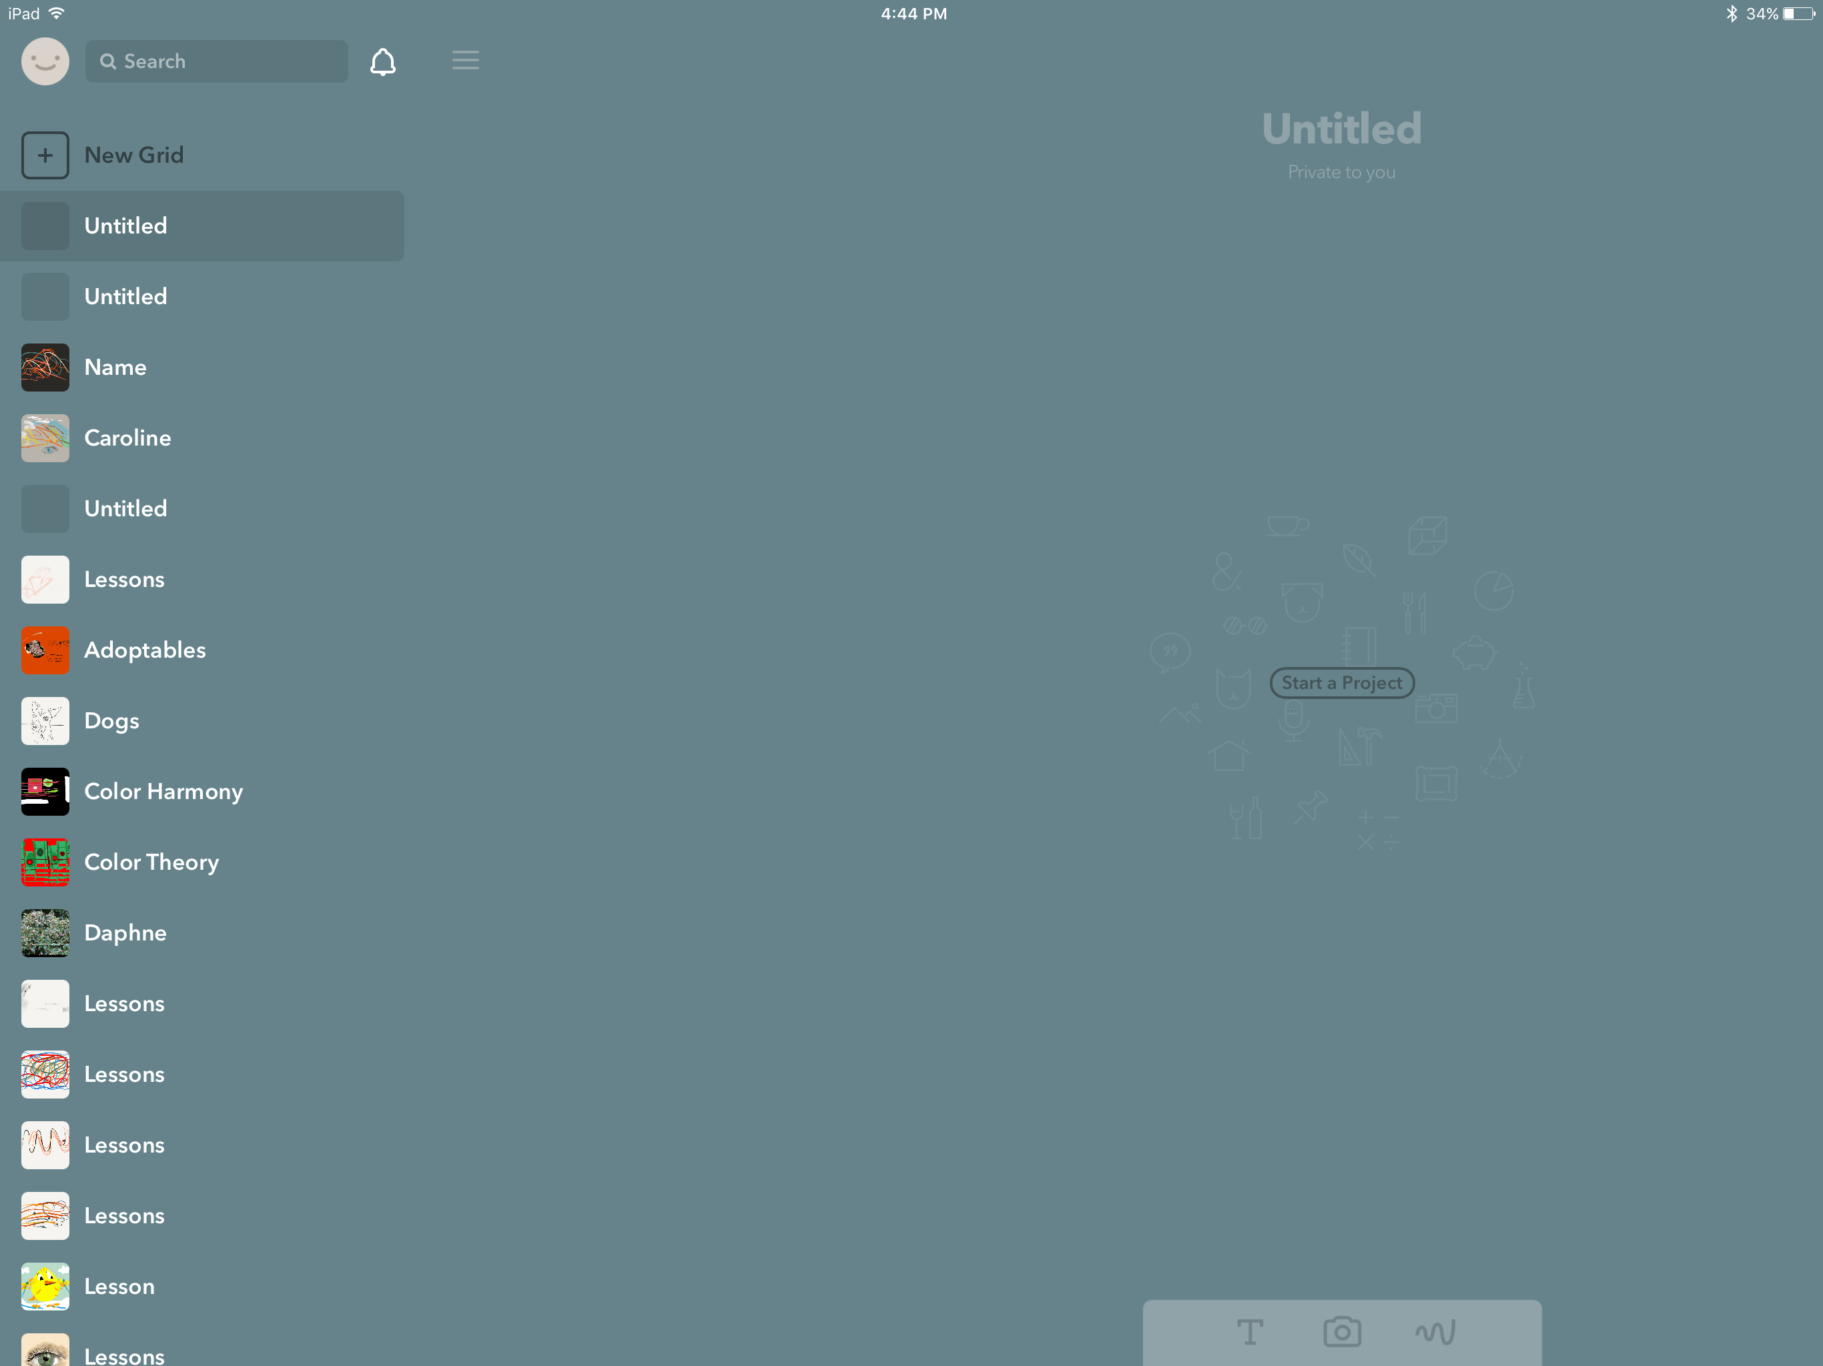
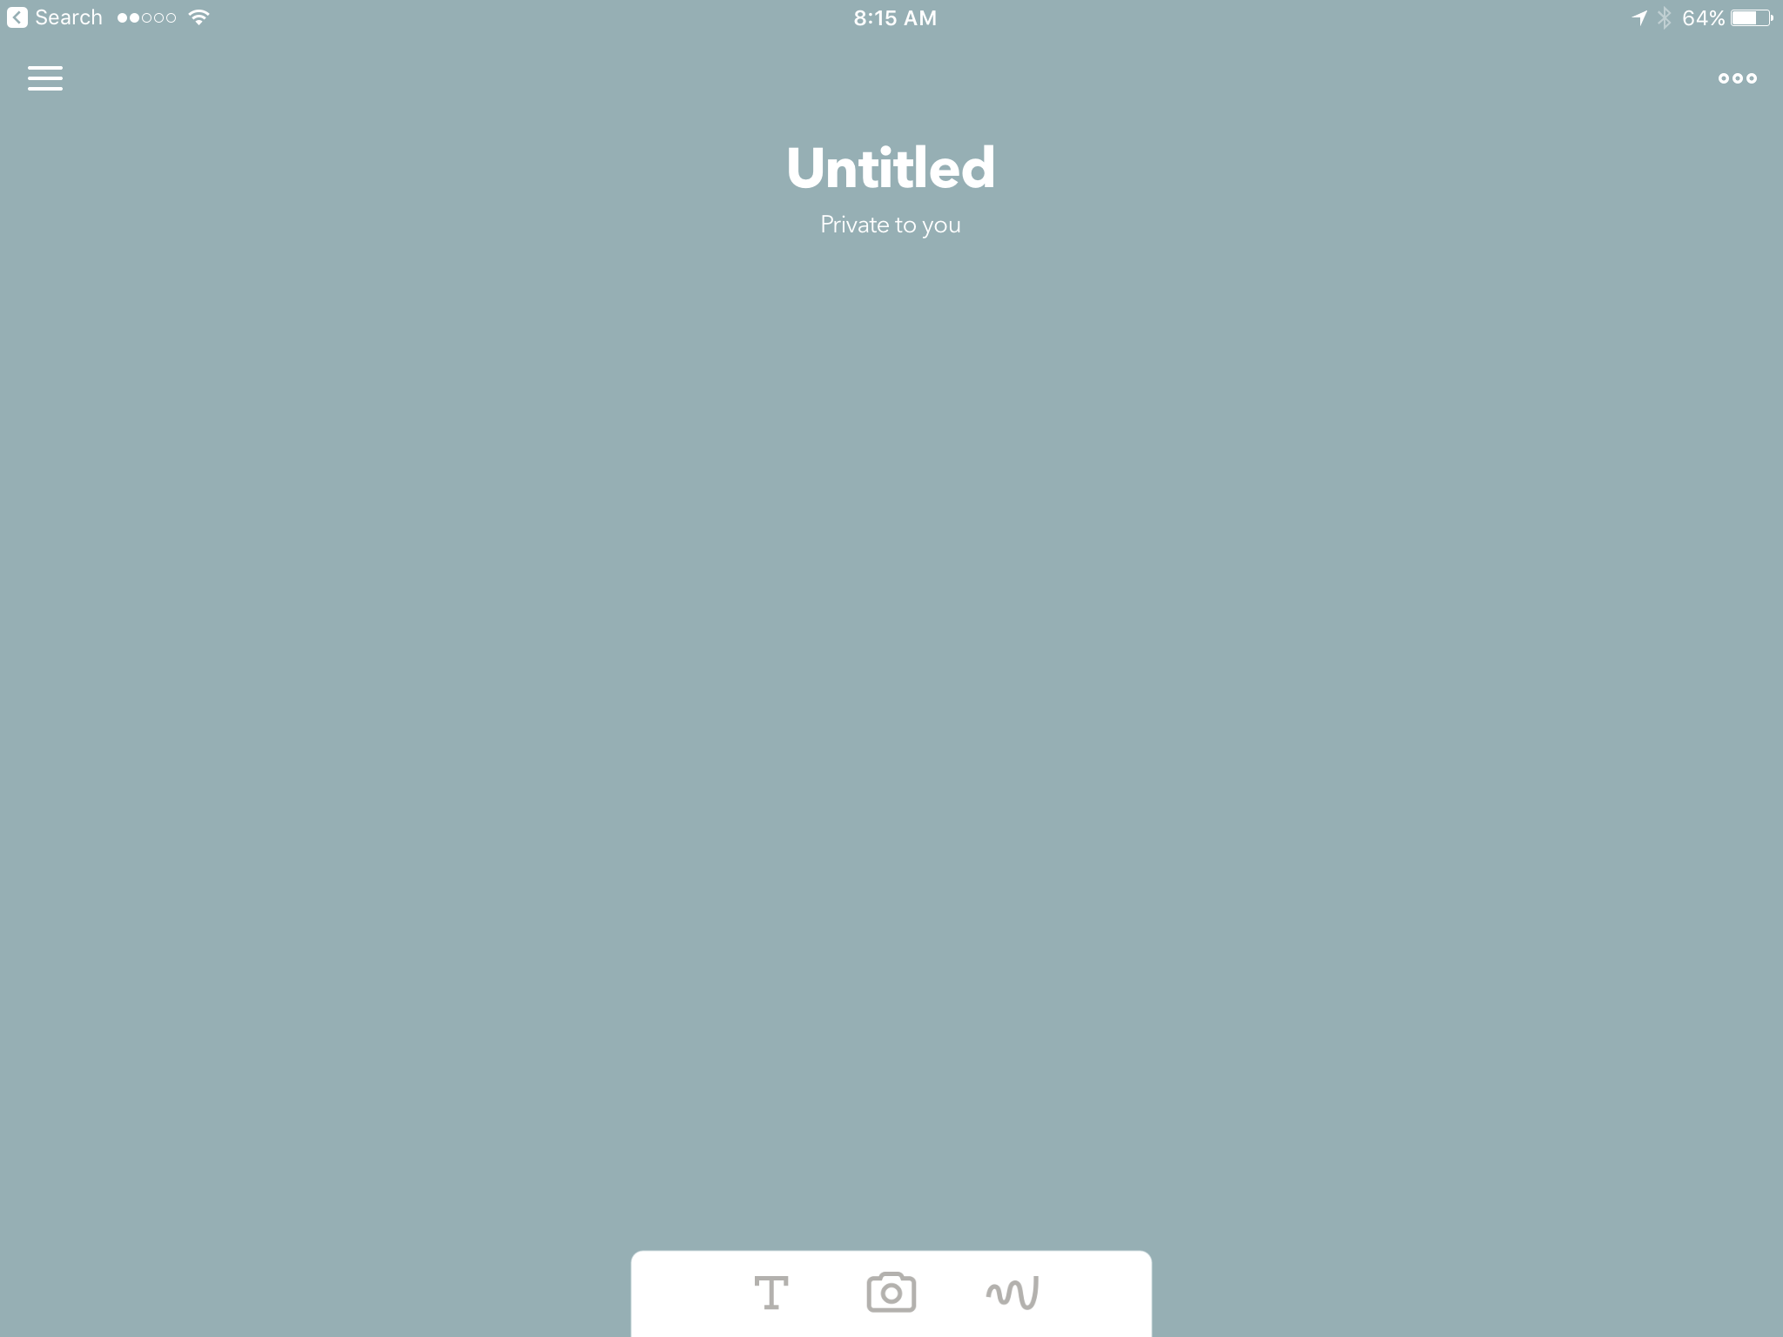
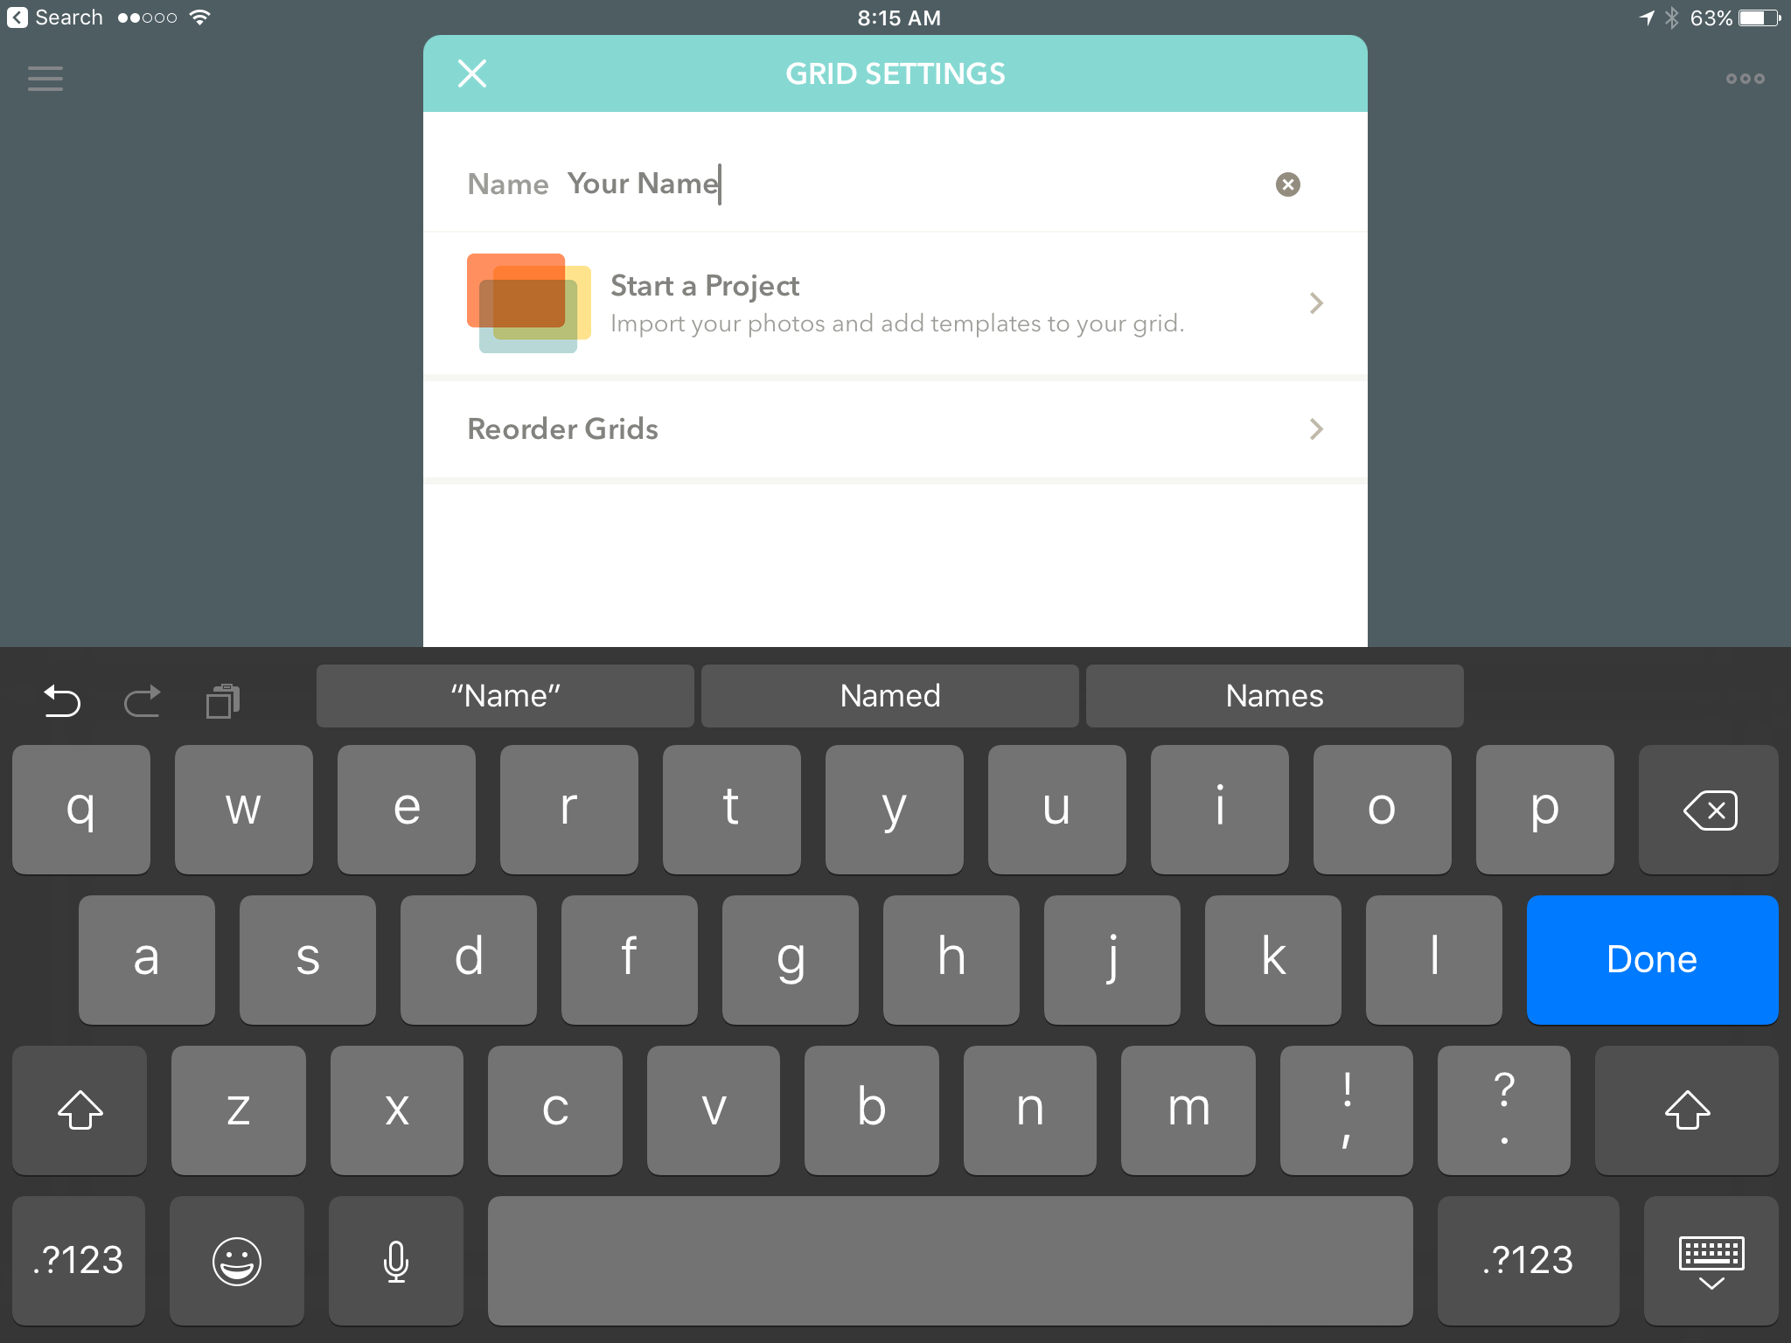
Make a folder
Tap NEW GRID at the top of the list
Type in Folder name
Tap Untitled
Open the Paper 53 app and pinch until you see the list of files appear at the left
Tap NEW GRID at the top of the list
Tap UNTITLED
Type in name of the grid and tap DONE
Tap x on window to exit the menu
3

Slide 4
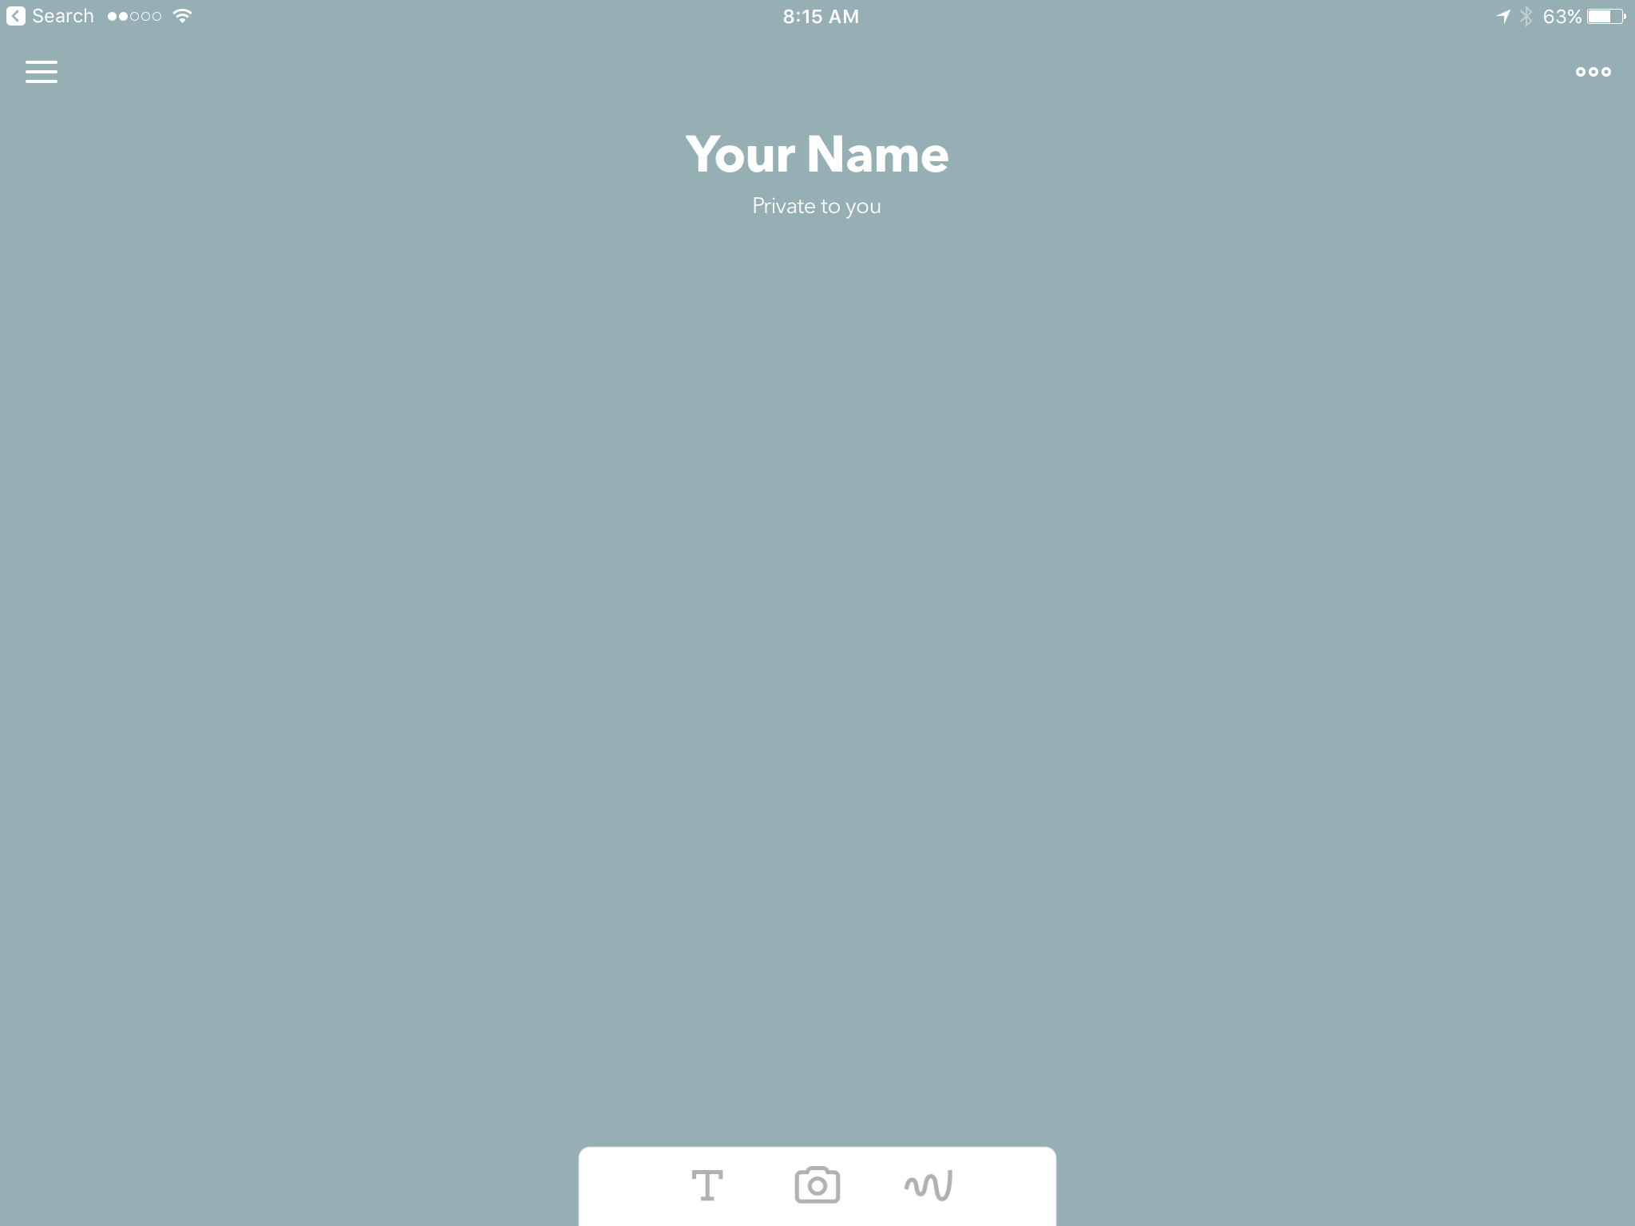
Open a page
The camera icon allows you to take or import photos
To open a new page tap the squiggly line on the right of the bottom three icons
The T icon means text and allows you to name your page
The squiggly line
opens a new drawing page
4

Slide 5
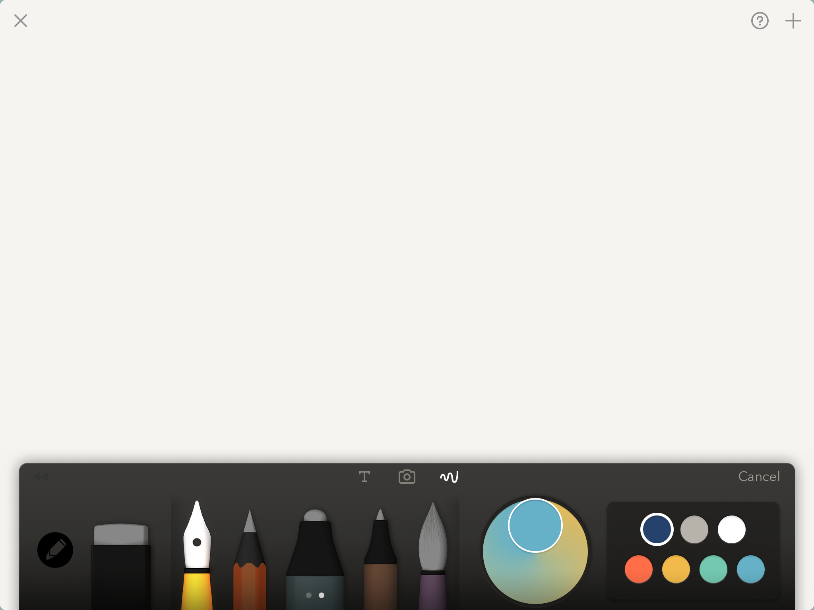
TOOLBAR-A
Undo/Redo
Pens, pencil and brush
Color mixer
Color palette
Eraser
To activate a tool tap it and it will become illuminated
Swipe up and down on the color palette to find the color you want. Tap the color to put it onto your pen, pencil or brush
5

Slide 6
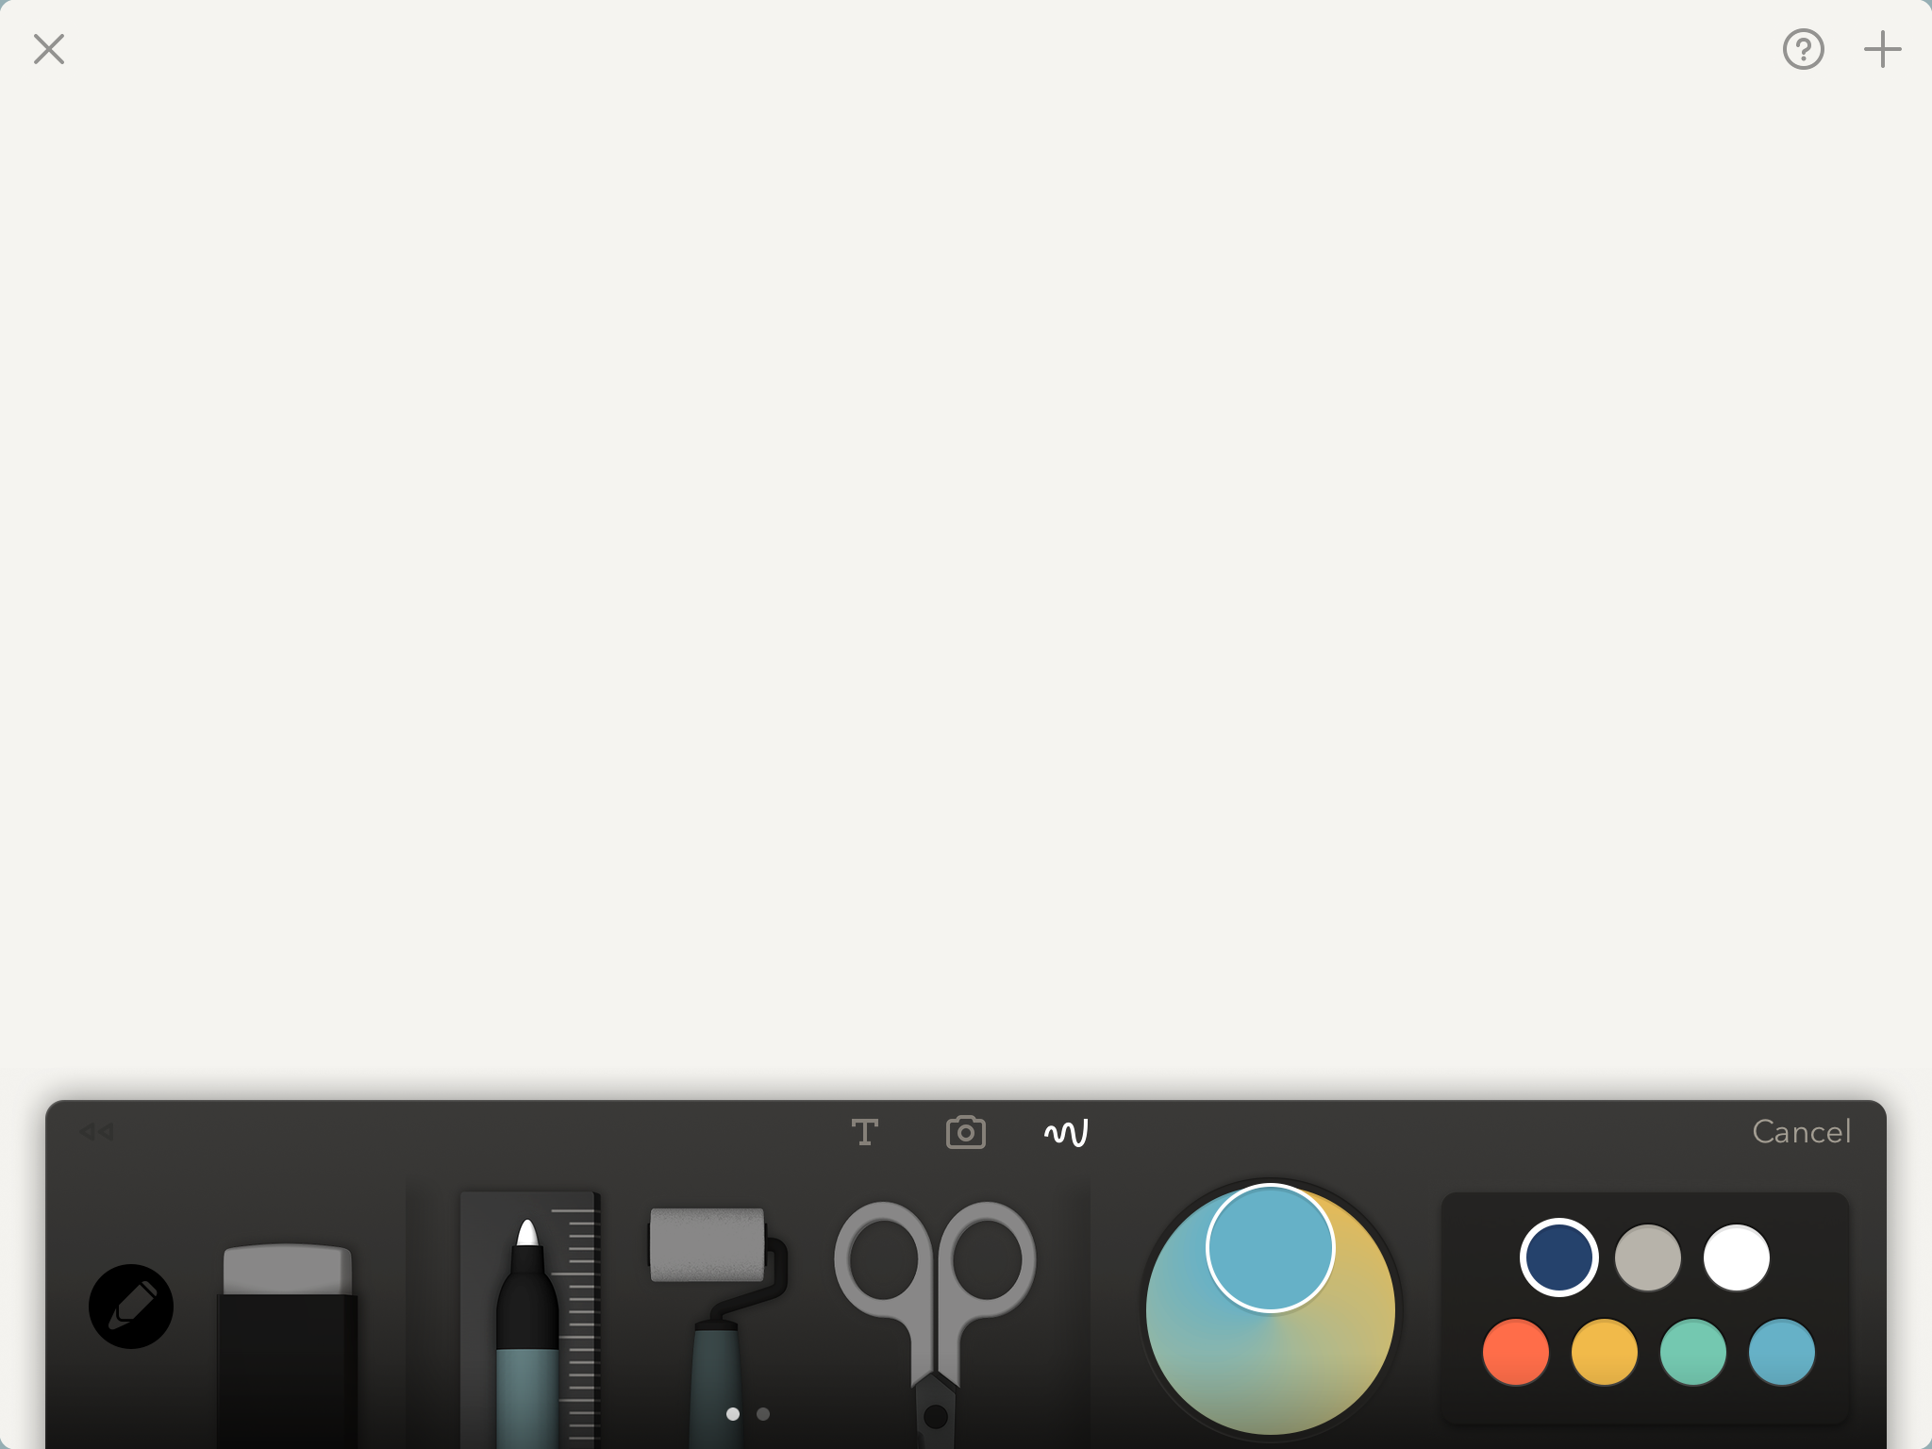
TOOLBAR-B
Roller
(vector brush which also fills shapes made by the ruler
Ruler (lines & shapes)
Scissors to select and move objects
Swipe over the brush tools to the right to reveal three more tools (NOTE: on the large iPad Pro all 8 tools are shown on one screen)
6

Slide 7
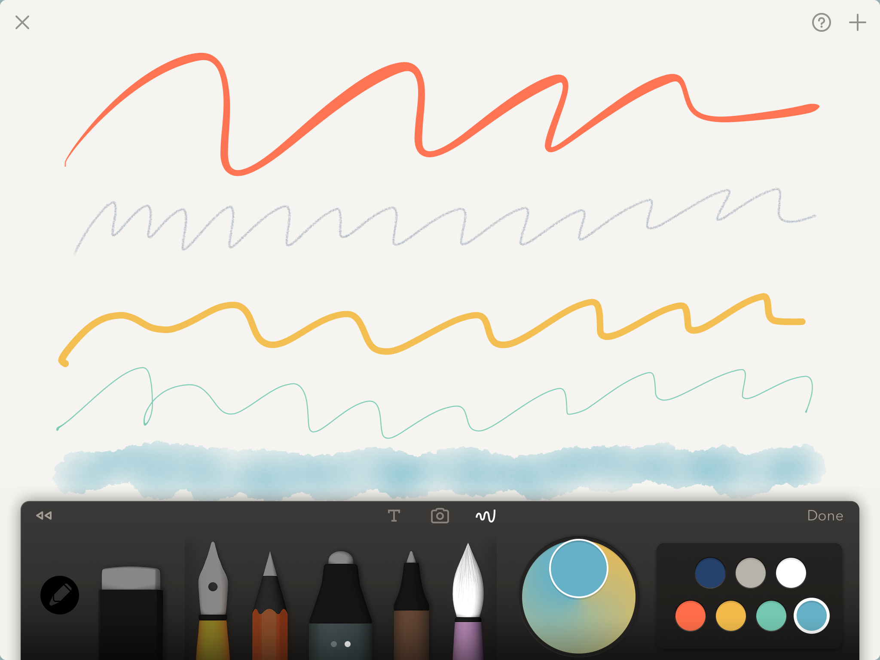
BRUSHES
Yellow Pen tool (99% opacity)
Orange Pencil tool (99% opacity)
The tools cannot be adjusted to change size or opacity
Try each out, putting different colors on each tool
Blue Marker tool (70% opacity)
Brown Fine Pen tool (99% opacity)
Purple Brush tool (40% opacity)
7

Slide 8
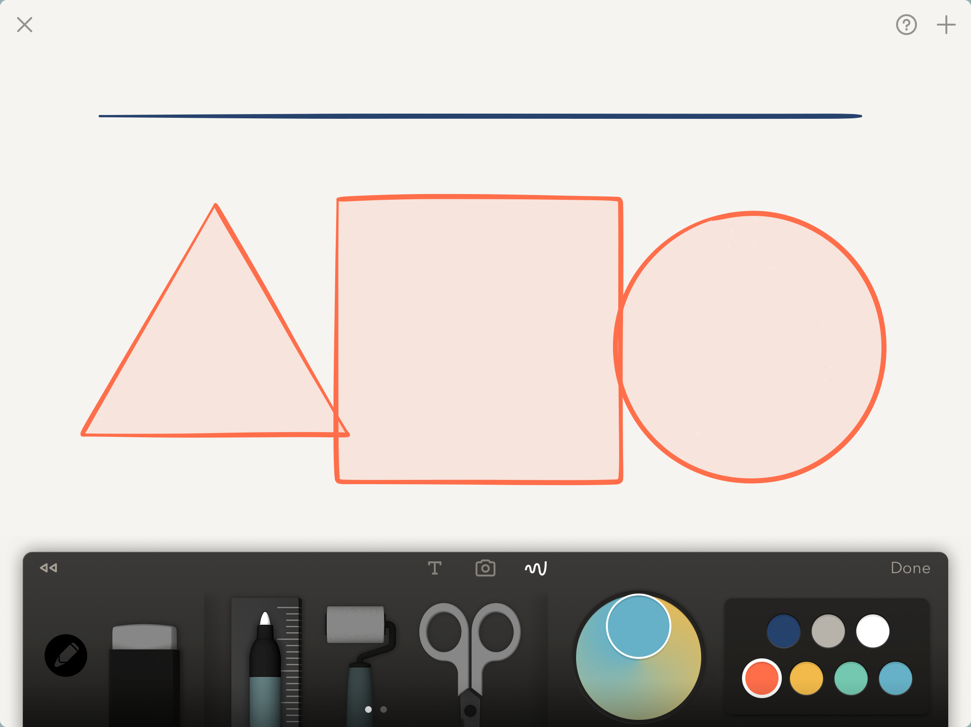
RULER
Swipe to create a line with the ruler and it will automatically straighten
Rapidly draw out shapes with the ruler and they will snap into geometric shapes with a light version of the color used to show it is ready to be filled
8

Slide 9
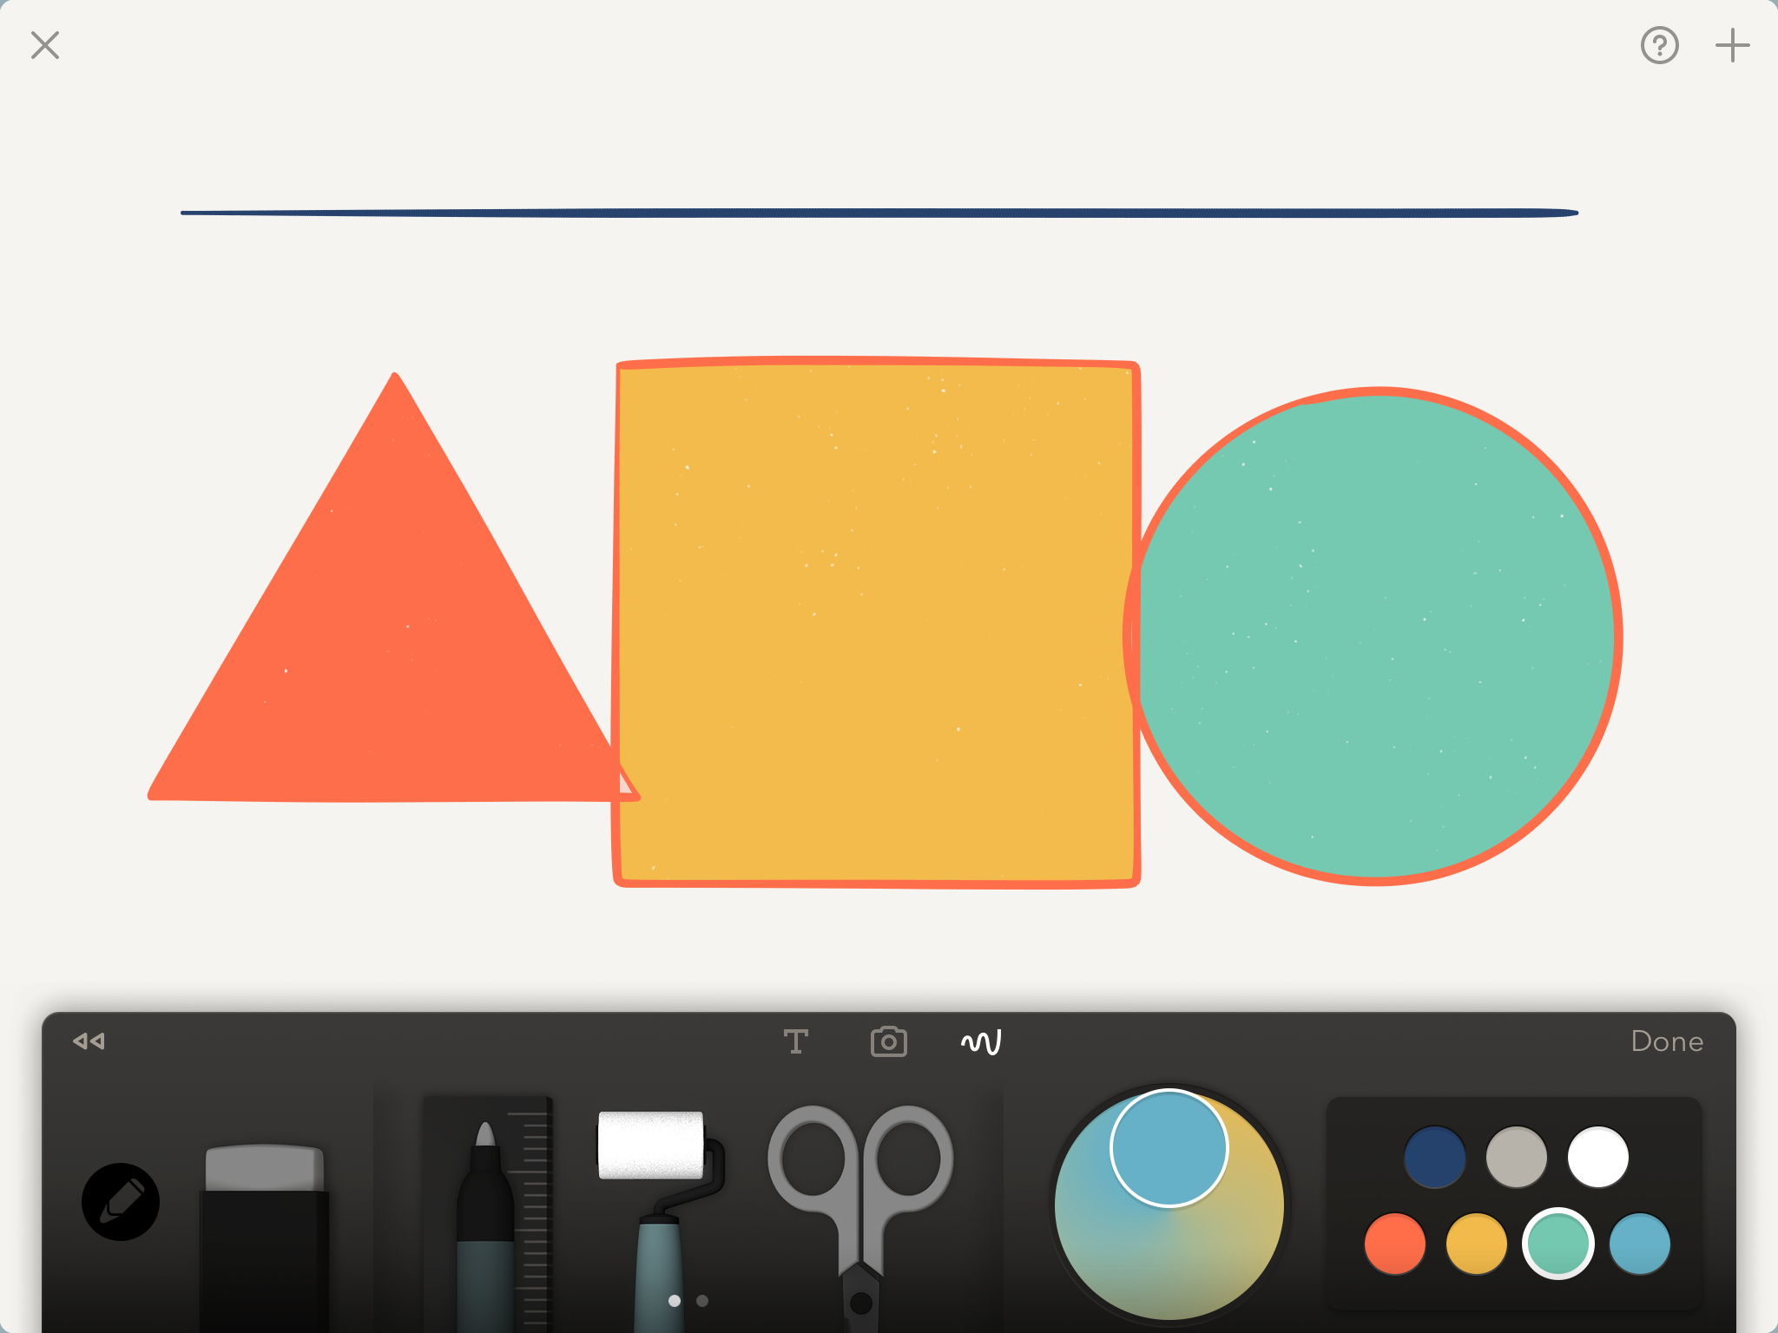
FILL SHAPES WITH COLOR
Tap the roller tool then select a color and tap the inside of each shape to fill that shape with color
9

Slide 10
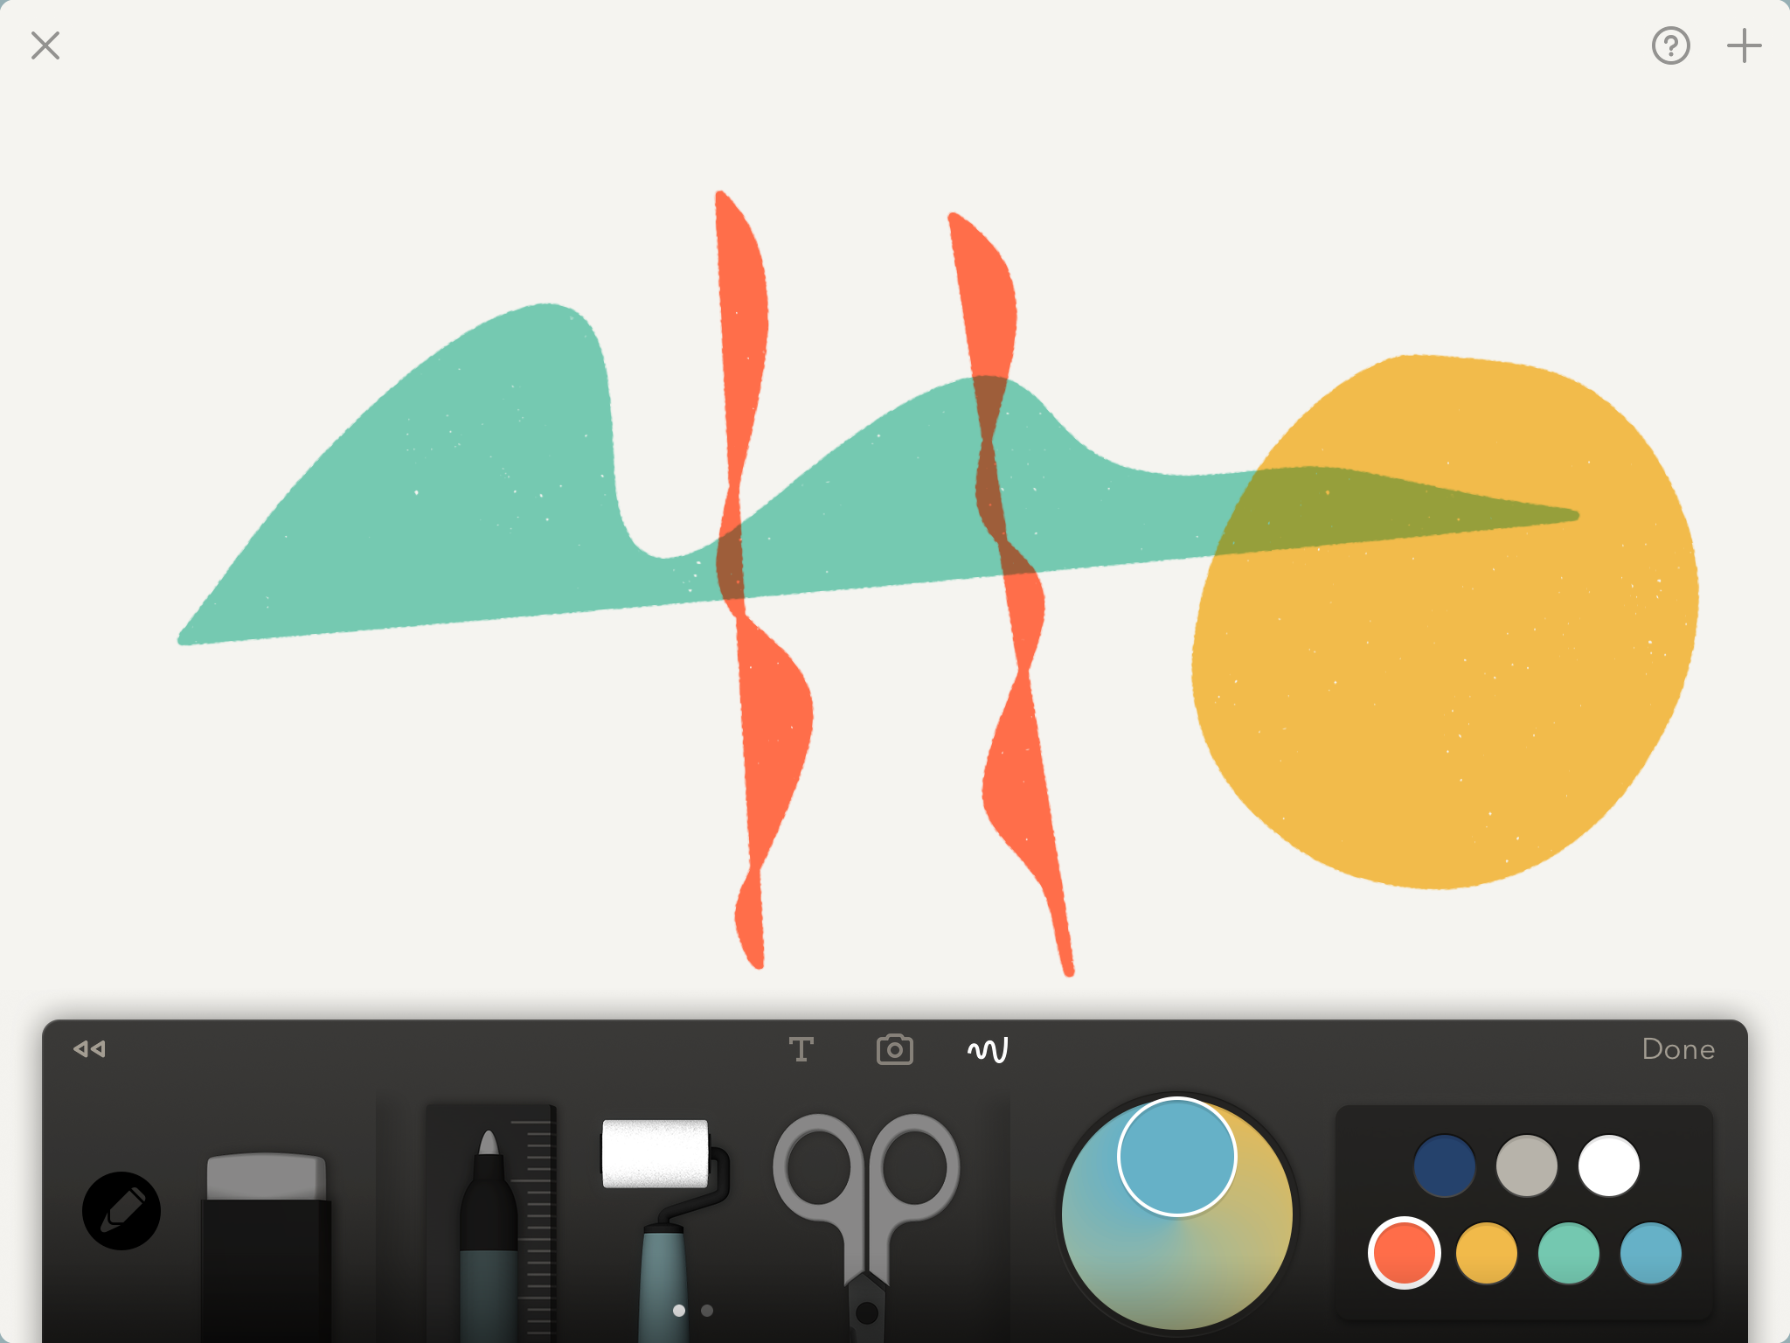
Paint with the roller
The roller tool is also a vector brush that is about 50% opacity
10

Slide 11
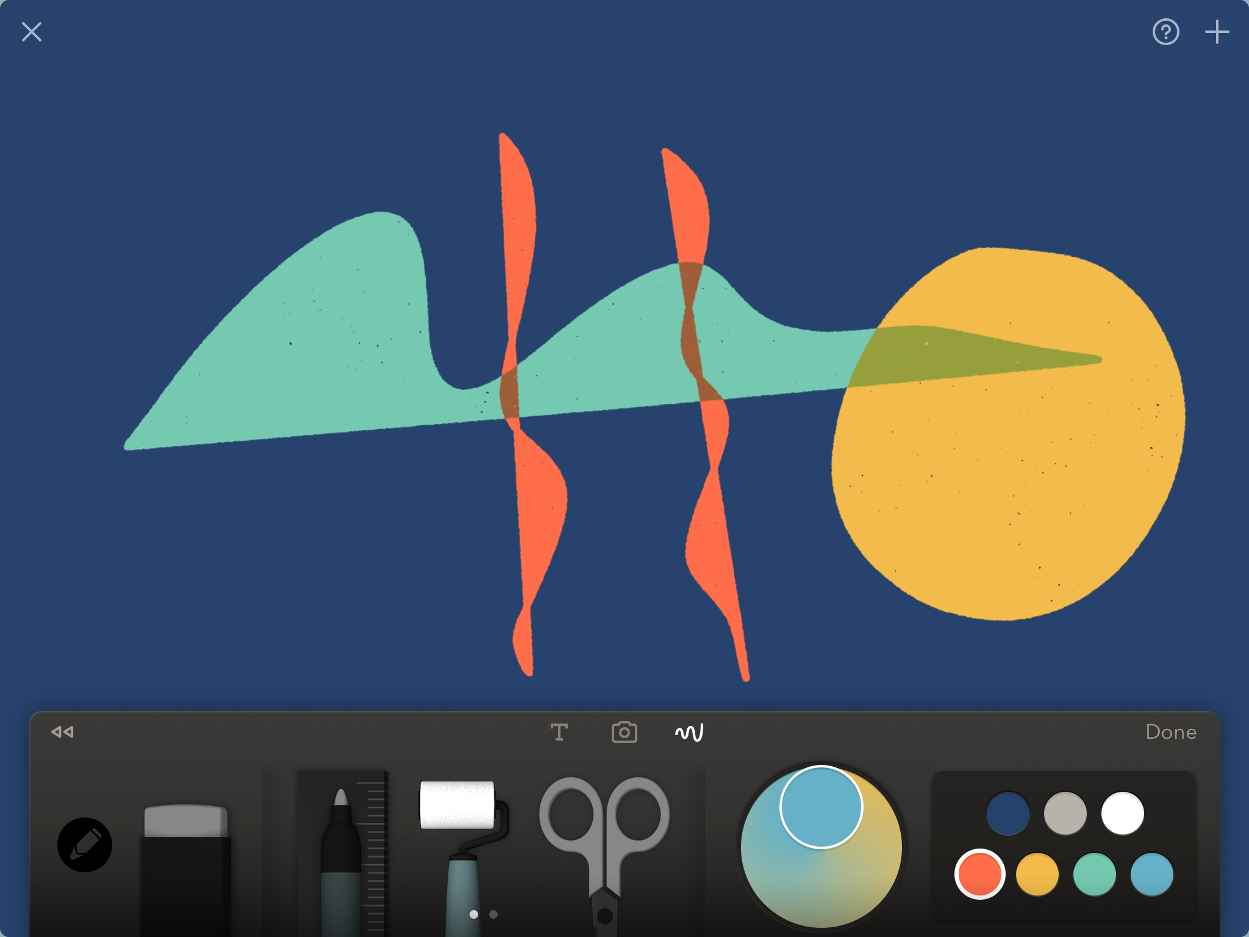
FILL THE BACKGROUND
Fill the background with color by tapping the color, hold your finger/stylus on the color until it gets large
Then drag it and drop it into the background
You can change the background as often as you like
11

Slide 12
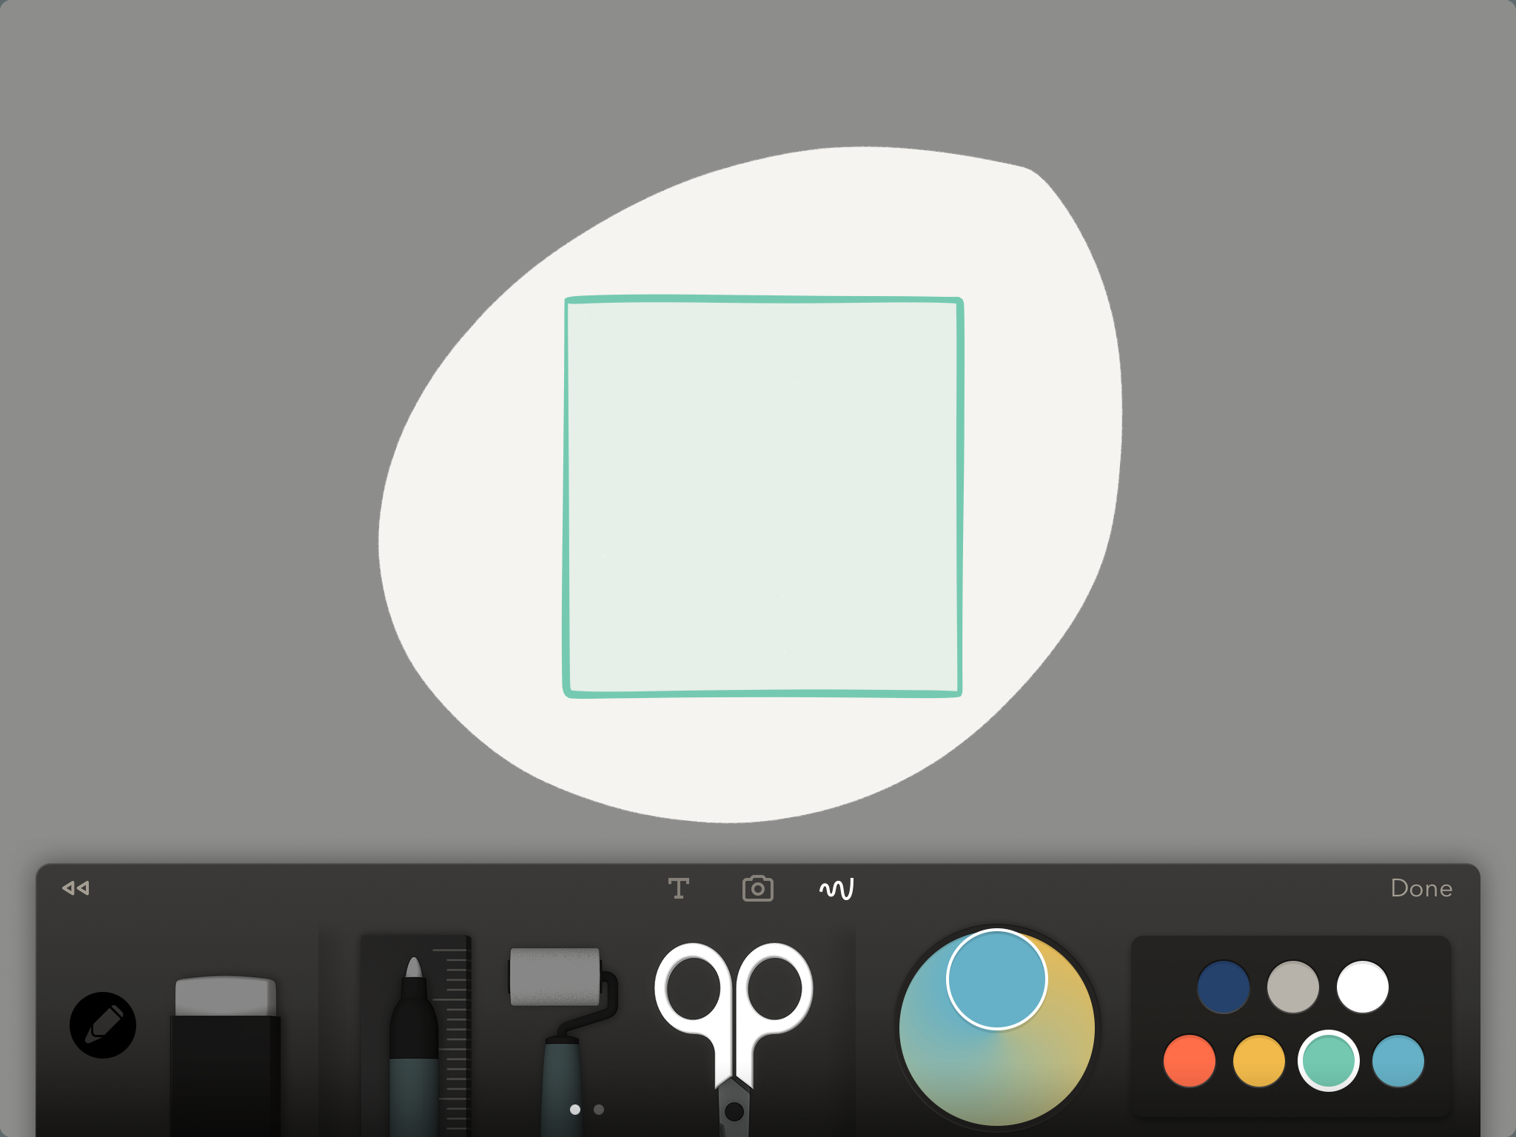
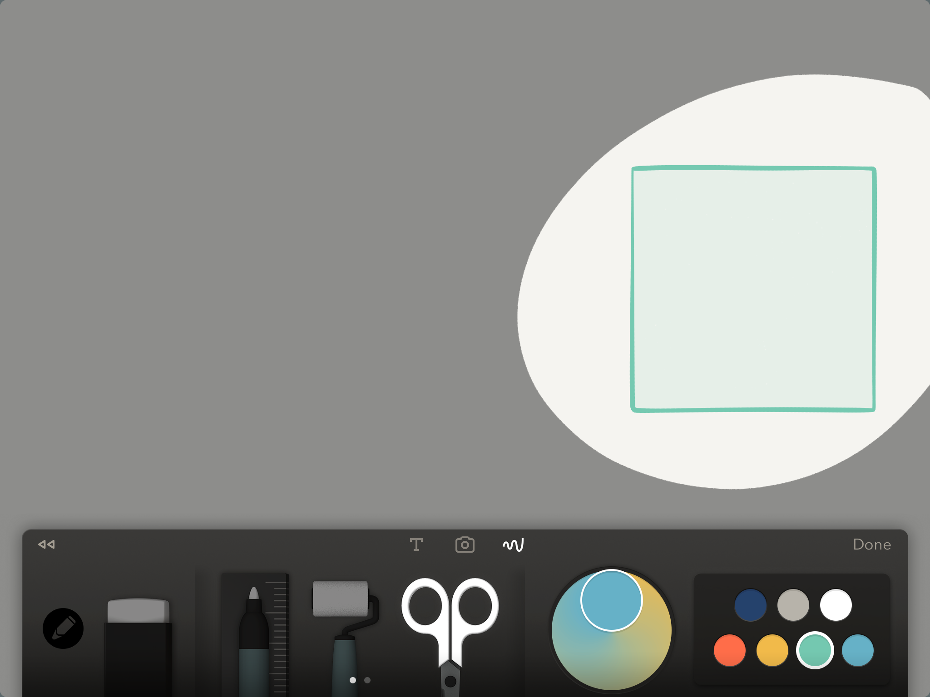
Select AND MOVE an object
Move the selected object around the page
Tap scissors tool and draw around object to select it. Then with your finger or stylus move the object around the page to a place you want to put it.
12

Slide 13
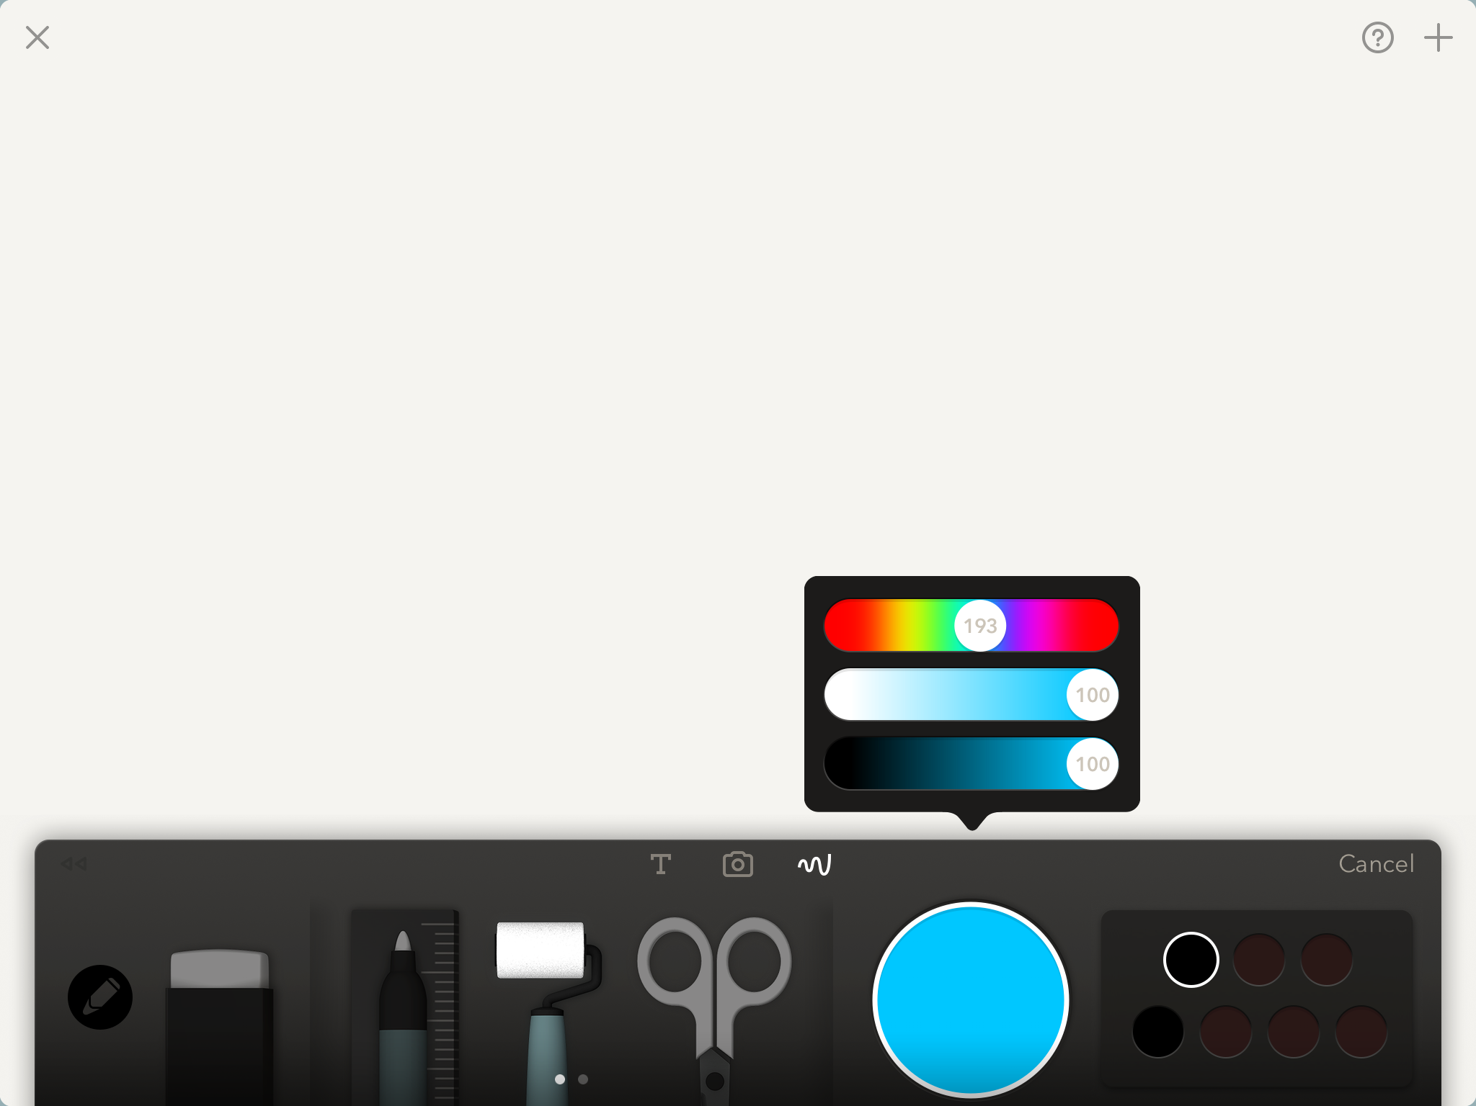
The color picker
Tap the color mixer and the color picker will appear. You can use this to mix any color you want
You can save new colors in the empty paint pots at the bottom of your color palette
13

Slide 14
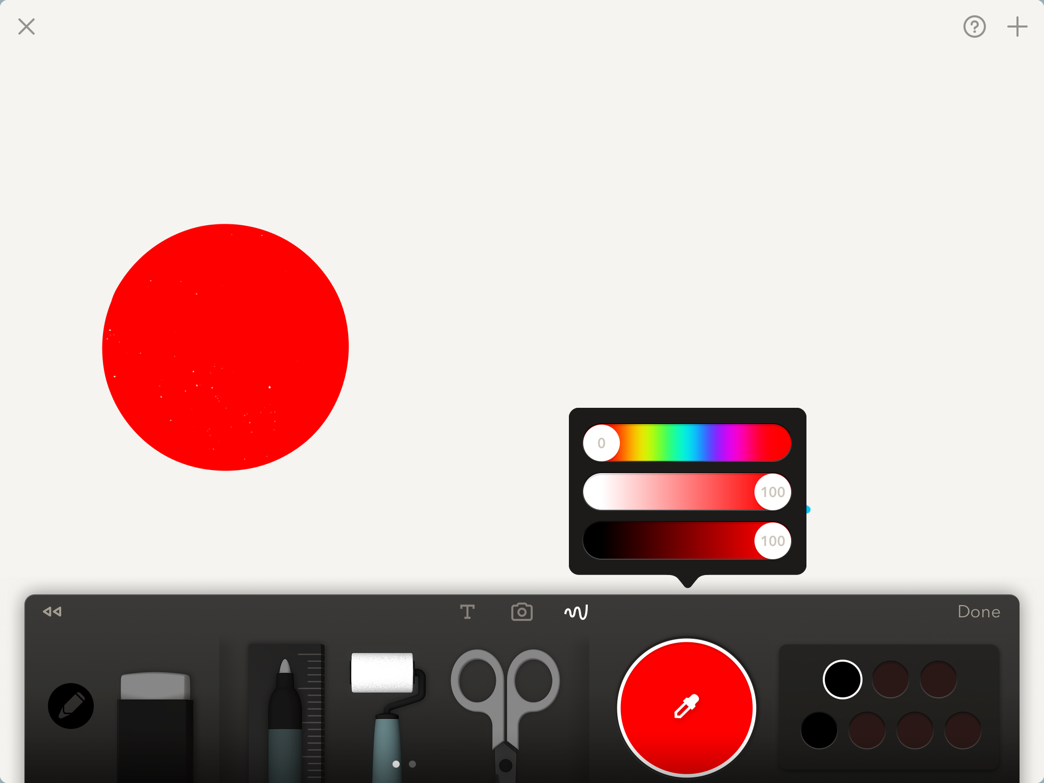
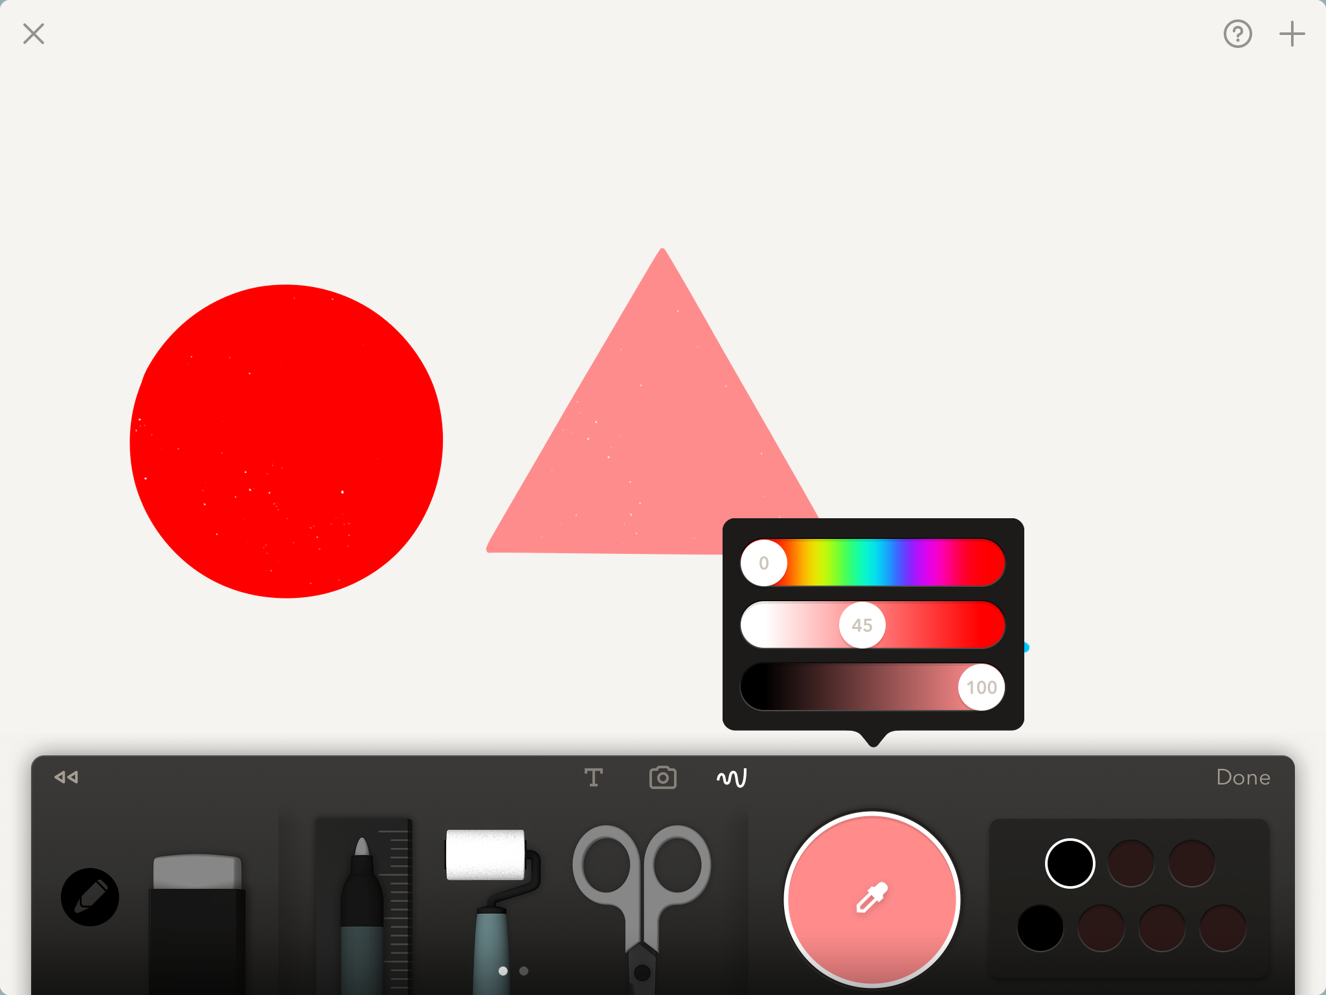
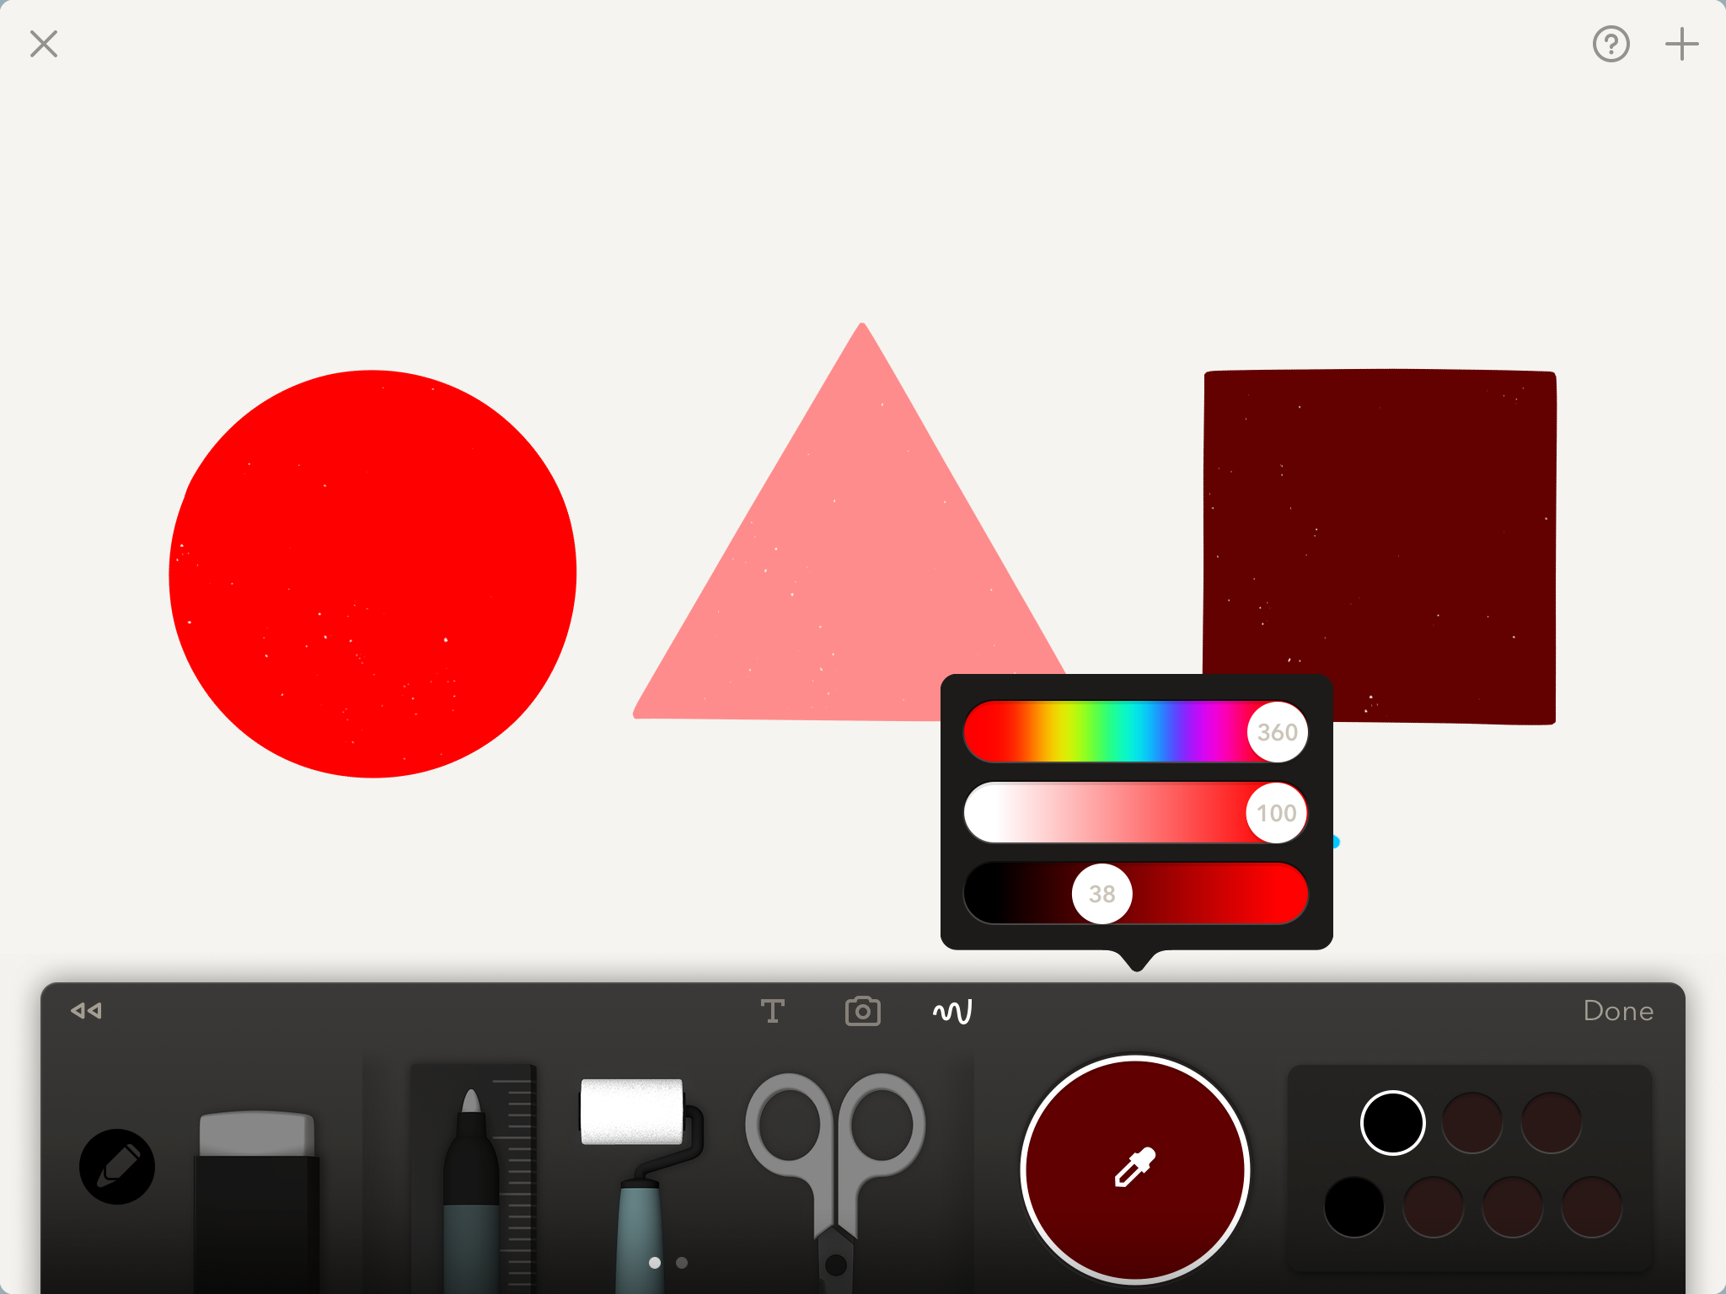
Color slider exercise
HUE SLIDER
SATURATION SLIDER
BRIGHTNESS SLIDER
Do this exercise to see how the sliders work to create a color and then create different SHADES of the color
Use the ruler to create a circle shape. Tap the color mixer and move the second and third sliders to 100. Move the top hue slider to RED (0) then tap the roller and fill the circle with red
Draw a triangle, slide the second slider (saturation) to half way and fill the triangle
Draw a square, then move the third slider to half way and fill with the roller
14

Slide 15
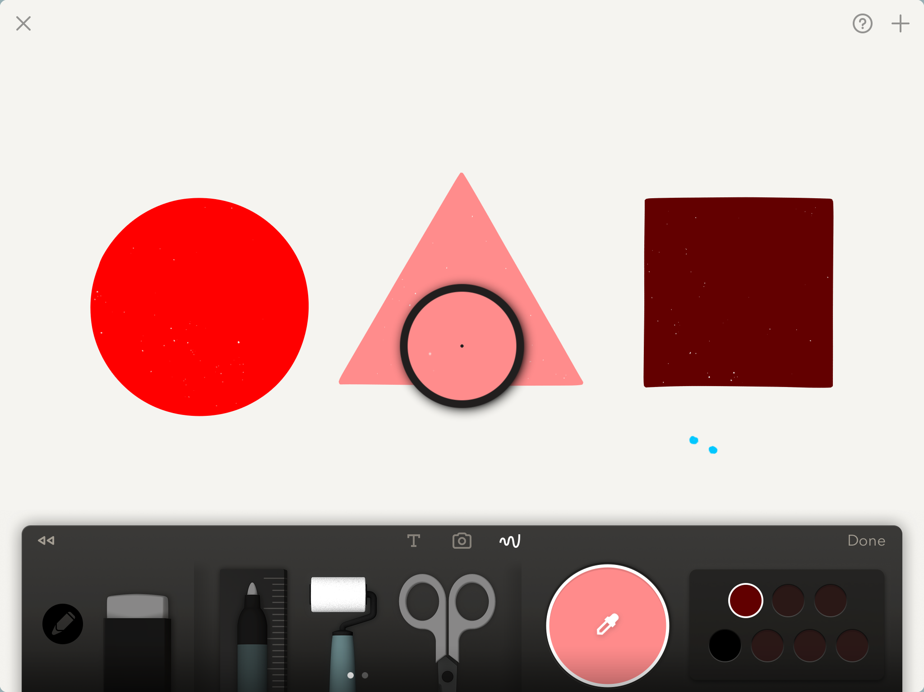
The eyedropper
Pick up a color from the page by tapping the color mixer and then lightly tap the eyedropper
Now move the circle that appears on the page around to select the color you want and then tap the mixing bowl to save the color so you can reuse it
15

Slide 16
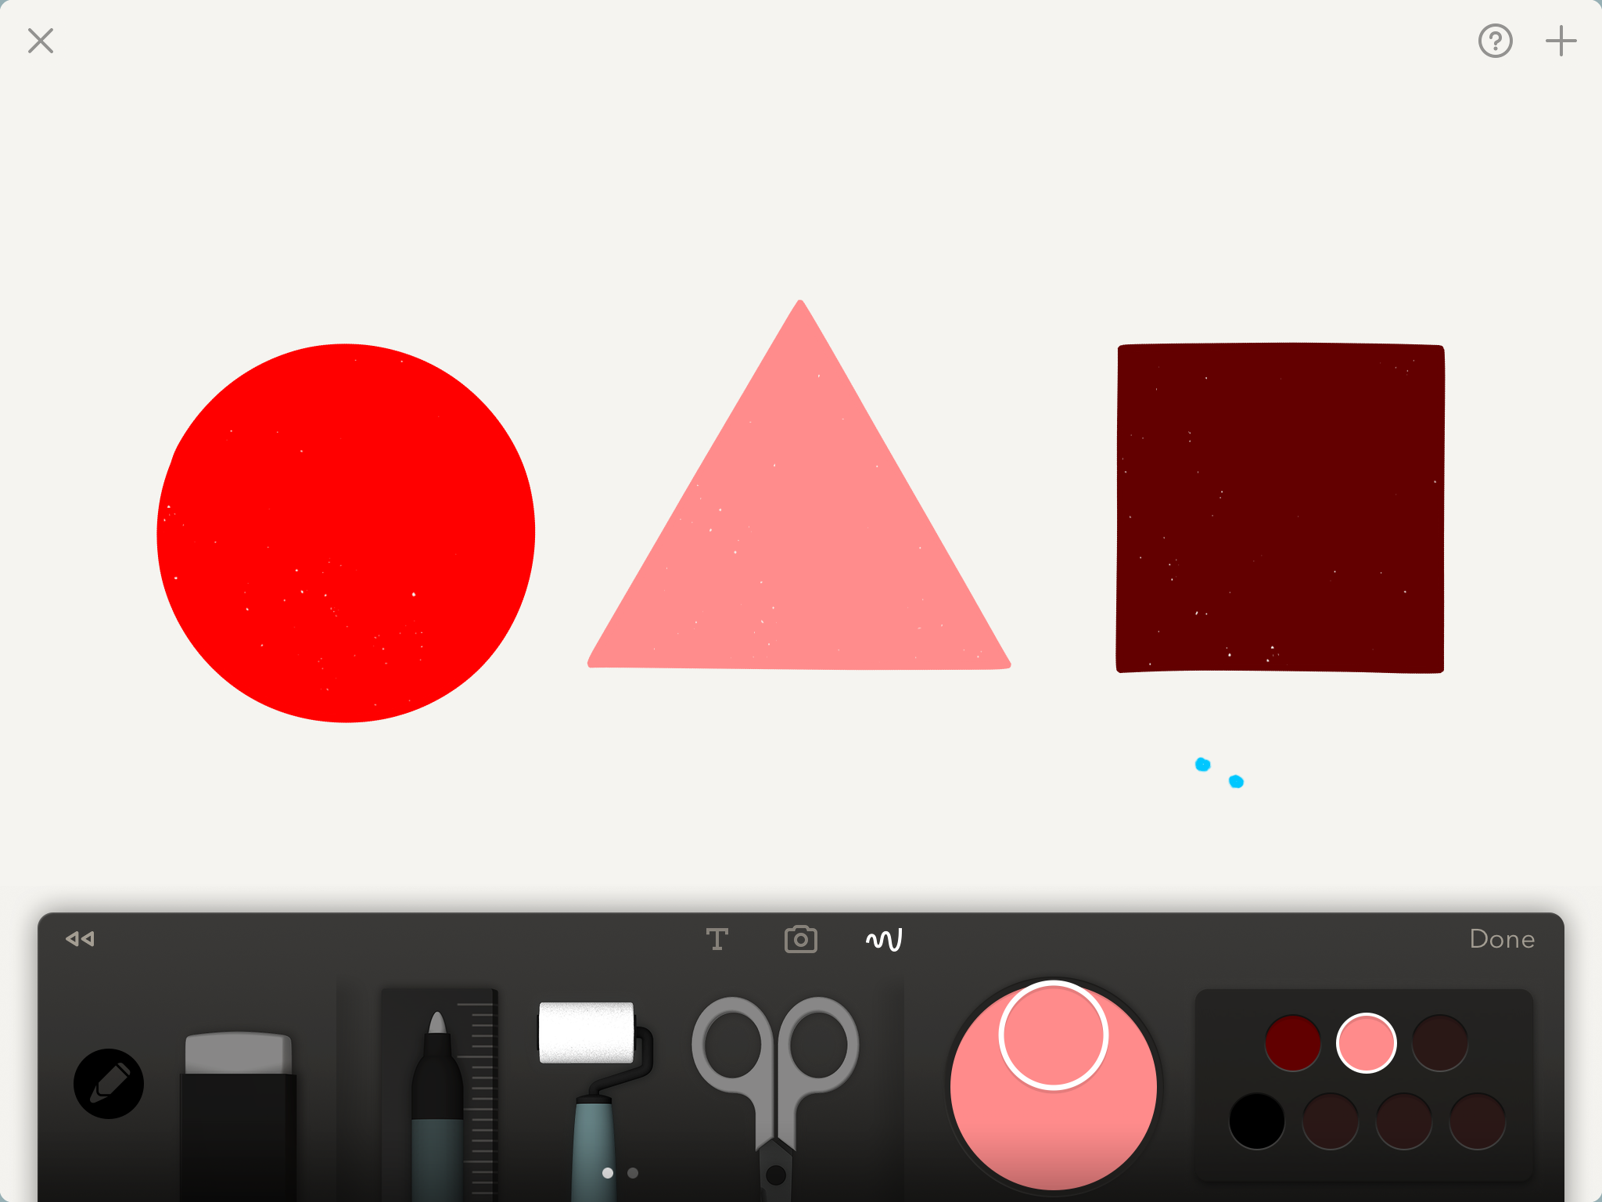
Save the color
Save the color to the color palette by taping the white circle in the color mixer and lightly holding down on it until it gets large
Then drag and drop it into one of the empty color pots
NOTE: Once the pots are filled, you can cover up old colors with new colors.
16

Slide 17
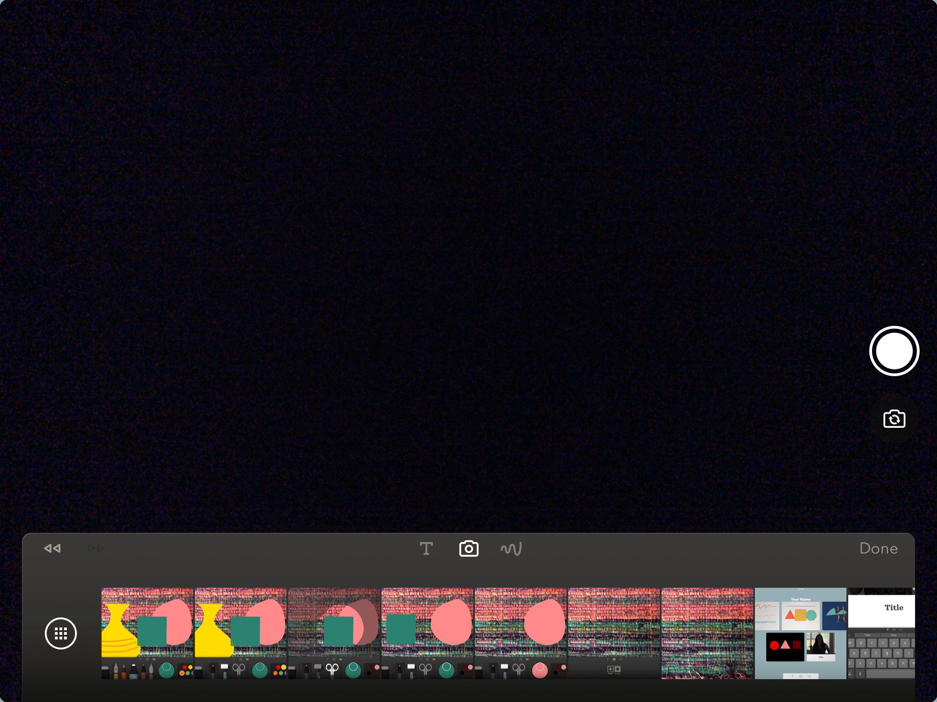
Take or insert a photo
Tap the camera icon
To take a photo
Or insert a photo
Recent photos are shown below
To access your camera roll tap here
Take a photo using this button
17

Slide 18
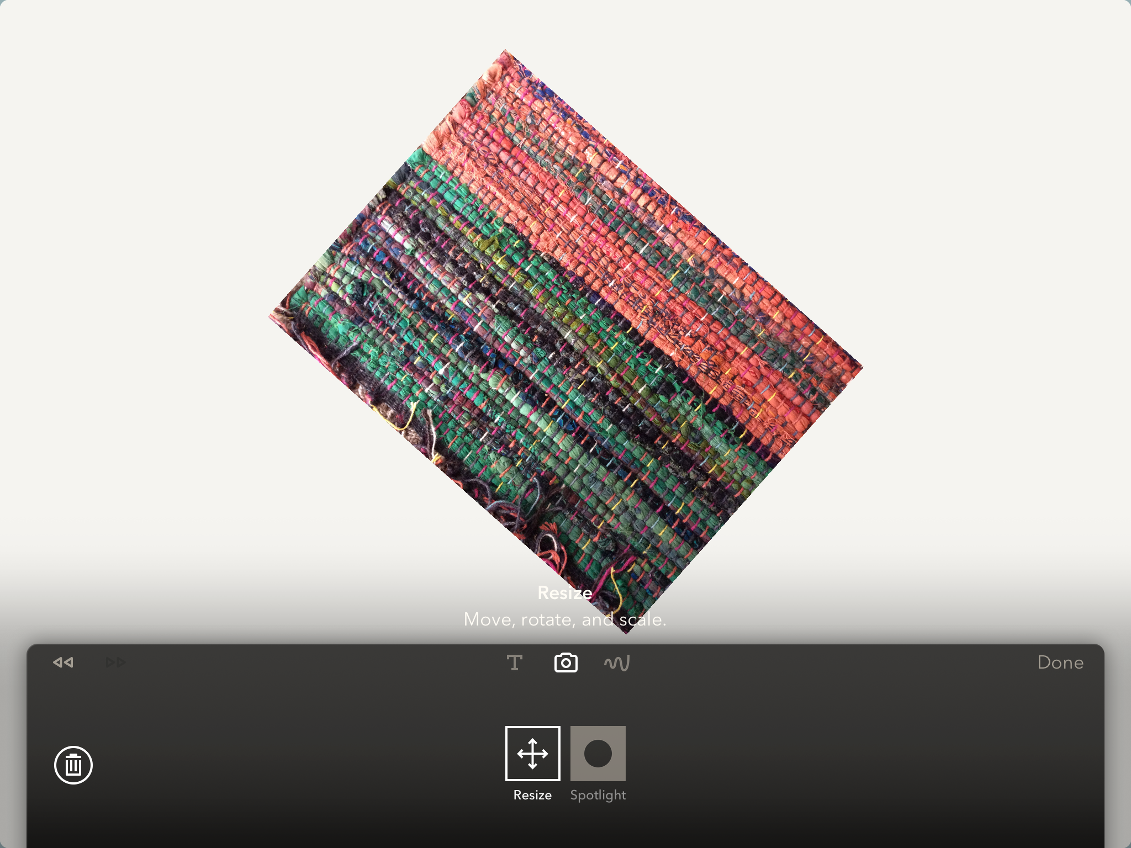
Adjust and reposition photo
Resize the photo using your thumb and forefinger to move it around, make it smaller or larger and place is where you want
You can delete the photo by tapping the trash can icon
18

Slide 19
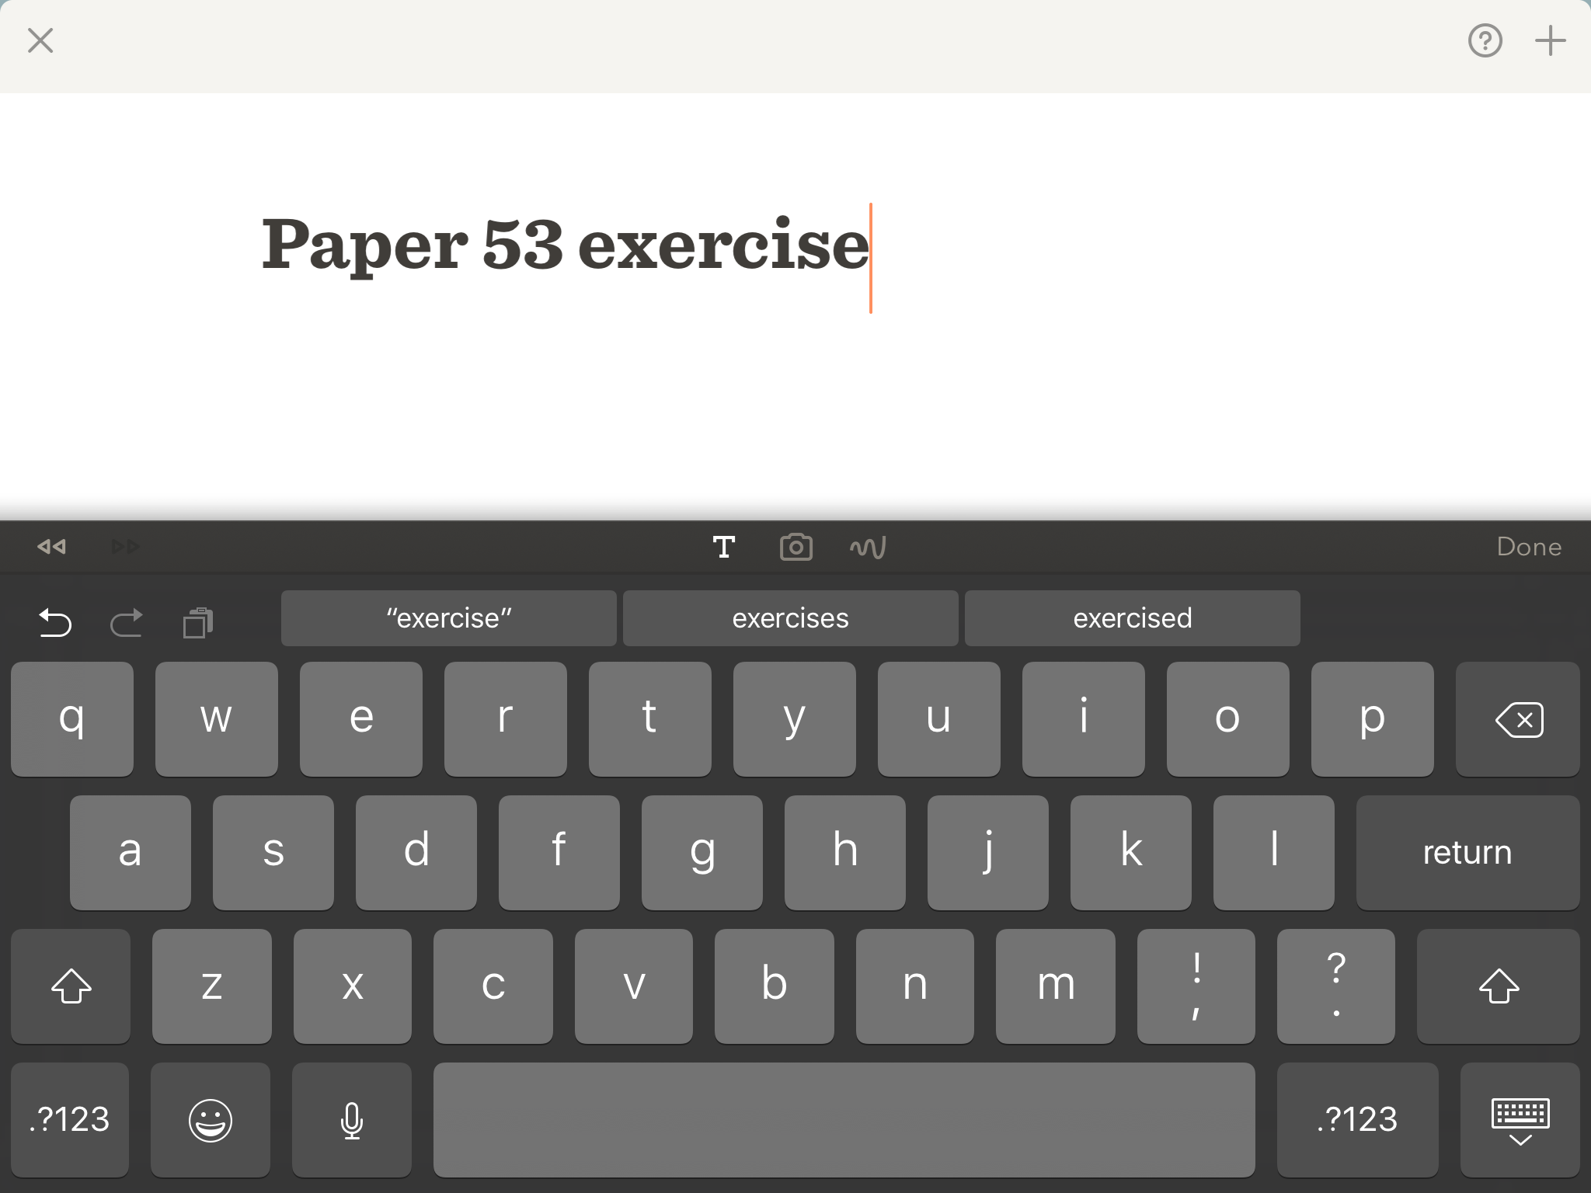
Name the page
Tap the Text Tool
Type in the name of your page.
Press return when done.
Your page will now have a title.
Text Tool
19

Slide 20
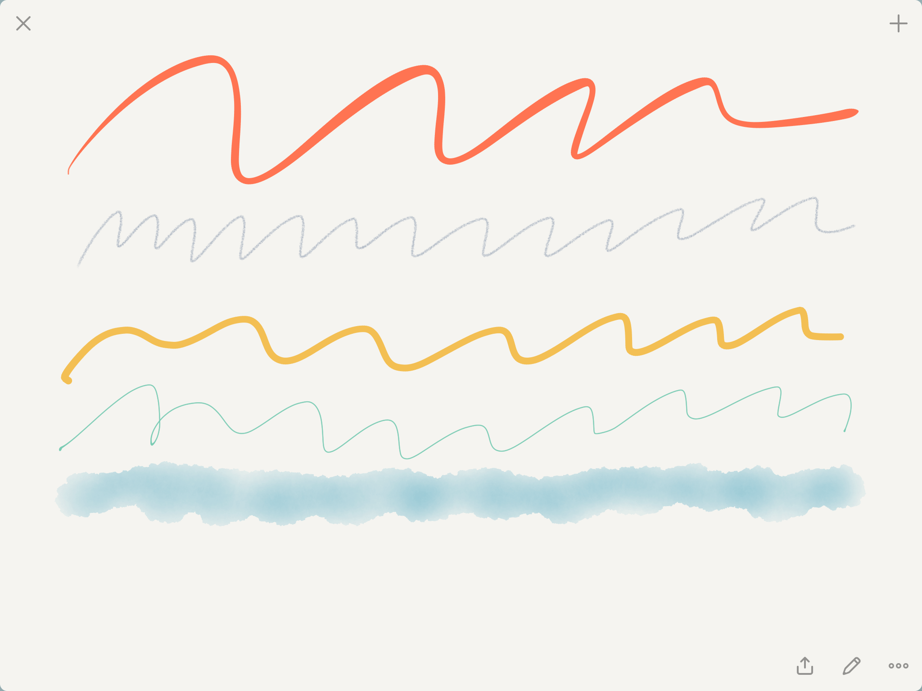
Save and reopen page
When you press the DONE button on the right of your toolbar it automatically saves the image in Paper 53 and you will see these three icons on the bottom. To reopen the page tap the middle icon
20

Slide 21
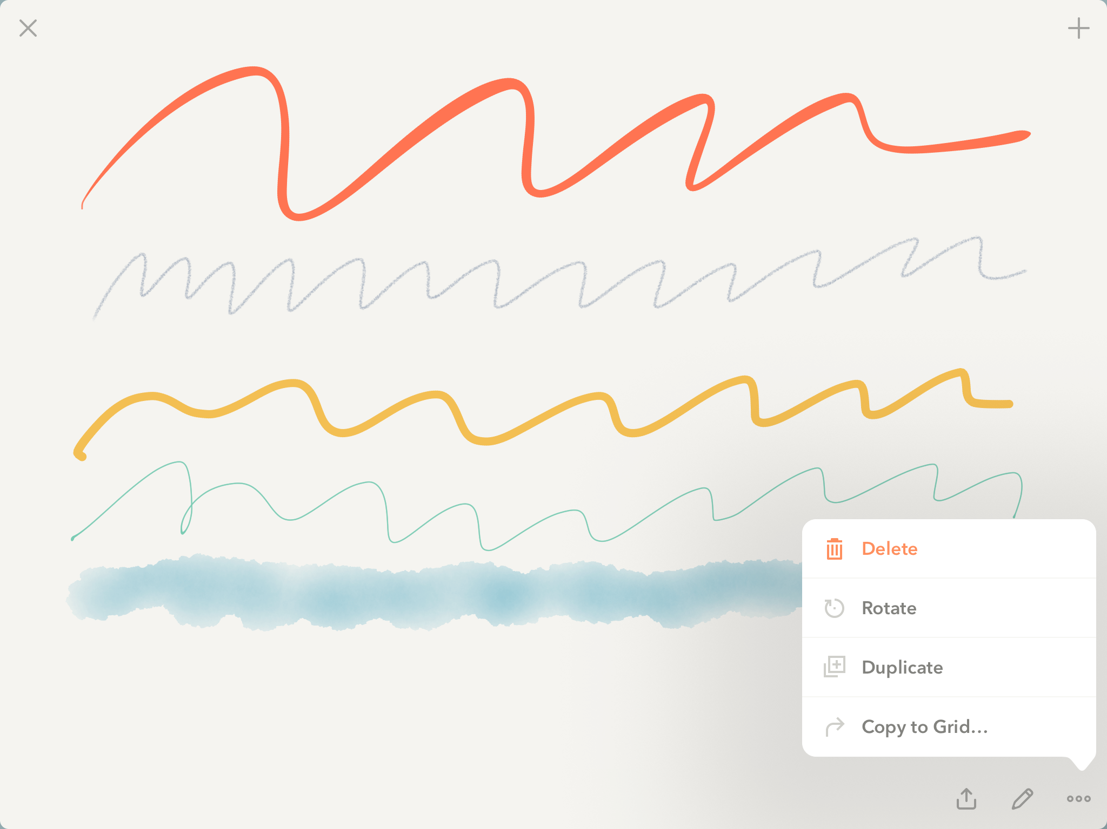
Delete, rotate, duplicate or move the page
Tap the 3 dots and this window appears.
You can delete the page
Rotate the page
Duplicate the page
Move it to another grid (folder)
21

Slide 22
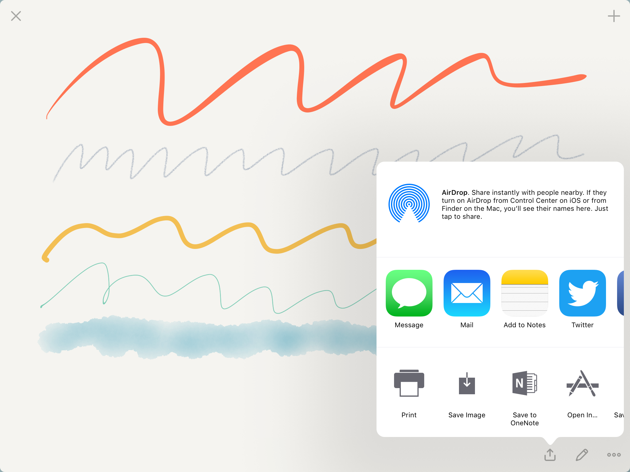
Share the page
The left hand share icon allows you to share in many ways
Here you can save the page to your camera roll and from there save it to a common folder such as Schoology, Google Drive or Dropbox
22

Slide 23
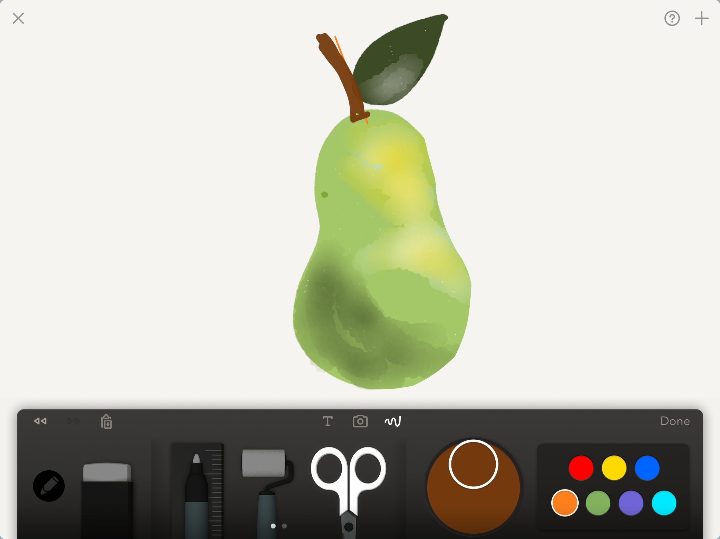
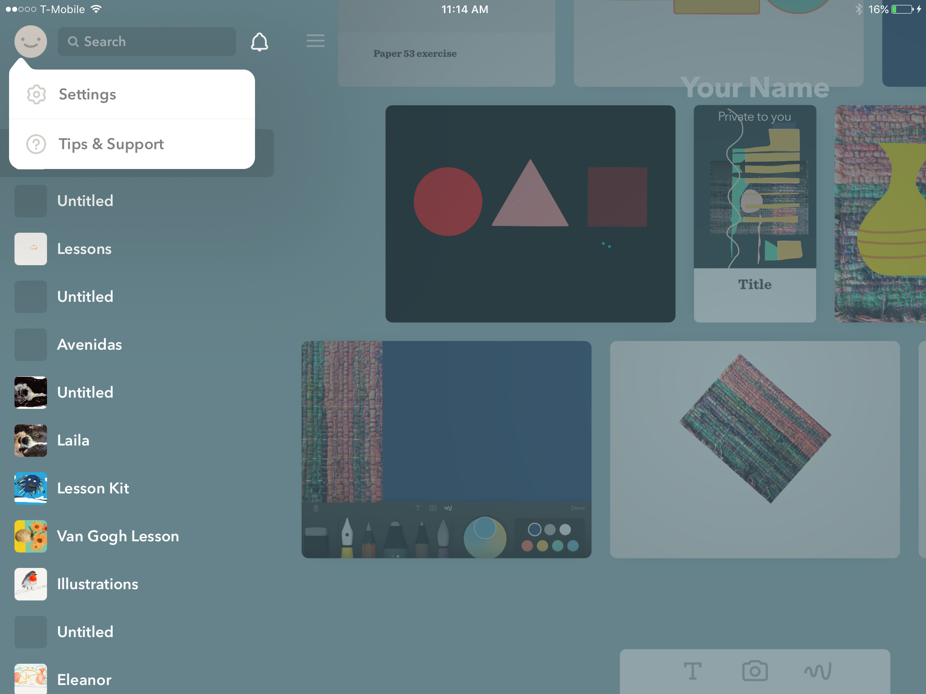
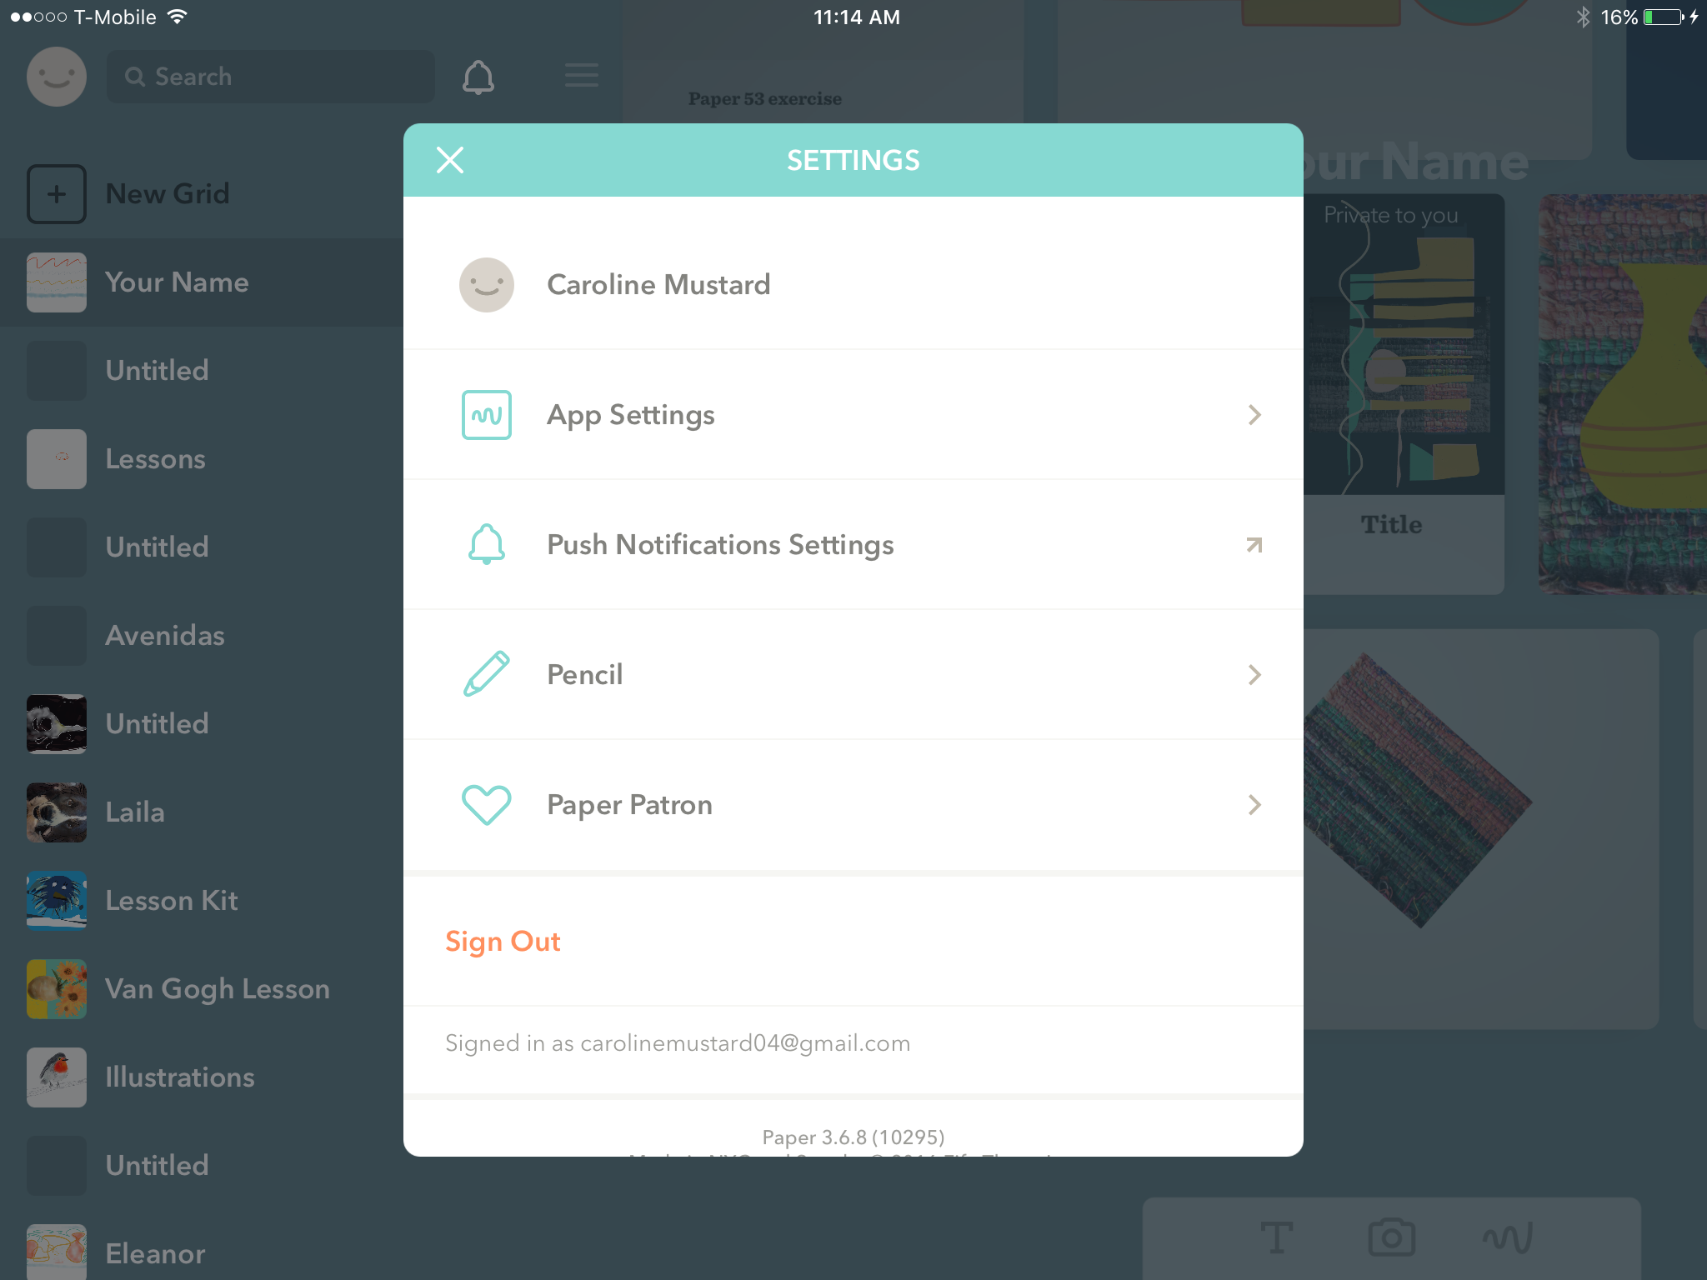
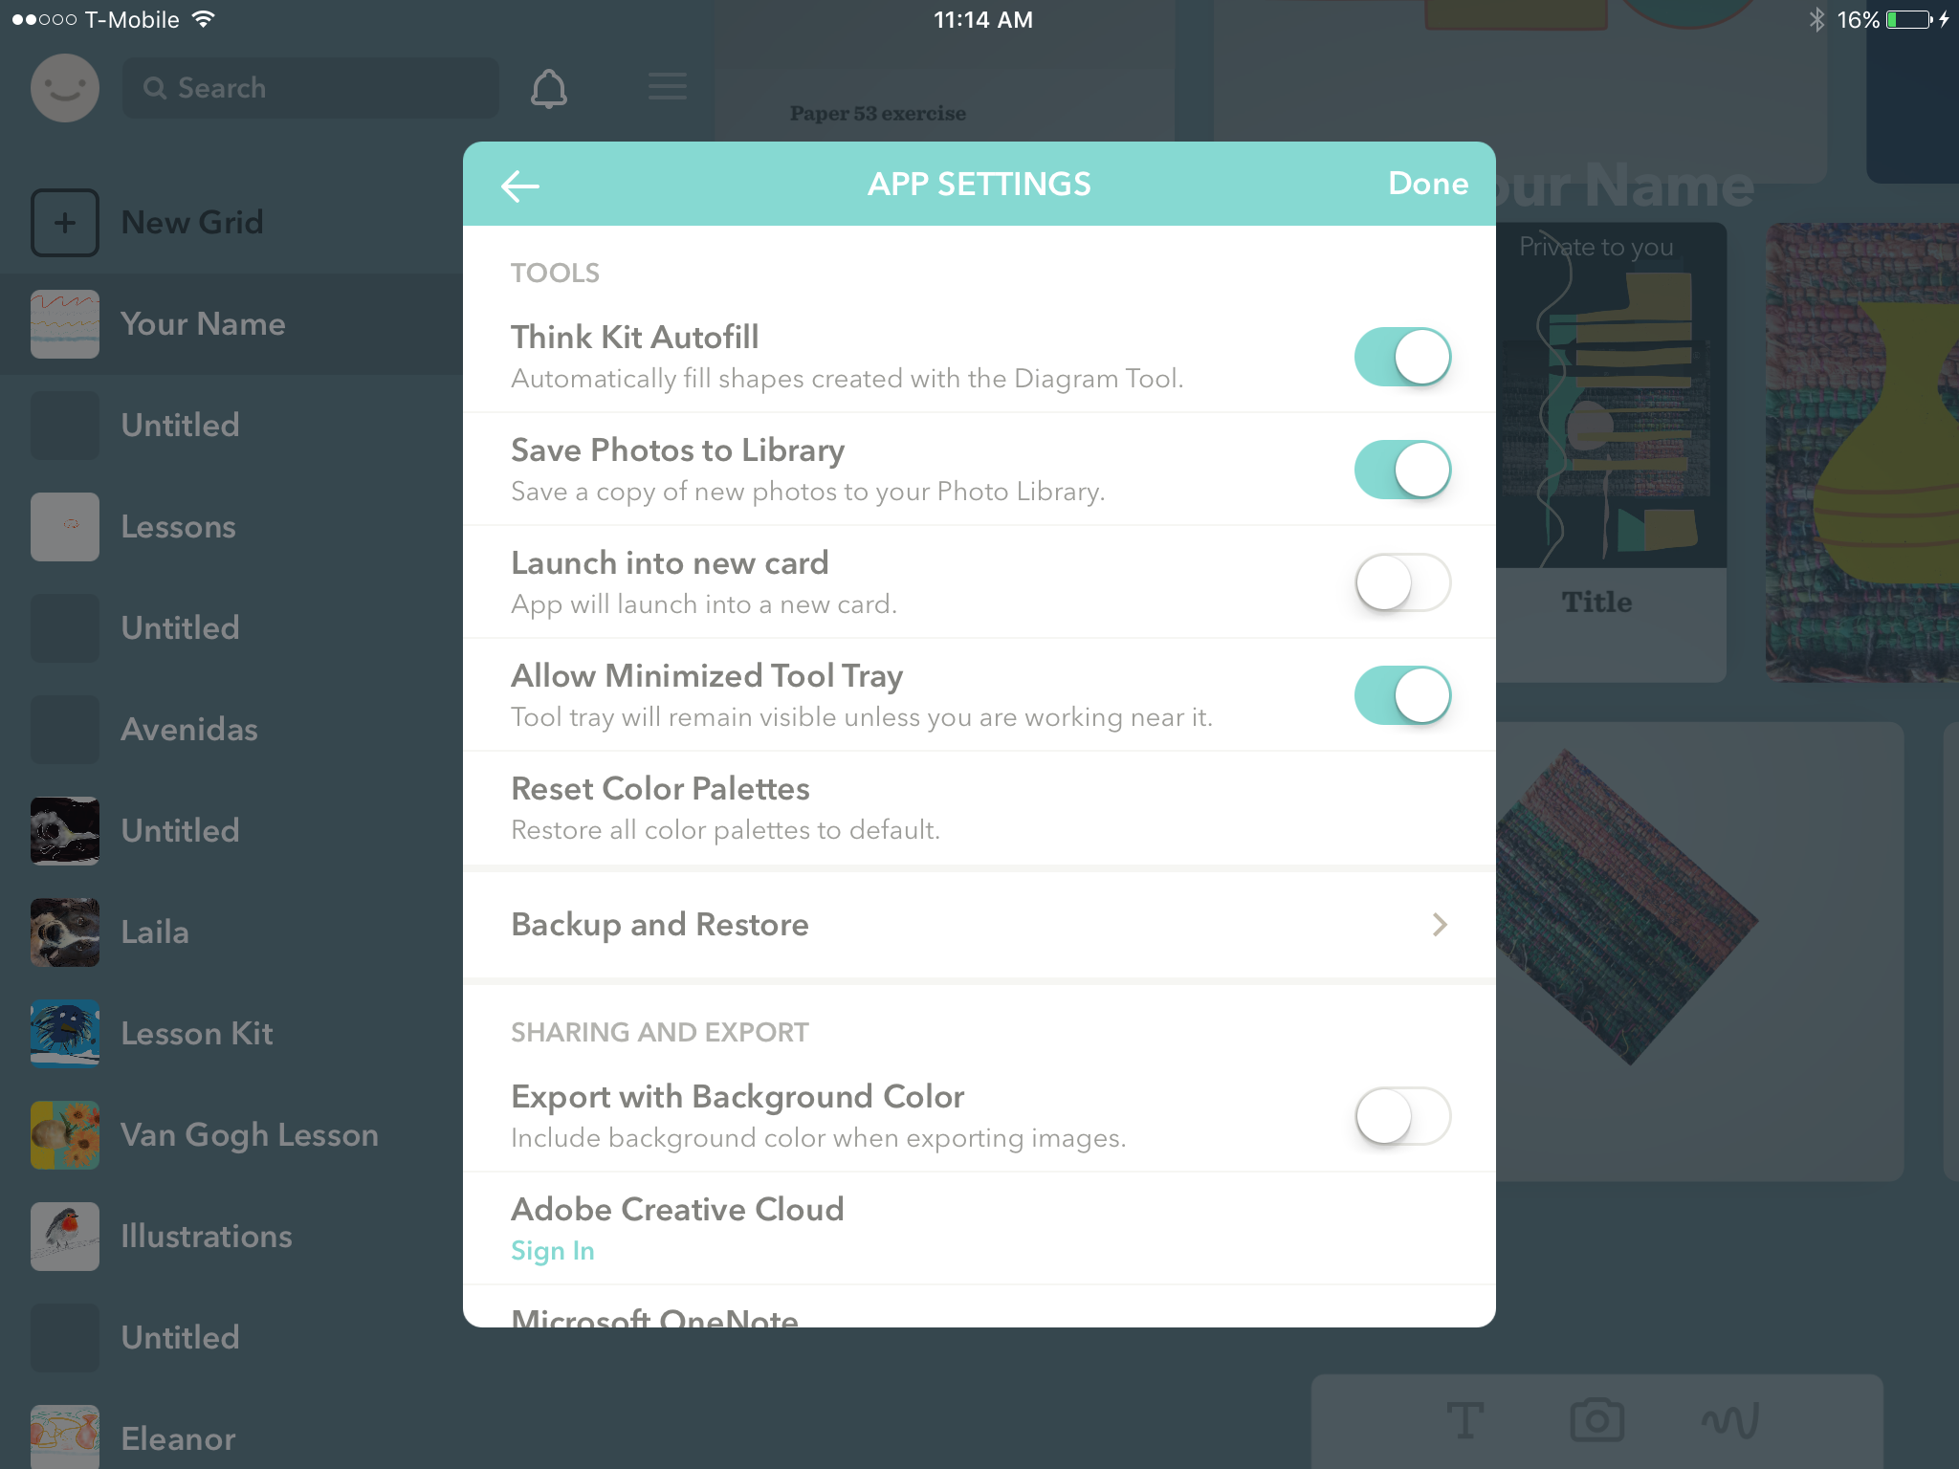
Save image without a background
You can create an object and then save it without a background so you can import the object and then put different colors behind it.
Tap the “X” on the top left of your screen
Now tap the Happy Face and tap SETTINGS
Tap APP Settings
Finally slide SAVE WITHOUT A BACKGROUND so it is OFF (no color showing)
TAP X
TAP SETTINGS
TURN OFF “SAVE WITHOUT A BACKGROUND”
TAP APP SETTINGS
23

Slide 24
MORE INFORMATION
Want to know more about Paper 53?
You can get more detailed directions going to the Paper 53 Support page at https://support.fiftythree.com/hc/en-us
Or you can enroll on our online class led by Caroline Mustard, co-founder of Mobile Art Academy. The online class will be provided to you free of charge. Request permission to access the class by contacting support@artinaction.org
24

