Slide 1
Brushes Redux
QUICK LOOK INSTRUCTIONS
PREPARED FOR ART IN ACTION

Slide 2
TABLE OF CONTENTS
Open a painting 3
Tool Bar 4
Color Picker 5
Brushes 6
Fill and Erase 7
Add Layer 8
Transform 9
Import image 10
Duplicate layer 11
Move & Merge 12
Share and Save 13
Name painting 14
Reopen 15
Export painting 16
More info 17

Slide 3
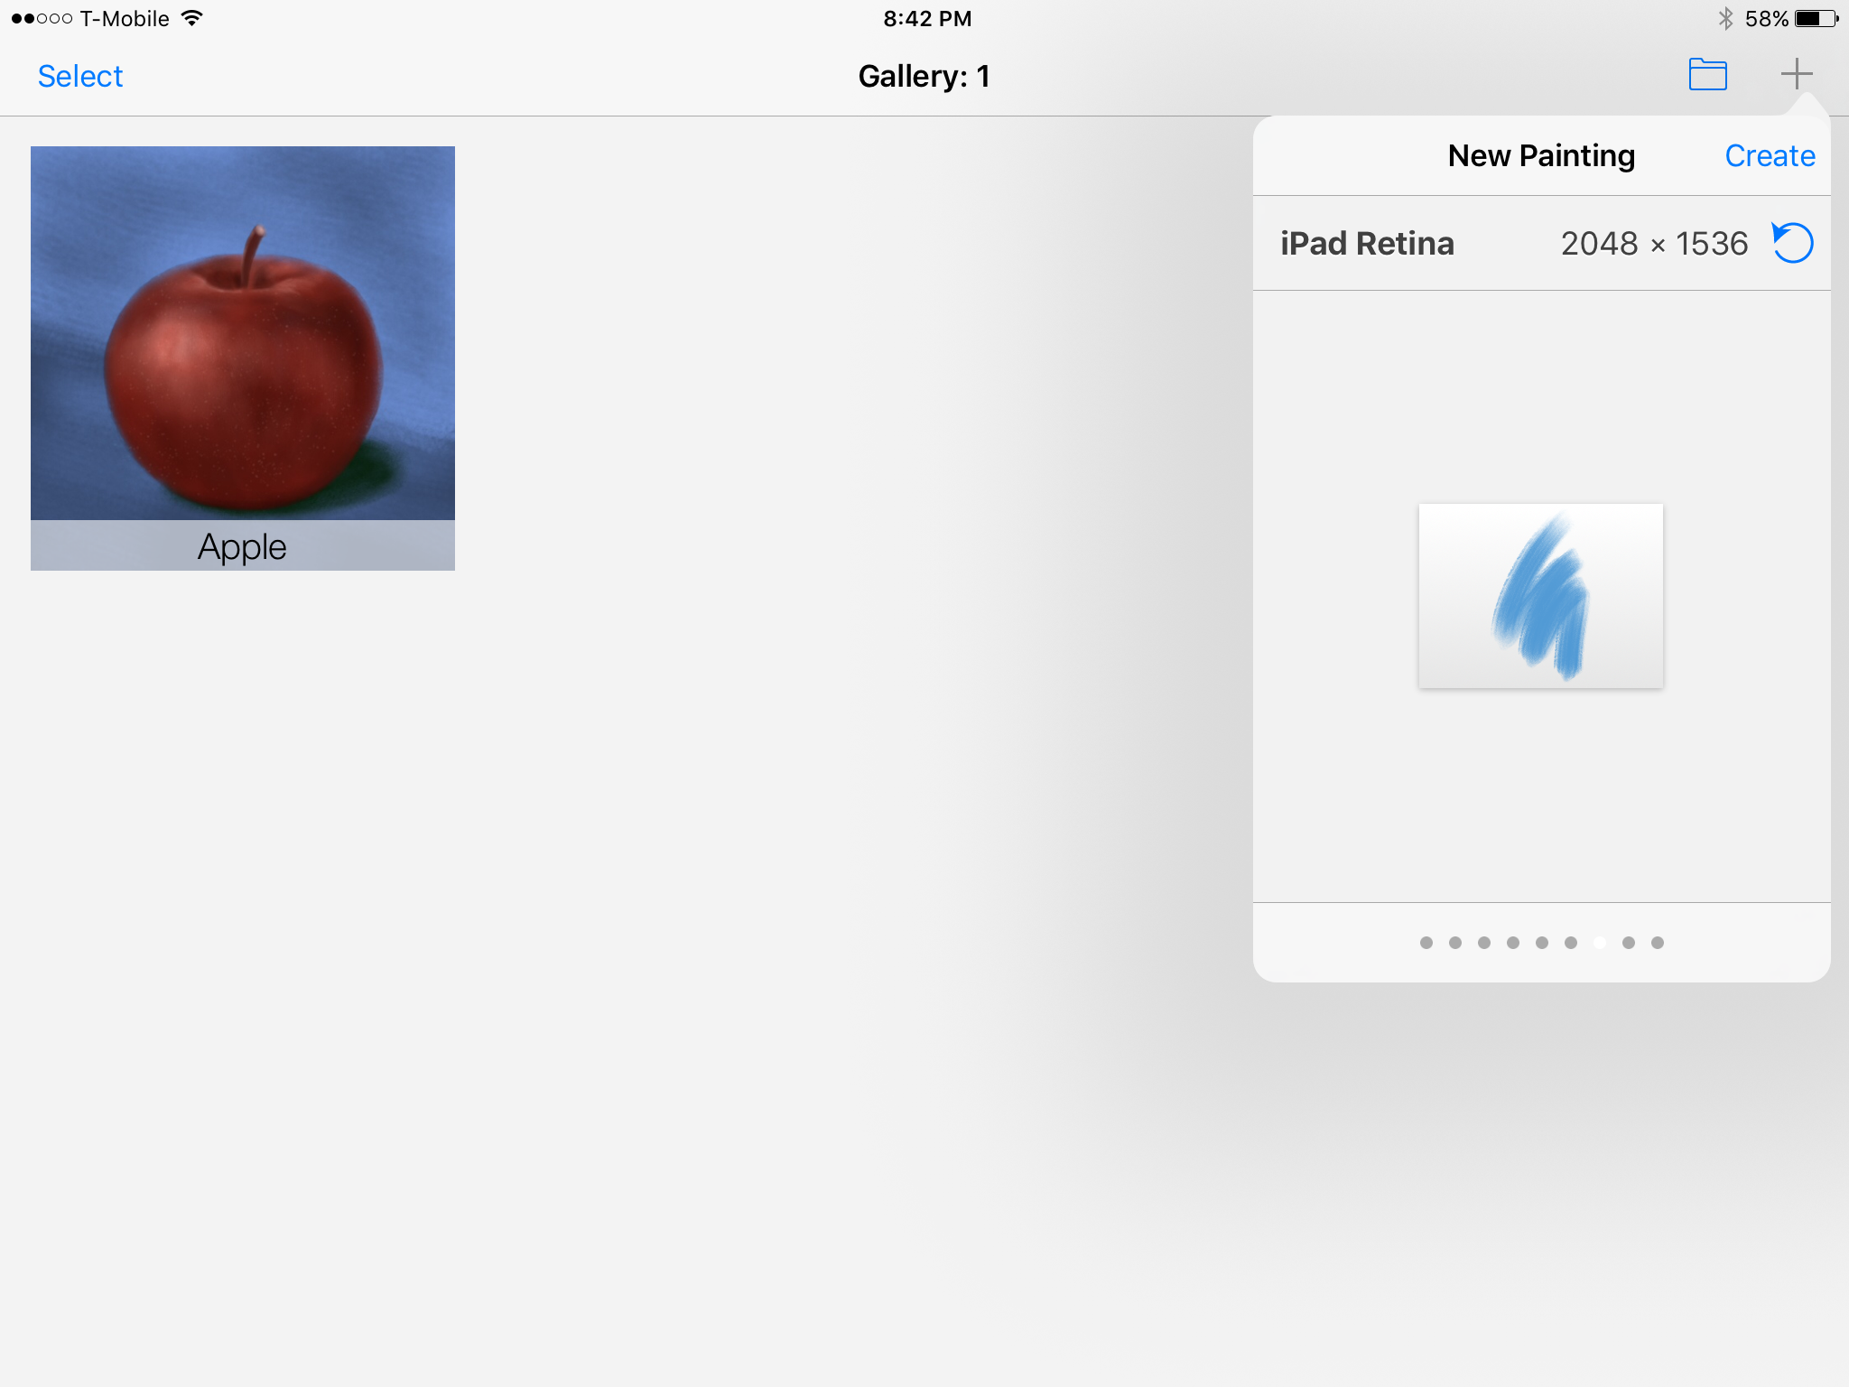
Opening a painting
Tap the + to open the New Painting menu.
Scroll through to select size
Click painting thumbnail to set orientation (portrait or landscape)
Once you have set the size and orientation, tap CREATE and the painting will open

Slide 4
Tool Bar
Save to Gallery
Accessories
Import photos
Share
Brush/Eraser shapes
Eraser Tool
Layers
Color Picker
Brush Tool
Undo
Redo
Adjustments
Brush/Eraser size slider
This is how the open painting looks. The toolbar is rather faint, so this will help you locate what you are looking for.

Slide 5
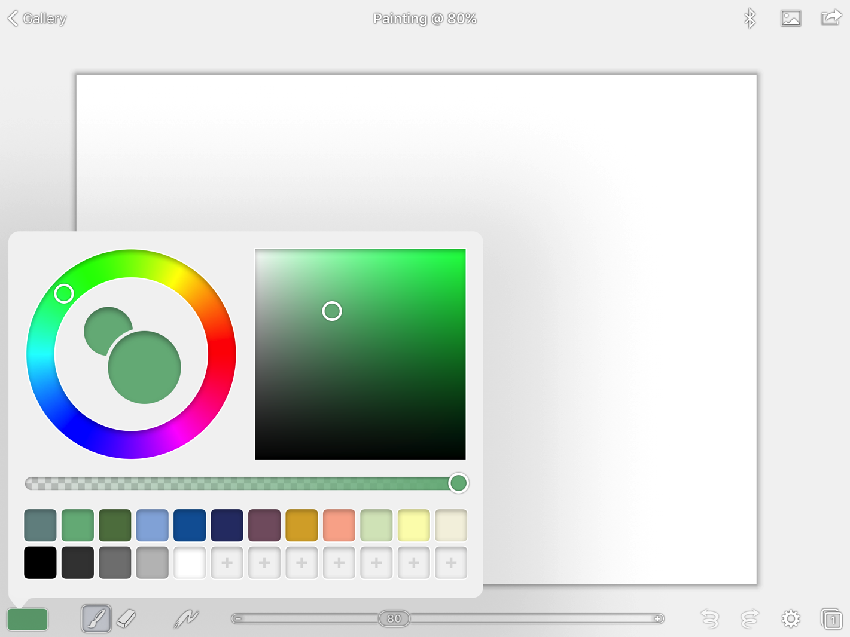
Color Picker
Color wheel
Shading square
Brush/Eraser size slider
Opacity slider
Palette boxes
Tap the color picker and tap the color wheel to select a hue. Then tap inside the shading square to set the shade (bright, dark, light etc). You will see the color show up in the inner circle. Move the slider to adjust opacity.
Save a color by tapping one of the empty palette boxes.

Slide 6
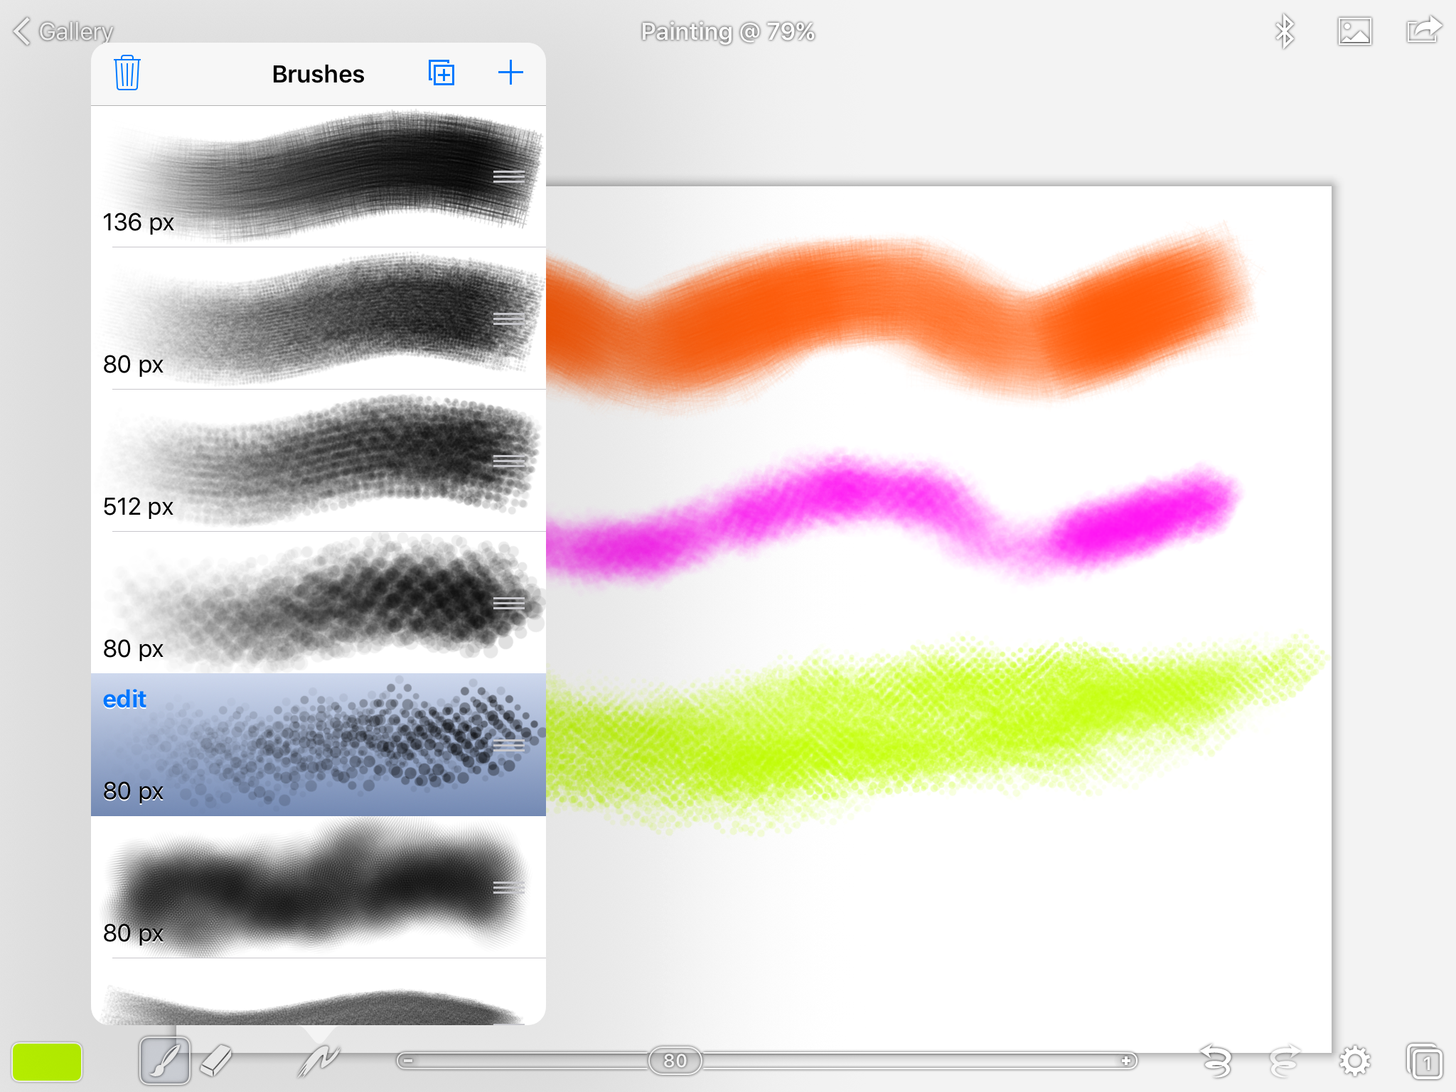
Brushes
Tap the Brush icon
Tap the Brush shape icon and select the brush you want to use
Practice making marks, noting that the harder you press the darker the color
Brush/Eraser size slider

Slide 7
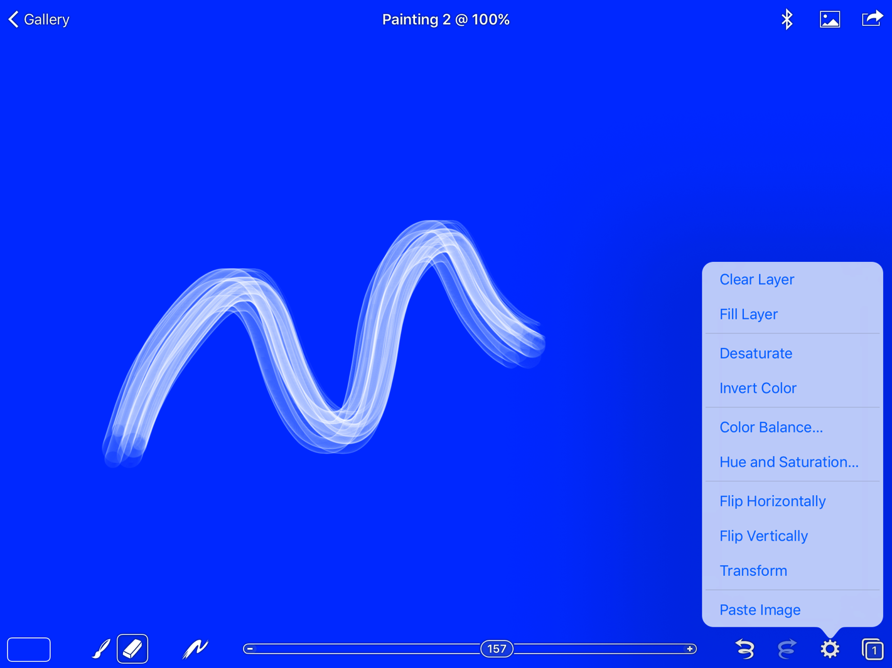
Fill and Erase
Fill the painting with color by tapping the Gear icon and tapping Fill Layer
Tap the eraser and erase through the background color
Brush/Eraser size slider
Eraser
Gear Icon

Slide 8
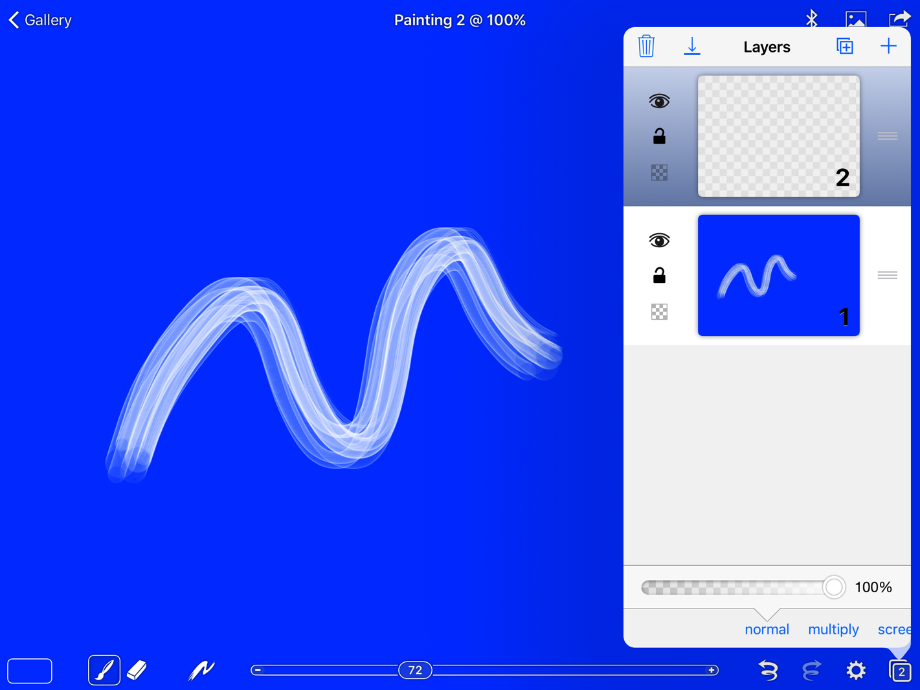
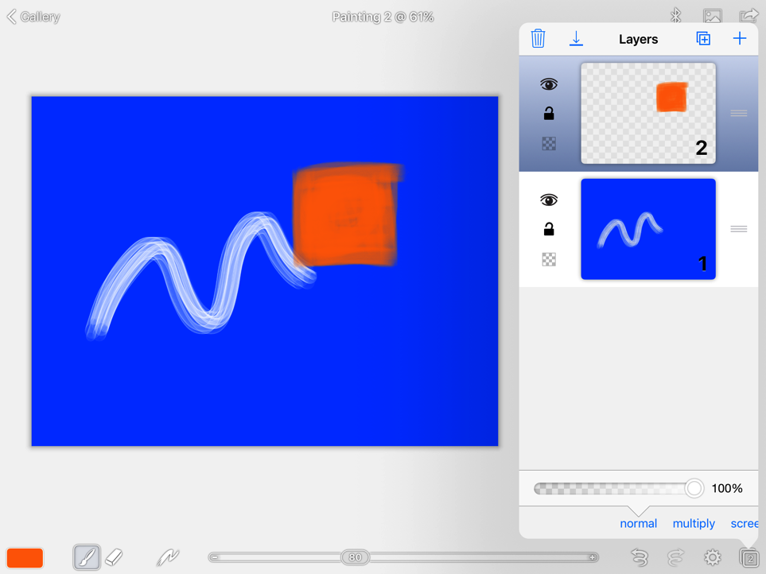
Add Layer
Brush/Eraser size slider
Tap the layers icon
Now tap the + icon on the top right of the layers window to open a new layer
Draw a shape in a different color, and reopen layers where the shape will show on the new layer

Slide 9
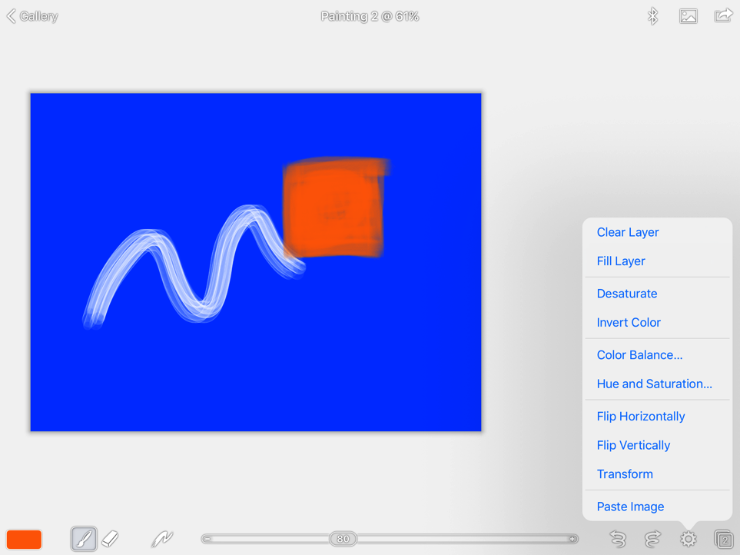
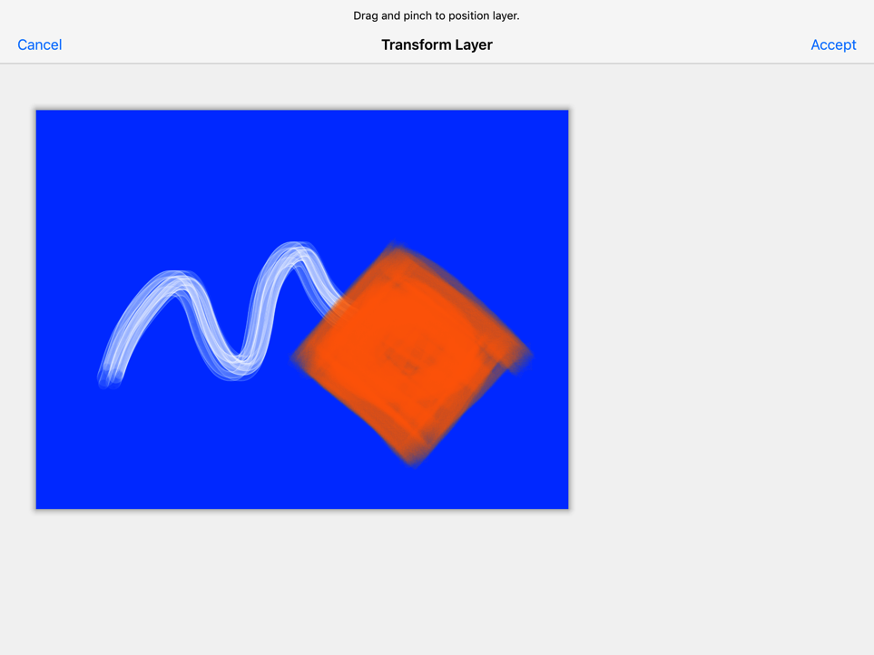
Transform
Brush/Eraser size slider
Tap the Gear Icon
Tap Transform to select the square so you can move it
Using your thumb and forefinger, make the square larger and then rotate it and place it where you want it

Slide 10
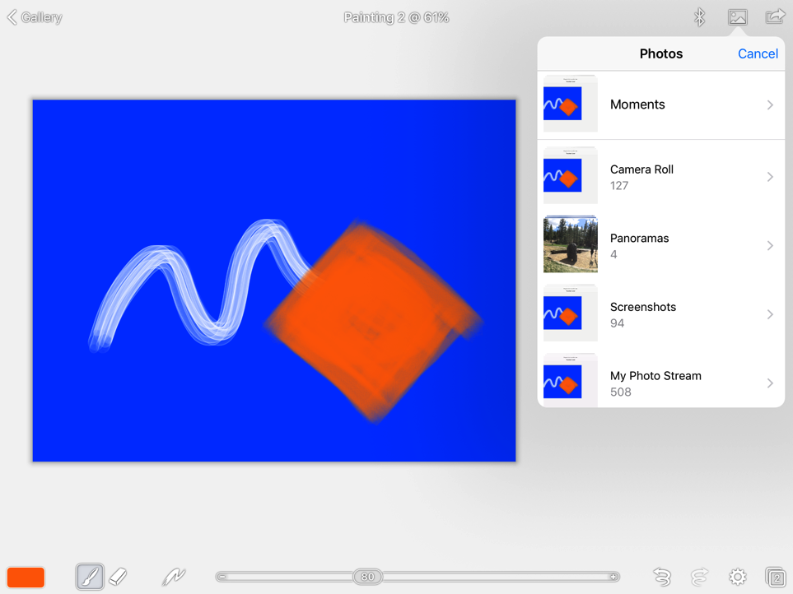
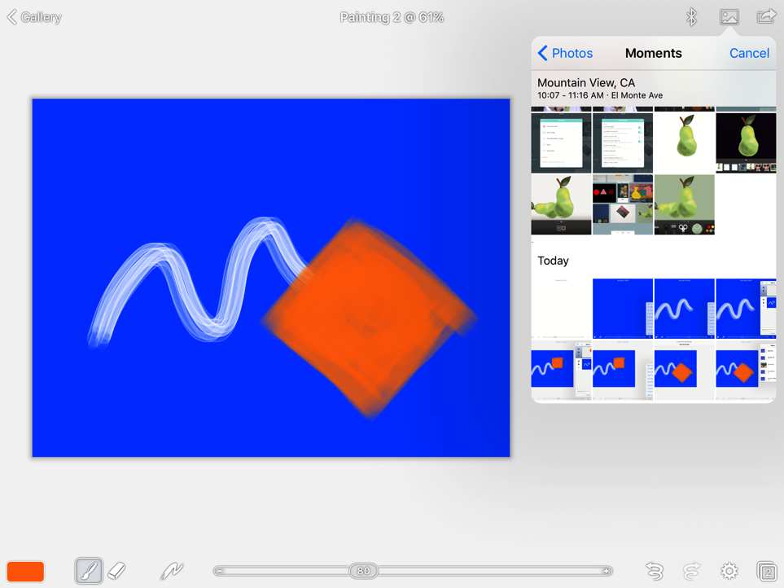
Import Image
Brush/Eraser size slider
Tap the Import image icon on the top toolbar and access your photo library
Select the photo you want to import (in this case the drawing of the pear was saved without a background)

Slide 11
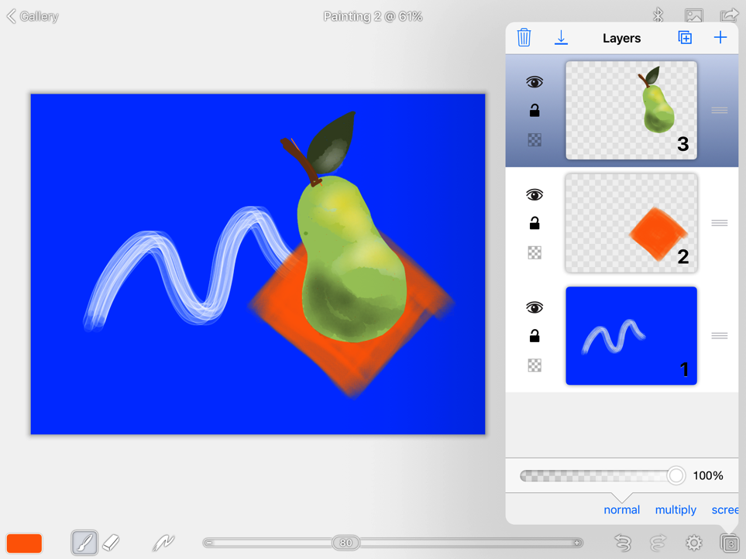
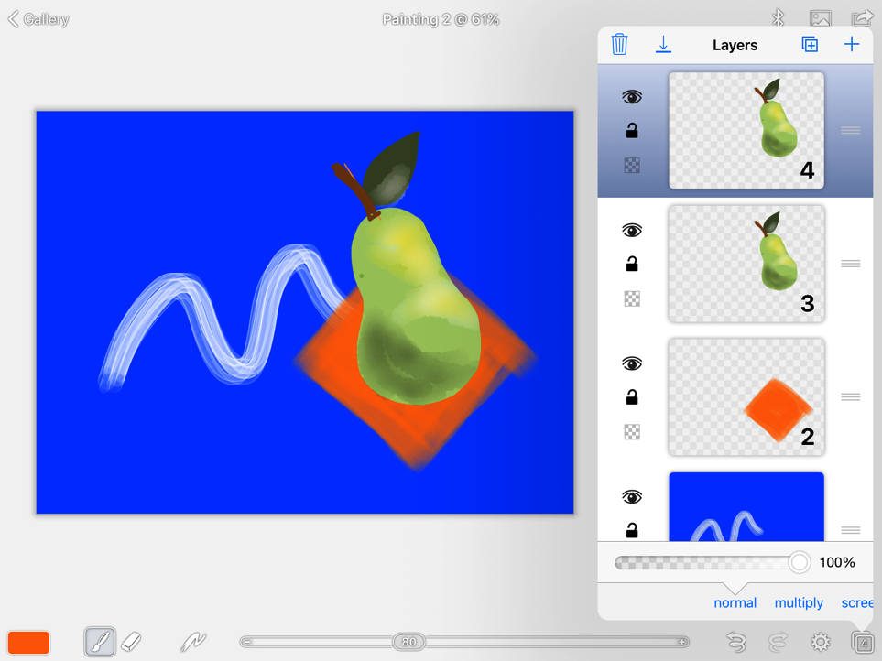
Duplicate
Duplicate Layer
Adjust imported image
Adjust and place the imported image where you want it
Open layers and tap the duplicate icon on top of the layers window to create a duplicate layer

Slide 12
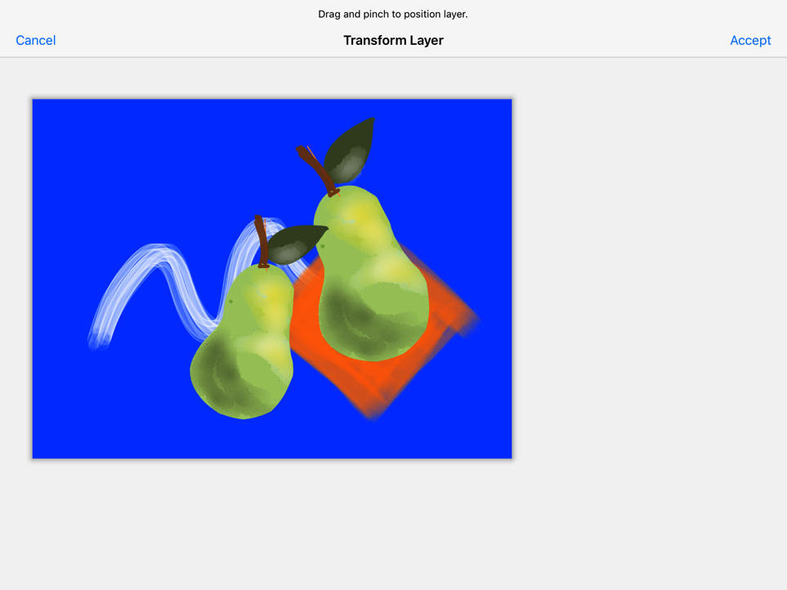
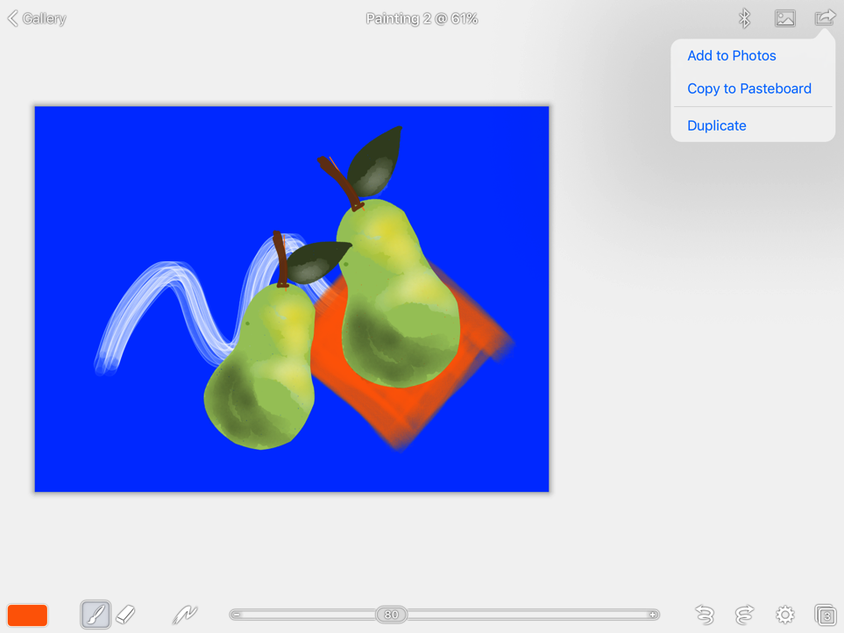
Share final painting
Tap accept when done
Share icon
Adjust duplicated layer image
Adjust the duplicated layer image and place it where you want it
Share the painting by tapping the share icon on the top right of the screen

Slide 13
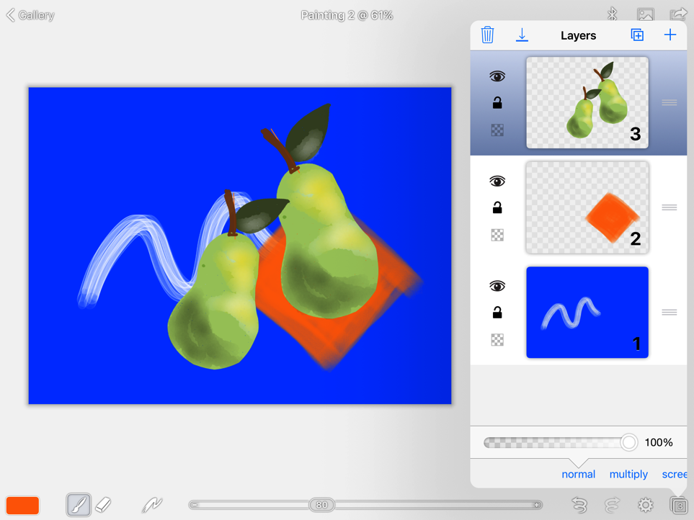
Share final painting
Tap accept when done
Merge
Adjust duplicated layer image
Adjust the duplicated layer image and place it where you want it
Share the painting by tapping the share icon on the top right of the screen

Slide 14
Share and Save
Save to
gallery
Share
Share or copy the painting by tapping the top right share icon
Save the painting to Gallery by tapping the Gallery icon at the top left

Slide 15
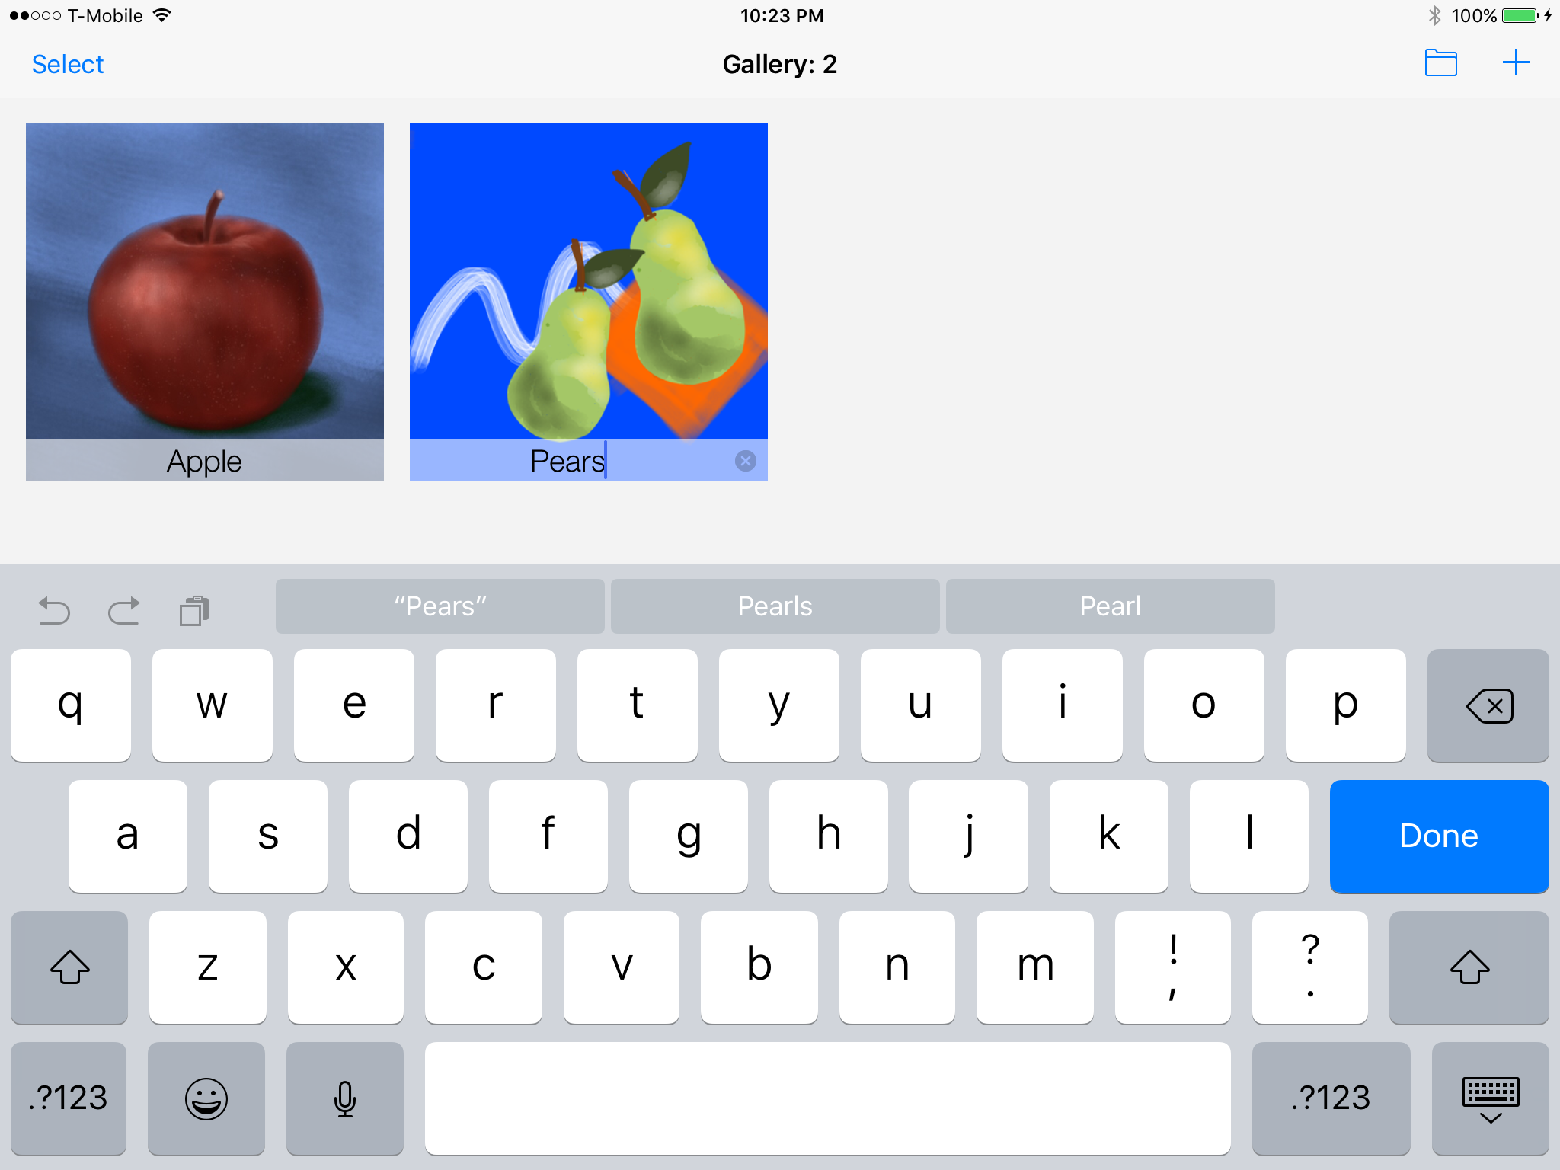
Name Painting
Tap to rename
Tap the title under the painting to rename it and then tap DONE

Slide 16
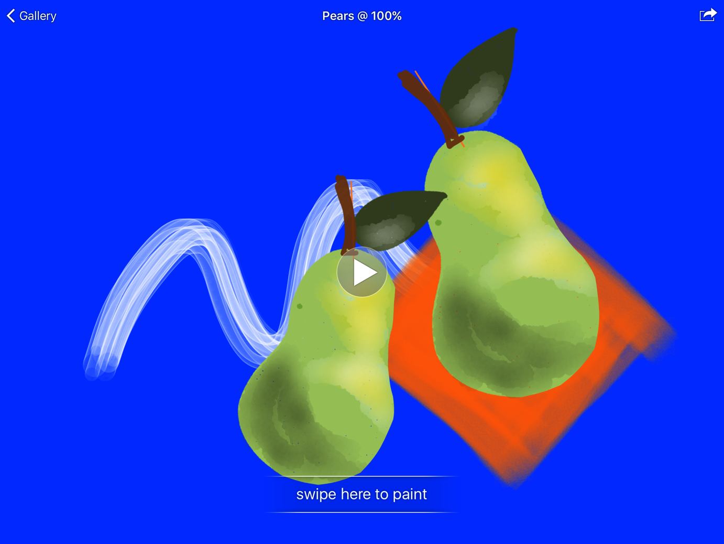
Reopen painting
Tap arrow to view video recording
If you want to do more work on the painting, just tap it in Gallery and then swipe to reopen
Note: The painting is also available as a video recording

Slide 17
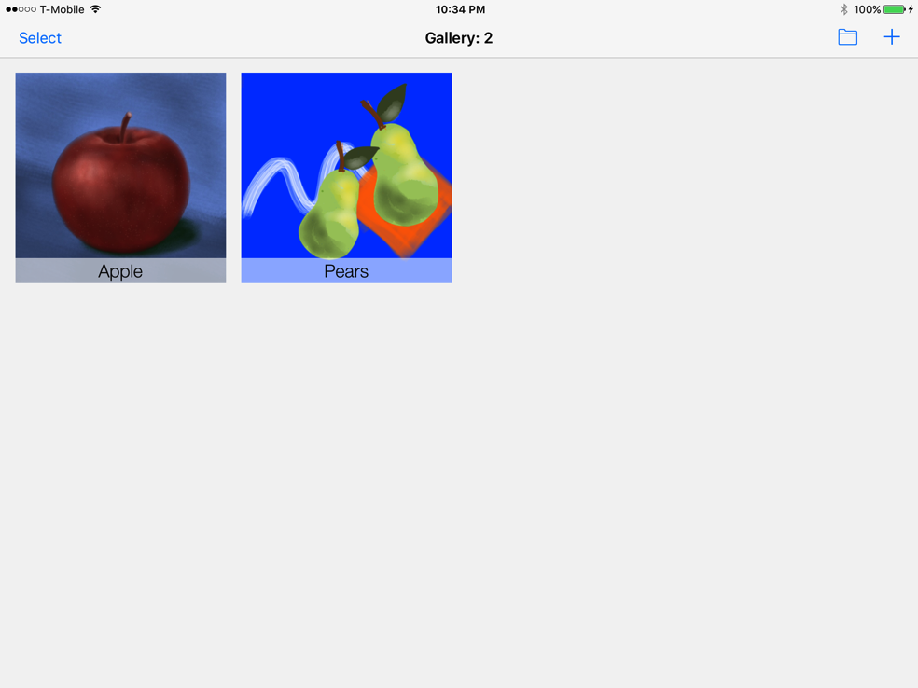
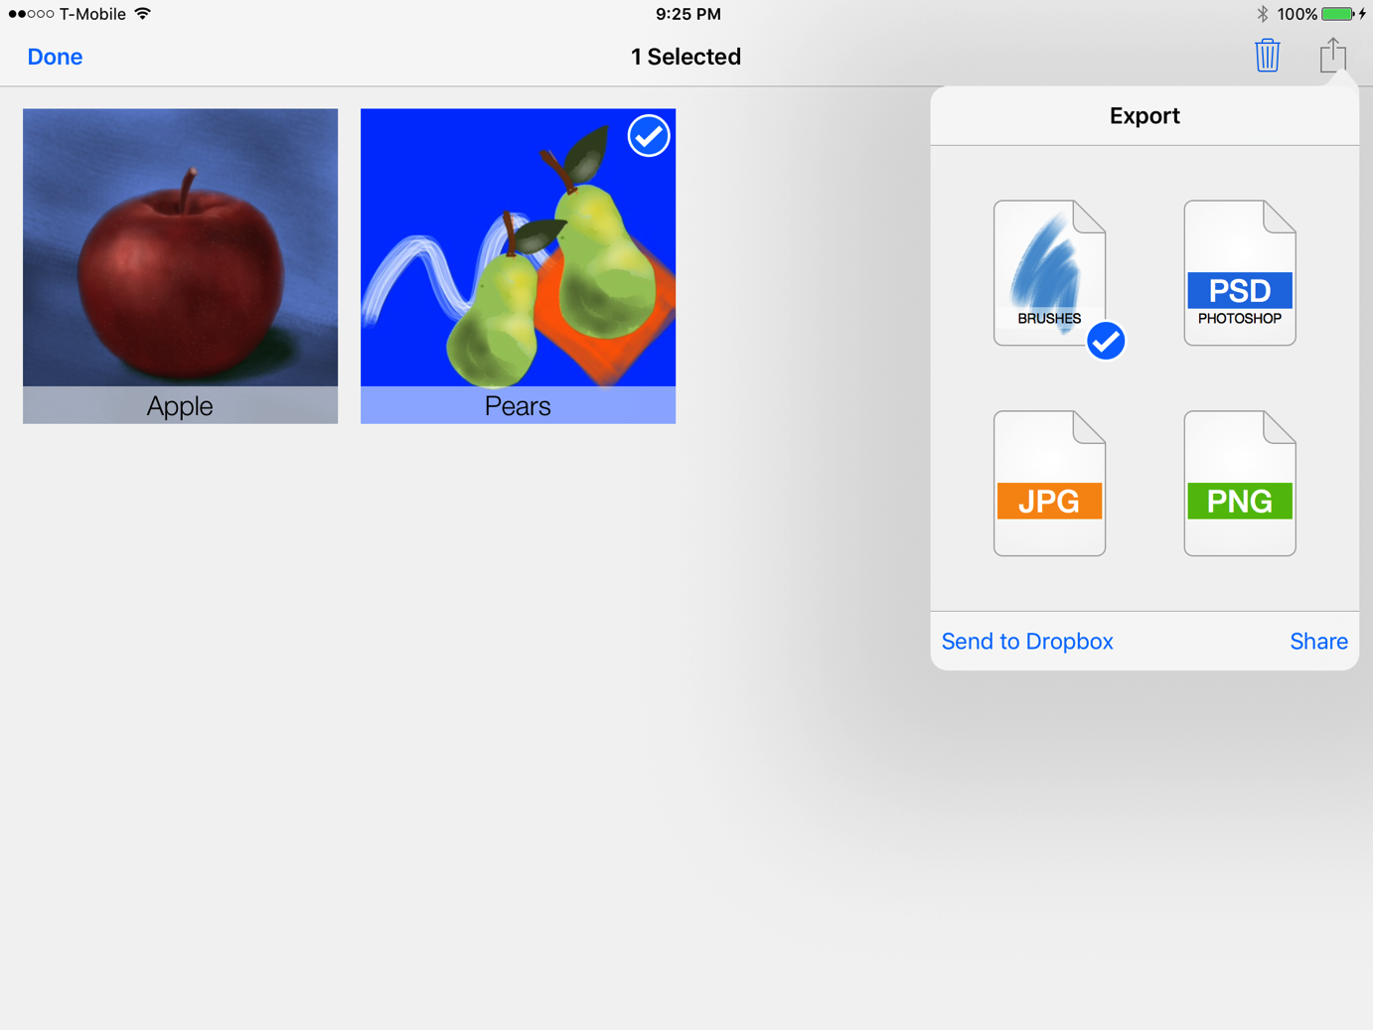
Export painting
Select button
Export formats
Share options
Tap SELECT at the top left of the screen and then tap the painting you want to export
Tap the export icon at the top right and select the format you want to use to share or save to Dropbox
Tap DONE to deselect the painting in the gallery

Slide 18
More Information
If you want to learn more about Brushes Redux then you can access different online videos by searching Google.
To learn other apps, visit www.mobileart.how where you can enroll on our online classes. Just request help from support@artinaction.org

