Slide 1
Quick Look
Adobe Draw
instructions
Prepared for Art in Action by

Slide 2
Table of contents
Opening the app 3
Project management 4
Open a new page 5
Tool bars 6
Brush size & opacity 7
Select brush color 8
Select and save palette 9
Change brush shape 10
Create a shape 11
Fill a shape 12
Add a layer & new shape 13
Import a photo 14
Use the blend tool 15
Share artwork 16
Adjust settings 17
© 2017 MOBILE ART ACADEMY

Slide 3
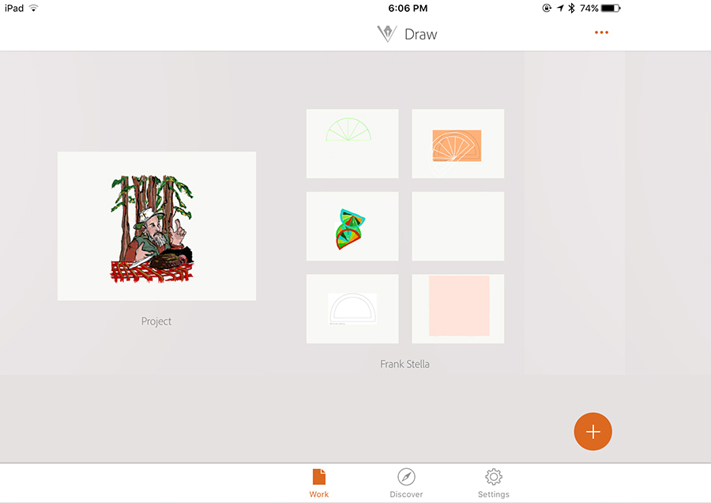
Opening the app
Project environment
Open the app and you will see all your current projects and any sketches within that project
Each project can contain several drawings
Two Projects
Select Projects
Choose a New Format for a New Sketch/Project
© 2017 MOBILE ART ACADEMY

Slide 4
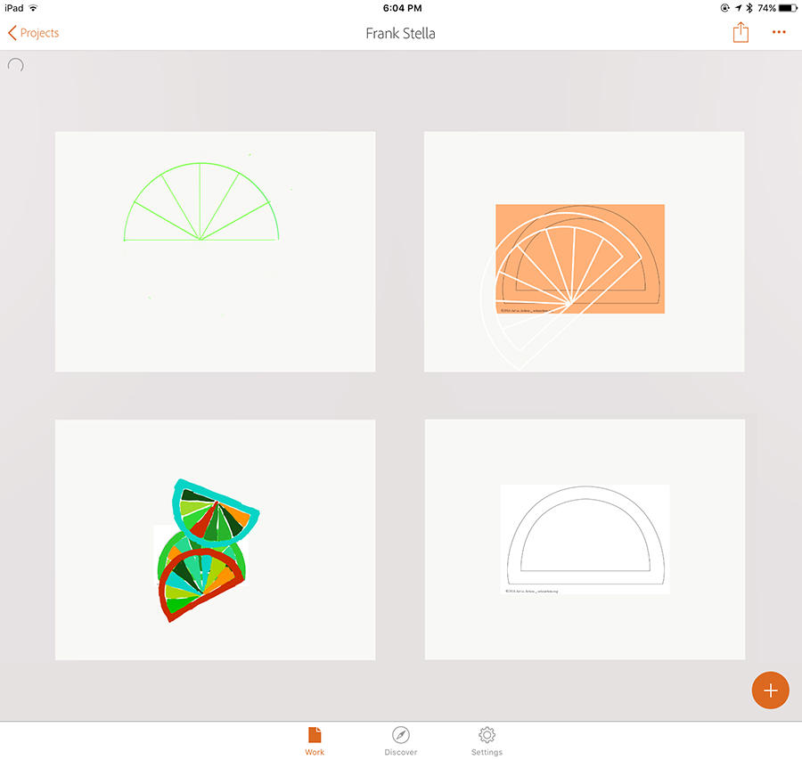
Project management
File Name
Share
You can Share, Select Documents, Rename Project, Duplicate Project and Delete a whole project or Select one or more drawings in the project to edit or trash
Select Documents
Rename Project
Duplicate Project
Delete Project
Choose a New Format for a New Sketch/Project
Explore Online
Preferences, etc.
© 2017 MOBILE ART ACADEMY

Slide 5
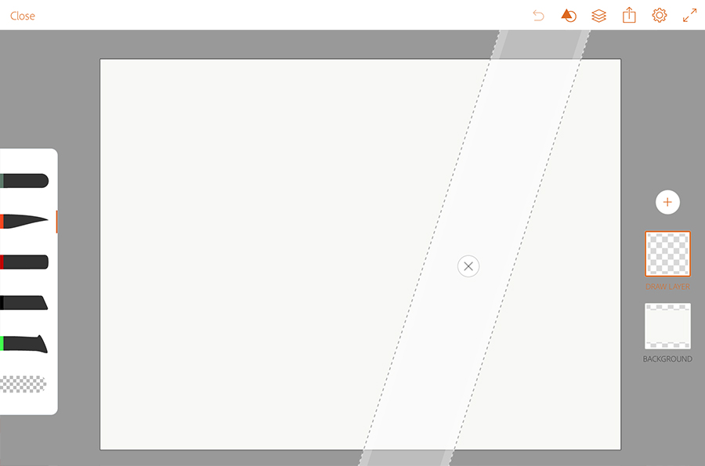
Create a new sketch
Create a new Sketch and this will open a new drawing
“Pinch” two fingers together so you will see the boundaries of your art board for your drawing
Also you will notice that a “ruler” appears
You may delete it or move it around to where you want it
The tool you select will draw against the side of the ruler for drawing straight lines
Tap “x” to remove ruler
© 2017 MOBILE ART ACADEMY

Slide 6
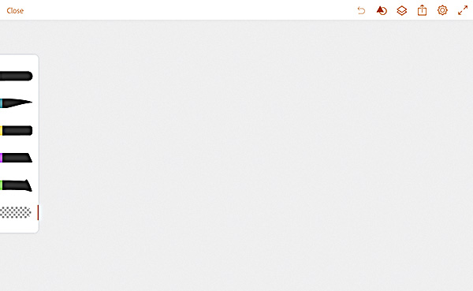
Toolbars
Hide toolbar
Close and save
Undo/redo
Shapes
Layers
Export/Share
Settings
Add layer
Five brushes
Eraser
© 2017 MOBILE ART ACADEMY

Slide 7
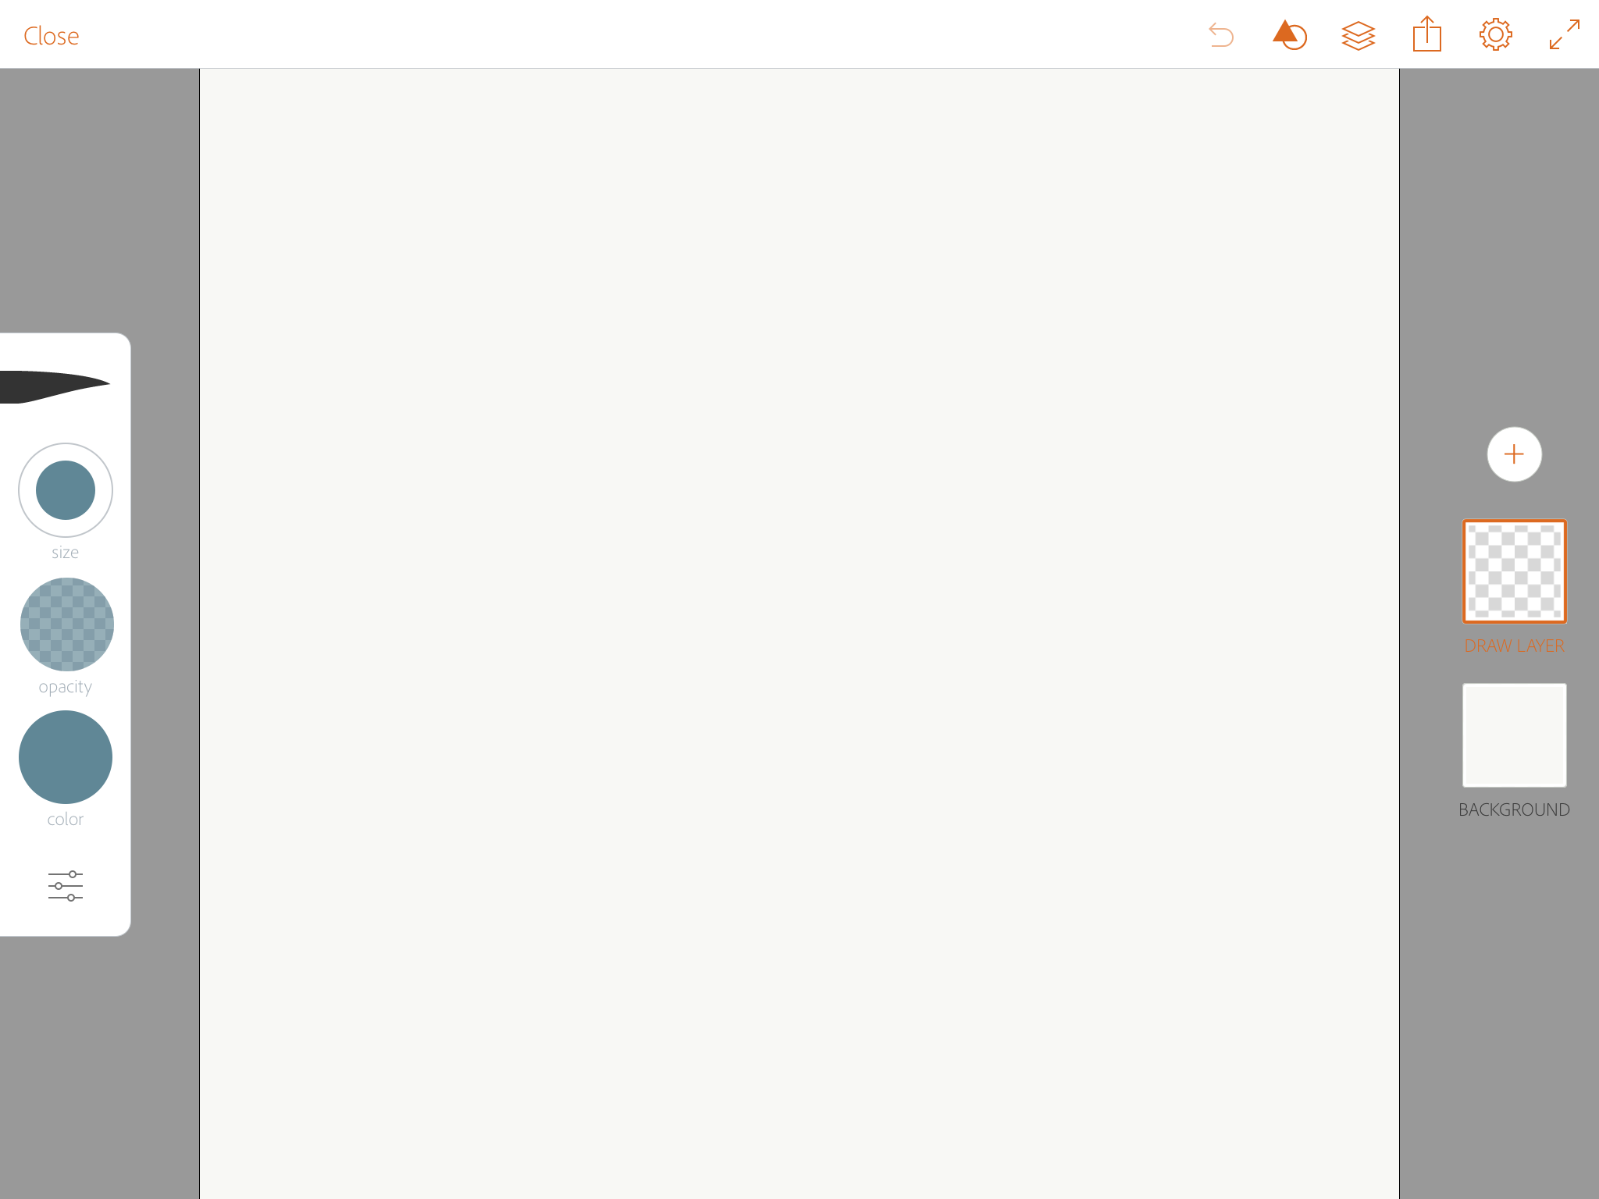
Brush SIZE & OPACITY
Tap one of the brushes and swipe up and down over the top circle to adjust SIZE
Then swipe up and down over the middle circle to adjust OPACITY
This is the same for all five brushes
Now tap the lower circle to access the color picker
© 2017 MOBILE ART ACADEMY

Slide 8
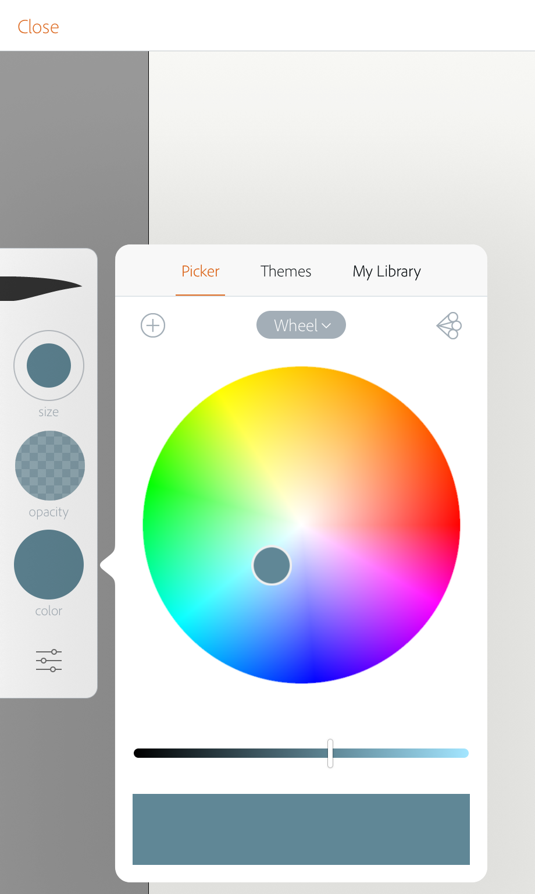
Select brush color
There are several ways to select color
The first is the color picker
Tap the color you want on the wheel
Move the inner button to the inside of the circle to desaturate the color (make it whiter)
Move the brightness slider to the left to make color darker
This box shows how the color will look
Tap this button to see further things you can do with your color picker
© 2017 MOBILE ART ACADEMY

Slide 9
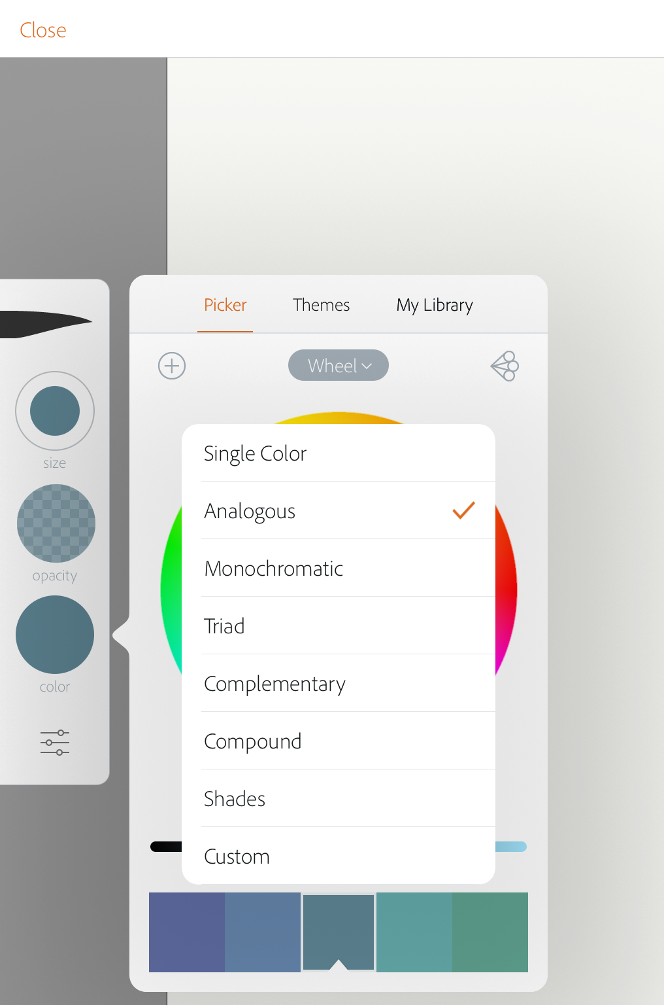
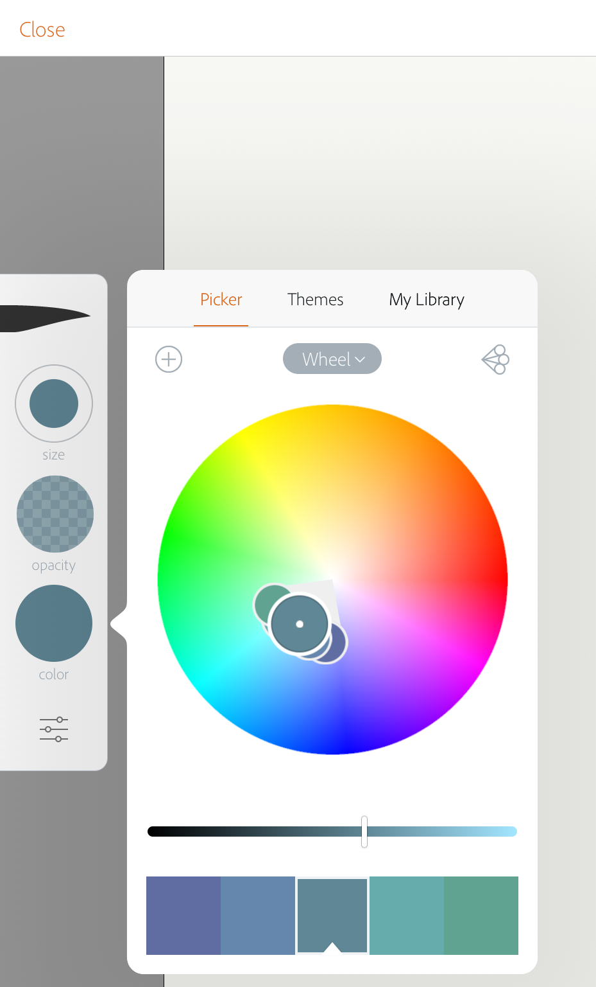
Select & save palette
Tap this button and save the 5-color palette to My Library so you can use it
This menu allows you to select different color harmonies which will automatically select them based on your initial selected color (we selected analogous)
This gives you a THEME of five harmonious colors you can use in your painting
© 2017 MOBILE ART ACADEMY

Slide 10
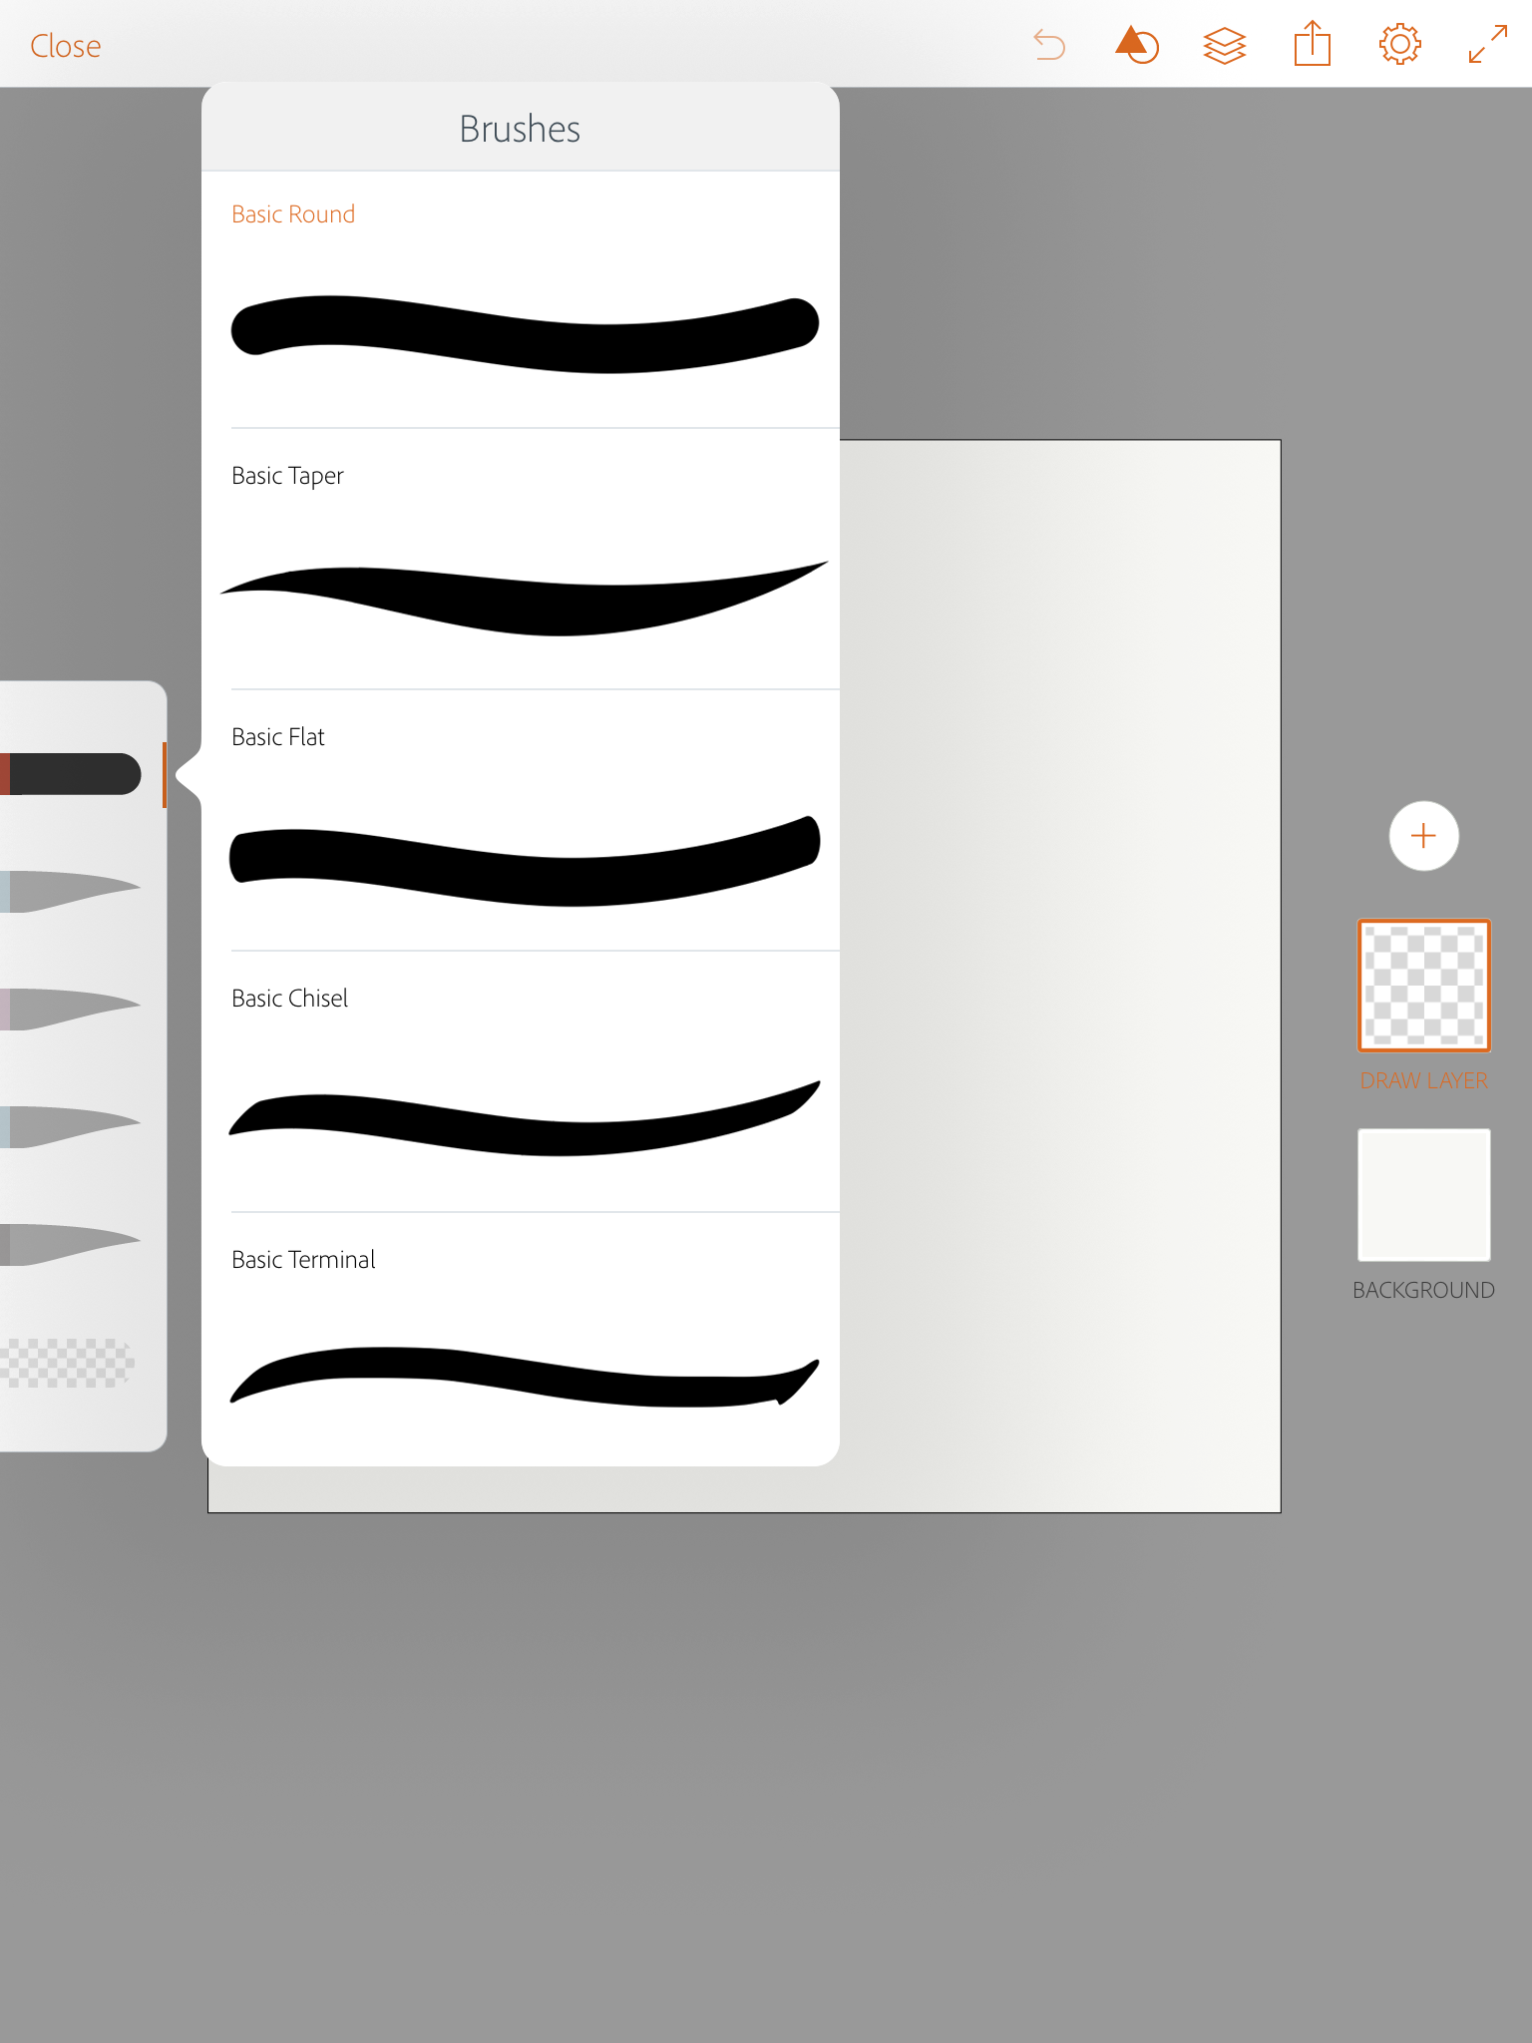
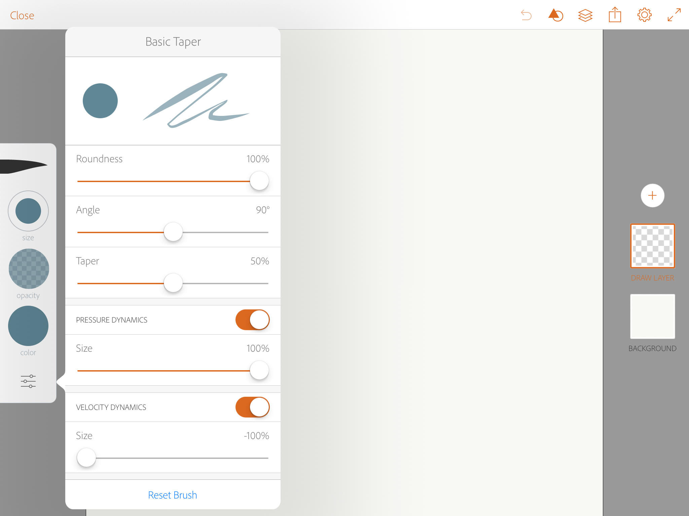
Change brush shape
You can change the shape of the brush you are using to one of the five different shapes
You can also tap the three lines at the bottom of the brush tool bar and change the dynamics of the brush shape to match what you want
© 2017 MOBILE ART ACADEMY

Slide 11
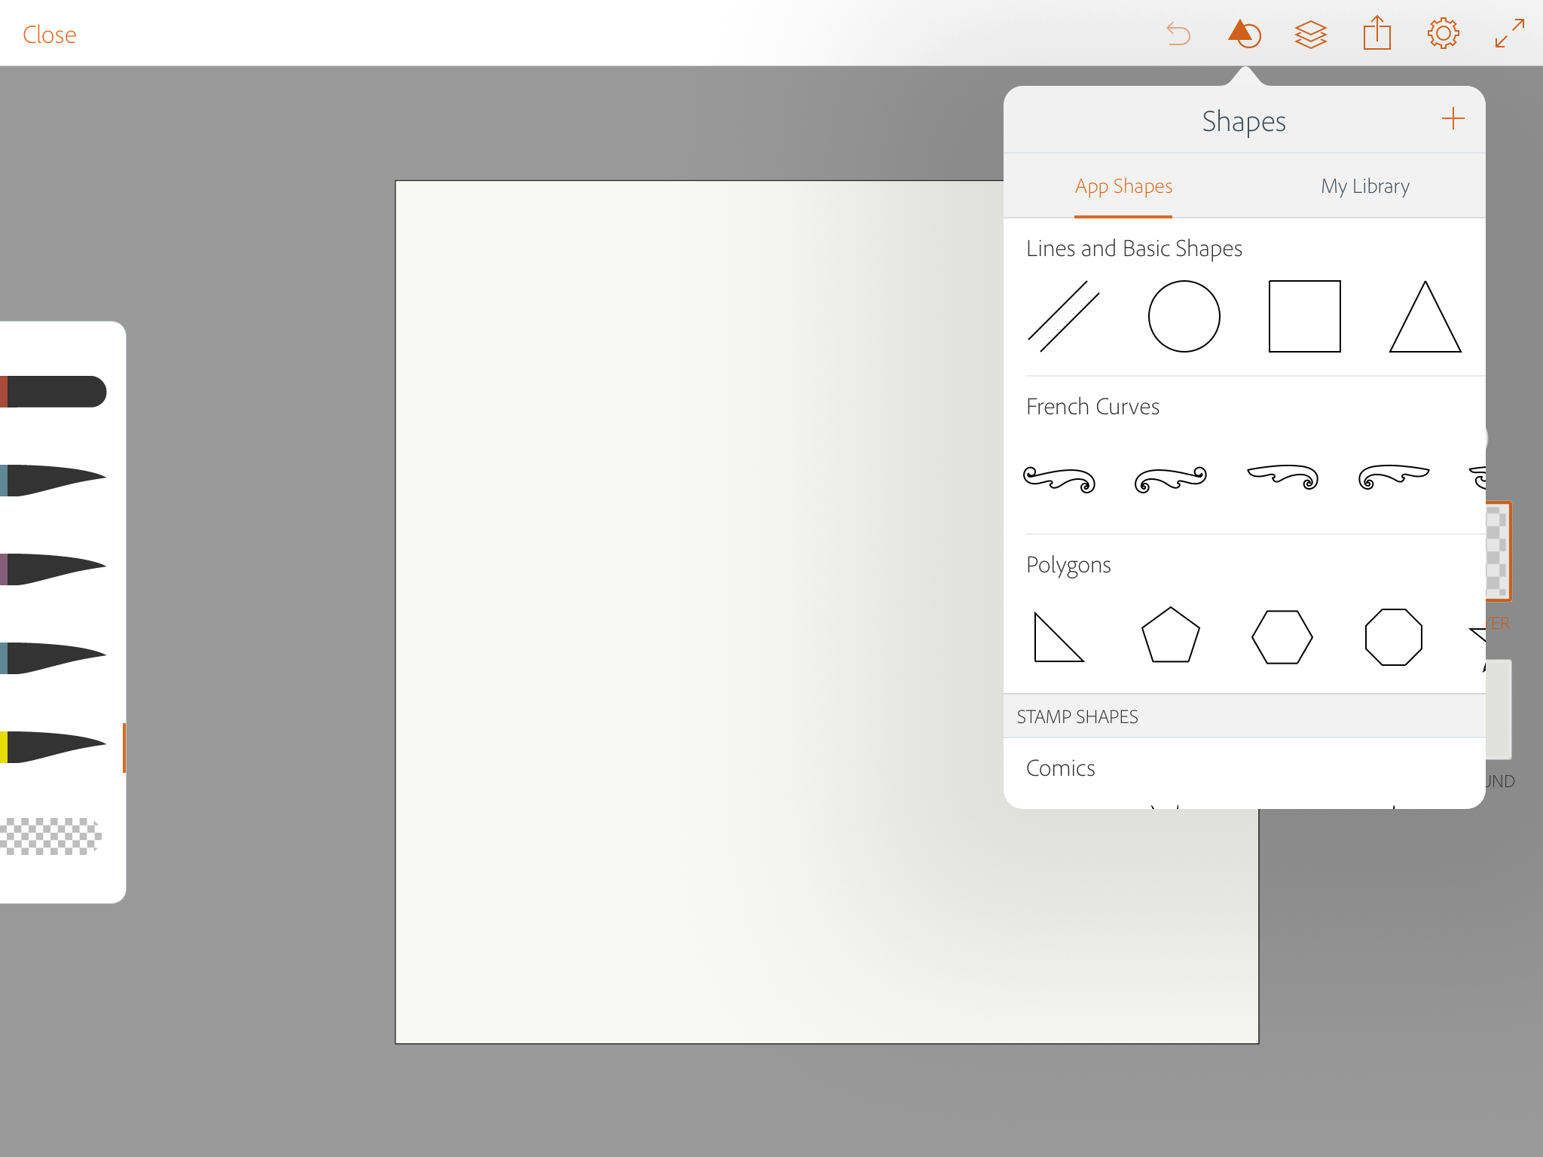
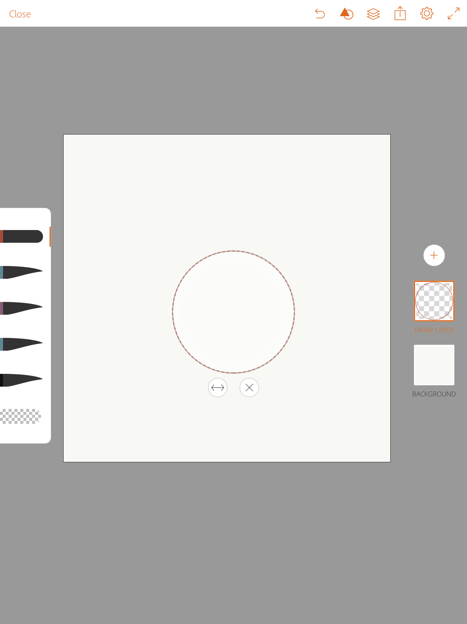
Create a shape
Tap the Shape icon on the top toolbar and select the shape you want
Select a brush and draw around the shape
Tap (x) to make the shape template disappear
© 2017 MOBILE ART ACADEMY

Slide 12
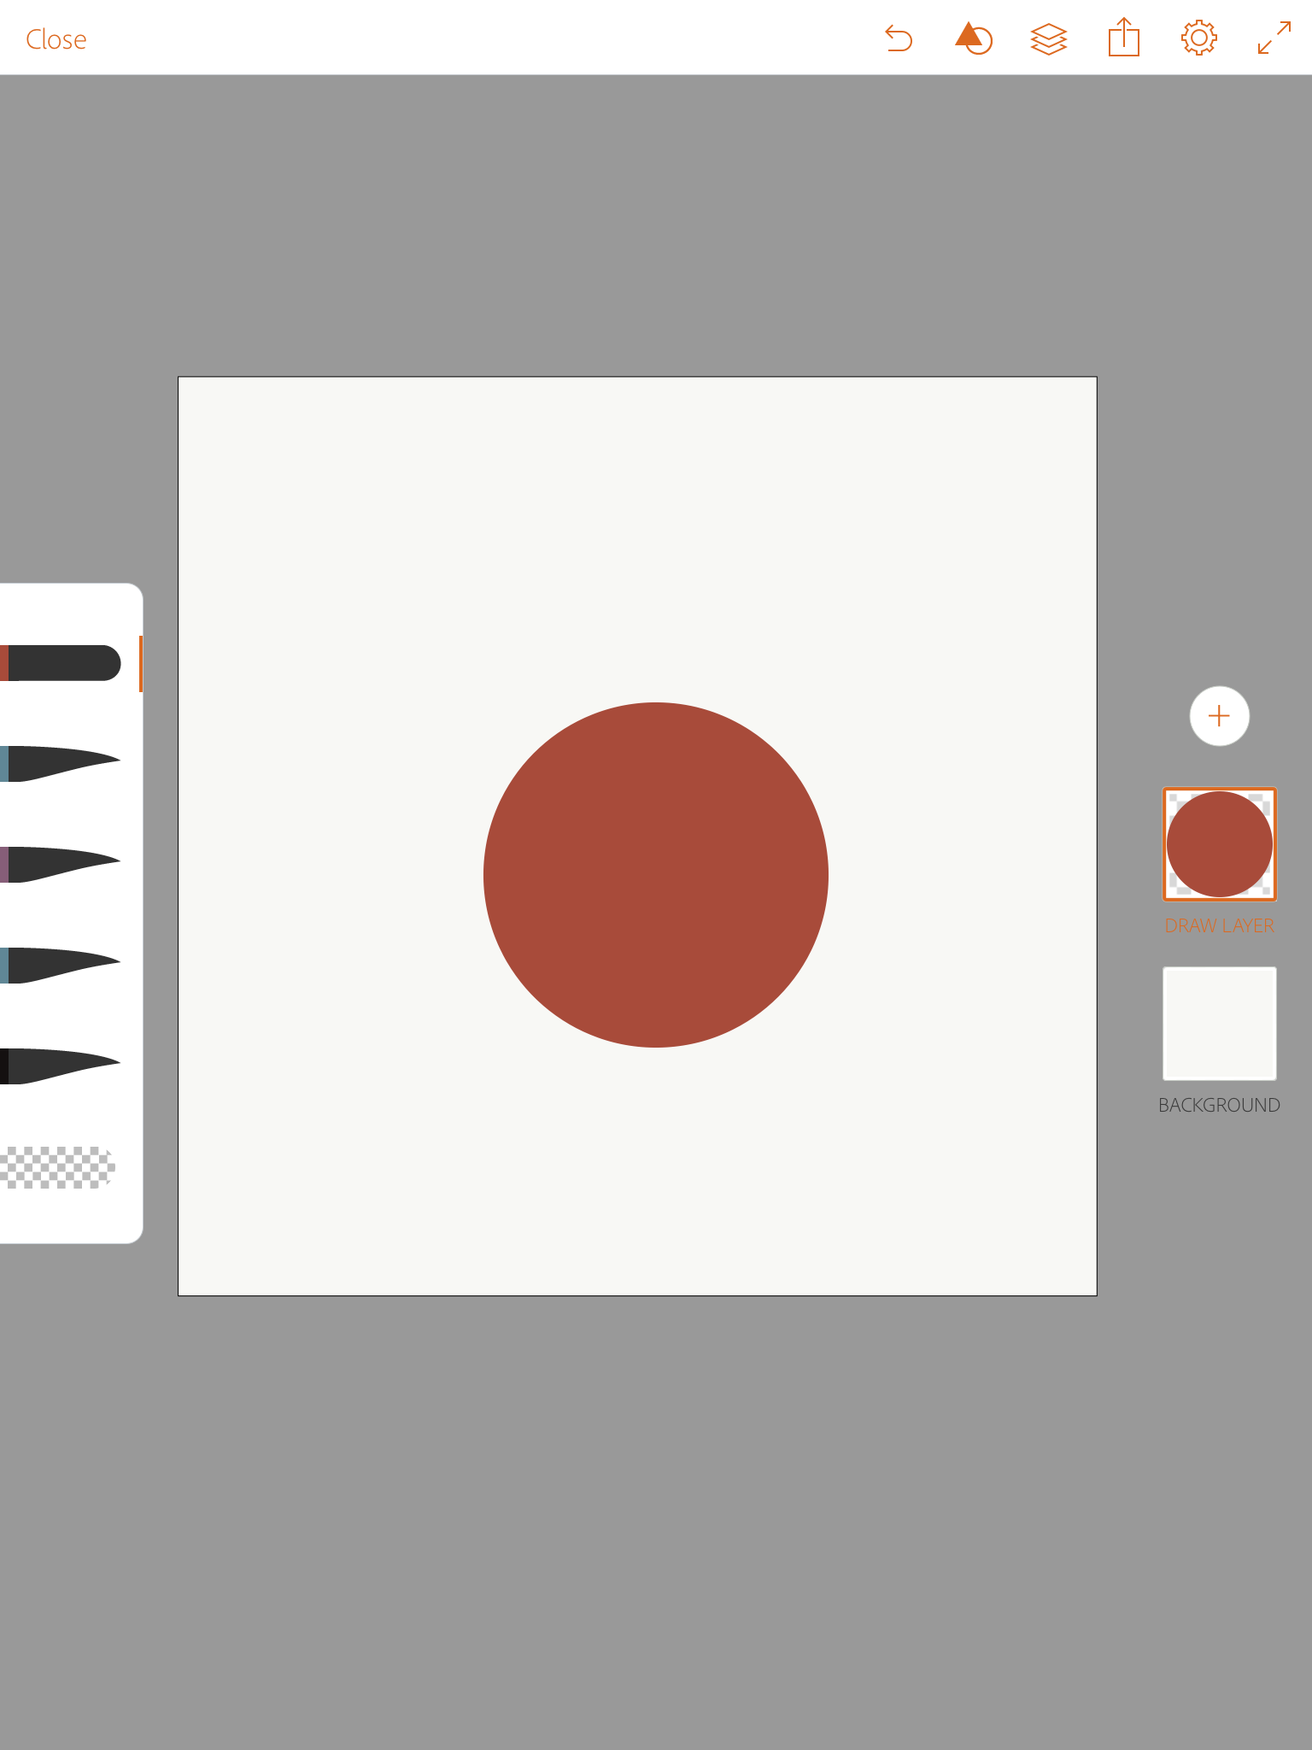
Fill A shape
Put the color you want on your brush, then tap and hold the middle of the shape and it will automatically fill with the color
© 2017 MOBILE ART ACADEMY

Slide 13
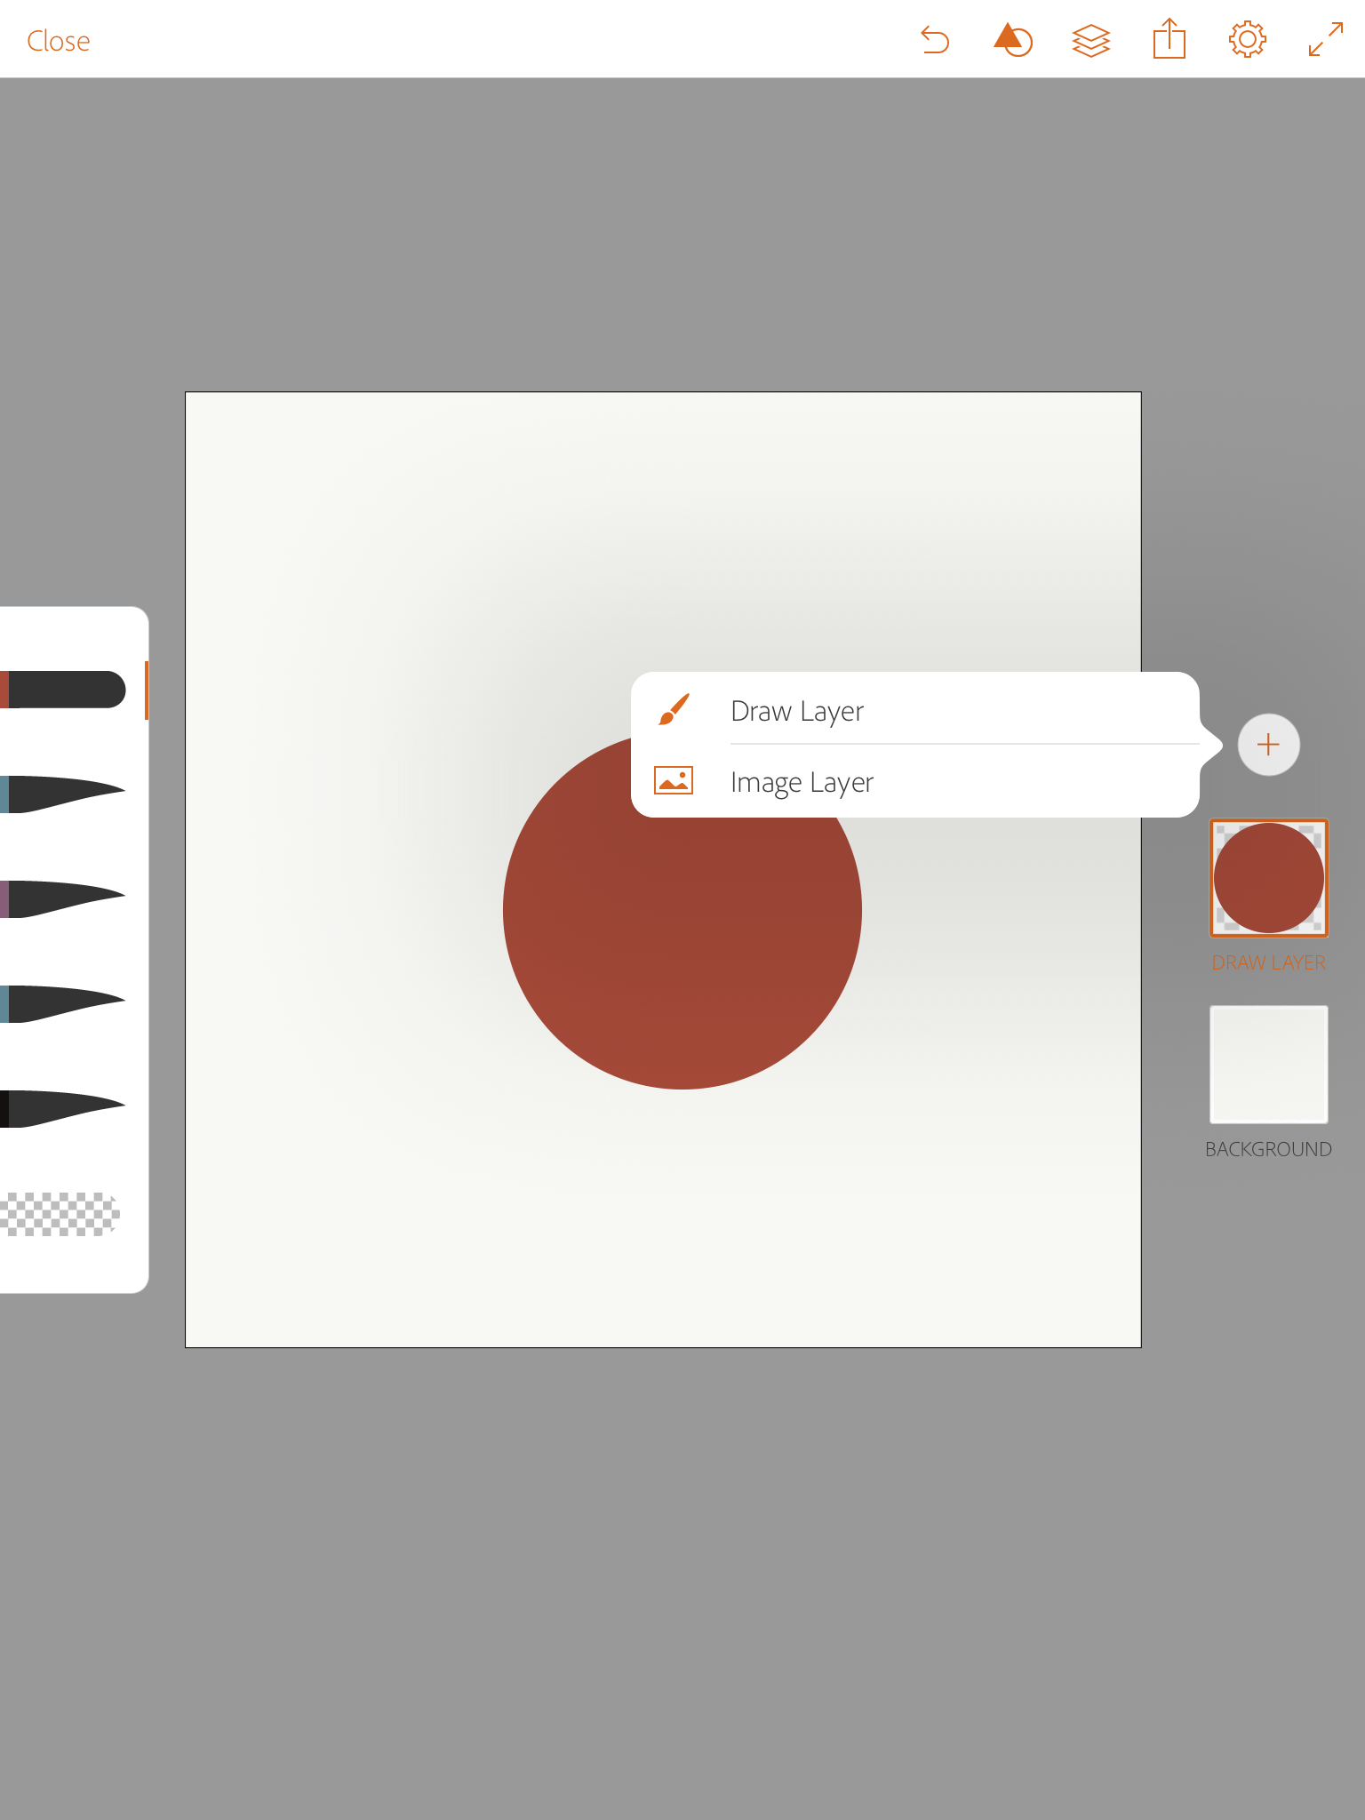
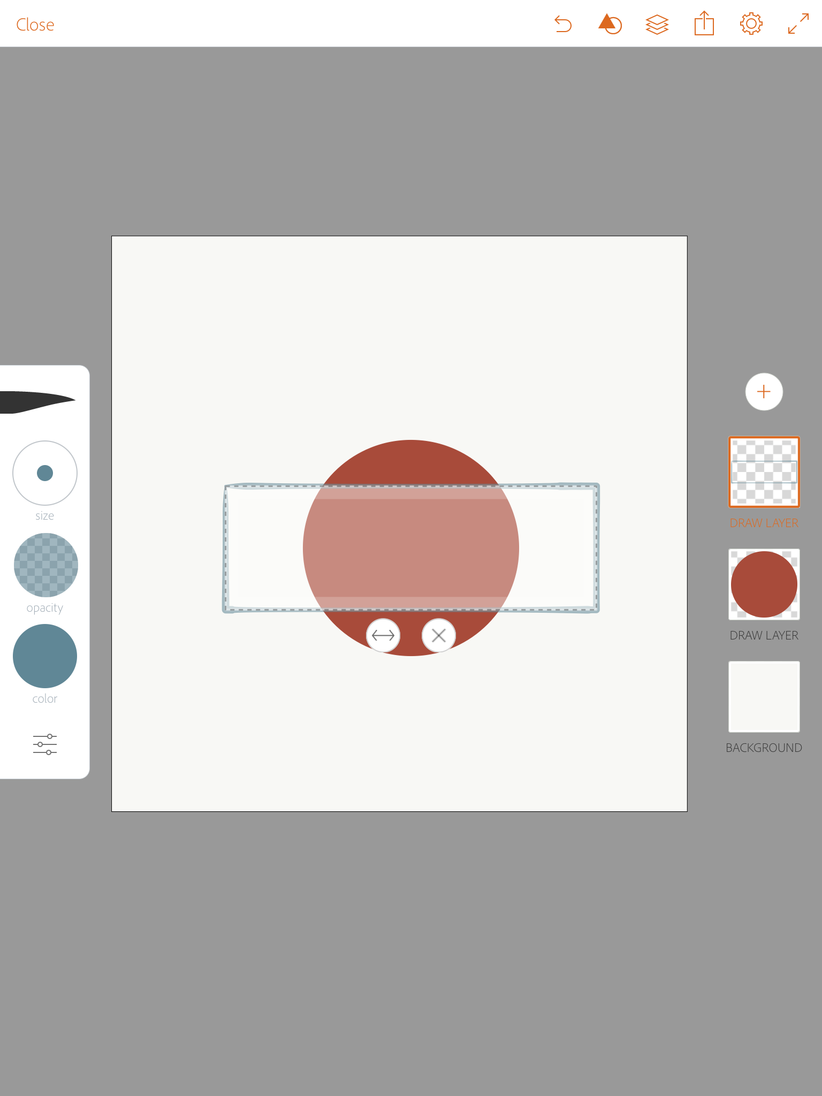
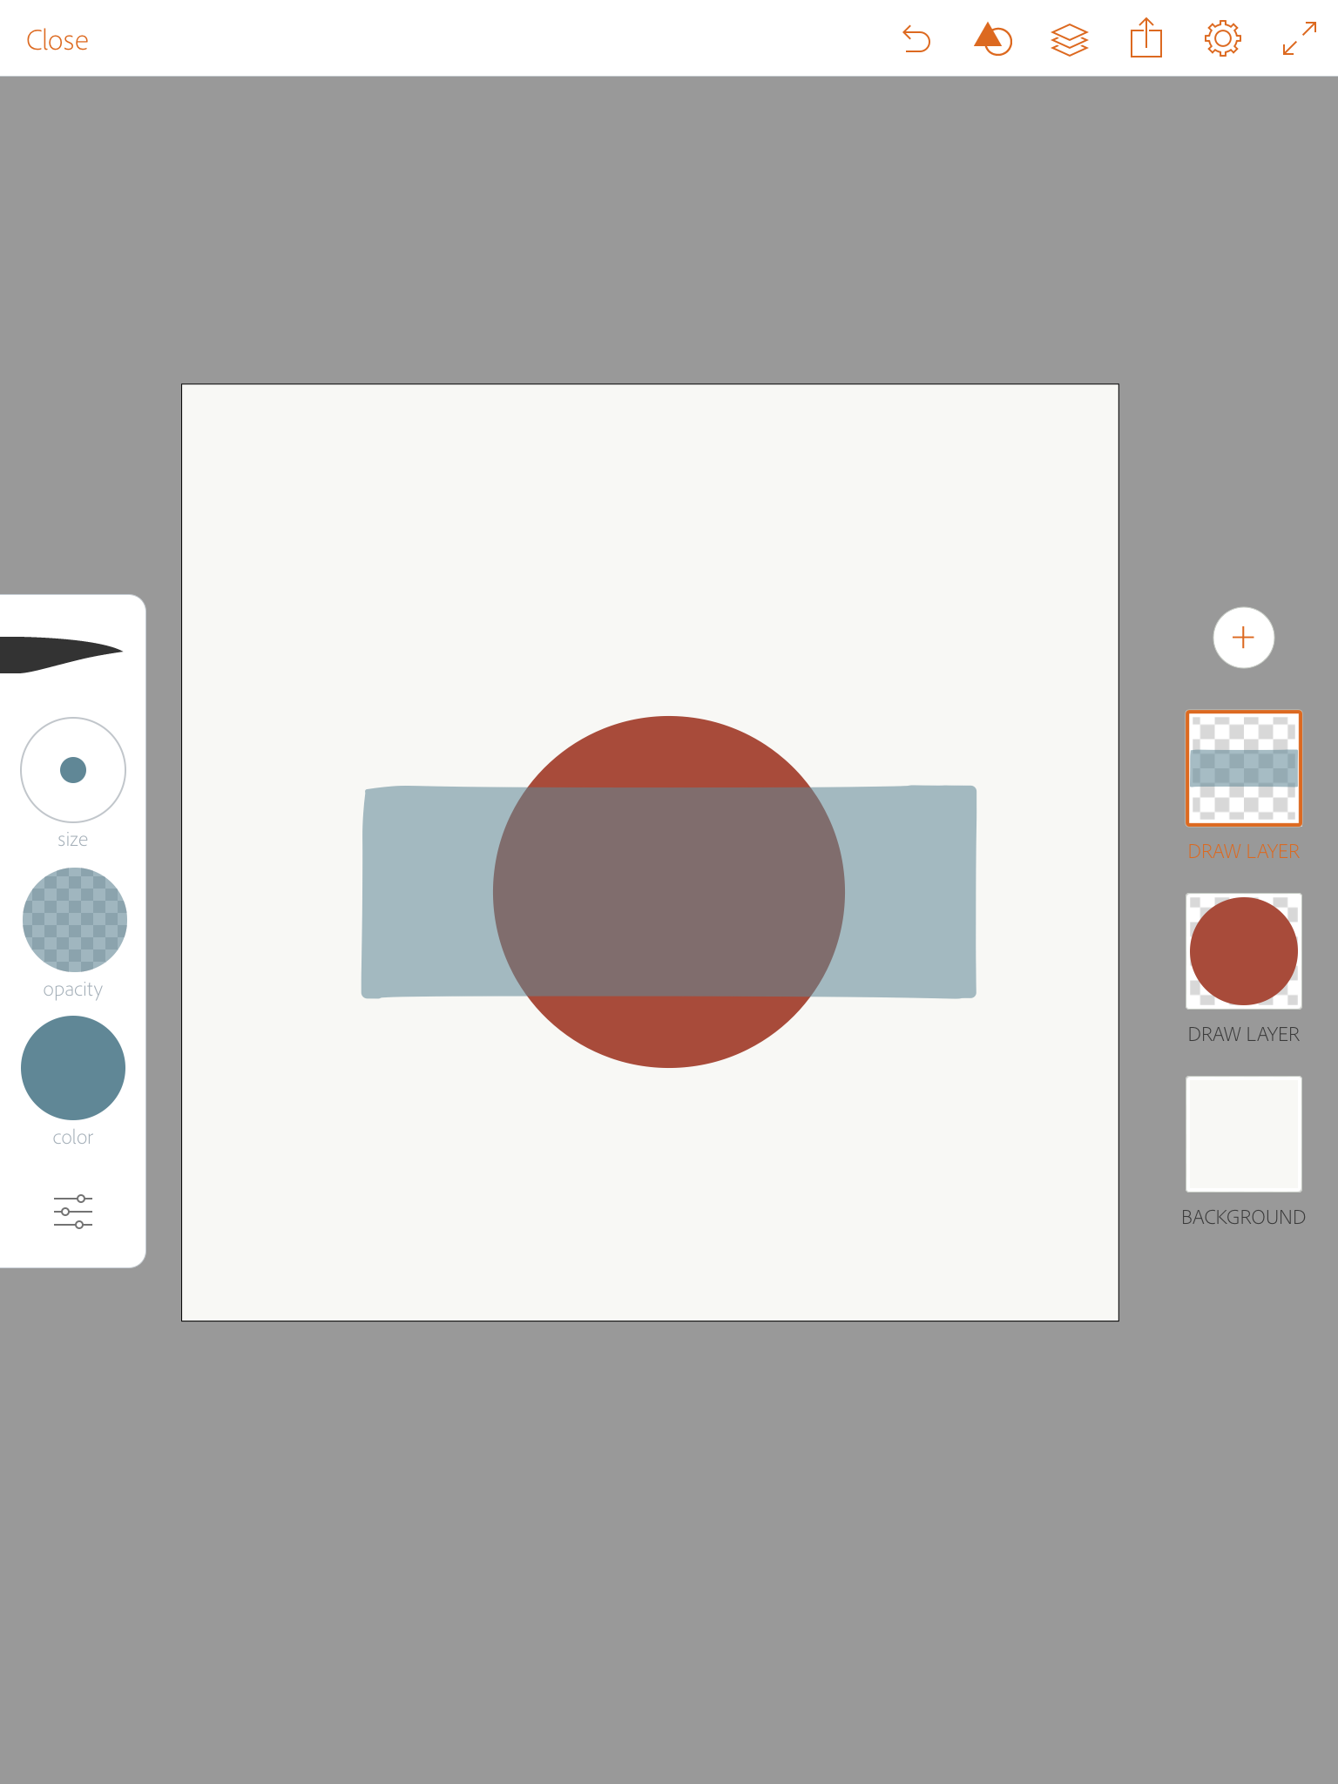
Add a layer & a new shape
Tap the + at the top of the layers bar and tap Draw Layer to open a new layer
Select square from the shape menu and adjust it to make it oblong
Select a new color and lower opacity and fill the new shape by tapping it
© 2017 MOBILE ART ACADEMY

Slide 14
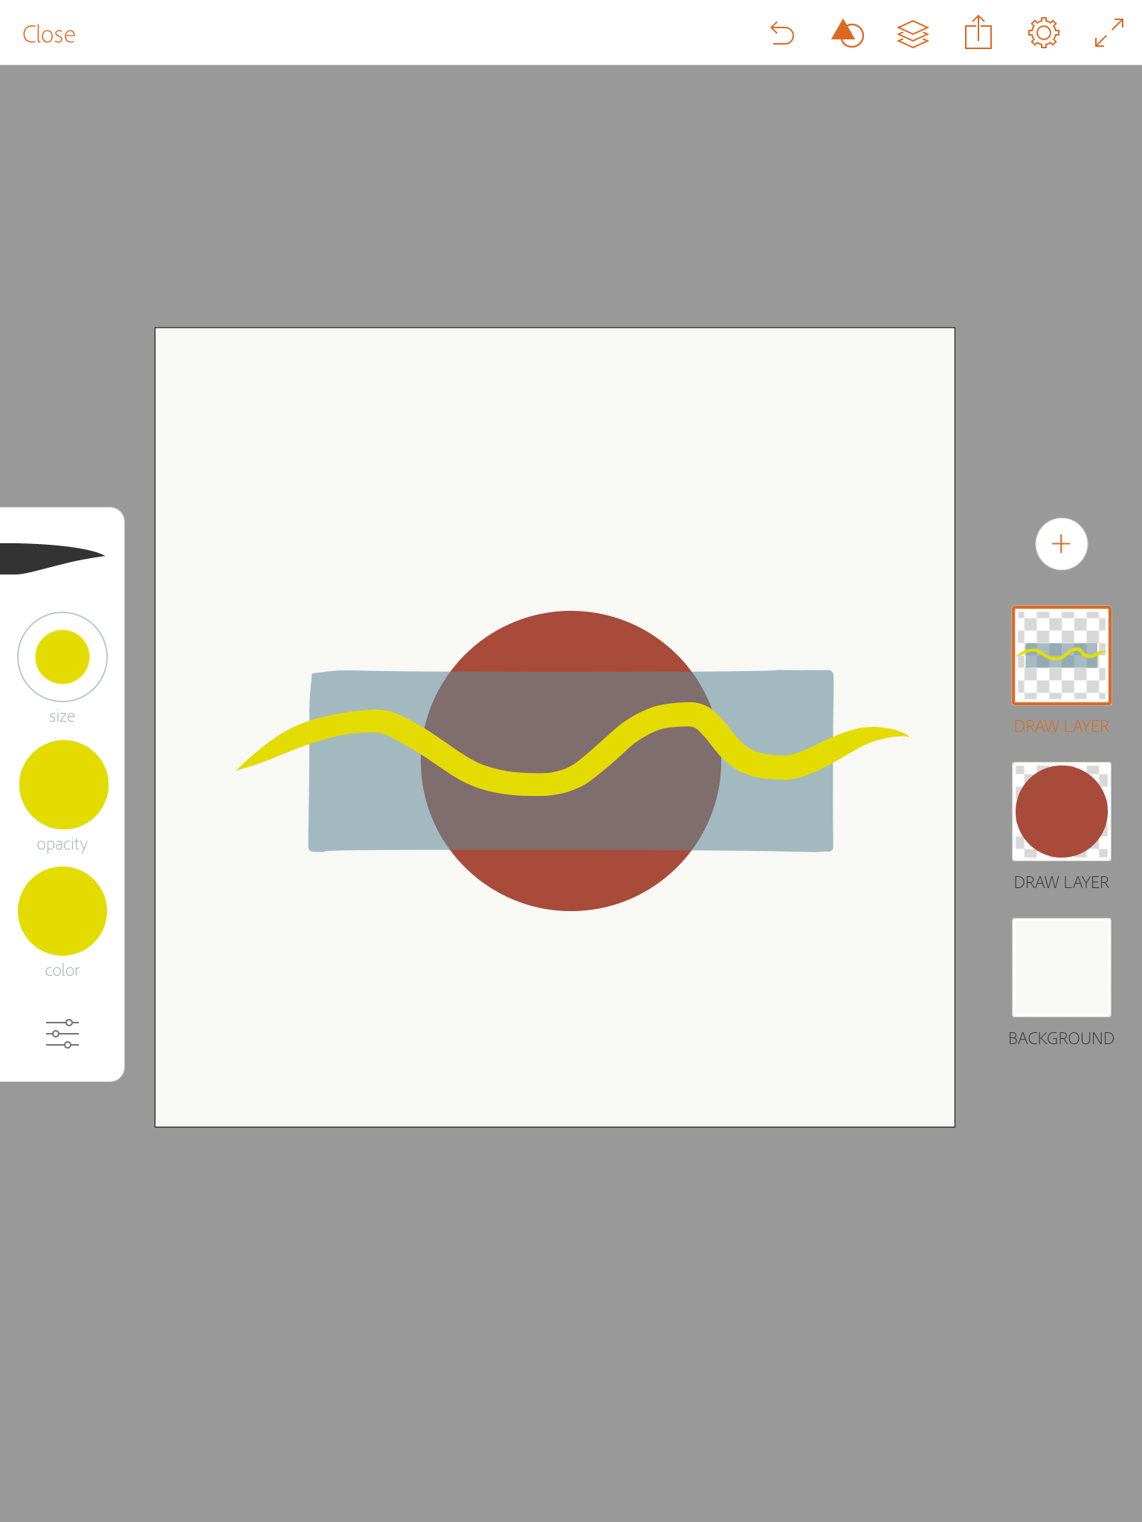
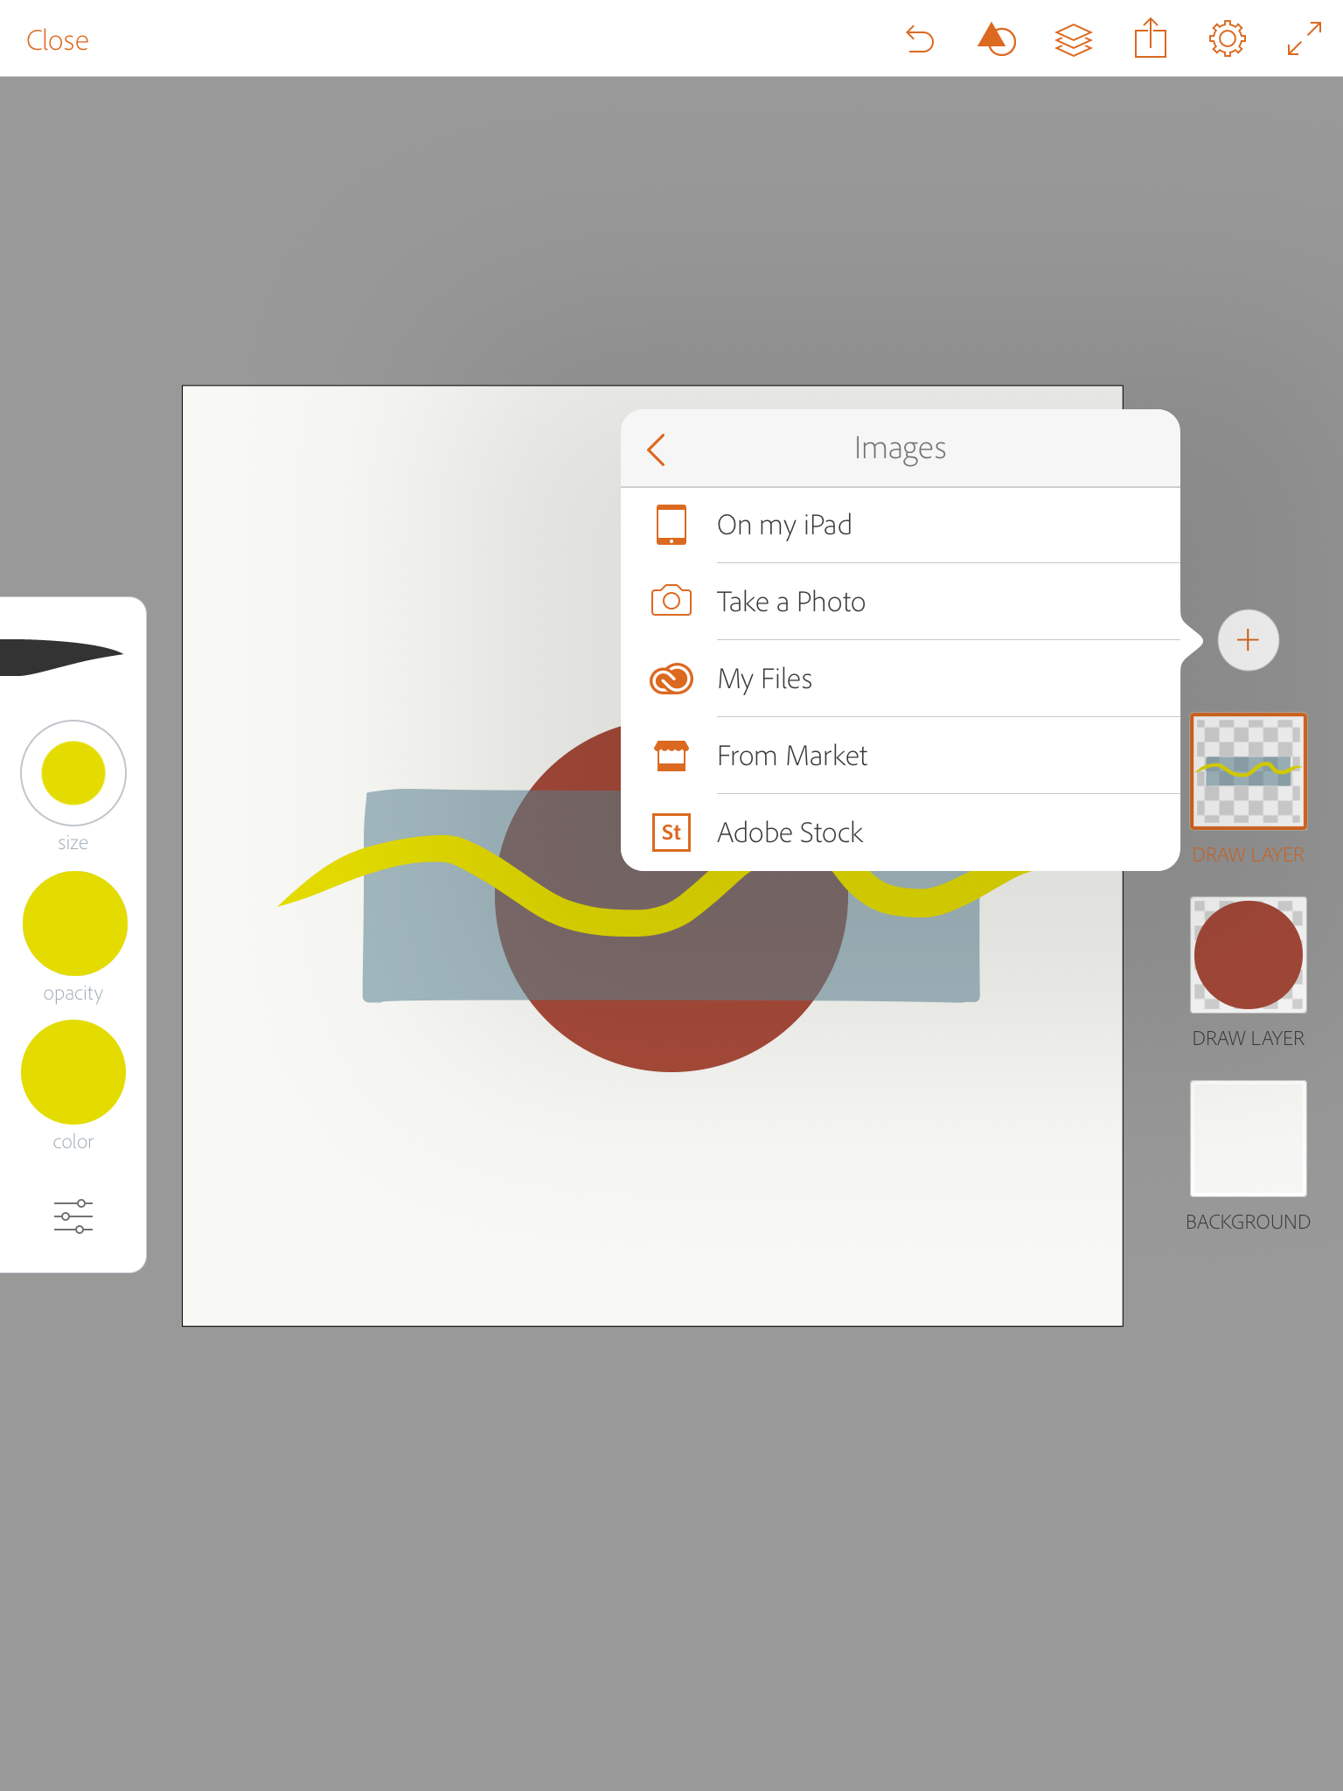
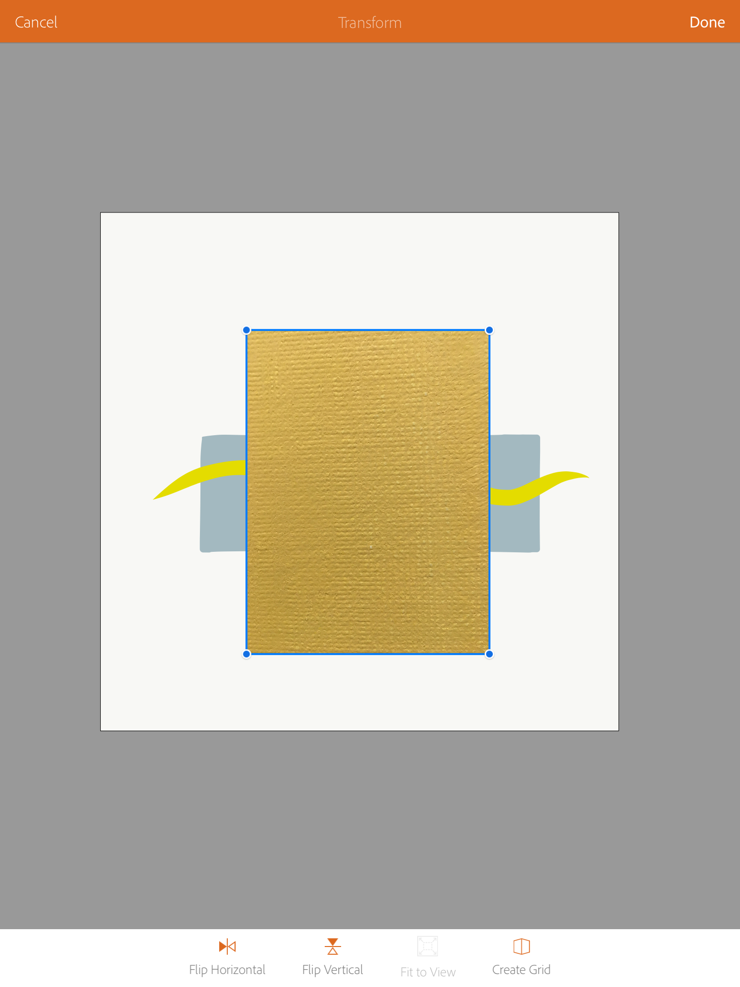
Import a photo
Use a pen to draw over top of the oblong shape
Open new layer and tap Image Layer, then select ON MY iPAD to import a photo from your camera roll
Import a photo and adjust its size
© 2017 MOBILE ART ACADEMY

Slide 15
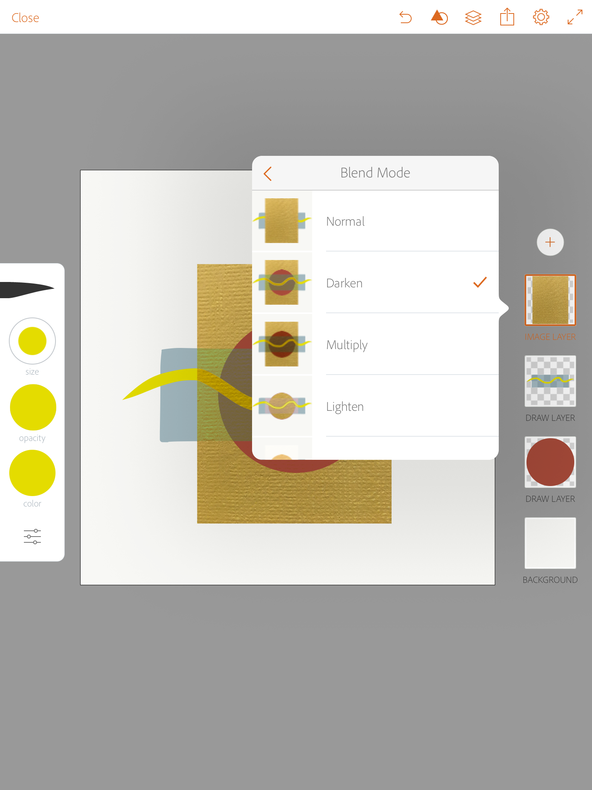
use the blend tool
Tap the photo layer and select BLEND on the menu window, then select a blend you like
Note that the menu gives you a preview of how the blend will look
© 2017 MOBILE ART ACADEMY

Slide 16
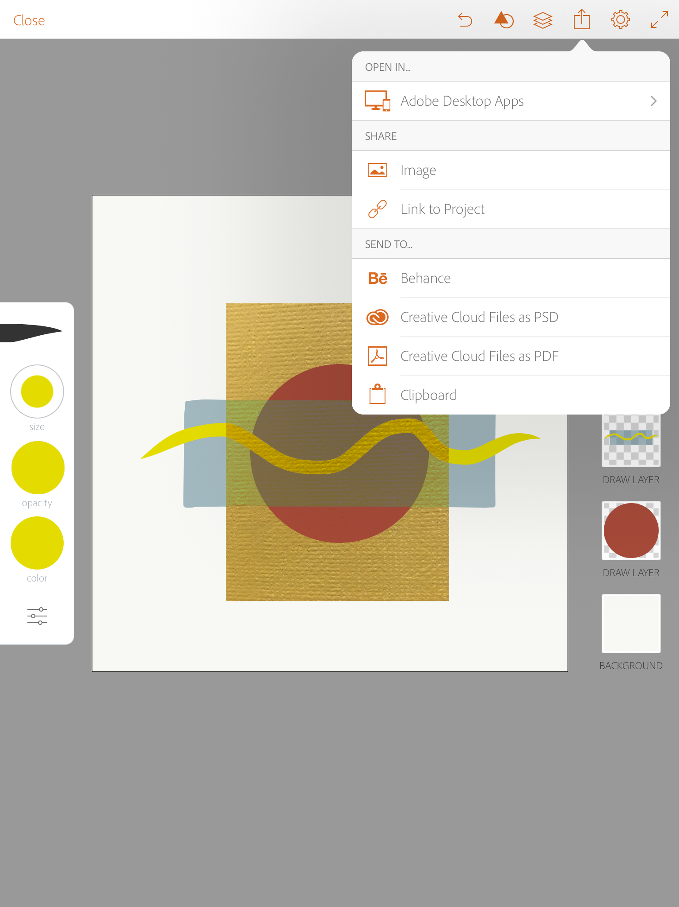
SHARE ARTwork
Tap the share icon on the top tool bar and select IMAGE, then SAVE IMAGE to save the painting to your camera roll
NOTE: As this is a VECTOR file, when it is shared to photos it will transfer into a pixel
To retain the vector format you must save to an Illustrator file on your computer
© 2017 MOBILE ART ACADEMY

Slide 17
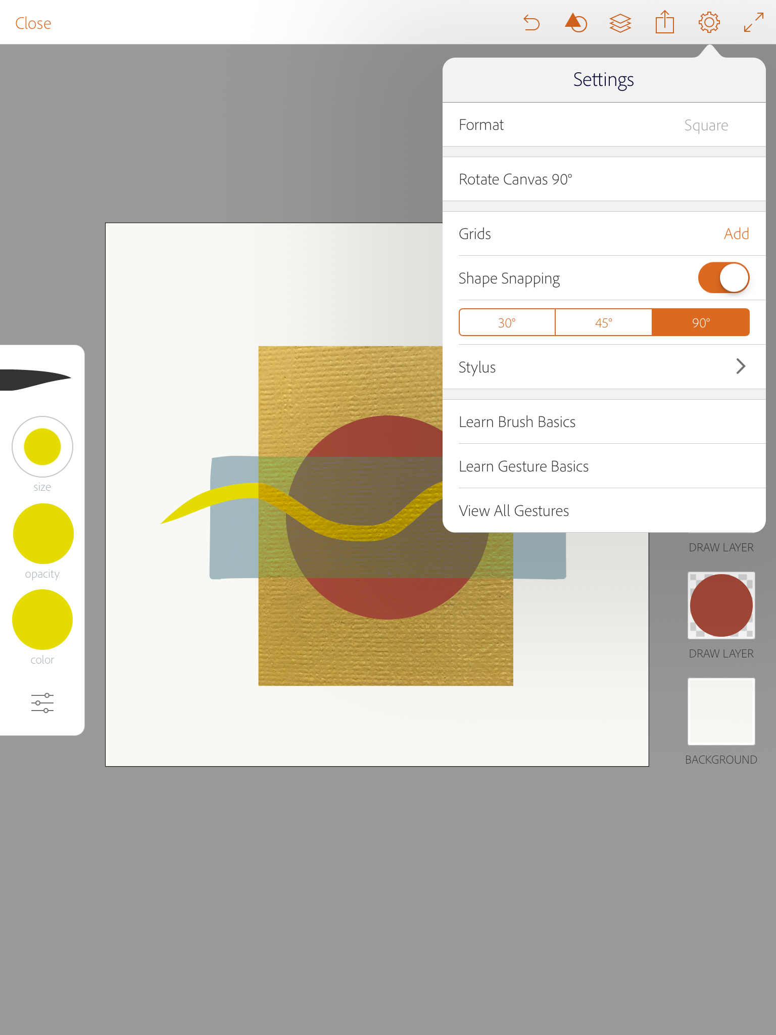
Adjust settings
Tap the gear icon to access different setting, grids and so forth
You can also access more training tools to get further use out of this app, Learn Brush Basics, Learn Gesture Basics and View All Gestures
© 2017 MOBILE ART ACADEMY

